Slide 1
CS 4593/6463 – Bitcoins and Cryptocurrencies
Prof. Murtuza Jadliwala
murtuza.jadliwala@utsa.edu
Note: most of the slides used in this course are derived from those available for the book “Bitcoins and Cryptocurrencies Technologies – A Comprehensive Introduction”, Arvind Narayanan, Joseph Bonneau, Edward Felten, Andrew Miller & Steven Goldfeder, 2016, Princeton University Press.

Slide 2
Lecture 6
Bitcoin and anonymity

Slide 3
Anonymity basics

Slide 4
Some say Bitcoin provides anonymity
“ Bitcoin is a secure and anonymous digital
currency ”
— WikiLeaks donations page

Slide 5
Others say it doesn’t
“ Bitcoin won't hide you from the NSA's prying
eyes”
— Wired UK

Slide 6
What do we mean by anonymity?
Literally: anonymous = `without a name’
Two interpretations:
1 – without using your real name
2 – without using any name at all
Bitcoins: Addresses are public key hashes rather than real identities
By first interpretation, Bitcoin is anonymous
By second interpretation, it is not anonymous! Bitcoin addresses → pseudo-identity
Computer scientists call this pseudonymity

Slide 7
Pseudonymity vs anonymity in forums
Reddit: pick a long-term pseudonym
vs.
4Chan: make posts with no attribution at all

Slide 8
Anonymity in computer science
Different interactions of the same user with the system should not be linkable to each other (and to the user’s real identity)
Anonymity = pseudonymity + unlinkability

Slide 9
Question: Why is unlinkability needed?
Answer: Pseudonymity is not enough for “privacy” in Bitcoins!
Bitcoin Block chain (and transactions) is public
Linking Bitcoin addresses to real identities is easy
Many Bitcoin services require real identity
Linked profiles can be deanonymized by a variety of side channels
Notes:
If linked at any point, all tx’s identified – past, present and future
KYC principle
side channel example: transaction timing correlates with twitter postings

Slide 10
Defining unlinkability in Bitcoin
Hard to link together different addresses of the same user
Hard to link together different transactions made by the same user
Hard to link sender of a payment to its recipient

Slide 11
Quantifying Bitcoin anonymity
Complete unlinkability (among all addresses/transactions) is hard → lets’ try to get something more feasible
Anonymity set: the crowd that one attempts to blend into
Anonymity set (for a Bitcoin transaction): set of transactions that an adversary cannot distinguish from the transaction in question
To calculate anonymity set:
define adversary model
reason carefully about: what the adversary knows, does not know, and cannot know
Notes:
In particular, techniques like “taint” aren’t very good

Slide 12
Alternate measures of Bitcoin anonymity
Taint Analysis: Give high “taint” score (to S-R pair) if Bitcoins sent by an address S always end up at an address R
Not a good measure of Bitcoin anonymity:
Makes implicit assumptions about the adversary’s calculations regarding linking pairs of addresses
Adversary may use alternate techniques for linking address pairs – e.g., timing analysis or wallet software idiosyncrasies.
Notes:
In particular, techniques like “taint” aren’t very good

Slide 13
Why anonymous cryptocurrencies?
Block chain based currencies are totally, publicly, and permanently traceable
Without anonymity, privacy is much worse than traditional banking!
Two motivations:
Achieve privacy level at least equivalent to traditional banking
If possible, go beyond the privacy level offered by traditional banking based solutions

Slide 14
Ethical concerns about anonymity
Legitimate “goods”: may prevent learning someone’s salary information or an organization’s private business dealing
Legitimate “worries” : money laundering
Bottleneck: moving large flows into and out of Bitcoin (“cashing out”)
Notes:
Researchers should work with AML. Pointer to next lecture
Even for traditional money laundering, difficulty is not technical but rather criminal penalties
Efforts to improve Bitcoin anonymity don’t solve the cashing out problem, so nothing to worry about there

Slide 15
Can we keep only the good uses?
Common conundrum in computer security and privacy:
uses that are very different morally are pretty much the same technologically

Slide 16
Similar dilemma: Tor
Anonymous communication network
Sender and receiver of message unlinkable
Used by:
Normal people
Journalists & activists
Law enforcement
Malware
Child pornographers
Funded by (among others):
U.S. State Department

Slide 17
Anonymous e-cash: history
Crypto
magic
David Chaum, 1982
Blind signature: two-party protocol to create digital signature without signer knowing the input

Slide 18
Anonymous e-cash via blind signatures
User | Balance
… | …
 | 10
… | …
 | 5
Spent coins
…
Withdraw anonymous coin
{317038628684424}
9
31703862…
Deposit coin # 317038628684424
{317038628684424}
6
OK
Bank cannot link the two users

Slide 19
Anonymity & decentralization: in conflict
Interactive protocols with bank are hard to decentralize
Decentralization often achieved via public traceability to enforce security

Slide 20
How to de-anonymize Bitcoin?

Slide 21
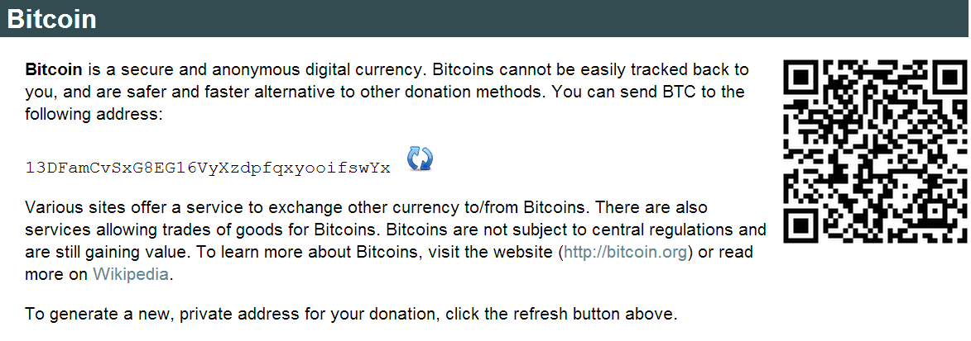

Slide 22
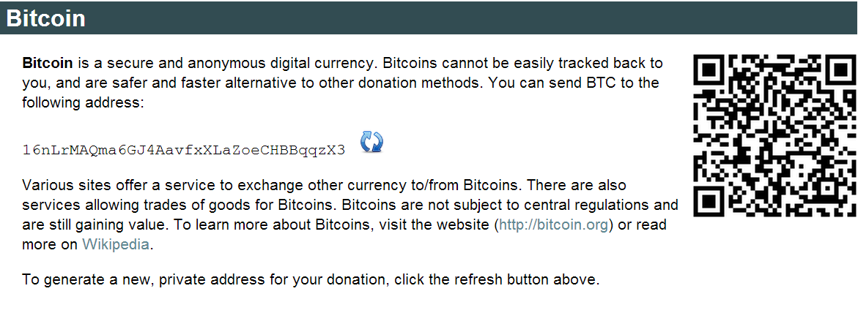

Slide 23
Trivial to create new address
Best practice: always receive at fresh address
So, unlinkable?

Slide 24
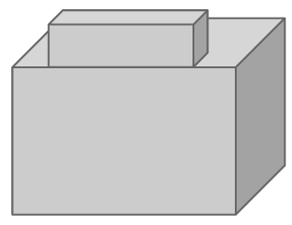
Alice buys a teapot at Big box store
5
8
3
Single
transaction
6

Slide 25
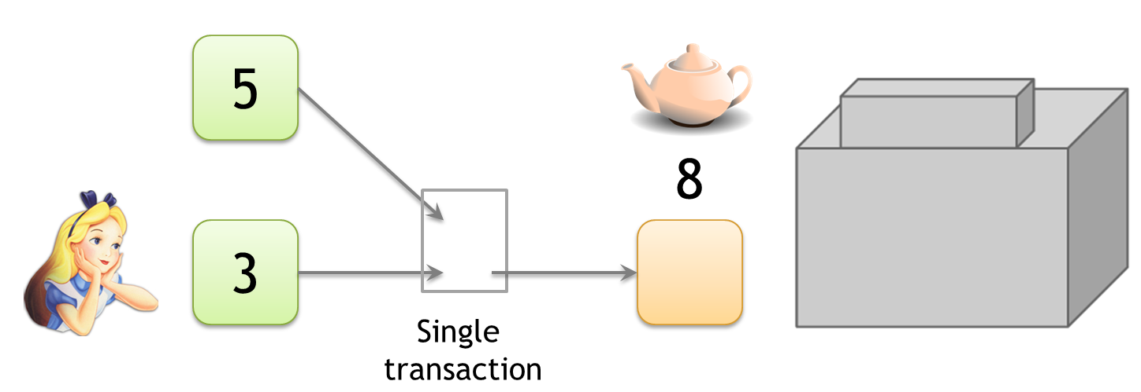
Linking addresses
Shared spending is evidence of joint control
Addresses can be linked transitively

Slide 26
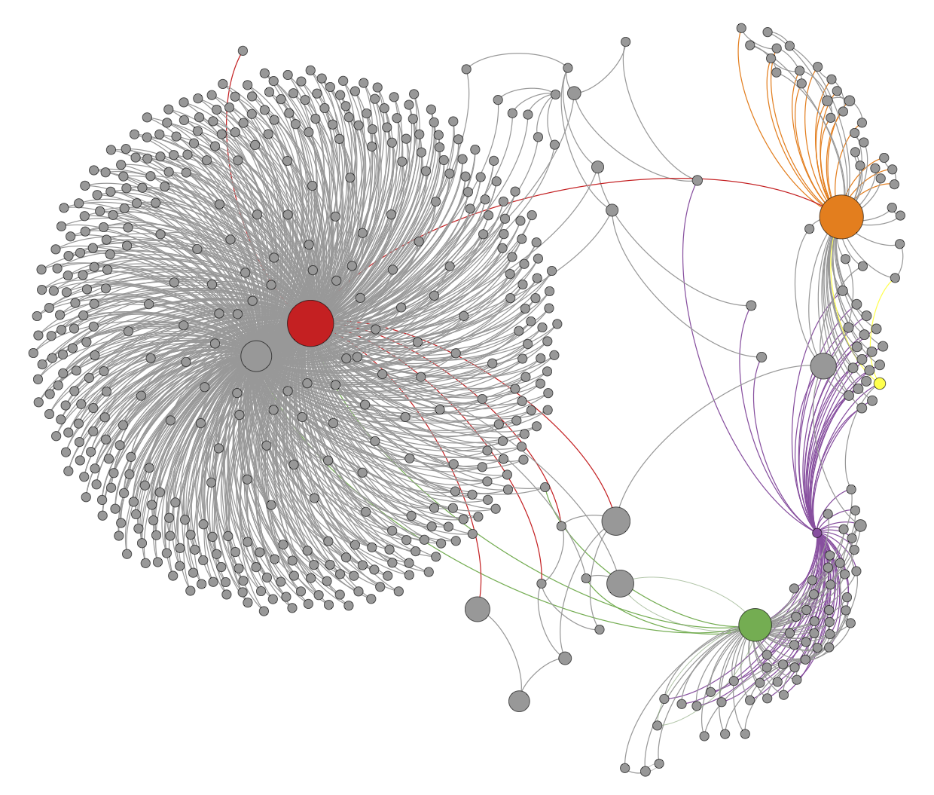
Clustering of addresses
An Analysis of Anonymity in the Bitcoin System
F. Reid and M. Harrigan
PASSAT 2011

Slide 27
Change addresses
5
8.5
3
6
.5
Which address
is change?

Slide 28
“Idioms of use”
Implementation details or Idiosyncratic features of wallet software that can be used to design heuristics for identifying (linking) change addresses
For example, most wallets generate a fresh address (never appeared on the Blockchain) when a change address is required
Bitcoin-Qt library bug → change output always first output in a transaction
Notes:
Fragile. Requires manual tuning, false positives

Slide 29
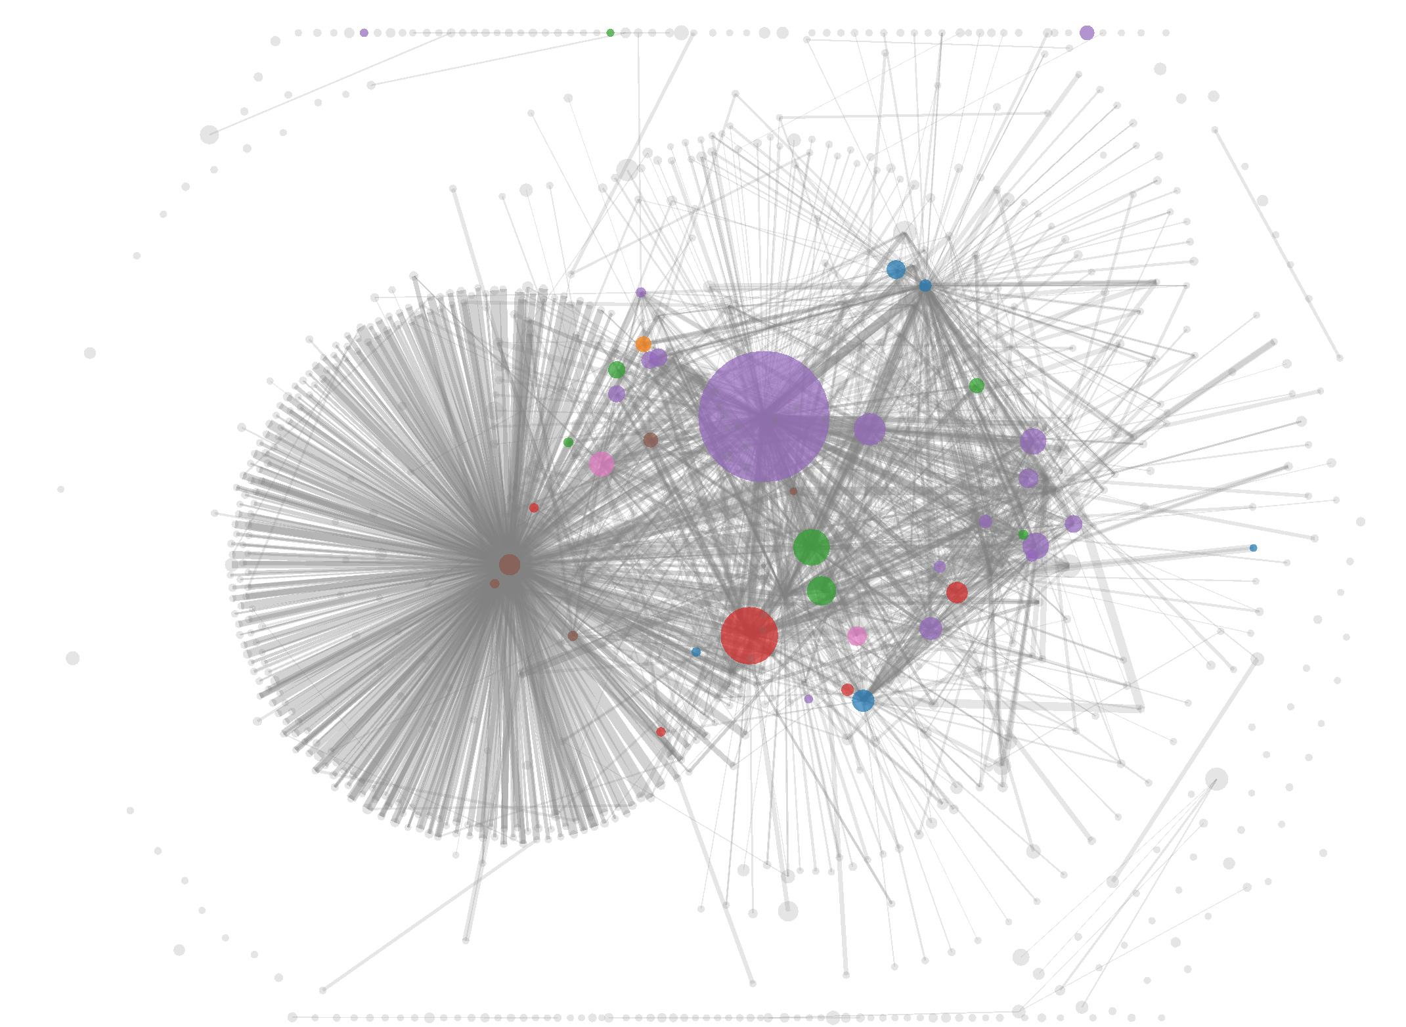
Shared spending + idioms of use
A Fistful of Bitcoins: Characterizing Payments Among Men with No Names
S. Meiklejohn et al.
IMC 2013

Slide 30
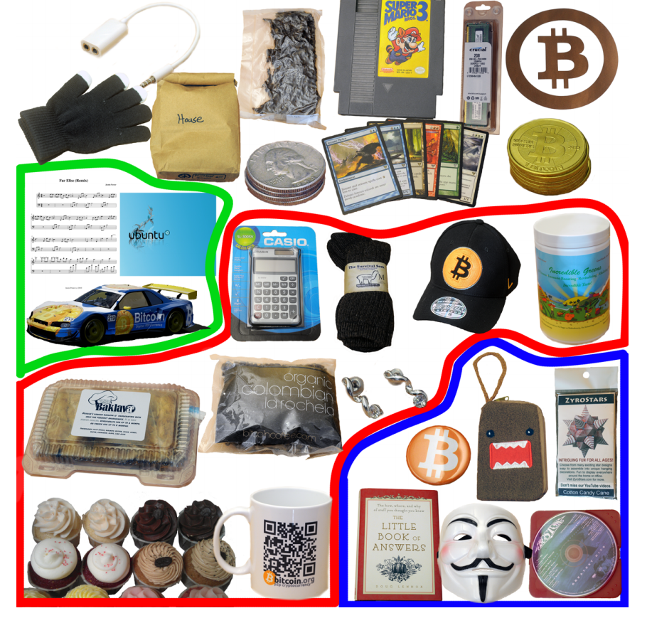
To tag service providers: transact!
A Fistful of Bitcoins: Characterizing Payments Among Men with No Names
S. Meiklejohn et al.
344 transactions
Mining pools
Wallet services
Exchanges
Vendors
Gambling sites

Slide 31
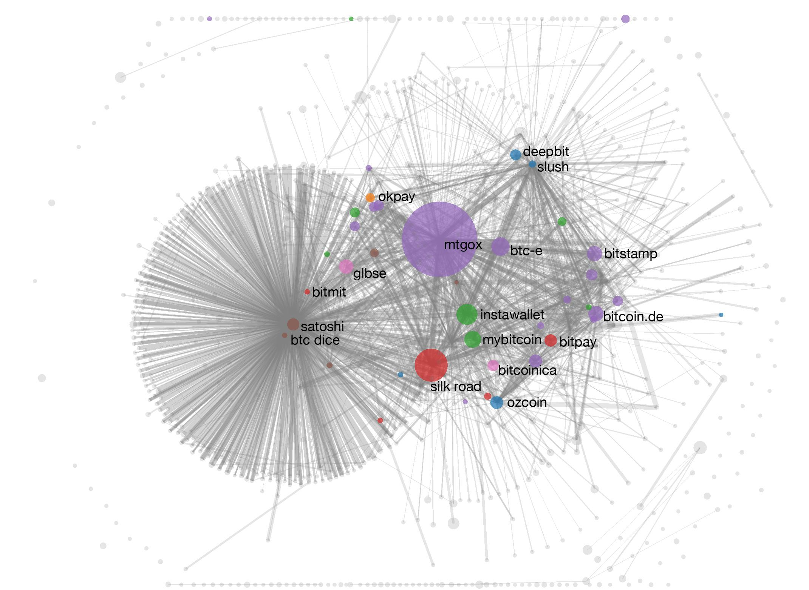
Shared spending + idioms of use
A Fistful of Bitcoins: Characterizing Payments Among Men with No Names
S. Meiklejohn et al.

Slide 32
From services to users
1. High centralization in service providers
Most flows pass through one of these — in a
traceable way
2. Address — identity links in forums

Slide 33
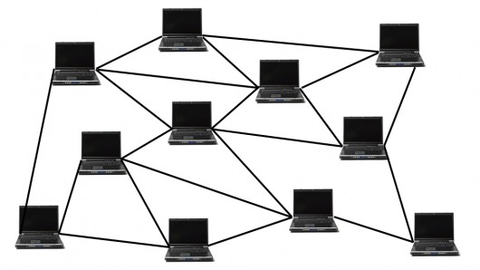
Network-layer de-anonymization
“The first node to
inform you of a
transaction is probably
the source of it”
Dan Kaminsky
Black Hat 2011 talk

Slide 34
Solution: use Tor
Caveat: Tor is intended for low-latency activities such as web browsing
Mix nets might provide better anonymity
BUT Tor is what’s deployed and works

Slide 35
Mixing

Slide 36
To protect anonymity, use an intermediary

Slide 37
To protect anonymity, use an intermediary
Online wallets do this
Do they provide anonymity?!

Slide 38
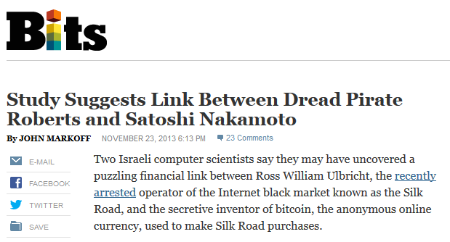

Slide 39
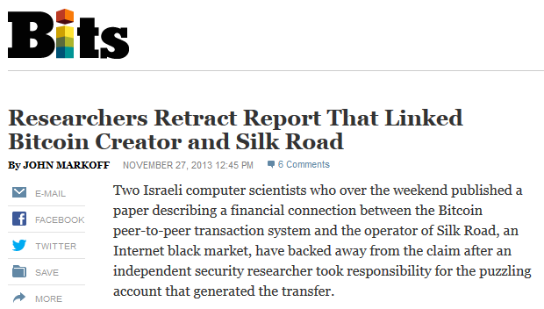

Slide 40
Online wallets for anonymity
Reputable, often regulated, businesses
Typically require identity, keep records ➔ no anonymity w.r.t. wallet service
Users trust them with their bitcoins➔ keep them for longer➔ bigger anonymity set w.r.t. everyone else

Slide 41
Dedicated mixing services
Promise not to keep records
Don’t ask for your identity
Essentially swaps a user’s coin (address) with other users’ coins (addresses)
Relatively small anonymity set (only comprise of those users who use the mixing service at that instant)!

Slide 42
Rest of this lecture:
assume a user for whom the trust requirements and anonymity properties of online wallets are unacceptable

Slide 43
Mixing: terminology
Mix vs. mixer
Another term: laundry
Won’t use in this lecture

Slide 44
Principles for mixing services
1. Use a series of mixes
Mixes should implement a
standard API to make this
easy
Mixcoin: Anonymity for Bitcoin with accountable mixes
J. Bonneau et al.
Financial Cryptography 2014

Slide 45
Series of mixes
Mix 1
Mix 2
Mix 3
Notes:
Generate a fresh address
Same principle behind Tor
Ideally we want all transactions to look identical, which motivates…

Slide 46
Principles for mixing services
2. Uniform transactions
In particular: all mix
transactions must have the
same value!
“Chunk size”
Mixcoin: Anonymity for Bitcoin with accountable mixes
J. Bonneau et al.
Financial Cryptography 2014

Slide 47
Principles for mixing services
3. Client side must be
automated
Desktop wallet software
Mixcoin: Anonymity for Bitcoin with accountable mixes
J. Bonneau et al.
Financial Cryptography 2014

Slide 48
Principles for mixing services
4. Fees must be all-or-nothing
Probabilistic fees:
0.1% mixing fee =
mix will swallow chunk
with 0.1% chance
Mixcoin: Anonymity for Bitcoin with accountable mixes
J. Bonneau et al.
Financial Cryptography 2014
Current mixes follow none of these principles

Slide 49
Remaining problem: trusting mixes
Stay in business, build up reputation
Users can test for themselves
Cryptographic “warranties”
Notes:
Current status: frequent reports of theft

Slide 50
Currently no reputable dedicated mix
Caution: Mixing services may themselves be operating with anonymity. As such, if the mixing output fails to be delivered or access to funds is denied there is no recourse. Use at your own discretion.
— Bitcoin Wiki
Notes:
Bootstrapping problem

Slide 51
Decentralized mixing

Slide 52
Why decentralized mixing?
No bootstrapping problem
Theft impossible
Possibly better anonymity
More philosophically aligned with Bitcoin

Slide 53
Coinjoin
Each signature is entirely separate
This is 1 mixing round
Mixing principles from before apply on top of basic protocol
Single
transaction
Proposed by Greg Maxwell, Bitcoin core developer

Slide 54
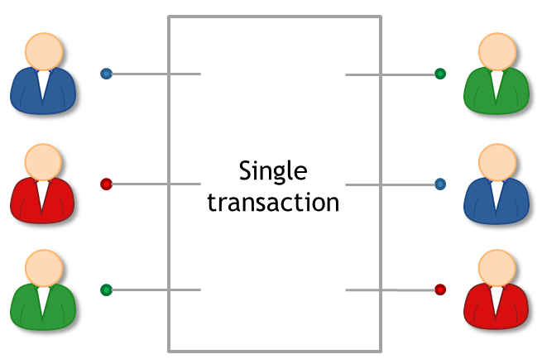
Coinjoin algorithm
Find peers who want to mix
Exchange input/output addresses
Construct transaction
Send it around, collect signatures (Before signing, each peer checks if her output is present)
Broadcast the transaction

Slide 55
Coinjoin: remaining problems
How to find peers
Peers know your input-output mapping (This is a worse problem than for centralized mixes)
Denial of service

Slide 56
Finding peers
Use an untrusted server to facilitate this process
Unlike centralized mixes, these servers cannot steal users’ funds

Slide 57
Peer anonymity
Strawman solution:
exchange inputs
disconnect and reconnect over Tor
exchange outputs
Better solution: special-purpose anonymous routing mechanism
Notes:
Note: not necessary to communicate outputs securely

Slide 58
Denial of service
Proposed solutions:
Proof of work
Proof of burn
Server kicks out malicious participant
Cryptographic “blame” protocol (CoinShuffle: Practical Decentralized Coin Mixing for Bitcoin, T. Ruffing et al., PETS 2014)

Slide 59
High-level flows could be identifying
Example:
Alice receives 43.12312 BTC / week as income Always immediately transfers 5% to retirement account

Slide 60
Heuristic: merge avoidance
Instead of a single payment transaction
receiver provides multiple output addresses
sender avoids combining different inputs
(Proposed by Mike Hearn)
Notes:
Can go a long way to improve anonymity even without mixes

Slide 61
Zerocoin and Zerocash

Slide 62
Zerocoin: protocol-level mixing
Mixing capability baked into protocol
Advantage: cryptographic guarantee of mixing
Disadvantage: not currently compatible with Bitcoin
Zerocoin: Anonymous Distributed E-Cash from Bitcoin
I. Miers et al.
IEEE S&P 2013

Slide 63
Basecoin and Zerocoin
Basecoin: Bitcoin-like Altcoin
Zerocoin: Extension of Basecoin
Basecoins can be converted into zerocoins and back
Breaks link between original and new basecoin

Slide 64
Zerocoins
A Zerocoin is a cryptographic proof that you owned a Basecoin and made it unspendable
Miners can verify these proofs
Gives you the right to redeem a new Basecoin (somewhat like poker chips)

Slide 65
Two challenges
How to construct these proofs?
How to make sure each proof can only be “spent” or “redeemed” once with a basecoin?
Otherwise, a basecoin could be turned to a zerocoin which could be redeemed into multiple basecoins

Slide 66
Zero-knowledge proofs
Crypto
magic
A way to prove a statement
without revealing any other
information
Example:
“I know an input that hashes to da39a3ee5e”
“I know an input that hashes to some hash in the following set: … ”

Slide 67
Minting zerocoins
Zerocoins come in standard denominations (Let’s assume 1 basecoin)
Anyone can make (or mint) one!
They have value once put on the block chain
That costs 1 basecoin

Slide 68
Minting a zerocoin: “commitment”
Generate serial number S (eventually made public)
and random secret r (never public, ensures unlinkability)
Compute Commit(S, r)
Serial number:
317038628684424
Simplification

Slide 69
Minting a zerocoin
To put Commit(S, r) on block chain:
Create “Mint” Tx with 1 basecoin as input
signed by A
Mint
Commit(S, r) H( )

Slide 70
To spend a zerocoin S:
Create a special “Spend” Tx that contains:
Serial number S
Zero-knowledge proof that: “I know a number r such that Commit(S, r) is one of the zerocoins or commitments {c₁, c₂, …., c_{N}} in the block chain”
Miners will verify S hasn’t been spent before. Miners will also verify the above zero-knowledge proof (which establishes the claimant’s ability to open one of the zerocoin commitments without actually opening it)
Output of the spend Tx now acts as a new basecoin
No link between the mined and redeemed commitment
Serial: <S>
Mint
Proof: <…>
Spend
Pay to: <pk>

Slide 71
Zerocoin is anonymous
Since r is secret, no one can figure out which zerocoin corresponds to serial number S
Commit(S, r)
…
c₁
c₂
c_{N}

Slide 72
Zerocoin is “efficient”
The proof is a giant disjunction over all zerocoins
Yet the proof is relatively small (logarithmic in N)!
I know r such that
Commit(S, r) = c₁
OR
Commit(S, r) = c₂
OR
…
OR
Commit(S, r) = c_{N}

Slide 73
Need for a Trusted Setup
One of the crypto tools (RSA accumulators) requires a one-time trusted setup
Security relies on difficulty in factorizing a composite N of large primes p and q!
A trusted party needs to select random p and q, compute N=pq, release N and permanently delete p & q
Sociological issue: Can we trust someone to do this?
Solution: “Threshold cryptography” – a set of delegates jointly compute N (even if one is honest, difficult to determine p & q)

Slide 74
Zerocash: Zerocoin without Basecoin
Two differences
Different crypto for proofs (More efficient)
Proposal to run system without Basecoin
Zerocash: Decentralized Anonymous Payments from Bitcoin
E. Ben-Sasson et al.
Usenix Security 2014
Notes:
Sender and recipients know amounts, but nobody else
Prove to miners in zero knowledge that input amount >= output amount
Avoids side-channel problems associated with mixing

Slide 75
Zerocash: untraceable e-cash
All transactions are zerocoins
Splitting and merging supported
Put transaction value inside the envelope
Ledger merely records existence of transactions
Notes:
Sender and recipients know amounts, but nobody else
Prove to miners in zero knowledge that input amount >= output amount
Avoids side-channel problems associated with mixing

Slide 76
Zerocash: the catch
Random, secret inputs are required to generate public parameters
These secret inputs must then be securely destroyed
No one can know them (anyone who does can break the system)
Notes:
Believability

Slide 77
5 levels of anonymity
System | Type | Anonymity attacks | Deployability
Bitcoin | Pseudonymous | Tx graph analysis | Default
Single mix | Mix | Tx graph analysis, bad mix | Usable today
Mix chain | Mix | Side channels, bad mixes/peers | Bitcoin-compatible
Zerocoin | Cryptographic mix | Side channels (possibly) | Altcoin
Zerocash | Untraceable | None | Altcoin, tricky setup
Notes:
Engineering complexity, believability

Slide 78
Tor and the Silk Road

Slide 79
Anonymous communication

Slide 80
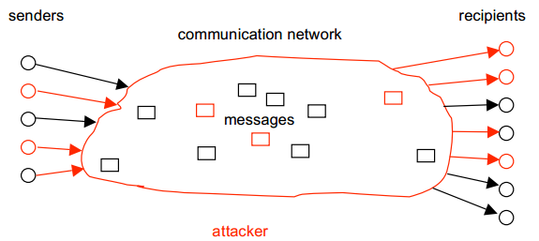
Threat model

Slide 81
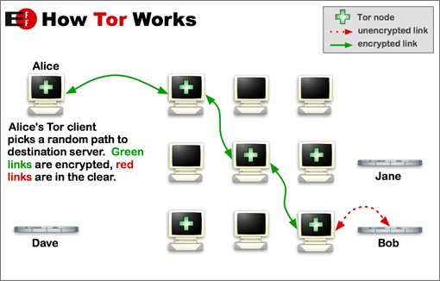
How Tor works
Safe(ish) if at least one router honest
Key challenge: hiding routing information

Slide 82
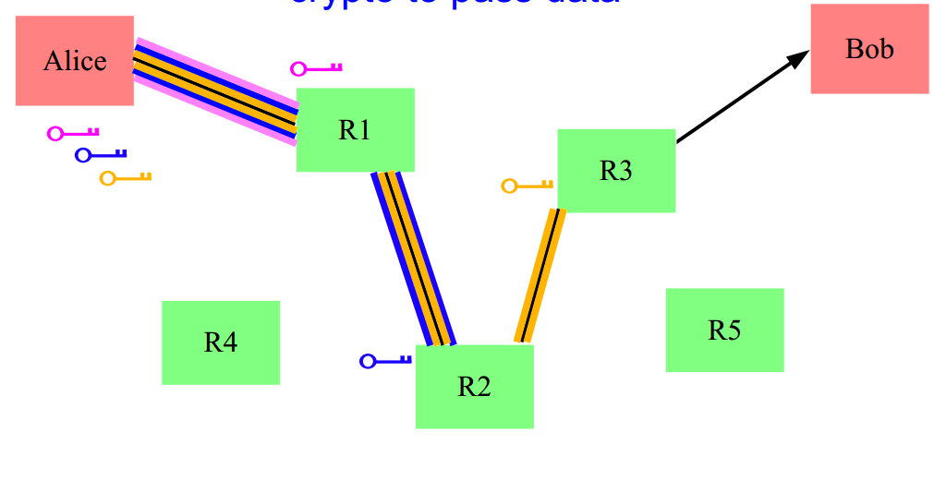
Solution: layered encryption
Side effect: contents encrypted from Alice to exit node
BUT: Unencrypted from exit node to Bob

Slide 83
Hidden services
What if the server wants to hide its address?
Simplified:
Connect to “rendezvous point” through Tor
Publish name → rendezvous point mapping
Client connects to rendezvous point
Onion address looks like http://3g2upl4pq6kufc4m.onion/

Slide 84
Silk Road
Communication: Tor hidden service
Payment: Bitcoin
Security?
Anonymous shipping?

