Slide 1

CS 4593/6463 – Bitcoins and Cryptocurrencies
Prof. Murtuza Jadliwala
murtuza.jadliwala@utsa.edu
Note: some of the slides used in this presentation are derived from those available for the book “Computer Security: Principles and Practice”, by Stallings and Brown, PEARSON

Slide 2
Background for CS 4593/6463
Cryptographic Tools

Slide 3
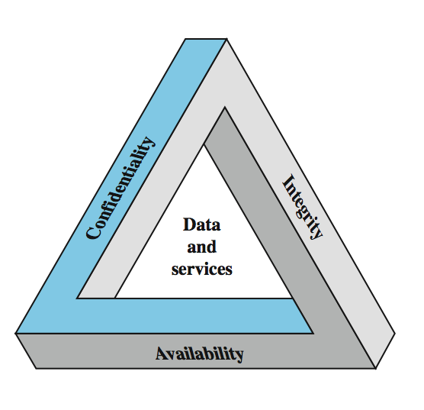
Information Security
Protection afforded to an automated information system in order to attain the applicable objectives of preserving the integrity, availability and confidentiality of information system resources (includes hardware, software, firmware, information/data, and telecommunications)
Notes:
The NIST Computer Security Handbook [NIST95] defines the term computer security as shown on this slide. This definition introduces three key objectives that are at the heart of computer security as we see on the next slide.
These three concepts form what is often referred to as the CIA triad (Figure 1.1). The three concepts embody the fundamental security objectives for both data and for information and computing services. FIPS PUB 199 provides a useful characterization of these three objectives in terms of requirements and the definition of a loss of security in each category:
• Confidentiality (covers both data confidentiality and privacy): preserving authorized restrictions on information access and disclosure, including means for protecting personal privacy and proprietary information. A loss of confidentiality is the unauthorized disclosure of information.
• Integrity (covers both data and system integrity): Guarding against improper information modification or destruction, and includes ensuring information non-repudiation and authenticity. A loss of integrity is the unauthorized modification or destruction of information.
• Availability: Ensuring timely and reliable access to and use of information. A loss of availability is the disruption of access to or use of information or an information system.
Although the use of the CIA triad to define security objectives is well established, some in the security field feel that additional concepts are needed to present a complete picture. Two of the most commonly mentioned are:
• Authenticity: The property of being genuine and being able to be verified and trusted; confidence in the validity of a transmission, a message, or message originator.
• Accountability: The security goal that generates the requirement for actions of an entity to be traced uniquely to that entity.

Slide 4
Confidentiality
Alice
channel
data, control messages
Bob
Sending System
Receiving System
data
data
“Hello”
“Hello”
Trudy
Confidentiality: Preventing unauthorized disclosure of information or disclosure of information to unauthorized entities
So, how to achieve confidentiality?
Encryption or Encipherment!
Notes:
The NIST Computer Security Handbook [NIST95] defines the term computer security as shown on this slide. This definition introduces three key objectives that are at the heart of computer security as we see on the next slide.

Slide 5
Encryption
What is Encryption (a.k.a Encipherment)?
  Process of perturbing or transforming information that needs to be protected (a.k.a plaintext) into something that is unintelligible (a.k.a ciphertext) to everyone except authorized receivers.
Encryption Techniques
Symmetric Encryption
Public-key Encryption
e.g., RSA, ElGamal, Elliptic Curve
Block Ciphers
Stream Ciphers
e.g., DES, AES
e.g., RC4

Slide 6
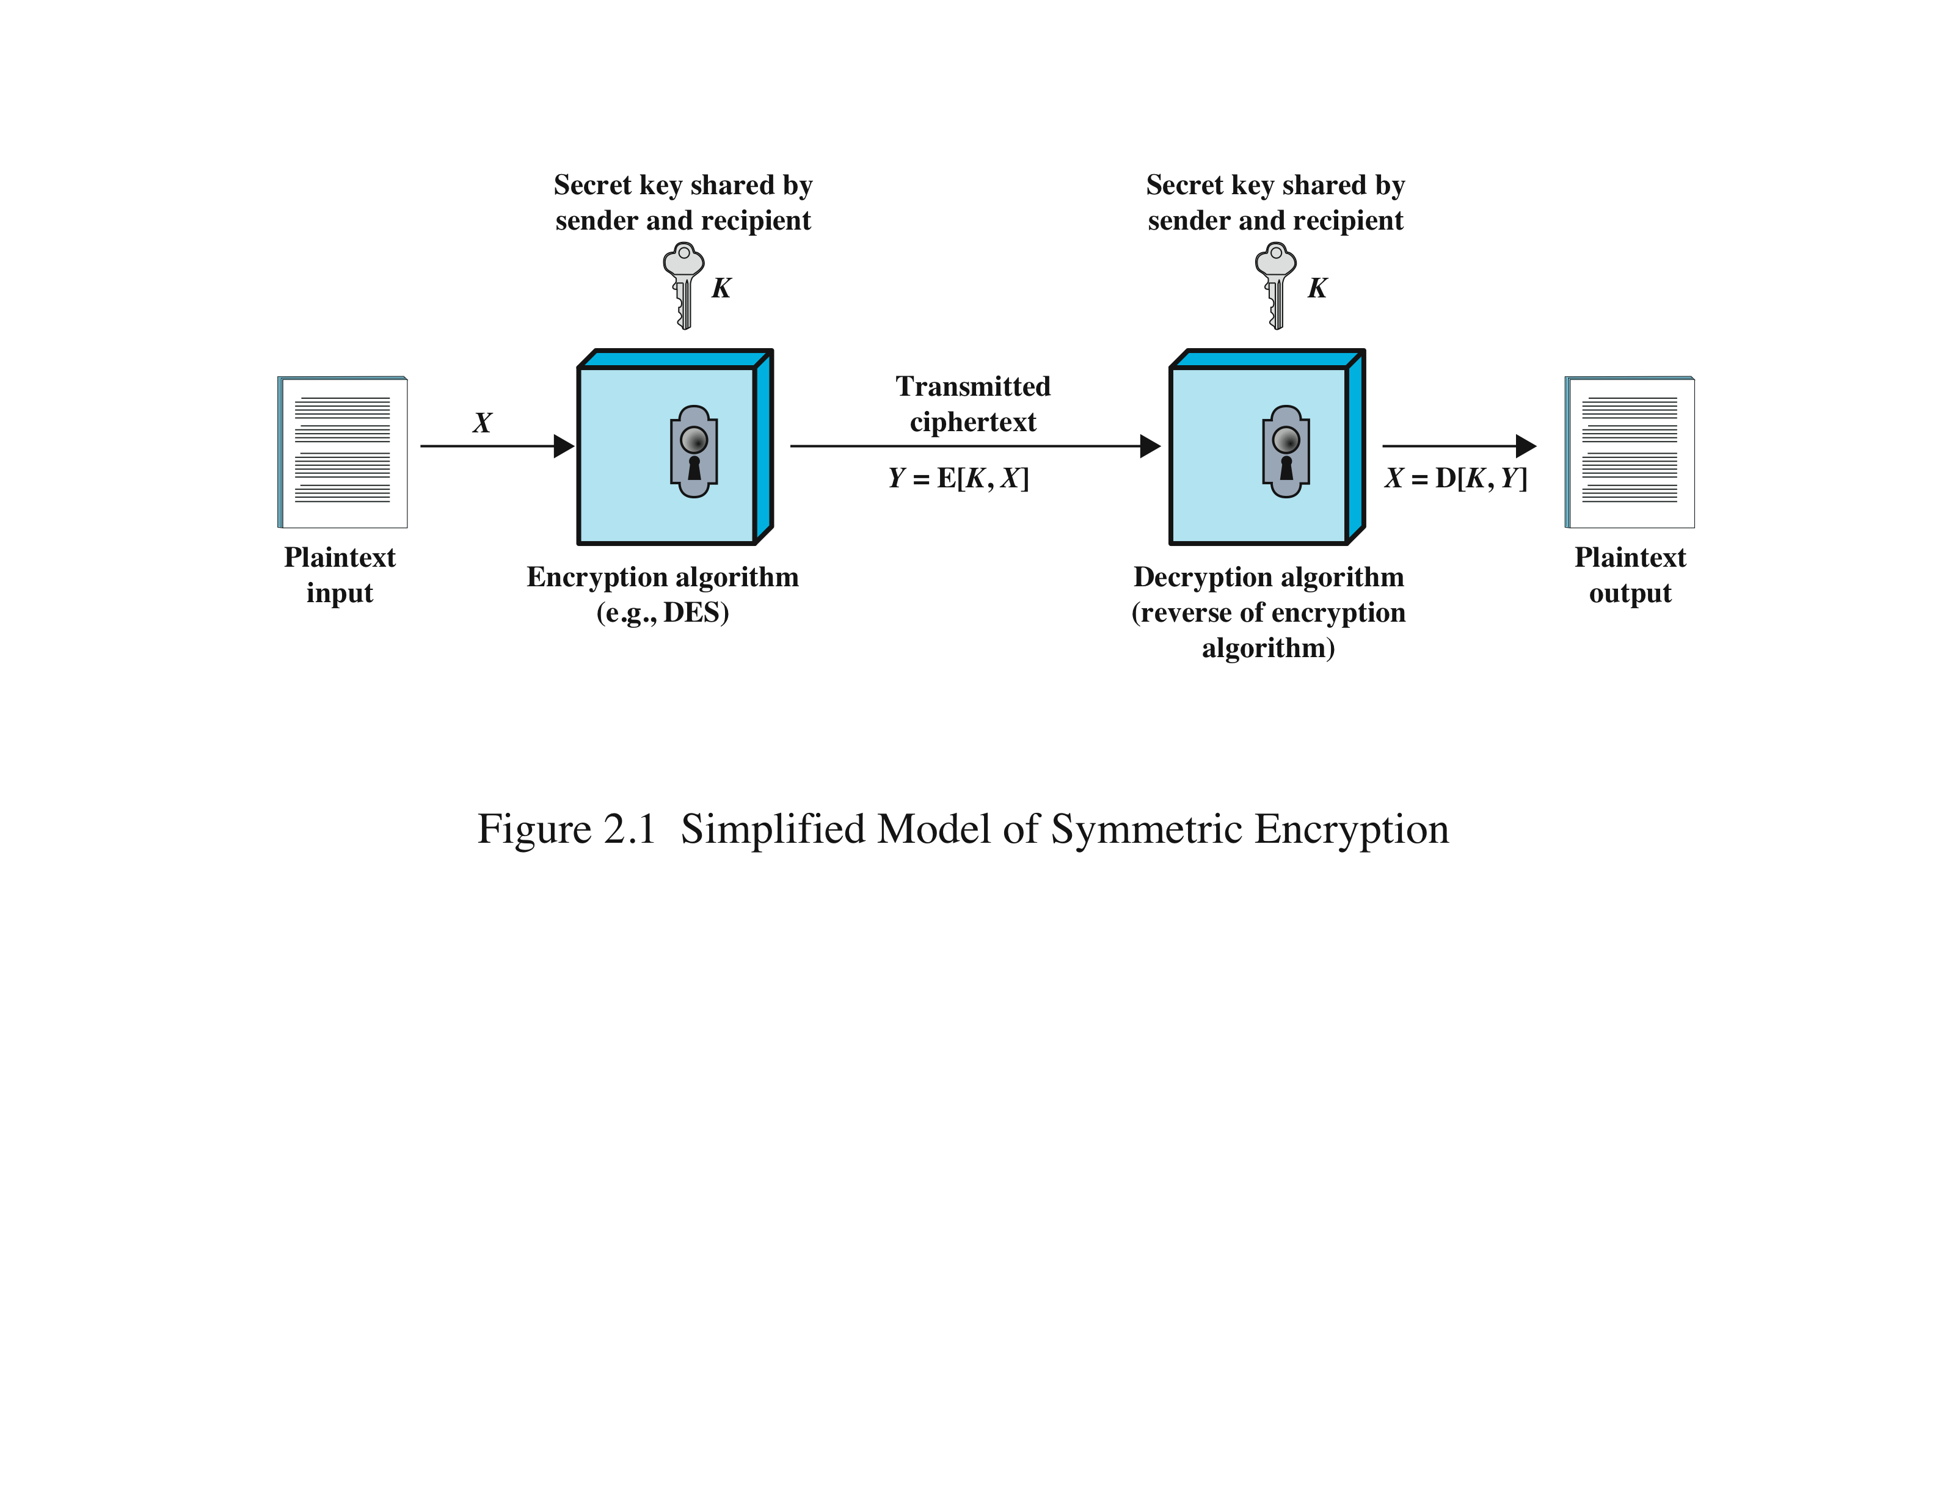
Symmetric Encryption
Encryption algorithm based on permutation and substitution operations
Algorithm uses the same key for encryption and decryption - also referred to as single-key encryption
Two requirements for secure use:
  Needs a strong encryption algorithm
  Sender and receiver must have obtained copies of the secret key in a secure fashion and must keep the key secure
Notes:
The universal technique for providing confidentiality for transmitted or stored
data is symmetric encryption.
This section introduces the basic concept of symmetric encryption. This is followed by an overview of the two most important symmetric encryption algorithms: the Data Encryption Standard (DES) and the Advanced Encryption Standard (AES), which are block encryption algorithms. Finally, this section introduces the concept of symmetric stream encryption algorithms.
Symmetric encryption, also referred to as conventional encryption or single-key
encryption, was the only type of encryption in use prior to the introduction of public-key
encryption in the late 1970s. Countless individuals and groups, from Julius Caesar to the
German U-boat force to present-day diplomatic, military, and commercial users, have
used symmetric encryption for secret communication. It remains the more widely used
of the two types of encryption.
There are two requirements for secure use of symmetric encryption:
1. We need a strong encryption algorithm. At a minimum, we would like the
algorithm to be such that an opponent who knows the algorithm and has
access to one or more ciphertexts would be unable to decipher the ciphertext
or figure out the key. This requirement is usually stated in a stronger form:
The opponent should be unable to decrypt ciphertext or discover the key even
if he or she is in possession of a number of ciphertexts together with the plaintext
that produced each ciphertext.
2. Sender and receiver must have obtained copies of the secret key in a secure
fashion and must keep the key secure. If someone can discover the key and
knows the algorithm, all communication using this key is readable.
A symmetric encryption scheme has five ingredients (Figure 2.1):
• Plaintext: This is the original message or data that is fed into the algorithm as
input.
• Encryption algorithm: The encryption algorithm performs various substitutions
and transformations on the plaintext.
• Secret key: The secret key is also input to the encryption algorithm. The exact
substitutions and transformations performed by the algorithm depend on the
key.
• Ciphertext: This is the scrambled message produced as output. It depends on
the plaintext and the secret key. For a given message, two different keys will
produce two different ciphertexts.
• Decryption algorithm: This is essentially the encryption algorithm run in
reverse. It takes the ciphertext and the secret key and produces the original
plaintext.

Slide 7
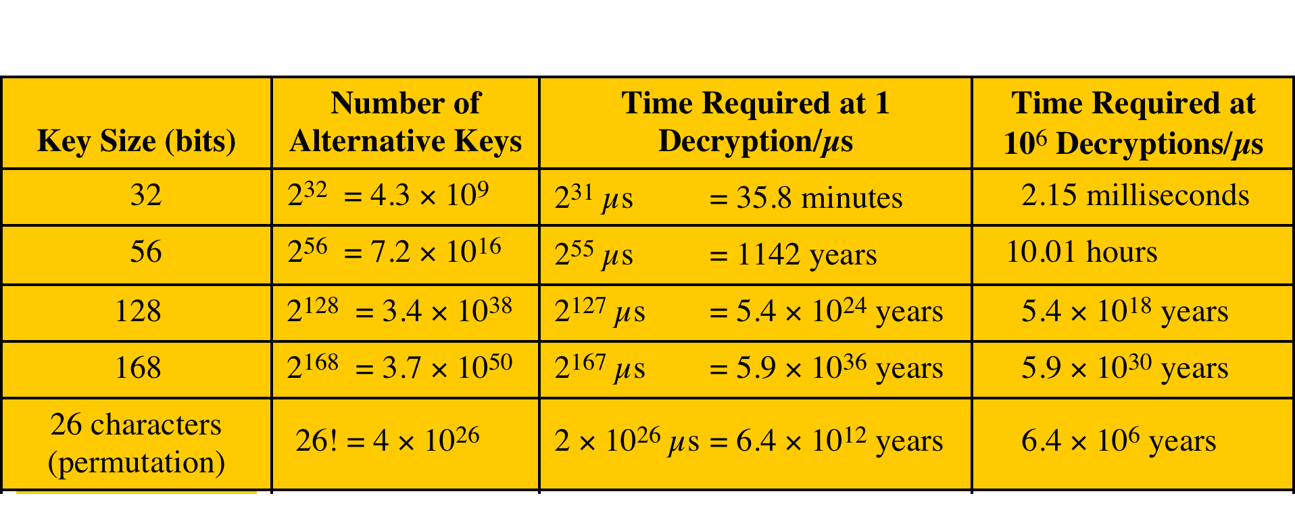
Attacking Symmetric Encryption
1. Brute-Force Attack
Try all possible keys on some ciphertext until an intelligible translation into plaintext is obtained
  On average half of all possible keys must be tried to achieve success
Notes:
There are two general approaches to attacking a symmetric encryption
scheme. The first attack is known as cryptanalysis. Cryptanalytic attacks rely on
the nature of the algorithm plus perhaps some knowledge of the general characteristics
of the plaintext or even some sample plaintext-ciphertext pairs. This type of
attack exploits the characteristics of the algorithm to attempt to deduce a specific
plaintext or to deduce the key being used. If the attack succeeds in deducing the
key, the effect is catastrophic: All future and past messages encrypted with that key
are compromised.
The second method, known as the brute-force attack, is to try every possible
key on a piece of ciphertext until an intelligible translation into plaintext is obtained.
On average, half of all possible keys must be tried to achieve success.

Slide 8
Attacking Symmetric Encryption
2. Cryptanalytic Attacks
  Relies on:
    Properties of the algorithm
    Knowledge of the plaintext
    Sample plaintext-ciphertext pairs
  Exploits characteristics of the algorithm to deduce the specific plaintext or the key being used
    If successful all future and past messages encrypted with that key are compromised
Notes:
There are two general approaches to attacking a symmetric encryption
scheme. The first attack is known as cryptanalysis. Cryptanalytic attacks rely on
the nature of the algorithm plus perhaps some knowledge of the general characteristics
of the plaintext or even some sample plaintext-ciphertext pairs. This type of
attack exploits the characteristics of the algorithm to attempt to deduce a specific
plaintext or to deduce the key being used. If the attack succeeds in deducing the
key, the effect is catastrophic: All future and past messages encrypted with that key
are compromised.
The second method, known as the brute-force attack, is to try every possible
key on a piece of ciphertext until an intelligible translation into plaintext is obtained.
On average, half of all possible keys must be tried to achieve success.

Slide 9
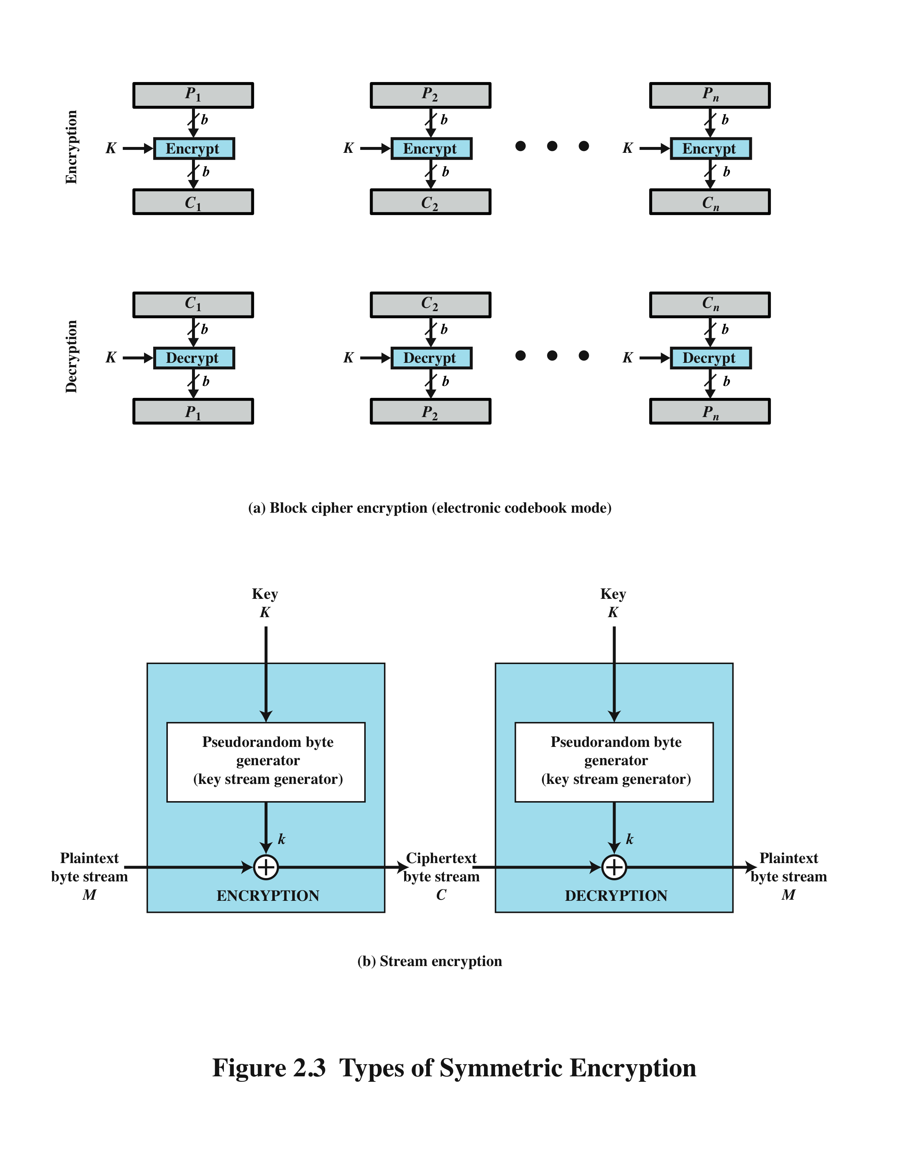
Block Cipher Encryption
Stream Encryption
Notes:
Figure 2.3a shows the
ECB mode. A plaintext of length nb is divided into n b-bit blocks (P1, P2,c,Pn).
Each block is encrypted using the same algorithm and the same encryption key, to
produce a sequence of n b-bit blocks of ciphertext (C1, C2,c,Cn).
Figure 2.3b is a representative diagram of stream cipher structure. In this
structure a key is input to a pseudorandom bit generator that produces a stream
of 8-bit numbers that are apparently random. A pseudorandom stream is one that
is unpredictable without knowledge of the input key and which has an apparently
random character (see Section 2.5). The output of the generator, called a keystream,
is combined one byte at a time with the plaintext stream using the bitwise exclusive-
OR (XOR) operation.
A block cipher processes the input one block of elements at a time, producing an
output block for each input block. A stream cipher processes the input elements
continuously, producing output one element at a time, as it goes along. Although
block ciphers are far more common, there are certain applications in which a stream
cipher is more appropriate. Examples are given subsequently in this book.
A typical stream cipher encrypts plaintext one byte at a time, although a stream
cipher may be designed to operate on one bit at a time or on units larger than a byte
at a time. Figure 2.3b is a representative diagram of stream cipher structure. In this
structure a key is input to a pseudorandom bit generator that produces a stream
of 8-bit numbers that are apparently random. A pseudorandom stream is one that
is unpredictable without knowledge of the input key and which has an apparently
random character (see Section 2.5). The output of the generator, called a keystream,
is combined one byte at a time with the plaintext stream using the bitwise exclusive-
OR (XOR) operation.
With a properly designed pseudorandom number generator, a stream cipher
can be as secure as block cipher of comparable key length. The primary advantage
of a stream cipher is that stream ciphers are almost always faster and use far less
code than do block ciphers. The advantage of a block cipher is that you can reuse
keys. For applications that require encryption/decryption of a stream of data, such as
over a data communications channel or a browser/Web link, a stream cipher might
be the better alternative. For applications that deal with blocks of data, such as file
transfer, e-mail, and database, block ciphers may be more appropriate. However,
either type of cipher can be used in virtually any application.

Slide 10
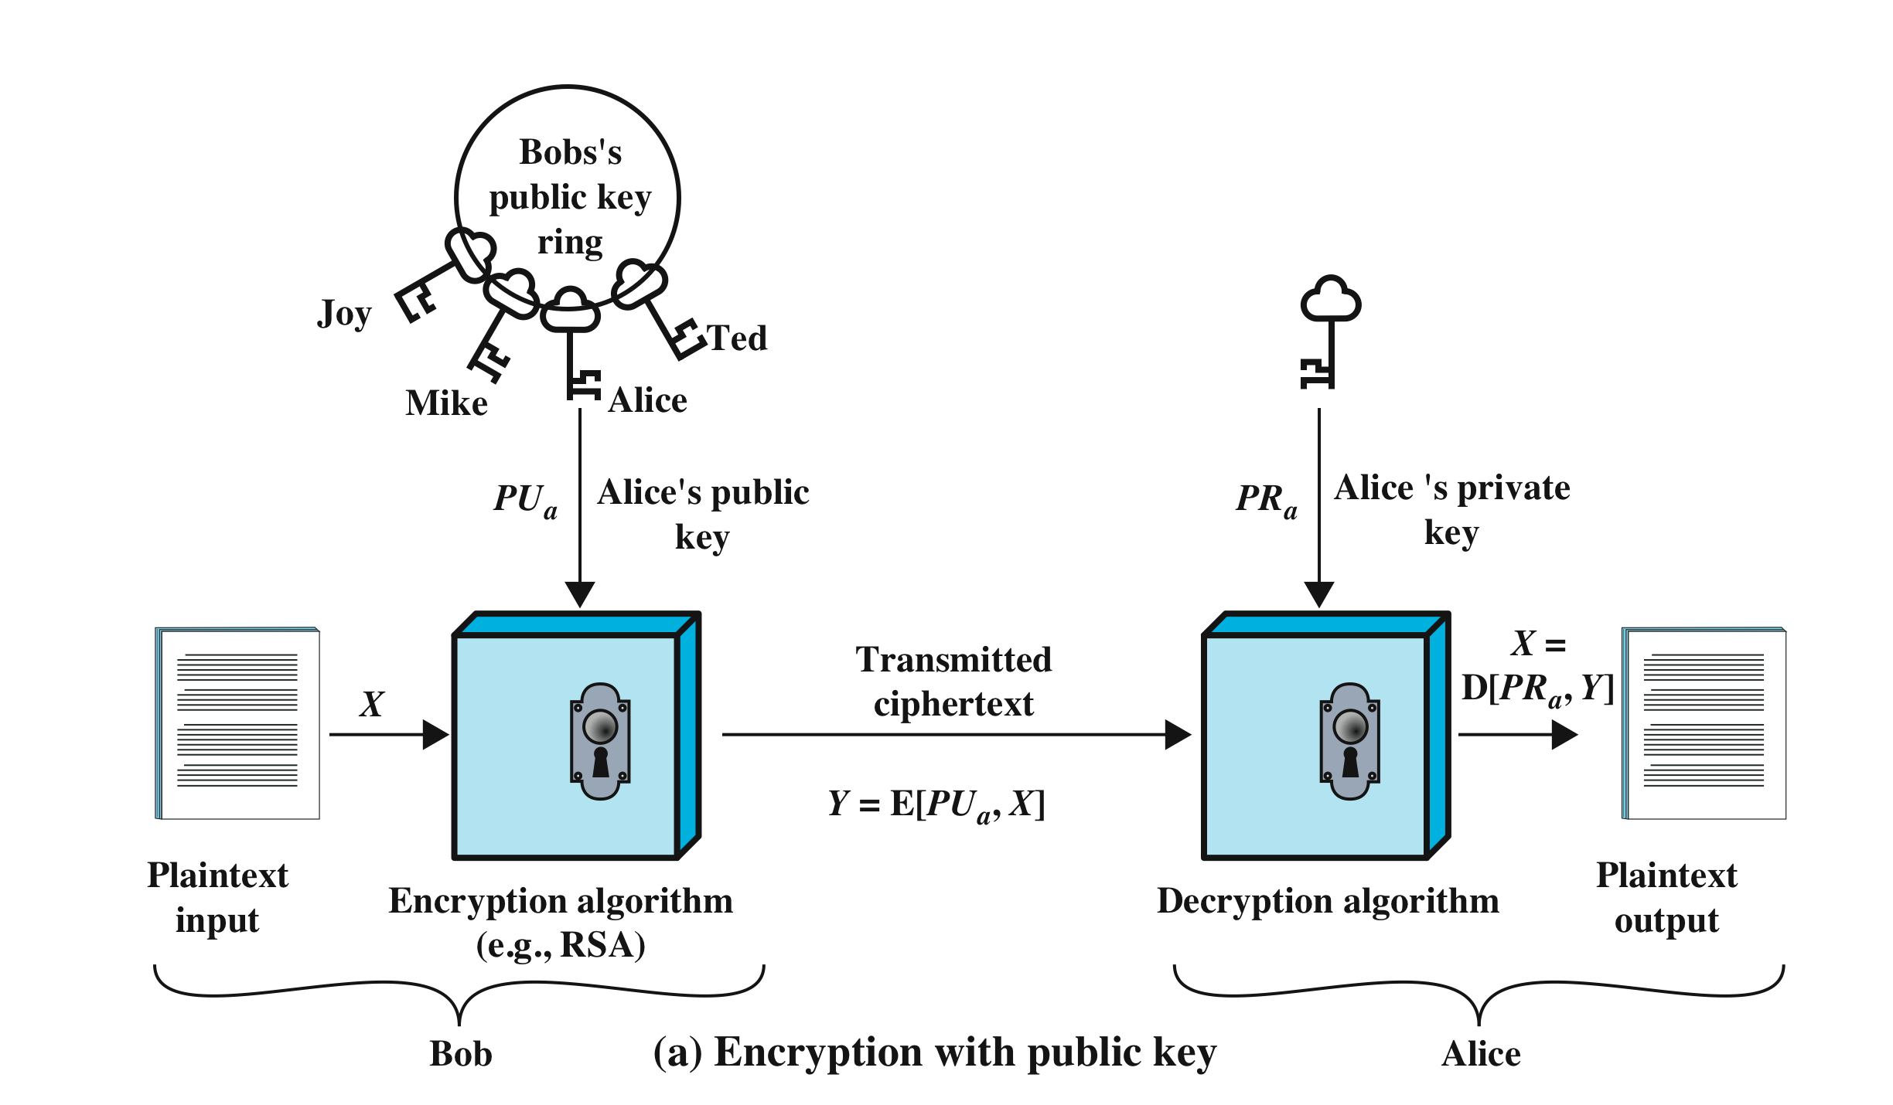
Public-Key Encryption
Encryption algorithms rely on mathematical functions that are easy to compute but difficult to invert!
Asymmetric - uses two separate keys
  Public key is made public for others to use
  Private key is secret and is never released
Notes:
Public-key encryption, first publicly proposed by Diffie and Hellman in 1976
[DIFF76], is the first truly revolutionary advance in encryption in literally thousands
of years. Public-key algorithms are based on mathematical functions rather than on
simple operations on bit patterns, such as are used in symmetric encryption algorithms.
More important, public-key cryptography is asymmetric, involving the use
of two separate keys, in contrast to symmetric encryption, which uses only one key.
The use of two keys has profound consequences in the areas of confidentiality, key
distribution, and authentication.
Before proceeding, we should first mention several common misconceptions
concerning public-key encryption. One is that public-key encryption is more secure
from cryptanalysis than symmetric encryption. In fact, the security of any encryption
scheme depends on (1) the length of the key and (2) the computational work involved
in breaking a cipher. There is nothing in principle about either symmetric or public-key
encryption that makes one superior to another from the point of view of resisting cryptanalysis.
A second misconception is that public-key encryption is a general- purpose
technique that has made symmetric encryption obsolete. On the contrary, because of
the computational overhead of current public-key encryption schemes, there seems no
foreseeable likelihood that symmetric encryption will be abandoned. Finally, there is
a feeling that key distribution is trivial when using public-key encryption, compared to
the rather cumbersome handshaking involved with key distribution centers for symmetric
encryption. For public-key key distribution, some form of protocol is needed,
often involving a central agent, and the procedures involved are no simpler or any
more efficient than those required for symmetric encryption.
As the names suggest, the public key of the pair is made public for others to
use, while the private key is known only to its owner. A general-purpose public-key
cryptographic algorithm relies on one key for encryption and a different but related
key for decryption.
The essential steps are the following:
1. Each user generates a pair of keys to be used for the encryption and decryption
of messages.
2. Each user places one of the two keys in a public register or other accessible
file. This is the public key. The companion key is kept private. As Figure 2.7a
suggests, each user maintains a collection of public keys obtained from others.
3. If Bob wishes to send a private message to Alice, Bob encrypts the message
using Alice’s public key.
4. When Alice receives the message, she decrypts it using her private key. No
other recipient can decrypt the message because only Alice knows Alice’s private
key.
With this approach, all participants have access to public keys, and private keys
are generated locally by each participant and therefore need never be distributed.
As long as a user protects his or her private key, incoming communication is secure.
At any time, a user can change the private key and publish the companion public
key to replace the old public key.
A public-key encryption scheme has six ingredients (Figure 2.7a):
• Plaintext: This is the readable message or data that is fed into the algorithm as
input.
• Encryption algorithm: The encryption algorithm performs various transformations
on the plaintext.
• Public and private key: This is a pair of keys that have been selected so that
if one is used for encryption, the other is used for decryption. The exact
transformations performed by the encryption algorithm depend on the public
or private key that is provided as input.
Ciphertext: This is the scrambled message produced as output. It depends on
the plaintext and the key. For a given message, two different keys will produce
two different ciphertexts.
• Decryption algorithm: This algorithm accepts the ciphertext and the matching
key and produces the original plaintext.
As the names suggest, the public key of the pair is made public for others to
use, while the private key is known only to its owner. A general-purpose public-key
cryptographic algorithm relies on one key for encryption and a different but related
key for decryption.
The essential steps are the following:
1. Each user generates a pair of keys to be used for the encryption and decryption
of messages.
2. Each user places one of the two keys in a public register or other accessible
file. This is the public key. The companion key is kept private. As Figure 2.7a
suggests, each user maintains a collection of public keys obtained from others.
3. If Bob wishes to send a private message to Alice, Bob encrypts the message
using Alice’s public key.
4. When Alice receives the message, she decrypts it using her private key. No
other recipient can decrypt the message because only Alice knows Alice’s private
key.
With this approach, all participants have access to public keys, and private keys
are generated locally by each participant and therefore need never be distributed.
As long as a user protects his or her private key, incoming communication is secure.
At any time, a user can change the private key and publish the companion public
key to replace the old public key.
Note that the scheme of Figure 2.7a is directed toward providing confidentiality:
Only the intended recipient should be able to decrypt the ciphertext because only
the intended recipient is in possession of the required private key. Whether in fact
confidentiality is provided depends on a number of factors, including the security of
the algorithm, whether the private key is kept secure, and the security of any protocol
of which the encryption function is a part.

Slide 11

Requirements for Public-Key Cryptosystems
Computationally easy to create key pairs
Computationally easy for sender knowing public key to encrypt messages
Computationally easy for receiver knowing private key to decrypt ciphertext
Computationally infeasible for opponent to determine private key from public key
Computationally infeasible for opponent to otherwise recover original message
Useful if either key can be used for each role
Notes:
The cryptosystem illustrated in Figure 2.7 depends on a cryptographic algorithm
based on two related keys. Diffie and Hellman postulated this system without demonstrating
that such algorithms exist. However, they did lay out the conditions that
such algorithms must fulfill [DIFF76]:
1. It is computationally easy for a party B to generate a pair (public key PUb,
private key PRb).
2. It is computationally easy for a sender A, knowing the public key and the
message to be encrypted, M, to generate the corresponding ciphertext:
C = E(PUb, M)
3. It is computationally easy for the receiver B to decrypt the resulting ciphertext
using the private key to recover the original message:
M = D(PRb,C) = D[PRb, E(PUb, M)]
4. It is computationally infeasible for an opponent, knowing the public key, PUb,
to determine the private key, PRb.
5. It is computationally infeasible for an opponent, knowing the public key, PUb,
and a ciphertext, C, to recover the original message, M.
We can add a sixth requirement that, although useful, is not necessary for all
public-key applications:
6. Either of the two related keys can be used for encryption, with the other used
for decryption.
M = D[PUb, E(PRb, M)] = D[PRb, E(PUb, M)]

Slide 12
Integrity
Alice
channel
data, control messages
Bob
Sending System
Receiving System
data
“Hello”
data
“Go Away!”
Trudy
Integrity: Preventing unauthorized modification of information or modification of information by unauthorized entities
So, how to achieve Integrity?
Message Authentication Codes (MAC)!

Slide 13
Authenticity
Alice
channel
data, control messages
Bob
Sending System
Receiving System
data
data
“Hello”
Source not verified! Message is not from Alice!
Source verified! Message is from Alice!
“Go Away!”
Trudy
Authenticity: Integrity protection + enabling verification of the authenticity of the information (and its origin)
So, how to achieve Authenticity?
Digital Signatures!
Notes:
The NIST Computer Security Handbook [NIST95] defines the term computer security as shown on this slide. This definition introduces three key objectives that are at the heart of computer security as we see on the next slide.

Slide 14
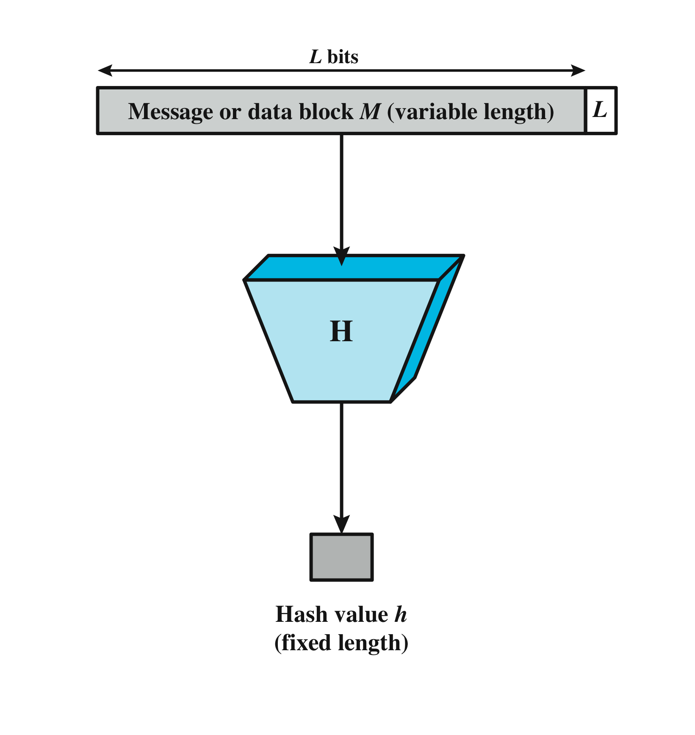
Secure Hash Functions
Important cryptographic primitive required for both Message Authentication Codes and Digital Signatures
Hash functions are key in the design of cryptocurrencies – will be clear later in the class
Notes:
An alternative to the message authentication code is the
one-way hash function. As with the message authentication code, a hash function
accepts a variable-size message M as input and produces a fixed-size message digest
H(M) as output (Figure 2.5). Typically, the message is padded out to an integer multiple
of some fixed length (e.g., 1024 bits) and the padding includes the value of the length
of the original message in bits. The length field is a security measure to increase the
difficulty for an attacker to produce an alternative message with the same hash value.

Slide 15
Hash Function Requirements
Can be applied to a block of data of any size
Produces a fixed-length output
H(x) is relatively easy to compute for any given x
One-way or pre-image resistant
  Computationally infeasible to find x such that H(x) = h
Second pre-image resistant or weak collision resistant
  Computationally infeasible to find y ≠ x such that H(y) = H(x)
Collision resistant or strong collision resistance
  Computationally infeasible to find any pair (x, y) such that H(x) = H(y)
We will come back to these properties again later in the class and see how they are relevant to cryptocurrencies
Notes:
The purpose of a hash function is to produce a
“fingerprint” of a file, message, or other block of data. To be useful for message
authentication, a hash function H must have the following properties:
1. H can be applied to a block of data of any size.
2. H produces a fixed-length output.
3. H(x) is relatively easy to compute for any given x, making both hardware and
software implementations practical.
4. For any given code h, it is computationally infeasible to find x such that
H(x) h. A hash function with this property is referred to as one-way or preimage
resistant.
5. For any given block x, it is computationally infeasible to find y x with
H(y) H(x). A hash function with this property is referred to as second preimage
resistant. This is sometimes referred to as weak collision resistant.
6. It is computationally infeasible to find any pair (x, y) such that H(x) H(y).
A hash function with this property is referred to as collision resistant. This is
sometimes referred to as strong collision resistant.
The first three properties are requirements for the practical application of a hash
function to message authentication.
The fourth property is the one-way property: It is easy to generate a code given a
message, but virtually impossible to generate a message given a code. This property is
important if the authentication technique involves the use of a secret value (Figure 2.6c).
The secret value itself is not sent; however, if the hash function is not one way, an attacker
can easily discover the secret value: If the attacker can observe or intercept a transmission,
the attacker obtains the message M and the hash code MDM H(SAB || M). The attacker
then inverts the hash function to obtain SAB || M H-1(MDM). Because the attacker now
has both M and SAB || M, it is a trivial matter to recover SAB.
The fifth property guarantees that it is impossible to find an alternative
message with the same hash value as a given message. This prevents forgery when
an encrypted hash code is used (Figures 2.6a and b). If this property were not true,
an attacker would be capable of the following sequence: First, observe or intercept
a message plus its encrypted hash code; second, generate an unencrypted hash code
from the message; third, generate an alternate message with the same hash code.
A hash function that satisfies the first five properties in the preceding list is
referred to as a weak hash function. If the sixth property is also satisfied, then it
is referred to as a strong hash function. A strong hash function protects against an
attack in which one party generates a message for another party to sign. For example,
suppose Bob gets to write an IOU message, send it to Alice, and she signs it.
Bob finds two messages with the same hash, one of which requires Alice to pay a
small amount and one that requires a large payment. Alice signs the first message
and Bob is then able to claim that the second message is authentic.

Slide 16
Security of Hash Functions
Two approaches to attacking a secure hash function:
  Cryptanalysis
      Exploit logical weaknesses in the algorithm
  Brute-force attack
      Strength of hash function depends solely on the length of the hash code produced by the algorithm
    SHA family of algorithms are the most widely used hash functions
    Applications:
  MACs and Digital signatures
  Cryptocurrencies
  Storage of passwords
  Intrusion detection
Notes:
As with symmetric encryption, there are two
approaches to attacking a secure hash function: cryptanalysis and brute-force attack.
As with symmetric encryption algorithms, cryptanalysis of a hash function involves
exploiting logical weaknesses in the algorithm.
The strength of a hash function against brute-force attacks depends solely on
the length of the hash code produced by the algorithm.
For a hash code of length n,
the level of effort required is proportional to the following:
Preimage resistant 2n
Second preimage resistant 2n
Collision resistant 2n/2
If collision resistance is required (and this is desirable for a general-purpose
secure hash code), then the value 2n/2 determines the strength of the hash code against
brute-force attacks. Van Oorschot and Wiener [VANO94] pre sented a design for a
$10 million collision search machine for MD5, which has a 128-bit hash length, that
could find a collision in 24 days. Thus a 128-bit code may be viewed as inadequate.
The next step up, if a hash code is treated as a sequence of 32 bits, is a 160-bit hash
length. With a hash length of 160 bits, the same search machine would require over
four thousand years to find a collision. With today’s technology, the time would be
much shorter, so that 160 bits now appears suspect.
In recent years, the most widely used
hash function has been the Secure Hash Algorithm (SHA). SHA was developed
by the National Institute of Standards and Technology (NIST) and published as
a federal information processing standard (FIPS 180) in 1993. When weaknesses
were discovered in SHA, a revised version was issued as FIPS 180-1 in 1995 and is
generally referred to as SHA-1. SHA-1 produces a hash value of 160 bits. In 2002,
NIST produced a revised version of the standard, FIPS 180–2, that defined three
new versions of SHA, with hash value lengths of 256, 384, and 512 bits, known as
SHA-256, SHA-384, and SHA-512. These new versions have the same underlying
structure and use the same types of modular arithmetic and logical binary operations
as SHA-1. In 2005, NIST announced the intention to phase out approval of SHA-1
and move to a reliance on the other SHA versions by 2010. As discussed in Chapter
21, researchers have demonstrated that SHA-1 is far weaker than its 160-bit hash
length suggests, necessitating the move to the newer versions of SHA.
We have discussed the use of hash functions for message authentication and for the
creation of digital signatures (the latter is discussed in more detail later in this chapter).
Here are two other examples of secure hash function applications:
• Passwords: Chapter 3 explains a scheme in which a hash of a password is
stored by an operating system rather than the password itself. Thus, the actual
password is not retrievable by a hacker who gains access to the password file.
In simple terms, when a user enters a password, the hash of that password is
compared to the stored hash value for verification. This application requires
preimage resistance and perhaps second preimage resistance.
• Intrusion detection: Store H(F) for each file on a system and secure the hash
values (e.g., on a CD-R that is kept secure). One can later determine if a file has
been modified by recomputing H(F). An intruder would need to change F without
changing H(F). This application requires weak second preimage resistance

Slide 17
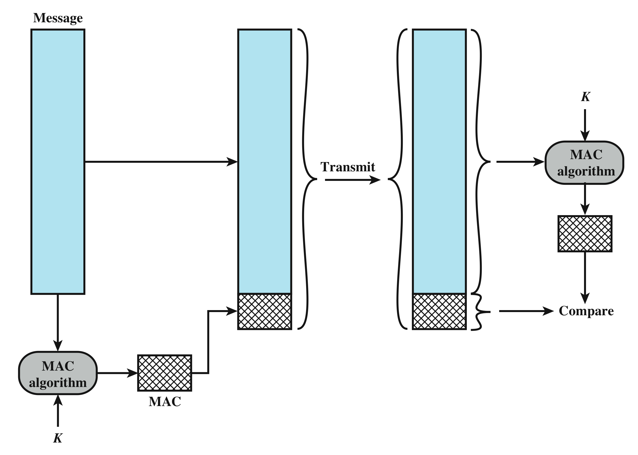
Message Authentication Codes (MAC)
MACs verify that information has not been altered and is from an authentic source.
But, can it really provide non-repudiation?
Notes:
One authentication technique involves
the use of a secret key to generate a small block of data, known as a message
authentication code, that is appended to the message. This technique assumes that
two communicating parties, say A and B, share a common secret key KAB. When
A has a message to send to B, it calculates the message authentication code as a
complex function of the message and the key: MACM F(KAB, M). The message
plus code are transmitted to the intended recipient. The recipient performs the same
calculation on the received message, using the same secret key, to generate a new
message authentication code. The received code is compared to the calculated code
(Figure 2.4). If we assume that only the receiver and the sender know the identity of
the secret key, and if the received code matches the calculated code, then
1. The receiver is assured that the message has not been altered. If an attacker
alters the message but does not alter the code, then the receiver’s calculation
of the code will differ from the received code. Because the attacker is assumed
not to know the secret key, the attacker cannot alter the code to correspond to
the alterations in the message.
2. The receiver is assured that the message is from the alleged sender. Because
no one else knows the secret key, no one else could prepare a message with a
proper code.
3. If the message includes a sequence number (such as is used with X.25, HDLC,
and TCP), then the receiver can be assured of the proper sequence, because
an attacker cannot successfully alter the sequence number.
A number of algorithms could be used to generate the code. The NIST specification,
FIPS PUB 113, recommends the use of DES. DES is used to generate an
encrypted version of the message, and the last number of bits of ciphertext are used
as the code. A 16- or 32-bit code is typical.
The process just described is similar to encryption. One difference is that the
authentication algorithm need not be reversible, as it must for decryption. It turns
out that because of the mathematical properties of the authentication function, it is
less vulnerable to being broken than encryption.

Slide 18
Digital Signatures
  Also known as private-key encryption.
  User encrypts data using his or her own private key
  Anyone who knows the corresponding public key will be able to decrypt the message
  Directed towards providing authentication with non-repudiation
So, how do Secure hash functions enable MACs and Digital Signatures?
Notes:
Figure 2.7b illustrates another mode of operation of public-key cryptography.
In this scheme, a user encrypts data using his or her own private key.
Anyone who knows the corresponding public key will then be able to decrypt the
message.
The scheme of Figure 2.7b is directed toward providing authentication
and/or data integrity. If a user is able to successfully recover the plaintext from
Bob’s ciphertext using Bob’s public key, this indicates that only Bob could have
encrypted the plaintext, thus providing authentication. Further, no one but
Bob would be able to modify the plaintext because only Bob could encrypt the
plaintext with Bob’s private key. Once again, the actual provision of authentication
or data integrity depends on a variety of factors. This issue is addressed
primarily in Chapter 21, but other references are made to it where appropriate in
this text.

Slide 19
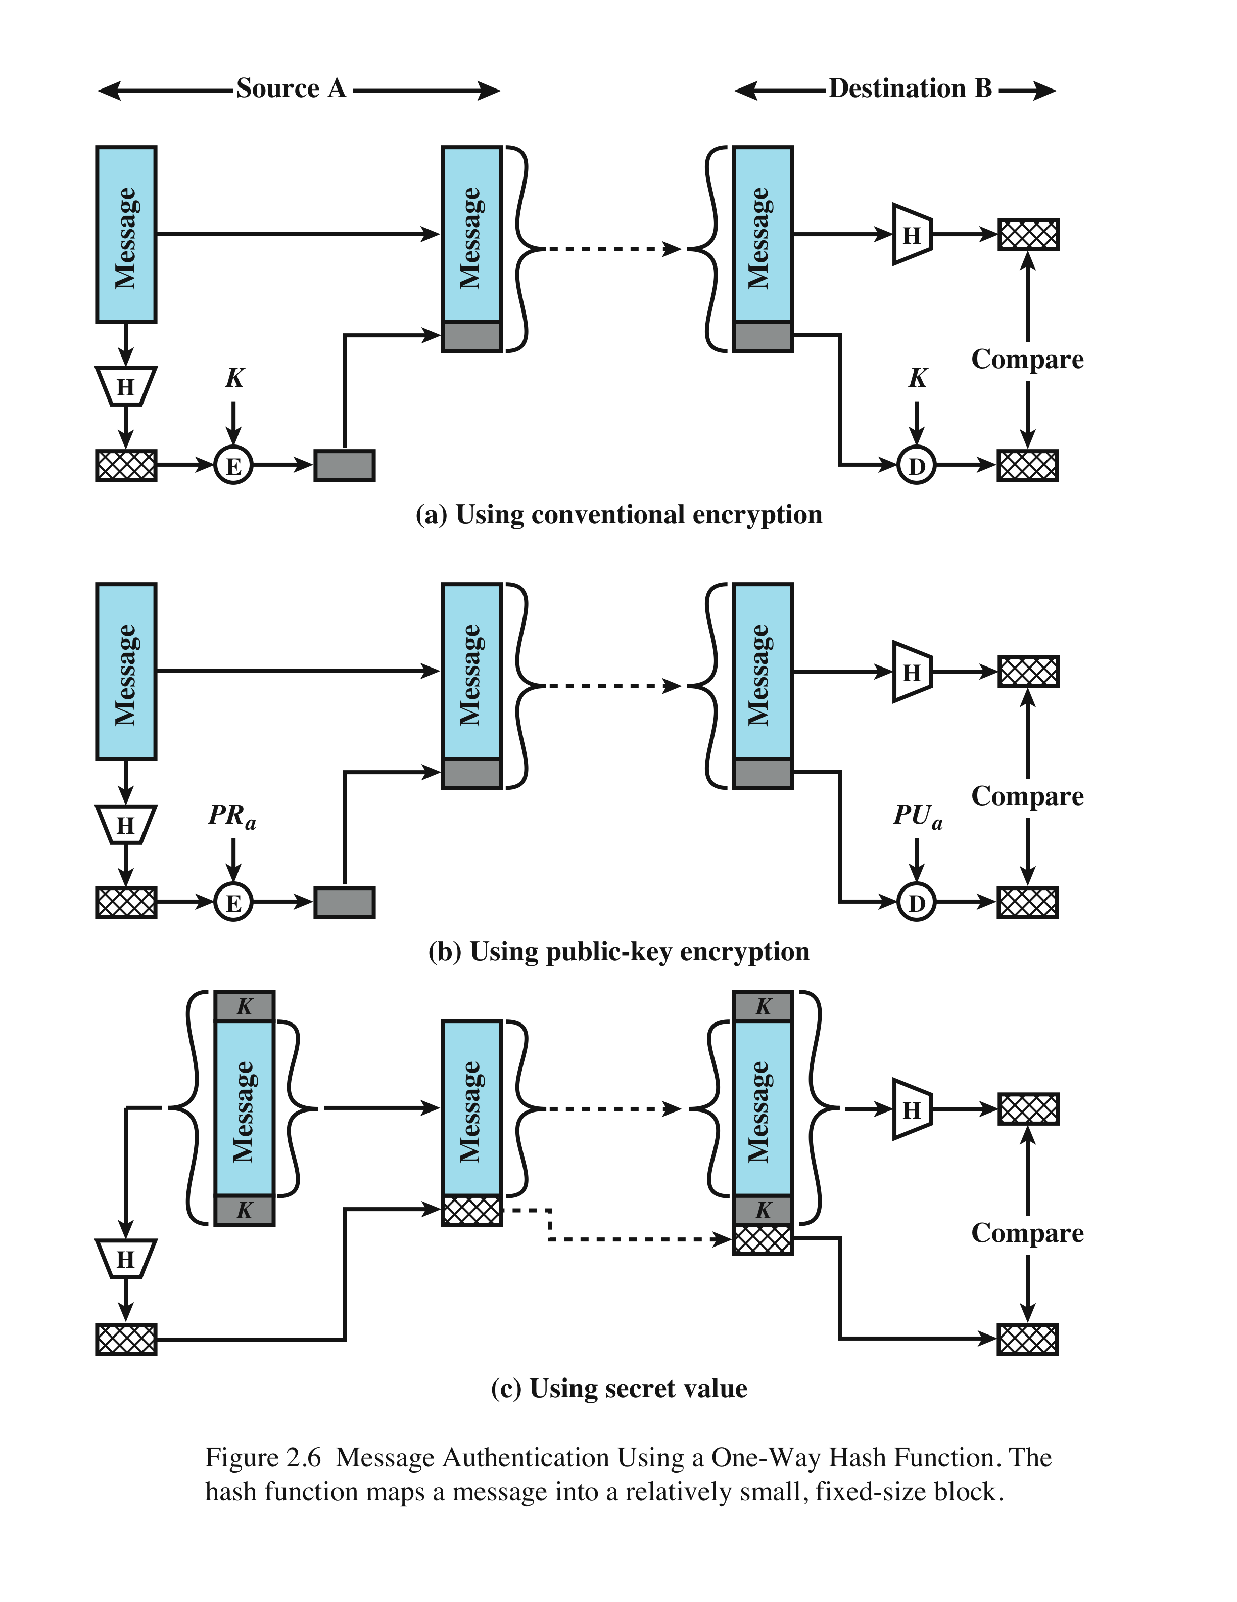
Secure Hash Functions in the realization of MACs and Digital Signatures
Digital Signatures
Message Authentication Codes
Notes:
Unlike the MAC, a hash function does not also take a secret key as input.
To authenticate a message, the message digest is sent with the message in such
a way that the message digest is authentic. Figure 2.6 illustrates three ways in
which the message can be authenticated using a hash code. The message digest
can be encrypted using symmetric encryption (part a); if it is assumed that only
the sender and receiver share the encryption key, then authenticity is assured. The
message digest can also be encrypted using public-key encryption (part b); this is
explained in Section 2.3. The public-key approach has two advantages: It provides
a digital signature as well as message authentication; and it does not require the
distribution of keys to communicating parties.
These two approaches have an advantage over approaches that encrypt the
entire message in that less computation is required. But an even more common approach is
the use of a technique that avoids encryption altogether. Several reasons
for this interest are pointed out in [TSUD92]:
• Encryption software is quite slow. Even though the amount of data to be
encrypted per message is small, there may be a steady stream of messages into
and out of a system.
• Encryption hardware costs are non-negligible. Low-cost chip implementations
of DES are available, but the cost adds up if all nodes in a network must have
this capability.
• Encryption hardware is optimized toward large data sizes. For small blocks of
data, a high proportion of the time is spent in initialization/invocation overhead.
• An encryption algorithm may be protected by a patent.
Figure 2.6c shows a technique that uses a hash function but no encryption
for message authentication. This technique, known as a keyed hash MAC, assumes
that two communicating parties, say A and B, share a common secret key K.
This secret key is incorporated into the process of generating a hash code. In the
approach illustrated in Figure 2.6c, when A has a message to send to B, it calculates
the hash function over the concatenation of the secret key and the message:
MDM = H(KMK).6 It then sends [ MMDM] to B. Because B possesses K, it can
recompute H(K7M7K) and verify MDM. Because the secret key itself is not sent, it
should not be possible for an attacker to modify an intercepted message. As long as
the secret key remains secret, it should not be possible for an attacker to generate a
false message.
Note that the secret key is used as both a prefix and a suffix to the message. If
the secret key is used as either only a prefix or only a suffix, the scheme is less secure.
This topic is discussed in Chapter 21. Chapter 21 also describes a scheme known
as HMAC, which is somewhat more complex than the approach of Figure 2.6c and
which has become the standard approach for a keyed hash MAC.

Slide 20
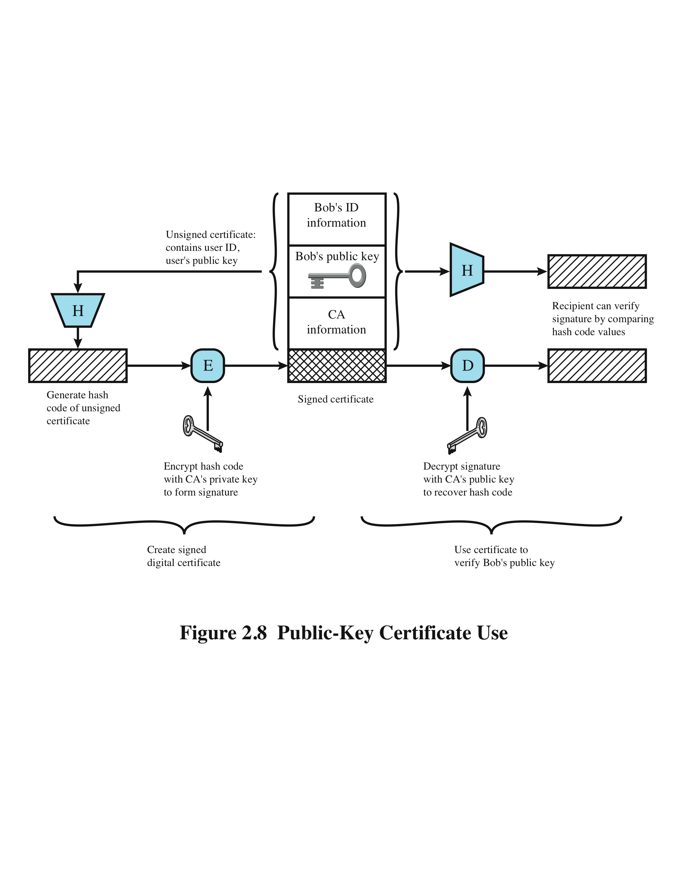
Public-Key Certificates
How do receivers verify that the public key of the sender actually belongs to the sender?
Senders employ public-key certificates to distribute their public-keys -> certificates contains the sender’s public-key signed using some trusted third-parties private key.
Notes:
On the face of it, the point of public-key encryption is that the public key is public.
Thus, if there is some broadly accepted public-key algorithm, such as RSA, any
participant can send his or her public key to any other participant or broadcast the
key to the community at large. Although this approach is convenient, it has a major
weakness. Anyone can forge such a public announcement. That is, some user could
pretend to be Bob and send a public key to another participant or broadcast such a
public key. Until such time as Bob discovers the forgery and alerts other participants,
the forger is able to read all encrypted messages intended for A and can use the
forged keys for authentication.
The solution to this problem is the public-key certificate. In essence, a certificate
consists of a public key plus a user ID of the key owner, with the whole block
signed by a trusted third party. The certificate also includes some information about
the third party plus an indication of the period of validity of the certificate. Typically,
the third party is a certificate authority (CA) that is trusted by the user community,
such as a government agency or a financial institution. A user can present his
or her public key to the authority in a secure manner and obtain a signed certificate.
The user can then publish the certificate. Anyone needing this user’s public key
can obtain the certificate and verify that it is valid by means of the attached trusted
signature. Figure 2.8 illustrates the process.
One scheme has become universally accepted for formatting public-key
certificates: the X.509 standard. X.509 certificates are used in most network security
applications, including IP Security (IPsec), Transport Layer Security (TLS), Secure
Shell (SSH), and Secure/Multipurpose Internet Mail Extension (S/MIME). We
examine most of these applications in Part Five.

Slide 21
Availability
Alice
channel
data, control messages
Bob
Sending System
Receiving System
data
data
“Hello”
Trudy
Notes:
The NIST Computer Security Handbook [NIST95] defines the term computer security as shown on this slide. This definition introduces three key objectives that are at the heart of computer security as we see on the next slide.

Slide 22
Random Numbers
Primarily used for:
  Generating keys for public-key and symmetric algorithms
  Generating key stream for symmetric stream cipher
  Sequence numbers in networking protocols
  Many other uses in cryptographic algorithms and networking protocols
    Including in cryptocurrencies (we will see more later)
Notes:
A number of network security algorithms based on cryptography make use of
random numbers. For example,
• Generation of keys for the RSA public-key encryption algorithm (described
in Chapter 21) and other public-key algorithms.
• Generation of a stream key for symmetric stream cipher.
• Generation of a symmetric key for use as a temporary session key or in creating
a digital envelope.
• In a number of key distribution scenarios, such as Kerberos (described in
Chapter 23), random numbers are used for handshaking to prevent replay
attacks.
• Session key generation, whether done by a key distribution center or by one of
the principals.
These applications give rise to two distinct and not necessarily compatible
requirements for a sequence of random numbers: randomness and unpredictability.

Slide 23
Random Number Requirements
Randomness
Uniform distribution
  Frequency of occurrence of each of the numbers should be approximately the same
  Independence
  Each number is statistically independent of other numbers in the sequence
  Opponent should not be able to predict future elements of the sequence on the basis of earlier elements
Notes:
Traditionally, the concern in the generation of a sequence of
allegedly random numbers has been that the sequence of numbers be random in
some well-defined statistical sense. The following two criteria are used to validate
that a sequence of numbers is random:
• Uniform distribution: The distribution of numbers in the sequence should be
uniform; that is, the frequency of occurrence of each of the numbers should be
approximately the same.
• Independence: No one value in the sequence can be inferred from the others.
Although there are well-defined tests for determining that a sequence of numbers
matches a particular distribution, such as the uniform distribution, there is no such
test to “prove” independence. Rather, a number of tests can be applied to demonstrate
if a sequence does not exhibit independence. The general strategy is to apply a number
of such tests until the confidence that independence exists is sufficiently strong.
In the context of our discussion, the use of a sequence of numbers that appear
statistically random often occurs in the design of algorithms related to cryptography.
For example, a fundamental requirement of the RSA public-key encryption scheme
is the ability to generate prime numbers. In general, it is
difficult to determine if a given large number N is prime. A brute-force approach
would be to divide N by every odd integer less than 1N. If N is on the order, say,
of 10150, a not uncommon occurrence in public-key cryptography, such a brute-force
approach is beyond the reach of human analysts and their computers. However, a
number of effective algorithms exist that test the primality of a number by using a
sequence of randomly chosen integers as input to relatively simple computations.
If the sequence is sufficiently long (but far, far less than 110150), the primality of
a number can be determined with near certainty. This type of approach, known
as randomization, crops up frequently in the design of algorithms. In essence, if a
problem is too hard or time-consuming to solve exactly, a simpler, shorter approach
based on randomization is used to provide an answer with any desired level of
confidence.
UNPREDICTABILITY
In applications such as reciprocal authentication and session key
generation, the requirement is not so much that the sequence of numbers be statistically
random but that the successive members of the sequence are unpredictable. With
“true” random sequences, each number is statistically independent of other numbers
in the sequence and therefore unpredictable. However, as is discussed shortly, true
random numbers are not always used; rather, sequences of numbers that appear to
be random are generated by some algorithm. In this latter case, care must be taken
that an opponent not be able to predict future elements of the sequence on the basis
of earlier elements.

Slide 24
Random versus Pseudorandom
Cryptographic applications typically use fixed algorithms for random number generation
  Algorithms are deterministic and therefore produce sequences of numbers that are not statistically random
  Called pseudorandom numbers are:
    Almost random or statistically close to random numbers
    Sequences produced that satisfy statistical randomness tests
    Likely to be predictable
True random number generator (TRNG):
  Uses a nondeterministic source to produce randomness
  Most operate by measuring unpredictable natural processes
    e.g. radiation, gas discharge, leaky capacitors
  Increasingly provided on modern processors
Notes:
Cryptographic applications typically make use of algorithmic techniques for random
number generation. These algorithms are deterministic and therefore produce
sequences of numbers that are not statistically random. However, if the algorithm is
good, the resulting sequences will pass many reasonable tests of randomness. Such
numbers are referred to as pseudorandom numbers.
You may be somewhat uneasy about the concept of using numbers generated
by a deterministic algorithm as if they were random numbers. Despite what might
be called philosophical objections to such a practice, it generally works. As one
expert on probability theory puts it [HAMM91],
For practical purposes we are forced to accept the awkward concept
of “relatively random” meaning that with regard to the proposed
use we can see no reason why they will not perform as if they were
random (as the theory usually requires). This is highly subjective
and is not very palatable to purists, but it is what statisticians regularly
appeal to when they take “a random sample”—they hope that
any results they use will have approximately the same properties as
a complete counting of the whole sample space that occurs in their
theory.
A true random number generator (TRNG) uses a nondeterministic source to
produce randomness. Most operate by measuring unpredictable natural processes,
such as pulse detectors of ionizing radiation events, gas discharge tubes, and leaky
capac itors. Intel has developed a commercially available chip that samples thermal
noise by amplifying the voltage measured across undriven resistors [JUN99].
A group at Bell Labs has developed a technique that uses the variations in the
response time of raw read requests for one disk sector of a hard disk [JAKO98].
LavaRnd is an open source project for creating truly random numbers using inexpensive
cameras, open source code, and inexpensive hardware. The system uses a
saturated charge- coupled device (CCD) in a light-tight can as a chaotic source to
produce the seed. Software processes the result into truly random numbers in a
variety of formats.

