Slide 1
CS 4593/6463 – Bitcoins and Cryptocurrencies
Prof. Murtuza Jadliwala
murtuza.jadliwala@utsa.edu
Note: most of the slides used in this course are derived from those available for the book “Bitcoins and Cryptocurrencies Technologies – A Comprehensive Introduction”, Arvind Narayanan, Joseph Bonneau, Edward Felten, Andrew Miller & Steven Goldfeder, 2016, Princeton University Press.

Slide 2
Introduction to CS 4593/6463
Bitcoins and Cryptocurrencies

Slide 3
This lecture
Get to know each other!
What is this course about?
Syllabus
What you should expect from this course
What are my expectations from you and what you should expect from me
Questions, Concerns, Suggestions

Slide 4
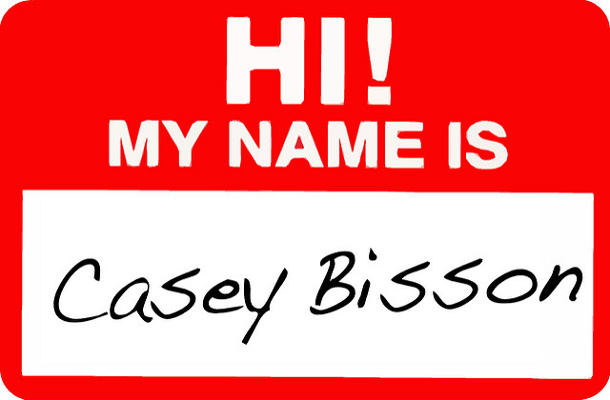
Let’s get to know each other!

Slide 5
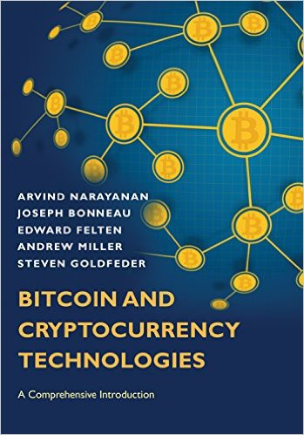
Textbook
Bitcoins and Cryptocurrencies Technologies – A Comprehensive Introduction, Arvind Narayanan, Joseph Bonneau, Edward Felten, Andrew Miller & Steven Goldfeder, 2016, Princeton University Press. (ISBN- 9780691171692).
Required for this course! If you do not have one, please order one asap!
A free pre-publication online (non-printable) PDF version of the book can be found here: http://bitcoinbook.cs.princeton.edu/ and can be used for this course.
Notes:
Lecture slides prepared for “Computer Security: Principles and Practice”, 2/e, by William Stallings and Lawrie Brown, Chapter 1 “Overview”.

Slide 6
What is this course about?

Slide 7
What are CryptoCurrencies?
Before that – What are Currencies?
According to Merriam-Webster dictionary:

Slide 8
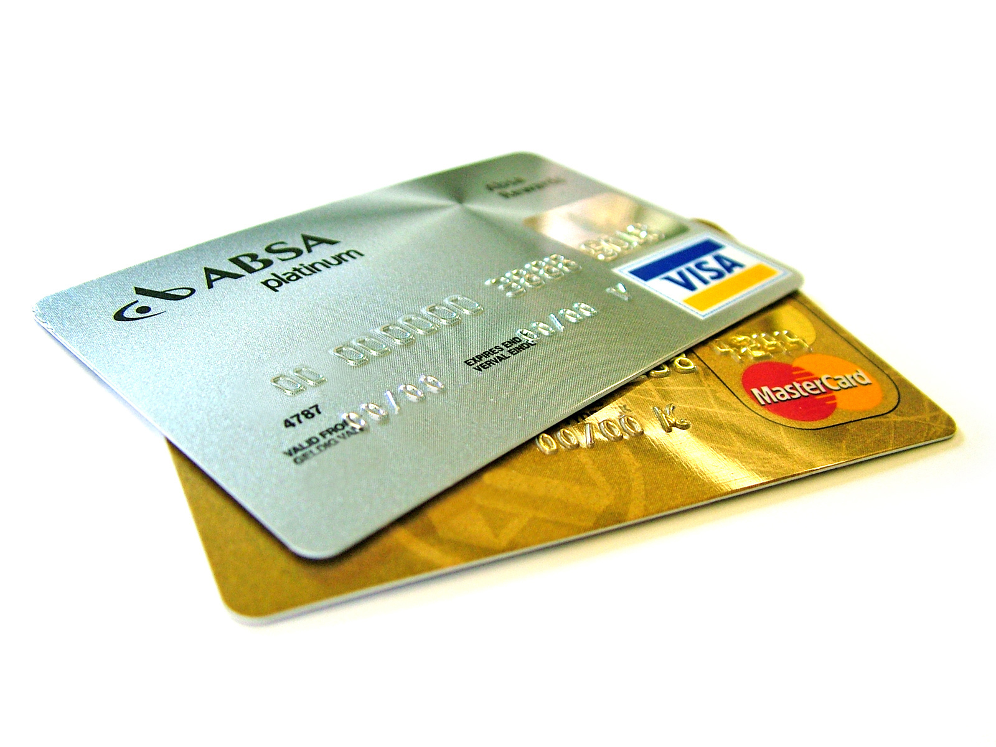
Mediums for Trade
Traditional Financial Systems
Cash or currency or money
(Fiat money, Commodity money)
Credit

Slide 9
Mediums for Online Trade
Cash
Credit
Ecash
Cyberbucks
MagicMoney
Bitcoins
Altcoins
FirstVirtual
SET
This course

Slide 10
Some requirements for online cash
Protection against double-spending
Anonymity (for both spender and recipient)
Should work in an offline fashion
Free-floating that acquires real value
Preferably, decentralized
Bootstrapping an online cash (currency) that satisfies some or all of these requirements will require a clever amalgamation of well-known cryptographic primitives and computing paradigms!
Thus the name,
Crypto + Currencies

Slide 11
Syllabus & Course Content
This course will primarily use Blackboard for course related announcements, course content dissemination, assignment submissions and grade posting.
I will also maintain a publicly-visible course website for your convenience which will contain all information related to the course.

Slide 12
Next Class
Introduction to Information Security and some popular Cryptographic Primitives.
Knowledge of these will be useful in understanding some important concepts related to cryptocurrencies later on.

Slide 13
Homework
Please view the lecture video on the history of Crypto Currencies by Prof. Jeremy Clark, Concordia University.
https://www.youtube.com/watch?time_continue=1&v=1VYs_zZsorU

Slide 14
Questions, Concerns and Suggestions

