Slide 1
CS 4593/6463 – Bitcoins and Cryptocurrencies
Prof. Murtuza Jadliwala
murtuza.jadliwala@utsa.edu
Note: most of the slides used in this course are derived from those available for the book “Bitcoins and Cryptocurrencies Technologies – A Comprehensive Introduction”, Arvind Narayanan, Joseph Bonneau, Edward Felten, Andrew Miller & Steven Goldfeder, 2016, Princeton University Press.

Slide 2
Lecture 5
Bitcoin mining

Slide 3
Recap: Bitcoin miners
Bitcoin depends on miners to:
Store and broadcast the block chain
Validate new transactions
Vote (by hash power) on consensus
But who are the miners? How did they get into this? How do they operate? What is there business model?...
Notes:
But what rules?

Slide 4
The task of Bitcoin miners

Slide 5
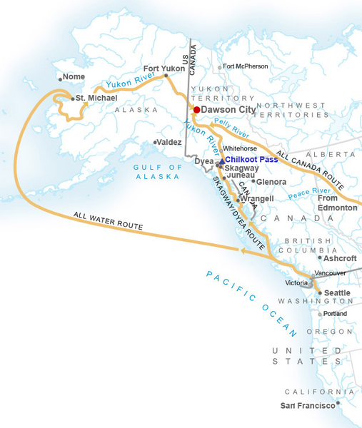
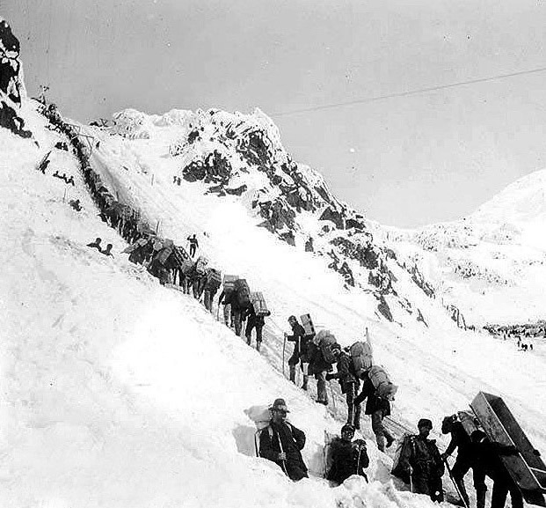
So you want to be a miner?
Some Gold miners of Klondike gold rush struck it rich, others lost everything
Bitcoin mining has similar challenges as gold rush and other get-rich-quick schemes!
Klondike gold rush of 1898 - Gold miners ascending the Chilkoot pass
Notes:
Image is public domain (Wikimedia commons)

Slide 6
Mining Bitcoins in 6 easy steps
Join the network, listen for transactions
Validate all proposed transactions
Listen for new blocks, maintain block chain
When a new block is proposed, validate it
Assemble a new valid block
Find the nonce to make your block valid
Hope everybody accepts your new block
Profit!
Useful to Bitcoin network
Incentivize miners to do above
Notes:
Image is public domain (Wikimedia commons)

Slide 7
Finding a valid block
prev: H( )
prev: H( )
mrkl_root: H( )
mrkl_root: H( )
nonce: 0x0001...
nonce: 0xffff...
nonce: 0x0000...
nonce: 0x0001...
nonce: 0x0002...
nonce: 0xf77e...
nonce: 0x7a83
nonce: 0x0000...
hash: 0xd0c7...
hash: 0x6a1f...
hash: 0x300c...
hash:
hash: 0x0224...
hash: 0xc9c8...
hash: 0x0000...
hash: 0x3485...
hash: 0x0000
hash:
All changed
H( ) H( )
H( ) H( )
H( ) H( )
12.5→A
coinbase:
0x3df5...65
12.5→A
coinbase:
0x0000...01
12.5→A
coinbase:
0x0000...00
transaction
transaction
transaction
Notes:
Make sure to point out-coinbase is why miners aren’t all solving the exact same problem

Slide 8
Mining difficulty “target” end of 2015
00000000000000000a9550000000000000000000000000000000000000000000
Hash of any valid block should be less than the following:
256 bit hash output
64+ leading zeroes required
Current difficulty = 2⁶⁸ =84,758,978,290,086,040,000
Less than 1 in about 2⁶⁸ nonces will work

Slide 9
Is everyone solving the same puzzle?
No!
Unlikely miners working on the same set of transactions (and thus the same block)
Even if some miners have the same transactions in the block, there is one which is not the same.
Q1: Do you know which one?
Answer: Coinbase!
Q2: Why?
Answer: Miners will specify their own address in the output (hopefully each miner will use a different address!)
Notes:
But what rules?

Slide 10
Setting the mining difficulty
Every two weeks (or approx. 2,016 blocks), compute:
next_difficulty= previous_difficulty *
(2 weeks)/(time to mine last 2016 blocks)
Expected number of blocks in 2 weeks at 10 minutes/block

Slide 11
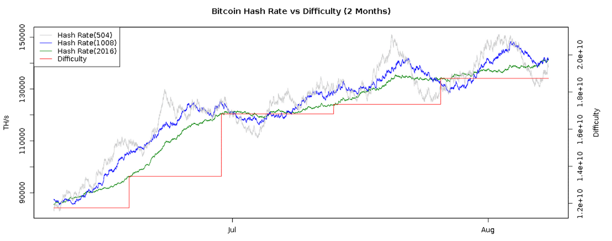
Mining difficulty over time
bitcoinwisdom.com

Slide 12
Mining difficulty over time
Factor(s) affecting mining difficulty:
How many new miners join the network ← current exchange rate of Bitcoins
Efficiency of mining hardware
As more miners join and mining hardware becomes efficient → blocks are found faster → difficulty is increased!
Goal: keep the difficult at approx. 10 min per block

Slide 13
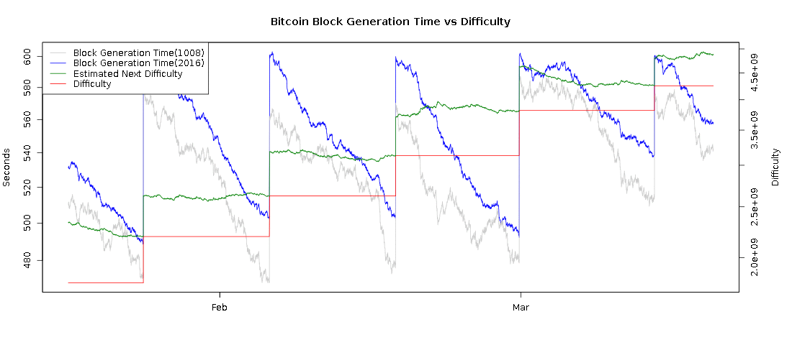
Time to find a block
10 minutes
2 weeks
bitcoinwisdom.com

Slide 14
Mining hardware

Slide 15
SHA-256
General purpose hash function
Part of SHA-2 family: SHA-224,SHA-384,SHA-512
Published in 2001
Designed by the NSA
Remains unbroken cryptographically
Weaknesses known
SHA-3 (replacement) under standardization
Notes:
Source: NIST standard (no copyright)

Slide 16
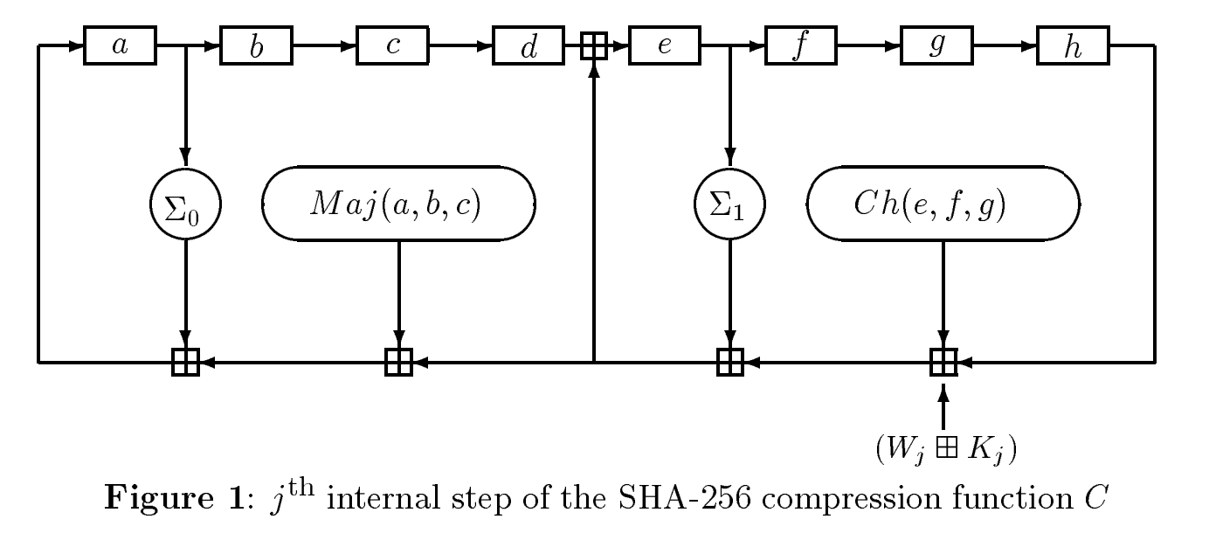
SHA-256 in more depth
256-bit state
Bitwise tweaks
x64 iterations
round constants
Addition mod 32
Notes:
Source: NIST standard (no copyright)

Slide 17
CPU mining
Using a SAT Solver to mine bitcoin
https://jheusser.github.io/2013/02/03/satcoin.html
TARGET = (65535 << 208)/DIFFICULTY;
coinbase_nonce = 0;
while (1){
header = makeBlockHeader(transactions, coinbase_nonce);
for (header_nonce=0;header_nonce < (1<<32);header_nonce++){
if (SHA256(SHA256(makeBlock(header,header_nonce))) < TARGET)
break; //block found!
}
coinbase_nonce++;
}
two hashes
Throughput on a high-end PC ≈ 20 million hashes/sec
≈ 139,461 years to find a block today!

Slide 18
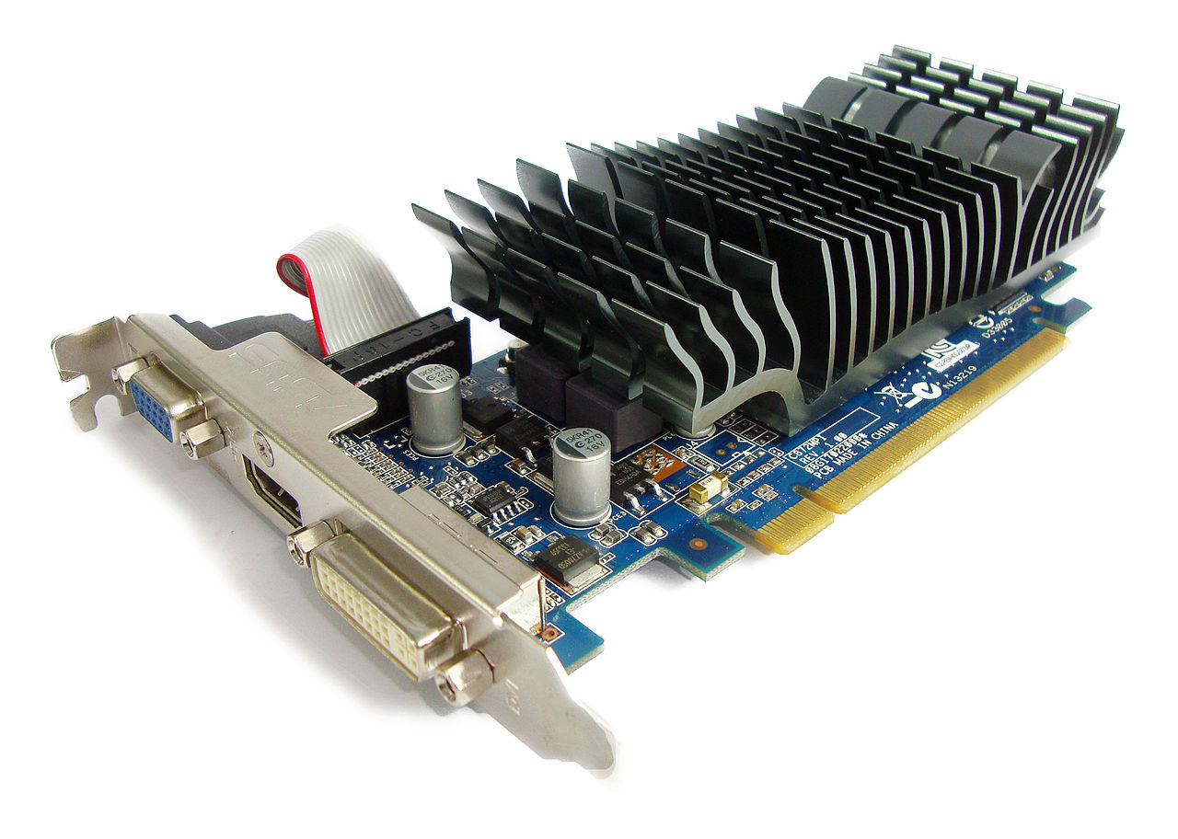
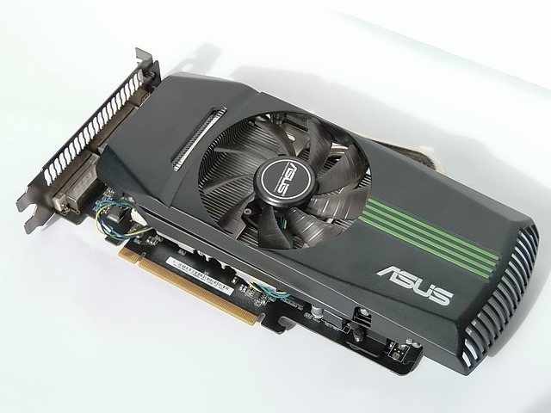
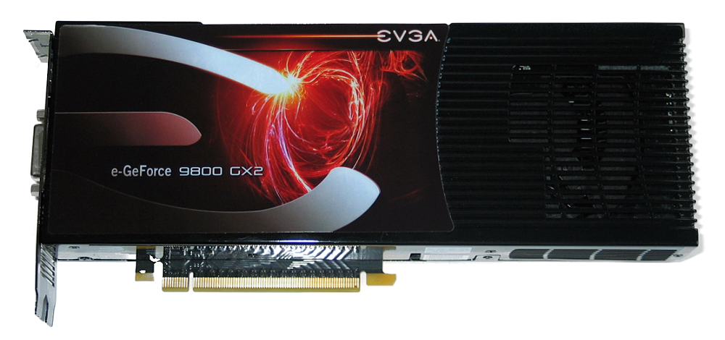
GPU mining
GPUs designed for high-performance graphics
High parallelism
High throughput
First used for Bitcoin mining in October 2010
Implemented in OpenCL
OpenCL: General purpose high level language for implementing non-graphic applications on GPUs

Slide 19
GPU mining advantages
Easily available, easy to set up
Parallel ALUs
Simultaneous SHA-256 computations
Some GPUs support instructions for bit-wise operations
Useful for SHA-256 computations
Can drive many from 1 CPU
Can overclock!
Run them faster than they are actually designed for
Only downside is that overclocking might introduce errors (but errors can be quickly verified) or overheat
Introduction of some errors to gain a speed-up in hash computation is a good trade-off
NVIDIA gpus are AWFUL at mining. ATI cards are great. Why?

Slide 20
“Goodput”
Observation: some errors are okay (may miss a valid block)
Goodput: throughput × success rate
Worth over-clocking by 50% with 30% errors!

Slide 21
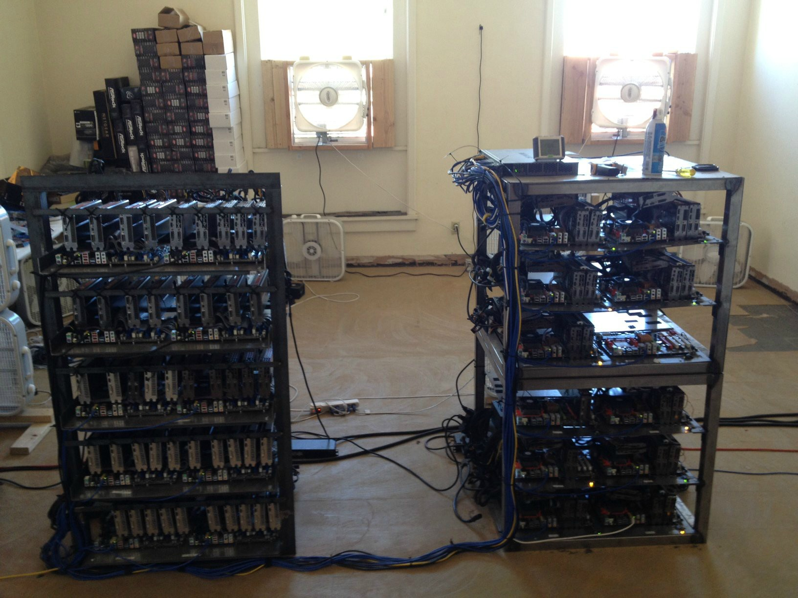
Source: LeonardH,
cryptocurrenciestalk.com

Slide 22
GPU mining disadvantages
Instead of time-to-find-block, compare to a lottery. What’s the chance of finding one in day?
Poor utilization of hardware
Contains FPUs which are not used for SHA-256 at all
Poor cooling
Cannot be stacked
Large power draw
Few boards to hold multiple GPUs
May need customized boards
Throughput on a good card = 20-200 MHz ≈ 200 million hashes/sec
≈173 years to find a block w/100 cards (at 2015 difficuly level)!
GPU mining is basically dead for Bitcoins ☹

Slide 23
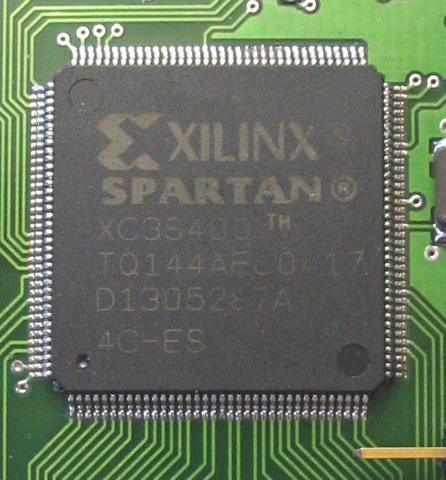
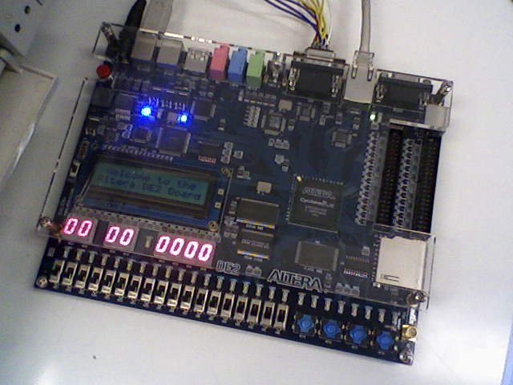
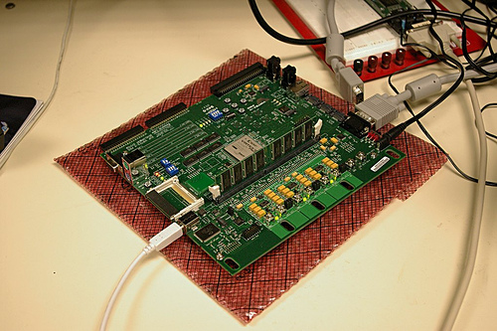
FPGA mining
Field Programmable Gate Area
First used for Bitcoin mining approx. June 2011
Implemented in Verilog

Slide 24
FPGA mining advantages
Higher performance than GPUs
Excellent performance on bitwise operations
Better cooling
Extensive customisation, optimisation

Slide 25
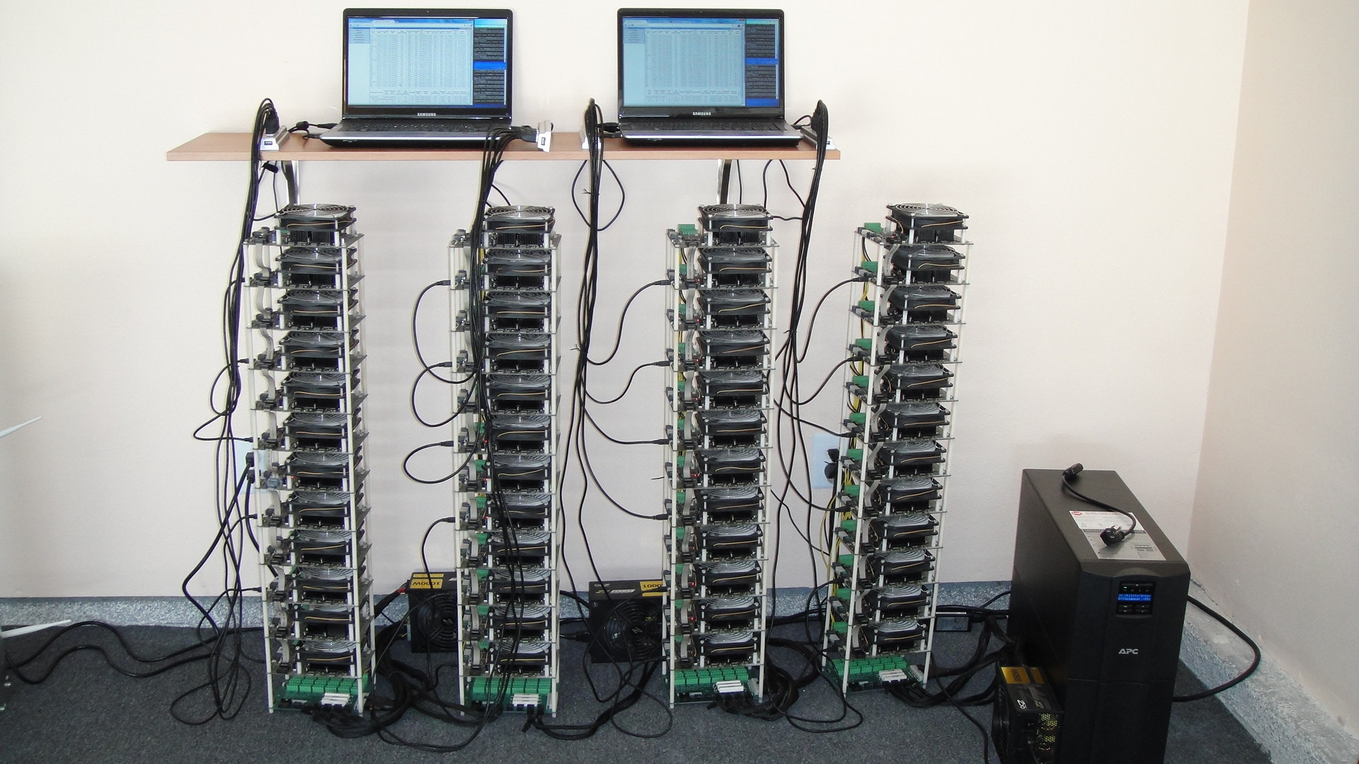
Bob Buskirk, thinkcomputers.org

Slide 26
FPGA mining disadvantages
Higher power draw than GPUs designed for
Frequent malfunctions, errors
Poor optimization of 32-bit adds
Critical for SHA-256 operations
Less accessible
Cannot buy them at regular stores
Fewer hobbyists with sufficient expertise to program them
More expensive than GPUs
Marginal performance/cost advantage over GPUs
Throughput on a good card = 100-1000 MHz ≈ 1 billion hashes / sec
25 years to find a block w/100 boards (at 2015 difficuly level)!
FPGA mining is also dead for Bitcoins – was even more short-lived that GPUs ☹

Slide 27
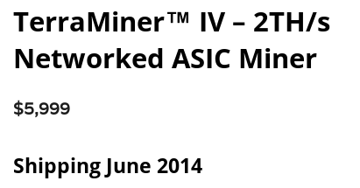
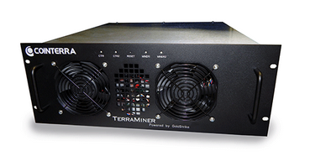
Bitcoin Application-specific Integrated Circuits (ASICs)

Slide 28
Bitcoin ASICs
Special purpose
Approaching known limits on feature sizes
Less than 10x performance improvement expected
Designed to be run constantly for life
Require significant expertise, long lead-times
Perhaps the fastest chip development ever!

Slide 29
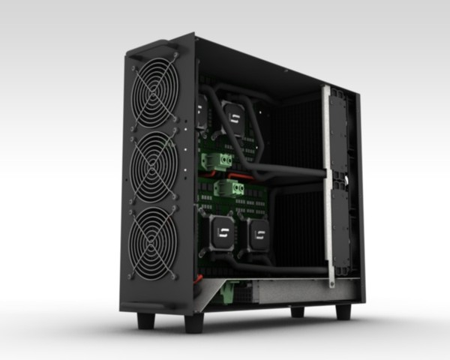
Case study: TerraMiner IV
First shipped Jan 2014
2 TH/s
Cost: US$6,000
Still, 14 months to find a block!

Slide 30
Market dynamics (2013/2014)
Most boards obsolete within 3-6 months
Half of profits made in first 6 weeks
Shipping delays are devastating to customers
Most companies require pre-orders
Most individual customers should have lost...
But... rising prices have saved them!

Slide 31
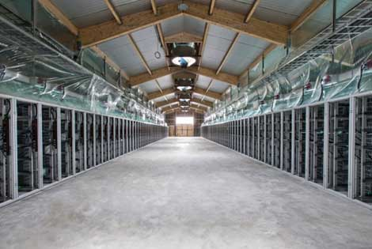
Professional mining centers
Needs:
Cheap power
Good network
Cool climate
(Georgia and Iceland are popular destinations for bitcoin mining)
BitFury mining center, Republic of Georgia

Slide 32
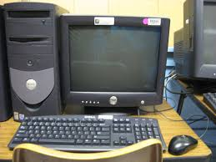
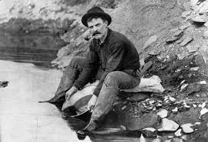
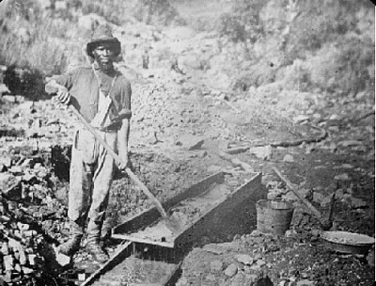
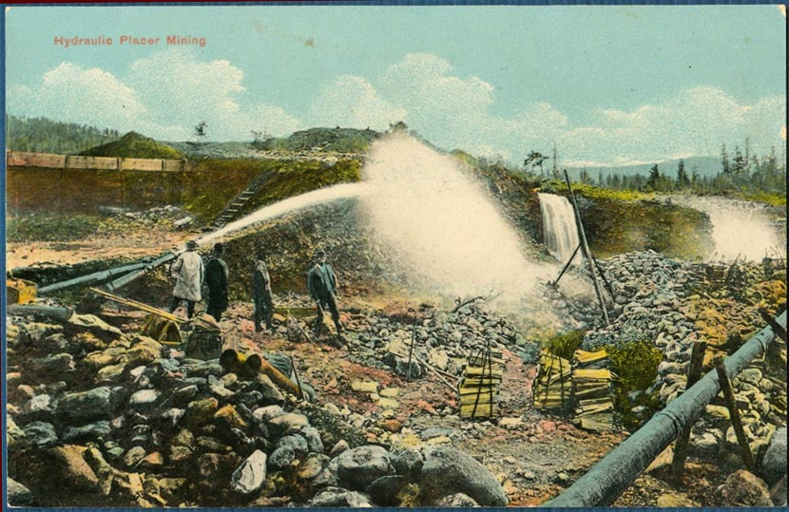
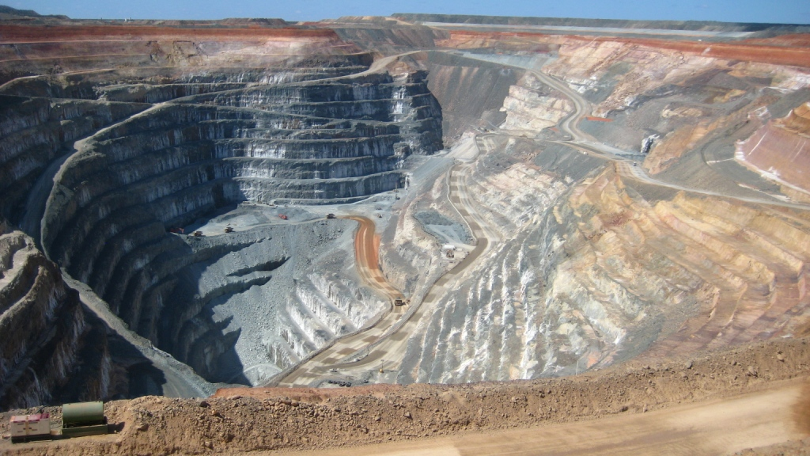
Evolution of mining
CPU GPU FPGA ASIC
Gold pan Sluice box Placer mining Pit mining

Slide 33
The future
Can small miners stay in the game?
Do ASICs violate the original Bitcoin vision?
Would we be better off without ASICs?
Stay tuned for our lecture on alt-mining!

Slide 34
Energy consumption & ecology

Slide 35
Thermodynamic limits
Landauer’s principle: Any non-reversible computation must consume a minimum amount of energy.
Specifically, each bit changed requires (kT ln 2) joules
SHA-256 is not reversible
Energy consumption is inevitable

Slide 36
Energy aspects of Bitcoin mining
Embodied energy: used to manufacture mining chips & other equipment
Should decrease over time
Returns to scale
Electricity: used to perform computation
Should increase over time
Returns to scale
Cooling: required to protect equipment
Costs more with increased scale!

Slide 37
Estimating energy usage: top-down
Each block worth approximately US$6,500
Approximately $11/s generated
Industrial electricity (US): $0.03/MJ
Equivalently, $0.10/kWh
If Bitcoin miners were spending all $11 per second of earnings on buying electricity
Upper bound on electricity consumed:
367 MJ/s = 367 MW

Slide 38
Estimating energy usage: bottom-up
Best claimed efficiency:
Most cutting edge ASIC - 3 gigahashes/sec per watt (or 3 billion hashes per second for 1 watt of power consumed)
Network hash rate: 350,000,000 gigahashes/sec
Excludes cooling and embodied energy
Lower bound on electricity consumed (to produce that many hashes per second at that efficiency):
150 MW

Slide 39
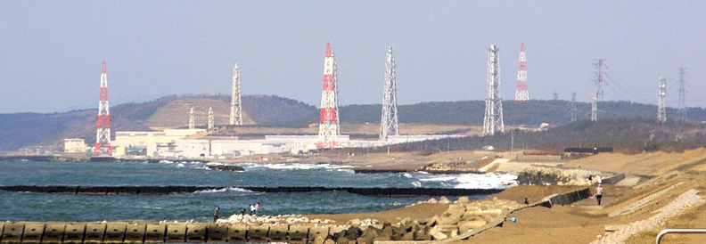
How much is a MW?
Three Gorges Dam = 10,000 MW
typical hydro plant ≈ 1,000 MW
Kashiwazaki-Kariwa
nuclear power plant = 7,000 MW
typical nuclear plant ≈ 4,000 MW
major coal-fired plant ≈ 2,000 MW

Slide 40
In summary – Bitcoin energy usage
The entire Bitcoin network consumes roughly 10% of a large power plant’s output
Significant but still small compared to other usages of electricity

Slide 41
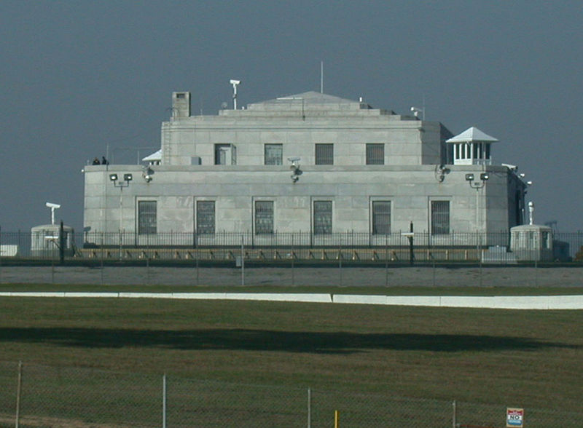
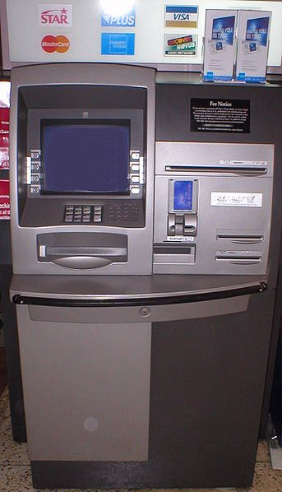
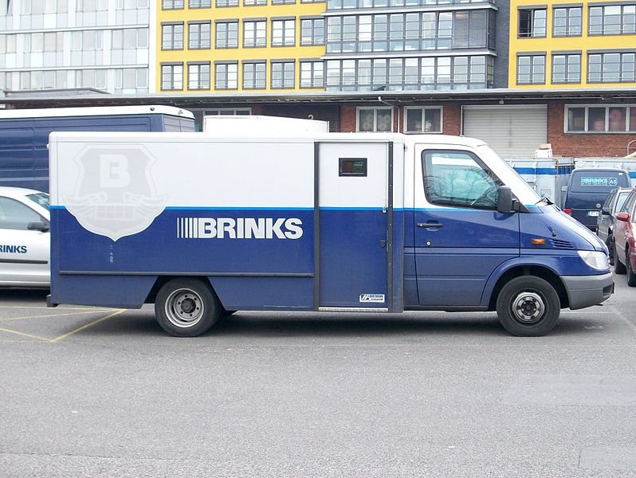
Is Bitcoin mining wasteful?
All payment systems require energy!
Although, it may be nice to have a currency with a less energy-intensive puzzle, but the same level of security!

Slide 42
Data furnaces
Observation: in the limit, computing devices produce heat almost as well as electric heaters!
Why not install mining rigs as home heaters?
Challenges:
Ownership/maintenance model
Gas heaters still at least 10x more efficient
What happens in summer?

Slide 43
Open questions
Will Bitcoin drive out electricity subsidies?
Will Bitcoin require guarding power outlets?
Can we make a currency with no proof-of-work?
Stay tuned for our lecture on alt-mining!

Slide 44
Mining pools

Slide 45
Economics of being a small miner
Cost of a mining rig: ≈US$6,000
Expected time to find a block: ≈14 months
In 2015, a block was worth ≈$10,000
Amortized expected revenue: ≈$400/month (after factoring in electricity and other operating costs
Given the above numbers, it may make sense to buy the mining rig, but remember mining is a random process → possible miner may never be able to mine a block → make any money
TerraMiner IV

Slide 46
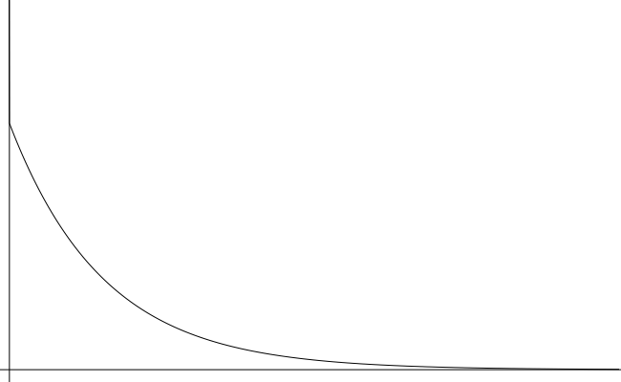
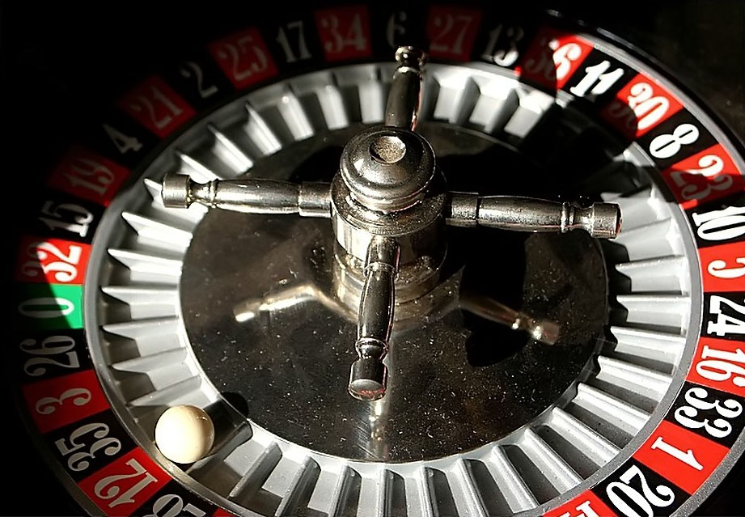
Mining uncertainty
# blocks found in one year | probability (Poisson dist.)
0 | 42.4%
1 | 36.4%
2 | 15.6%
3+ | 5.6%
14
months
Probability density
Time to find first block

Slide 47
Idea: could small miners pool risk?

Slide 48
Mining pools
Goal: pool participants all attempt to mine a block with the same coinbase recipient (aka pool manager)
Send money to key owned by pool manager
Distribute revenues to members based on how much work they have performed
Minus a cut for pool manager
How do we know how much work members perform?

Slide 49
Mining shares
Idea: prove work with “near-valid blocks” (shares)
4AA087F0A52ED2093FA816E53B9B6317F9B8C1227A61F9481AFED67301F2E3FB
D3E51477DCAB108750A5BC9093F6510759CC880BB171A5B77FB4A34ACA27DEDD
00000000008534FF68B98935D090DF5669E3403BD16F1CDFD41CF17D6B474255
BB34ECA3DBB52EFF4B104EBBC0974841EF2F3A59EBBC4474A12F9F595EB81F4B
00000000002F891C1E232F687E41515637F7699EA0F462C2564233FE082BB0AF
0090488133779E7E98177AF1C765CF02D01AB4848DF555533B6C4CFCA201CBA1
460BEFA43B7083E502D36D9D08D64AFB99A100B3B80D4EA4F7B38E18174A0BFB
000000000000000078FB7E1F7E2E4854B8BC71412197EB1448911FA77BAE808A
652F374601D149AC47E01E7776138456181FA4F9D0EEDD8C4FDE3BEF6B1B7ECE
785526402143A291CFD60DA09CC80DD066BC723FD5FD20F9B50D614313529AF3
000000000041EE593434686000AF77F54CDE839A6CE30957B14EDEC10B15C9E5
9C20B06B01A0136F192BD48E0F372A4B9E6BA6ABC36F02FCED22FD9780026A8F

Slide 50
Mining pools
Hey folks! Here’s our next block to work on
Pool manager
prev: H( )
mrkl_root: H( )
coinbase:
25→pool
$$$
nonce:
hash:
$$
0x00000000000a877902e...
$
0x000000000001e8709ce...
0x00000000000000003f89...
0x00000000000490c6b00...
0x0000000000007313f89...
0x0000000000045a1611f...

Slide 51
Mining pool variations
Pay per share: flat reward per share
Typically minus a significant fee
What if miners never send in valid blocks?
Proportional: typically since last block
Lower risk for pool manager
More work to verify
“Luke-jr” approach: no management fee

Slide 52
Pool Hopping
Miners may be incentivized to switch pools (of different types) at different times.
For instance, a clever miner might try mining in a proportional pool early in the cycle (while rewards per share are relatively high), only to “hop” to a pay-per-share pool later (while rewards per share are relatively low in the proportional pool)
Open problem: How to design mining pool reward that is not vulnerable to manipulation!

Slide 53
Mining pool protocols
API for fetching blocks, submitting shares
Stratum
Getwork
Getblockshare
Proposed for standardization with a BIP
Increasingly important; some hardware support

Slide 54
Mining pool history
First pools appear in late-2010
Back in the GPU era!
By 2014: around 90% of mining pool-based
June 2014: GHash.io exceeds 50%

Slide 55
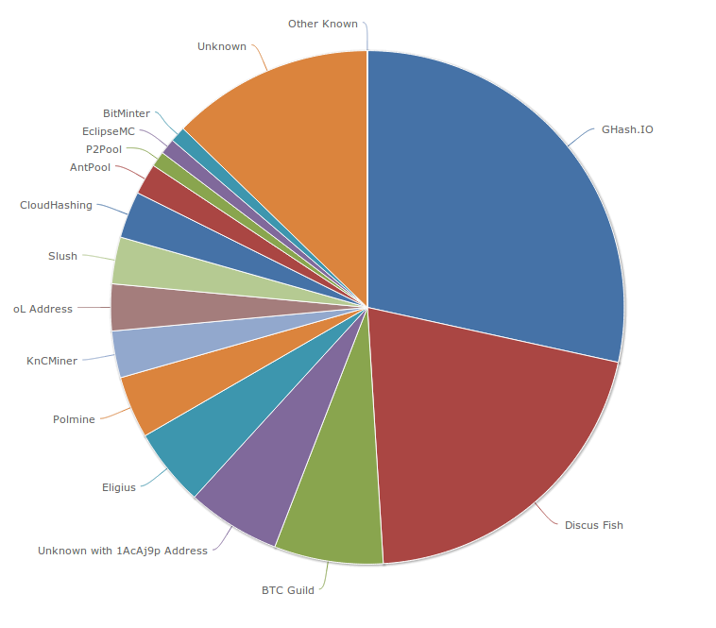
Mining pools (as of August 2014)
Latest mining pool info: https://blockchain.info/pools

Slide 56
Are mining pools a good thing?
Pros
Make mining more predictable
Allow small miners to participate
More miners using updated validation software
Cons
Lead to centralization
Discourage miners from running full nodes
Can we prevent pools?
Stay tuned for our lecture on alt-mining!

Slide 57
Mining incentives and strategies

Slide 58
Game-theoretic analysis of mining
Several strategic decisions
Which transactions to include in a block
Default: any above minimum transaction fee
Which block to mine on top of
Default: longest valid chain
How to choose between colliding blocks
Default: first block heard
When to announce new blocks
Default: immediately after finding them

Slide 59
Game-theoretic analysis of mining
Assume you control 0 < α < 1 of mining power
Can you profit from a non-default strategy?
For some α, YES, though analysis is ongoing!

Slide 60
Forking attacks
M→M’
M→M’
M→B
M→B

Slide 61
Forking attacks
I expect you to die, Mr. Bitcoin
Certainly possible if α >0.5
may be possible with less
avoid block collisions
Attack is detectable
Might be reversed
Might crash exchange rate
Goldfinger Attack?

Slide 62
Forking attacks via bribery
Idea: building α > 0.5 is expensive. Why not rent it instead?
Payment techniques:
Out-of-band bribery
Run a mining pool at a loss
Insert large “tips” in the block chain
Will miners accept bribes?
It is possible → Tragedy of Commons
This is an open problem!

Slide 63
Checkpointing
Default clients ship with built-in checkpoint

Slide 64
Block-withholding attacks
Strategy: don’t announce blocks right away. Try to get ahead!
“Selfish mining”
Secret Block
Secret Block
All other miners are wasting effort here!

Slide 65
Block-withholding attacks, take 2
What happens if a block is announced when you’re ahead by 1?
Secret Block
The race is on!

Slide 66
Block-withholding attacks
Improved strategy for any α if you can win every race
Ideal network position
Bribery?
With a 50% chance of winning races, improved strategy for α > 0.25
Not yet observed in practice!
Surprising departure from previous assumptions

Slide 67
Punitive forking
Suppose you want to blacklist transactions from address X
Freeze an individual’s money forever
Extreme strategy: announce that you will refuse to mine on any chain with a transaction from X
With α < 0.5, you’ll soon fall behind the network

Slide 68
Feather-forking strategy
To blacklist transactions from X, announce that you will refuse to mine directly on any block with a transaction from X
But you’ll concede after n confirming blocks
Chance of pruning an offending block is α²

Slide 69
Response to feather forking
For other miners, including a transaction from X induces an α² chance of losing a block
Might be safer to join in on the blacklist
Can enforce a blacklist with α < 0.5!
Success depends on convincing other miners you’ll fork

Slide 70
Feather-forking: what is it good for?
Freezing individual bitcoin owners
ransom/extortion
law enforcement?
Enforcing a minimum transaction fee...

Slide 71
A second look at transaction fees
Default policy:
priority = sum(input_value * input_age)/size_in_bytes
?
Accept without fees if:
priority > 0.576

Slide 72
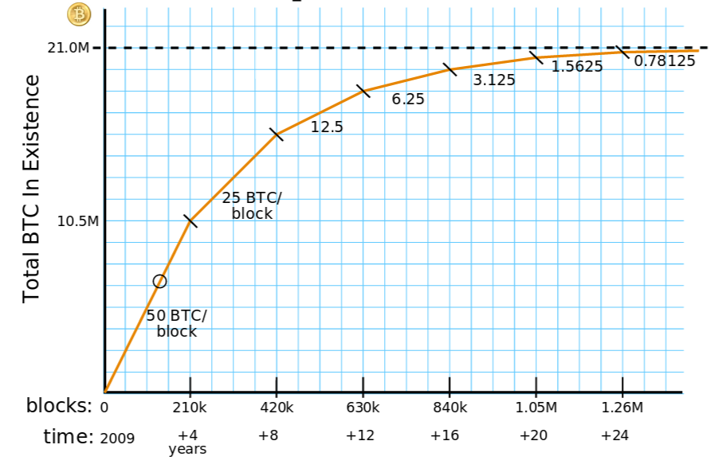
Transaction fees will matter more
Currently, block rewards are > 99% of miner revenue. But:
Eventually, transaction fees will dominate
Courtesy: Brian Warner

Slide 73
Will miners cooperate to enforce fees?

Slide 74
Bribery attacks
Start a new mining pool paying 25+ε
Guarantee payment instead of dividing up wins
Mutual trust issues
Pay miners directly
Potentially cheaper
Trust/information issues
Kickbacks
Solve some trust issues
Complicated technically

Slide 75
Summary
Miners are free to implement any strategy
Very little non-default behavior in the wild
No complete game-theoretic model exists
Things might be about to get interesting...

Slide 76
In the next lecture...
How much anonymity does Bitcoin provide?

