Slide 1
CS 4593/6463 – Bitcoins and Cryptocurrencies
Prof. Murtuza Jadliwala
murtuza.jadliwala@utsa.edu
Note: most of the slides used in this course are derived from those available for the book “Bitcoins and Cryptocurrencies Technologies – A Comprehensive Introduction”, Arvind Narayanan, Joseph Bonneau, Edward Felten, Andrew Miller & Steven Goldfeder, 2016, Princeton University Press.

Slide 2
Lecture 4
How to Store and Use Bitcoins

Slide 3
Simple Local Storage

Slide 4
To spend a Bitcoin, you need to know:
Some info from the public blockchain, and
The owner’s secret signing key
So it’s all about key management.

Slide 5
Lecture 4
How to Store and Use Bitcoins
Secret Keys

Slide 6
Goals
Availability: Being able to spend your coins when you want to.
Security: Making sure nobody else can spend your coins.
Convenience: Managing your keys (and thus your coins)
Achieving all the three simultaneously could be a challenge!

Slide 7
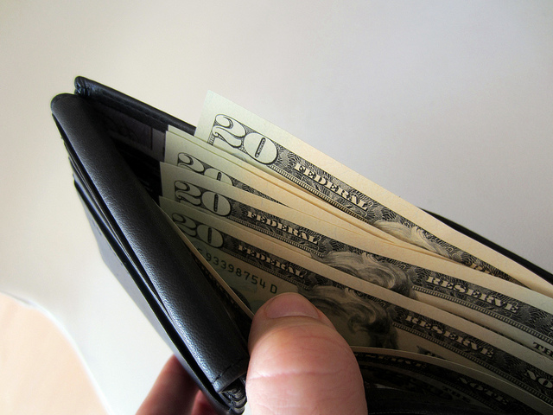
Simplest approach
Store key in a file, on your computer or phone
Very convenient.
As available as your device.
device lost/wiped ⇒ key lost ⇒ coins lost
As secure as your device.
device compromised ⇒ key leaked ⇒ coins stolen
Notes:
Not adequate for most people. Certainly not for companies/services. So we see lots of methods to try to improve/change the tradeoff between convenience, security, availability. Also privacy.

Slide 8
Wallet software
Software used when bitcoins are stored locally on a device
Wallet software → software that:
Keeps track of your coins.
Manage details of your keys.
Provides nice user interface.
Nice trick: use a separate address/key for each coin.
benefits privacy (looks like separate owners)
wallet can do the book-keeping, user needn’t know

Slide 9
Encoding addresses
Encode as text string: base58 notation
123456789ABCDEFGHJKLMNPQRSTUVWXYZabcdefghijkmnopqrstuvwxyz
or use QR code

Slide 10
Hot and Cold Storage

Slide 11
Hot storage
Cold storage
online
offline
convenient but risky
archival but safer
separate keys

Slide 12
Hot storage
Cold storage
online
offline
hot secret key(s)
payments
cold secret key(s)
cold address(es)
hot address(es)

Slide 13
Hot storage
Cold storage
online
hot secret key(s)
payments
cold address(es)
offline

Slide 14
Problem:
Want to use a new address (and key) for each coin sent to cold
But how can hot wallet learn new addresses if cold wallet is offline?
Awkward solution:
Generate a big batch of addresses/keys, transfer to hot beforehand
Better solution:
Hierarchical wallet

Slide 15
Regular key generation:
address
generateKeys
private key

Slide 16
Hierarchical key generation:
i
doesn’t leak keys
address
gen info
i^{th}
address
genAddr
generateKeysHier
private key
gen info
i^{th}
key
genKey
i

Slide 17
hot side
i
address
gen info
i^{th}
address
genAddr
generateKeysHier
private key
gen info
i^{th}
key
genKey
cold side
i

Slide 18
How to store cold info
(1) Info stored in device, device locked in a safe
(2) “Brain wallet”
encrypt info under passphrase that user remembers
(3) Paper wallet
print info on paper, lock up the paper
(4) In “tamperproof” device
device will sign things for you, but won’t divulge keys
In general, a combination of one more more of these techniques can be used
Notes:
Highlight activity of stealing these

Slide 19
Splitting and Sharing Keys

Slide 20
Current key storage schemes
Problem: single point of failure
Trivial solution: make multiple copies or backup
Advantage: Availability improves
Disadvantage: Security of stored keys is worst (multiple avenues to steal)
Question: Can we improve both availability and security?
Answer: Surprisingly, yes! Using some cute cryptographic / mathematical tricks → Secret Sharing!
Notes:
Highlight activity of stealing these

Slide 21
Secret sharing
Idea: split secret into N pieces, such that
given any K pieces, can reconstruct the secret
given fewer than K pieces, don’t learn anything
Example: N=2, K=2
P = a large prime
S = secret in [0, P)
R = random in [0, P)
split:
X₁ = (S+R) mod P X₂ = (S+2R) mod P
reconstruct:
(2X₁-X₂) mod P = S

Slide 22
y
random slope R
(4, S+4R)
(2, S+2R)
(3, S+3R)
given any two points,
can interpolate and find S
(0, S)
(1, S+R)
(do arithmetic modulo large prime P)
x

Slide 23
Secret sharing
Equation | Random parameters | Points needed to recover S
(S + RX) mod P | R | 2
(S + R₁X + R₂X²) mod P | R₁, R₂ | 3
(S + R₁X + R₂X² + R₃X³) mod P | R₁, R₂, R₃ | 4
etc.
support K-out-of-N splitting, for any K, N

Slide 24
Secret sharing
Good: Store shares separately, adversary must
compromise several shares to get the key.
Bad: To sign, need to bring shares together,
reconstruct the key. ⇐ vulnerable

Slide 25
Multi-sig
Recall multi-sig from Lecture 3.
Lets you keep shares apart, approve transaction without reconstructing key at any point.

Slide 26
Example
Andrew, Arvind, Ed, and Joseph are co-workers.
Their company has lots of Bitcoins.
Each of the four generates a key-pair,
puts secret key in a safe, private, offline place.
The company’s cold-stored coins use multi-sig, so that three of the four keys must sign to release a coin.

Slide 27
Online Wallets and Exchanges

Slide 28
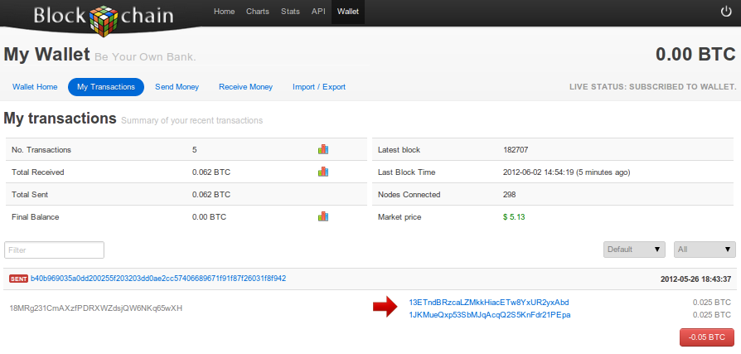
Online wallet
Like a local wallet
but “in the cloud”
Runs in your browser
Site sends code
Site stores keys
You log in to access wallet

Slide 29
Online wallet tradeoffs
Convenient: nothing to install, works on multiple devices
Security worries: vulnerable if site is malicious or compromised
Ideally, site is run by security professionals

Slide 30
Bank-like services
You give the bank money (a “deposit”)
Bank promises to pay you back later, on demand
Bank doesn’t actually keep your money in the back room
Typically, bank invests the money
Keeps some around to meet withdrawals (“fractional reserve”)

Slide 31
Bitcoin Exchanges
Accept deposits of Bitcoins and fiat currency ($, €, …)
Promise to pay back on demand
Lets customers:
Make and receive Bitcoin payments
Buy/sell Bitcoins for fiat currency
typically, match up BTC buyer with BTC seller

Slide 32
What happens when you buy BTC
Suppose my account at Exchange holds $5000 + 3 BTC and I use Exchange to buy 2 BTC for $580 each
Result: my account holds $3840 + 5 BTC
Note: no BTC transaction appears on the blockchain
Only effect: Exchange is making a different promise now

Slide 33
Exchanges: Pros and Cons
Pros:
Connects BTC economy to fiat currency economy
Easy to transfer value back and forth
Cons:
Risk - same kinds of risks as banks

Slide 34
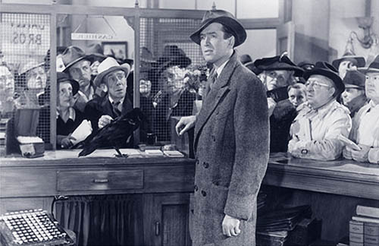
Risk 1: Bank Run

Slide 35
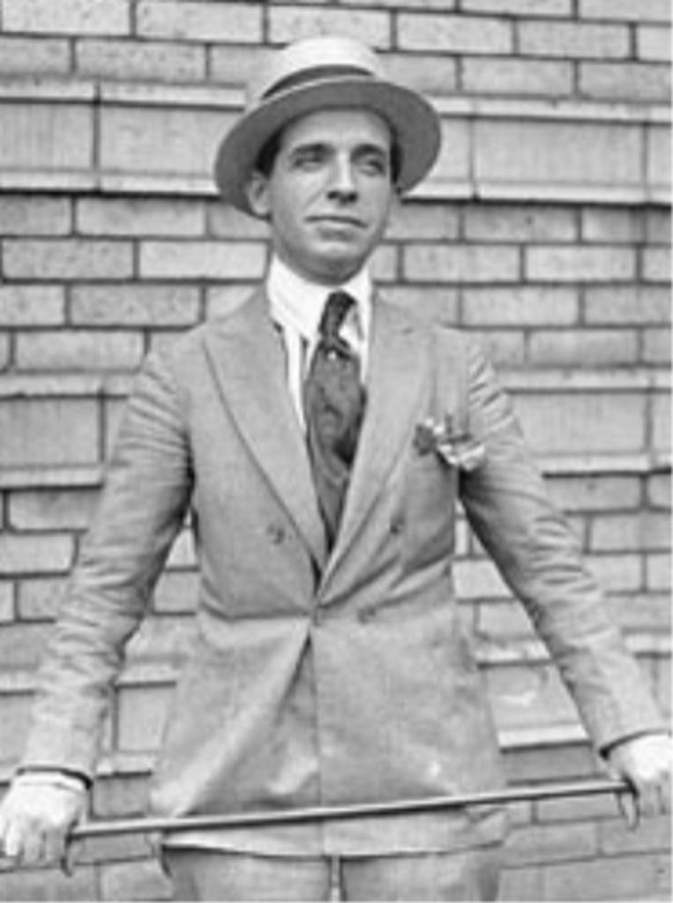
Risk 2: “Ponzi” Schemes or Cheating
Charles Ponzi

Slide 36
Risk 3: Security Threats (Cyber and or Physical)

Slide 37
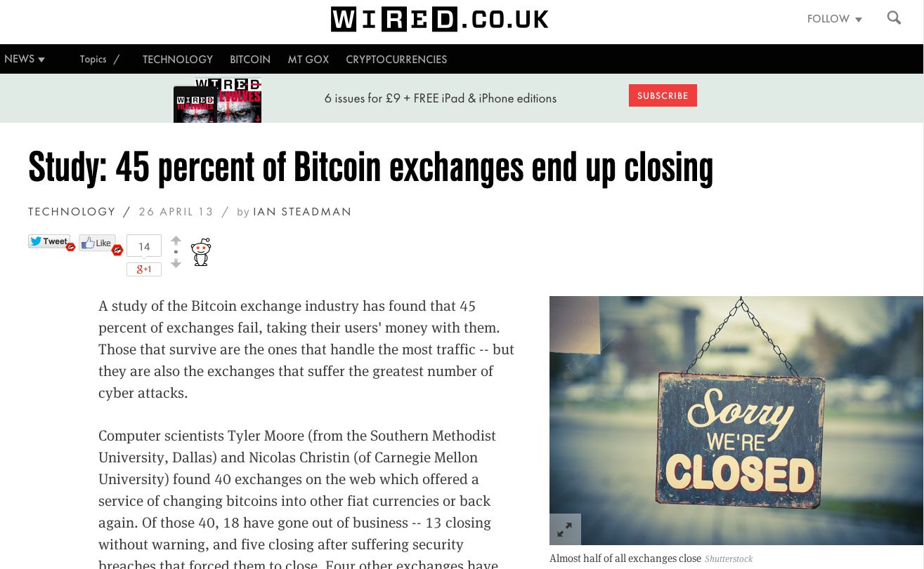

Slide 38
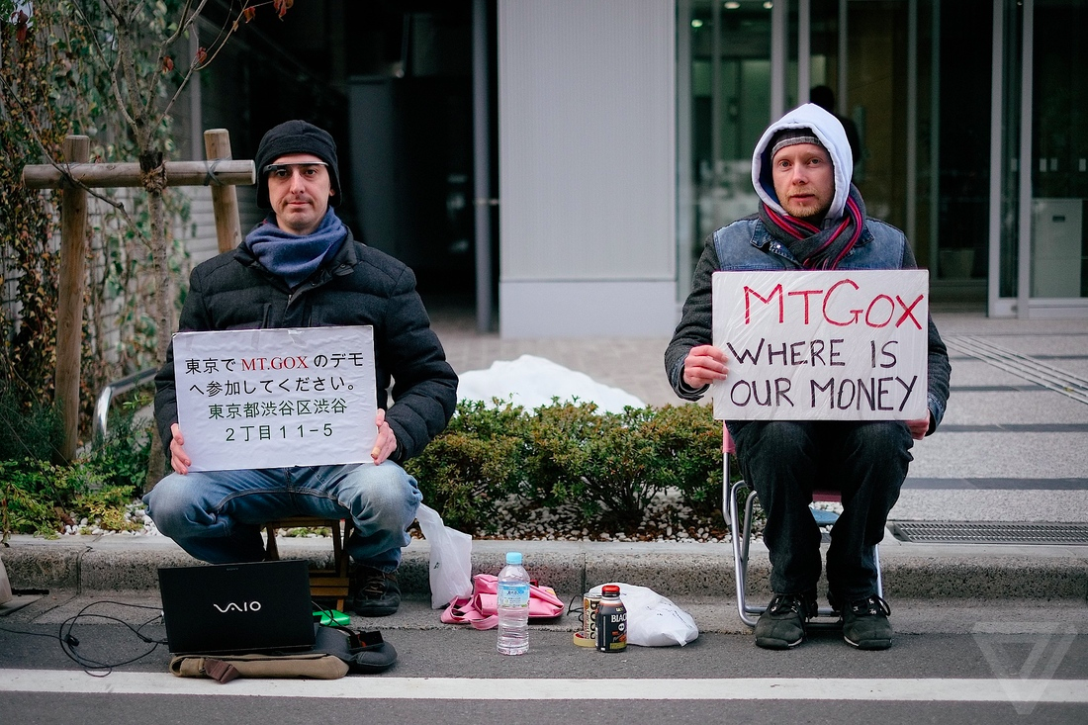

Slide 39
Bank Regulation
For traditional banks, government typically:
Imposes minimum reserve requirements
Must hold some fraction of deposits in reserve
Regulates behavior, investments
Insures depositors against losses
Acts as lender of last resort
Notes:
Reserve requirement in the U.S. is typically 3-10%.

Slide 40
Proof of Reserve
Bitcoin exchange can prove it has fractional reserve.
Fraction can be 100%
Prove how much reserve you’re holding:
Publish valid payment-to-self of that amount
Sign a challenge string with the same private key
Prove how many demand deposits you hold: ...

Slide 41
Merkle tree with subtree totals
each hashpointer includes total value in its subtree
H( ) H( )
H( ) H( )
H( ) H( )
H( ) H( )
H( ) H( )
H( ) H( )
H( ) H( )
user1
acct
user2
acct
user3
acct
user4
acct
user5
acct
user6
acct
user7
acct
user8
acct

Slide 42
Checking that you’re represented in the tree
show O(log n) items
H( ) H( )
H( ) H( )
H( ) H( )
your
acct

Slide 43
Proof of Reserve
Prove that you have at least X amount of reserve currency
Prove that customers have at most Y amount deposited
So reserve fraction ≥ X / Y

Slide 44
Payment Services

Slide 45
Scenario: merchant accepts BTC
Customer wants: to pay with Bitcoin
Merchant wants:
To receive dollars
Simple deployment
Low risk (tech risk, security risk, exchange rate risk)

Slide 46
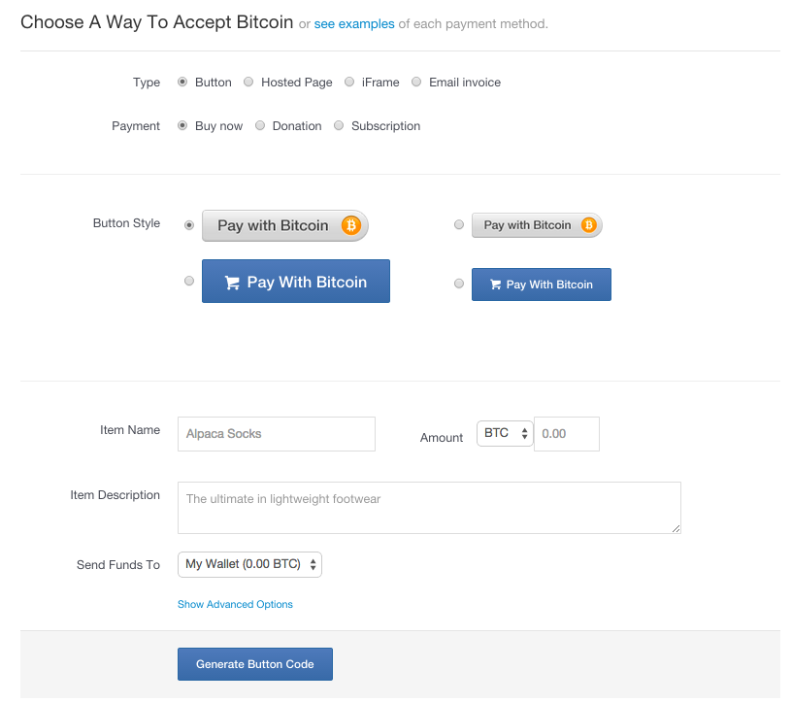
HTML for
payment button

Slide 47
payment
service
merchant
(5) confirm <transID, amount>
(4) redirect
(3) payment interaction
(4b) ok so far
(1) Pay with BTC button <transID, amount>
(2) clicked <transID, amount>
user

Slide 48
End result
customer: pays Bitcoins
merchant: gets dollars, minus a small percentage
payment service:
gets Bitcoins
pays dollars (keeps small percentage)
absorbs risk: security, exchange rate
needs to exchange Bitcoins for dollars, in volume

Slide 49
Transaction Fees

Slide 50
Transaction Fees
Recall:
Transaction fee = value of inputs - value of outputs
Fee goes to miner who records the transaction
Interesting economics, discussed in later lecture
How are transaction fees set today?

Slide 51
Transaction Fees
It costs resources for
Peers to relay your transaction
Miner to record your transaction
Transaction fee compensates for (some of) these costs
Generally, higher fee means transaction will be forwarded and recorded faster!

Slide 52
Consensus Fee Structure
Current consensus fees:
No fee if:
Transaction less than 1000 bytes in size,
All outputs are 0.01 BTC or larger, and
Priority is large enough
Priority = (sum of inputAge*inputValue) / (trans size)
Otherwise fee is 0.0001 BTC per 1000 bytes
Approx transaction size: 148 N_{inputs}+ 34 N_{outputs} + 10
Notes:
Transaction threshold is 4 BTC-days per 1000 bytes.

Slide 53
Consensus Fee Structure
Most miners enforce the consensus fee structure.
If you don’t pay the consensus fee, your transaction will take longer to be recorded!
Miners prioritize transactions based on fees and the priority formula.
Notes:
Transaction threshold is 4 BTC-days per 1000 bytes.

Slide 54
Currency Exchange Markets

Slide 55
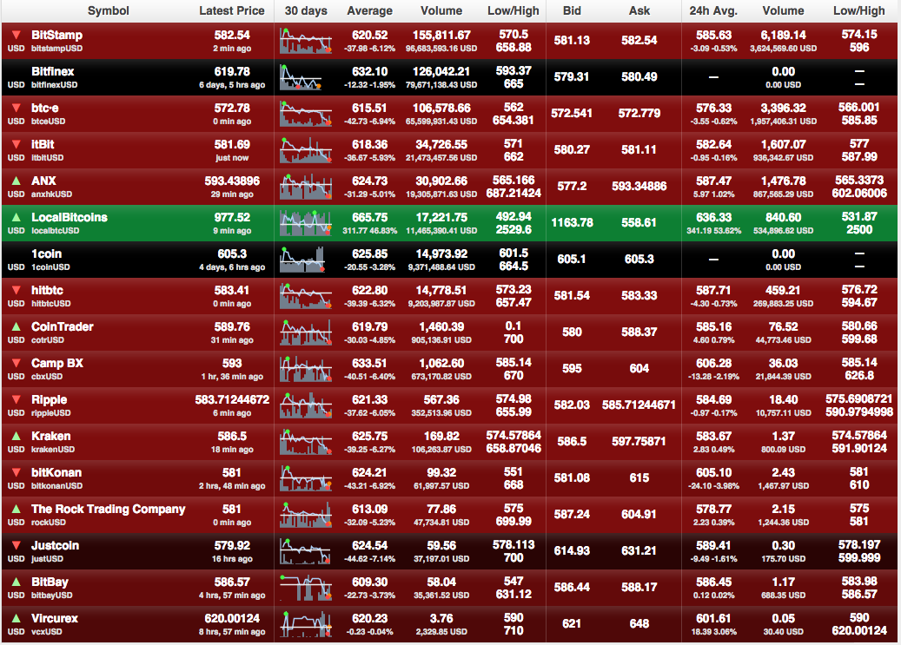
http://bitcoincharts.com/markets

Slide 56
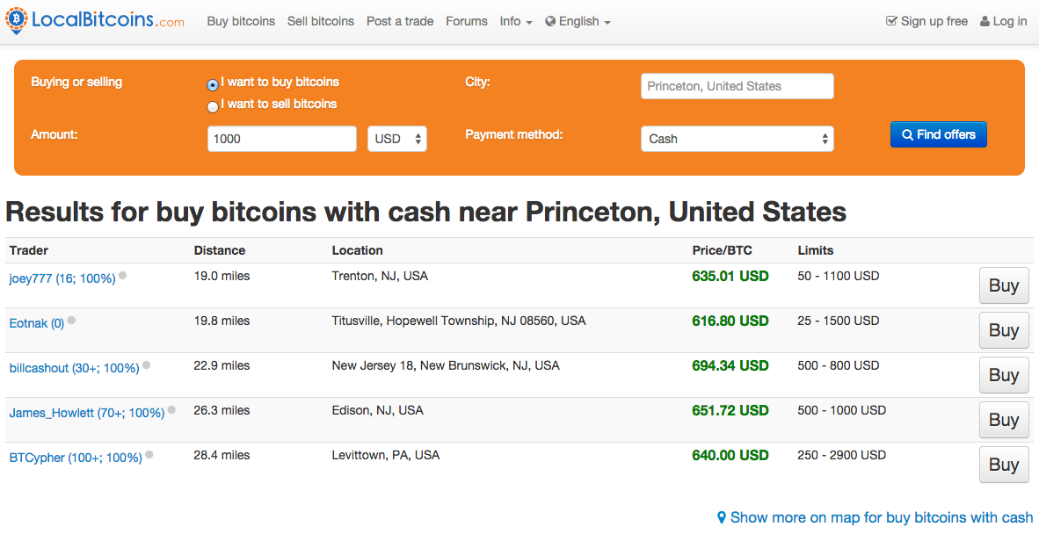

Slide 58
Basic Market Dynamics
Market matches buyer and seller
Large, liquid market reaches a consensus price
Price set by supply (of BTC) and demand (for BTC)

Slide 59
Supply of Bitcoins
Supply = coins in circulation (+ demand deposits?)
Coins in circulation: fixed number, currently ~13.1 million
When to include demand deposits?
When they can actually be sold in the market.

Slide 60
Demand for Bitcoins
BTC demanded to mediate fiat-currency transactions
Alice buys BTC for $
Alice sends BTC to Bob
Bob sells BTC for $
BTC demanded as an investment
If the market thinks demand will go up in future
BTC “out of circulation” during this time

Slide 61
Demand for Bitcoins
Simple model of transaction-demand
T = Total transaction value mediated via BTC ($ / sec)
D = Duration that BTC is needed by a transaction (sec)
S = Supply of BTC (not including BTC held as long-term investments)
S
D
Bitcoins become available per second
Equilibrium:
P =
T
P
TD
Bitcoins needed per second
S

