Slide 1
An integrative approach to transcriptional co-regulatory network construction and characterization in Arabidopsis
Garry Sunter¹, Maryam Zand², Zhen Gao² and Jianhua Ruan²
¹Department of Biology
²Department of Computer Science
University of Texas at San Antonio
Southern Section-ASPB
New Orleans, LA
March 24-26, 2018

Slide 2
Transcription Factor Binding
Induce or repress expression of their target genes.
Mounting evidence suggests gene expression governed by the cooperative functioning of TFs.
Propose to leverage publicly available information (e.g. gene regulatory network and gene co-expression profiles)
Establish large regulatory networks addressing interactions between isolated TFs and their target genes.

Slide 3
Transcription Factor Network Analysis
Appropriate prediction of TF-TF interaction is a fundamental step in better understanding of the transcriptional regulation.
A co-regulatory network is:
TF-TF interaction network where nodes are TFs
link between a pair of TF denotes they are cooperatively involved in regulating gene expression.

Slide 4
Transcription Factor Network
Integrating the transcription regulatory network, gene
expression data and information about TF motifs.
Our network of pairwise cooperative TFs based on two biologically rational assumptions.
There is a link between two TFs if:
they have a significantly higher number of common target genes than random expectation
ii) there is a positive correlation between their gene expression.

Slide 5
Data Sets and Workflow
Plant TFDB (TF + Target Genes)
+
AtGenExpress (Microarray)
For each TF pair we calculated two metrics:
1) Target overlap
N = #genes in Arabidopsis genome (27655),
N1 and N2 = # target genes of the first and second TFs respectively
m = # common target genes.
The lower the P_{overlap}, the more significant is the target overlap.
Provides a network expected to have some false positive interactions.

Slide 6
Data Sets and Workflow
2) co-expression correlation.
Biological rational that cooperative TFs often tend to be expressed together
at least for conditions they co-regulate
Calculated pairwise correlation coefficient between the expression profile of all TFs.
Describes similarity between expression patterns of the TF pair across all the samples.

Slide 7
Data Sets and Workflow
Choice of TF-TF co-expression correlation cut-off:
Trade-Off: high quality network
maximum possible numbers of TF-TF interaction.
Constructing the network:
co-expression correlation score > cut-off (0.1)
significant target overlap (p–value < 10⁻⁵)
Establish edge between any pair of two nodes (representing TFs)

Slide 8
Network Characterization
Do the majority of interacting TFs have similar motifs or not?
Divide all the set of predicted TF-TF interactions into two groups of similar and non-similar motifs.
Pairwise TF binding motif similarity calculated using Tomtom.
(ungapped alignment of motifs requiring minimum # of overlapping position)
The smaller the p–value, the more similarity exists between motifs of a TF pair.

Slide 9
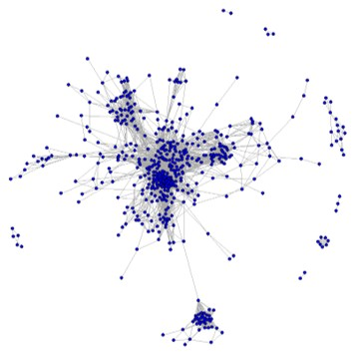
Network Characterization
Final predicted TF-TF co-regulatory network in Arabidopsis contains 5807 edges among 525 TFs.

Slide 10
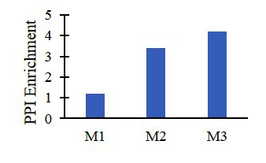
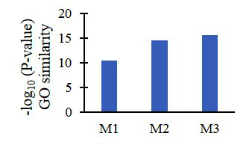
Network Quality
(1) enrichment of protein-protein interactions between TFs predicted to be cooperative
(2) extent that predicted TF cooperative pairs are involved
in common biological processes defined by gene ontology.

Slide 11
Network Quality
Predicted cooperative TF pairs have significantly higher level of protein-protein interactions and functional similarities.
Enrichment of PPIs and functional similarity between TF pairs significantly higher than those in control networks predicted by co-expression or target overlap alone

Slide 12
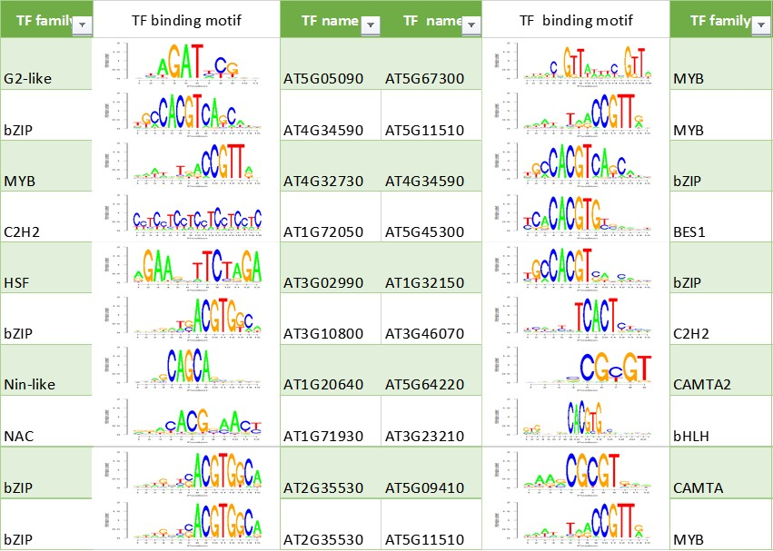
Functional Relevance
54% interactions within same family
46% occurred between different families

Slide 13
Functional Relevance
Concerted action of bZip and cMyb TFs induces brlA expression and asexual development in Aspergillus nidulans

Slide 14
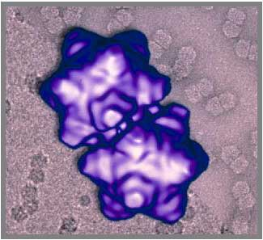
Relevance to Geminivirus Gene Regulation
Three promoters in DNA A
Two promoters in B

Slide 15
BR1 Promoter
Activity requires viral AL2 protein encoded by DNA A
BR1 Promoter

Slide 16
BR1 Promoter
Between -144 and -36 upstream of transcription start site for BR1 (~100 bp)

Slide 17
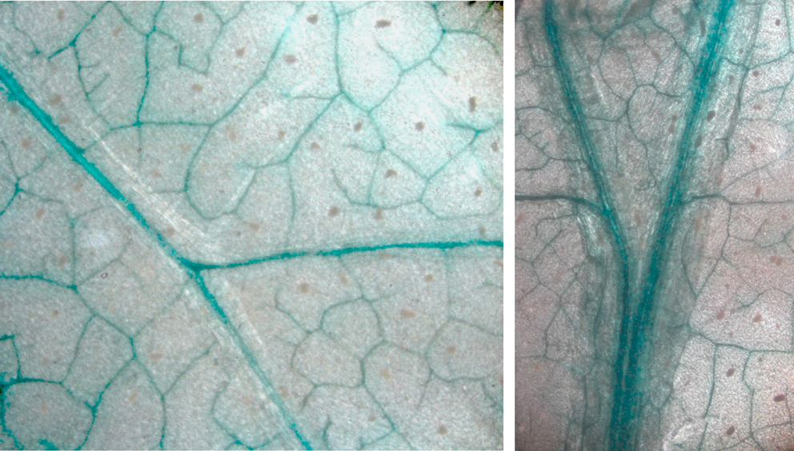
Promoter Activity in Phloem
Transgenic Plants
BR1p::GUS
Expression in phloem is independent of AL2
Two different regulatory circuits

Slide 18
Binding to Promoter
Addition of nuclear extracts produces a shift
Competition with cold probes demonstrates specificity

Slide 19
TF Binding Sites
Fragment that binds searched for TF binding sites
Compare sequences in all geminiviruses

Slide 20
TF Binding Sites
Which are actually regulating BR1 promoter activity?
Can use genetic screens to identify TF that binds
Can be time consuming
Produces false positives or negatives

Slide 21
TF Binding Sites
Use promoter sequences in all geminiviruses to probe TF network
Identification of cooperative TFs in regulating gene expression can help guide:
Mutational analysis
Functional analysis of TFs
Complex formation

Slide 22
TF Binding Sites
Probe changes in the TF network during infection
Could reveal groups of TFs that are manipulated by geminiviruses
Present targets to prevent infection

Slide 23
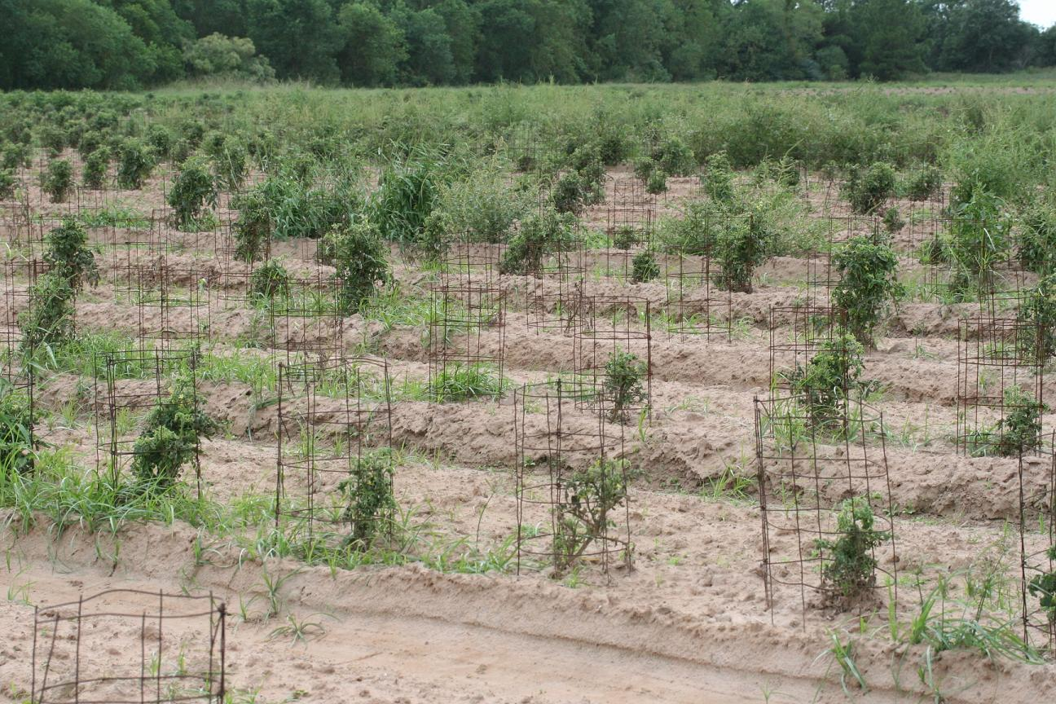
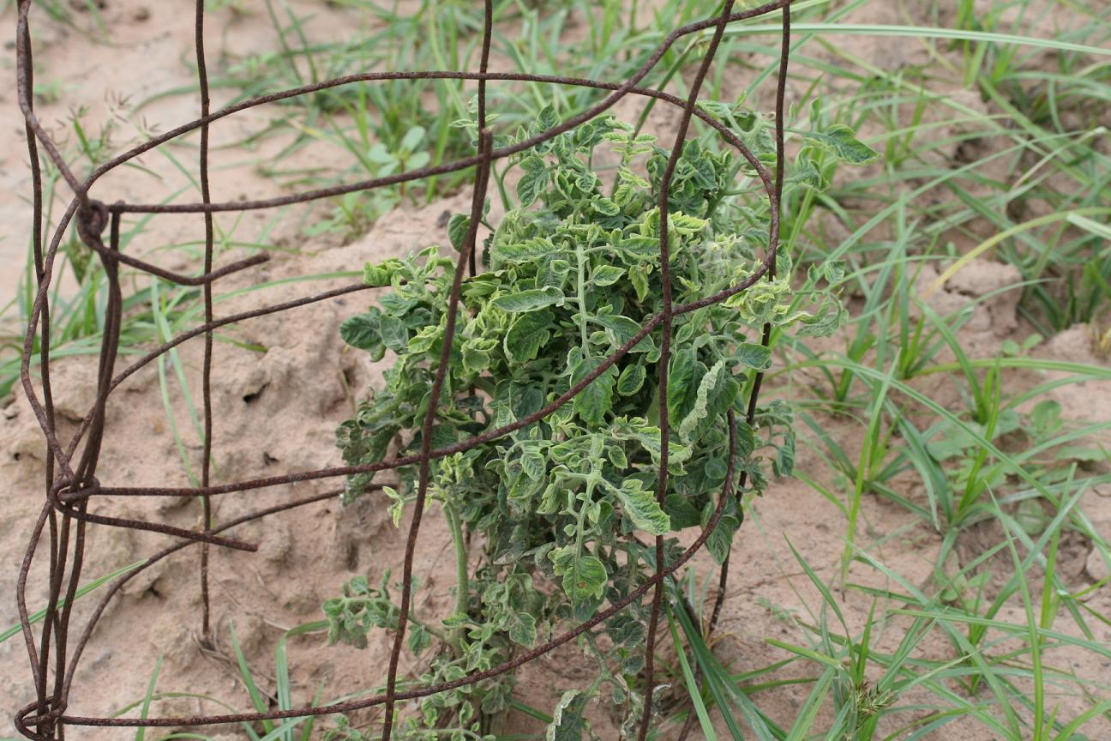
2006: Tomato yellow leaf curl virus, Von Ormy TX (Southside SA)

Slide 24
Acknowledgments
Current Lab Members:
Janet Sunter
Jackie Williams
Jennifer Guerrero
Mary Berger
Maria Lockwood
Anthony Escalante
Collaborators:
Prof. Xueping Zhou (IPP, Beijing, China)
Dr. David M Bisaro (Ohio State University)
Dr. Jianhua Ruan (UTSA, Dept. Computer Science)
Funding
Former Lab Members:
Ho Yong Chung
Jun Tu
Suren Baliji
Connie Shung
Gabriela Lacatus
Kavitha Rao
CMB Program, Dept. of Biology
USDA/CSREES/NRi

