Slide 1
Social Hash: An Assignment Framework for Optimizing Distributed Systems Operations on Social Networks
Alon Shalita, Brian Karrer, Igor Kabiljo, Arun Sharma, Alessandro Presta, Aaron Adcock, Herald Kllapi, and Michael Stumm (Facebook, University of Athens, University of Toronto)
March 2016 in 13th USENIX Symposium on Networked Systems Design and Implementation
Manju Priya Hari Krishnan
Computer Science, UTSA

Slide 2
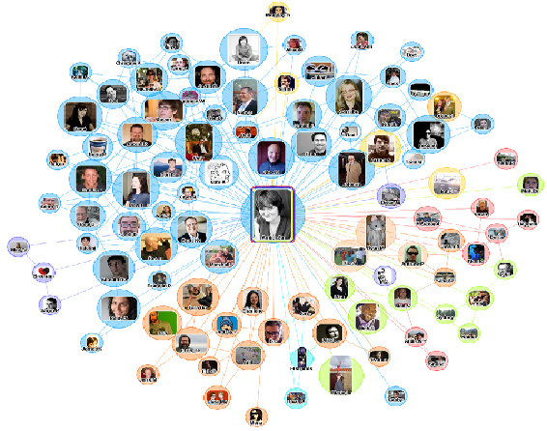
Introduction
All User-visible data and information in Facebook is maintained by Social Graph
Friends, Checkins, Tags, Posts, Likes and Comments are presented as vertices and edges in graph
The information presented to user from Facebook are results of the queries to this graph
So the graph contains billions of vertices, trillions of edges. And the Graph must serve billions of queries per second
To scale the graph and volume of queries, there is a need for Distributed Systems

Slide 3
Problem
Assignment Problem : Assigning objects to components.
Example -Assigning user requests to compute servers (HTTP request routing)

Slide 4
Solution

Slide 5
Solution Requirements
Balance: Each of the cluster should receive similar traffic
Adaptive: If one cluster goes down, the requests should be redirected to other clusters
Stable: The same requests given multiple time should go to the same cluster
Fast Decision: It cannot take the latency to decide which cluster the request can be routed to

Slide 6
Social hash Framework

Slide 7
Static assignment
Goal: Assign similar objects to same group
Data access pattern -> represent as graph -> graph partitioning
They built custom graph partitioning solution on top of Apache Giraph graph processing system

Slide 8
Dynamic Assignment
Goal: Keep load balanced despite changes in access patterns and infrastructure
Factors affecting Load balancing strategy:
Accuracy in predicting future loads
Dimensionality of loads
Group transfer overhead
Assignment memory

Slide 9
Architecture

Slide 10
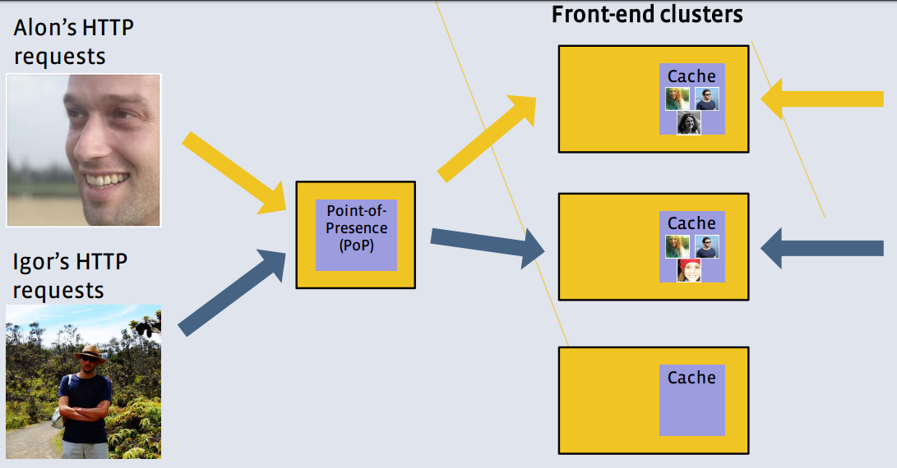
Facebook’s Web Traffic Routing
Objects: HTTP request identified by user
Components: front-end clusters
Static Assignment: Unipartite graph, partitioned (friends and socially similar users tend to consume same data)
Dynamic assignment: PoP by hash ring

Slide 11
Web Traffic Routing – Edge Locality Graph
Edge Locality: Fraction of “friend” edges connecting two users that are both assigned to the same group

Slide 12
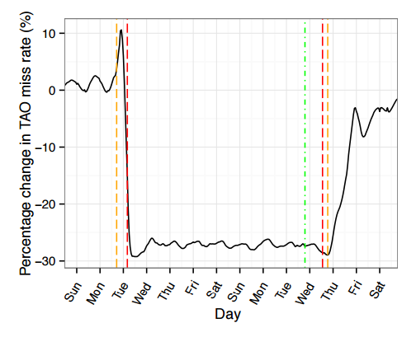
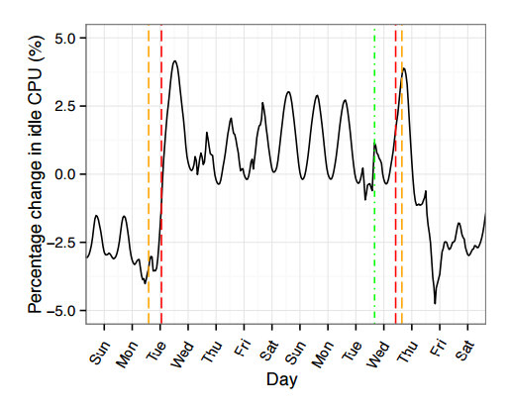
Web Traffic Routing – Live traffic experiment
Red line: Period of test Orange line: traffic shifts Green line: Social hash table update

Slide 13
Storage Sharding
Objects: Data records
Components: Storage machines
Static Assignment: Bipartite graph partitioning to minimize fanouts
Latency and CPU utilization was reduced by over 50%

Slide 14
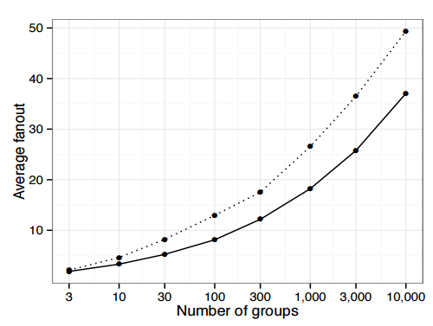
Storage Sharding – Fanout Graph
Dotted line: Edge-locality optimization
Solid line: Fanout optimization
Fanout: number of storage systems that must be contacted for multi-get queries

Slide 15
Conclusion
Distributed Systems are required for maintaining, querying the social graph of Facebook
Assignment Problem is common in Distributed Systems
Social Hash: which is a two-level optimization is introduced, which optimizes the performance
Two applications of Facebook, which uses Social Hash is explained
Web Traffic Routing: Social Hash reduced the TAO miss rate by 25%
Storage sharding: Social Hash reduces Latency and CPU utilization by over 50%

