Slide 1
VAST: A unified Platform for Interactive Network Forensics
Matthias Vallentin Vern Paxson Robin Sommer
UC Berkely UC Berkely/ICSI ICSI/LBNL
By Roy Guillen

Slide 2
Table of Contents
Introduction
Current Solutions/Tools for Forensics
What is VATS
How does VATS work?
Questions

Slide 3
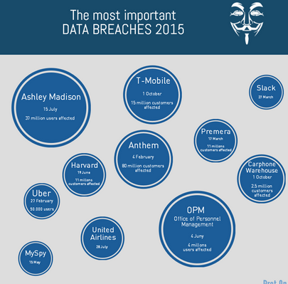
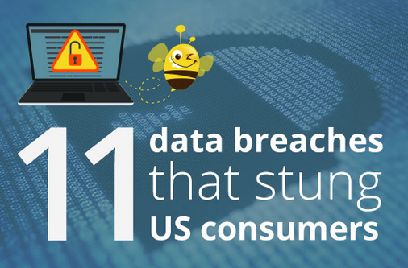
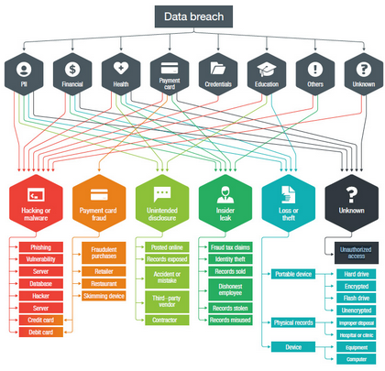
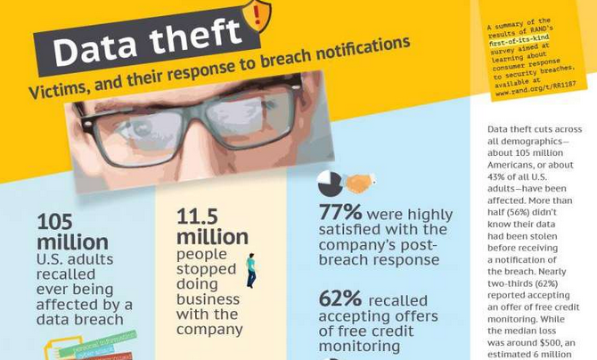

Slide 4
Problem
Security Incidents are happening more frequently.
12 Large scale data breaches already in 2017 – Worst So Far (IdentityForce)
Ex. Xbox, Arby’s, Verifone, UNC Healthcare, FAFSA: IRS Data Retrieval Tool.
2016 – Record year for data breaches (Bloomberg Technology)
1093 data breaches – Costs companies 73.7 billion dollars
Ex. Yahoo, Playstation, HP, Oracle, Verizon, Department of Health, Myspace
It is estimated that it costs companies roughly 20% in revenue for a large scale breach. (CorporateEncryption)

Slide 5
Breach Timeline
Detection
Compromise
Forensics
Time

Slide 6
Questions that need to be answered
When a breach occurs companies want the following questions answered:
How did it happen?
Why did it happen?
How long has it been happening for?
Who is responsible for the breach?
How do we prevent this from happening again?

Slide 7
How do we answer those Questions?
Interactive data exploration
Interactive Query Refinement
High-Dimensional Search
Disparate Data access
Temporal
Spatial

Slide 8
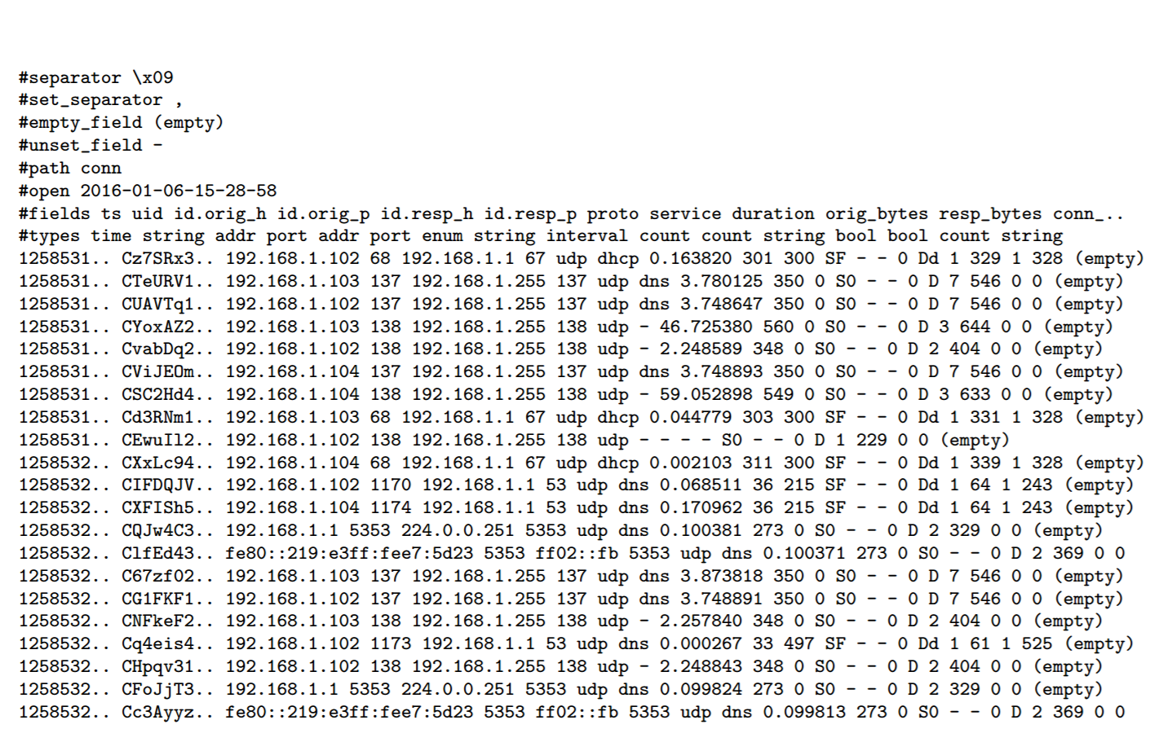
What is holding us Back?
Massive data volumes
50-100k events/sec
10s TBs/day

Slide 9
Existing Solutions
MapReduce (Hadoop)
Scalability
Batch-oriented: no iterative, exploratory analysis
In-Memory Cluster Computing (Spark)
Efficient & Complex analysis
Thrashing when working set does not fit in aggregate memory

Slide 10
Introducing Vast
VAST
Visibility Across Space and Time
Architecture
Performance: concurrent & modular design
Scaling: intra-machine & inter-machine
Typing: Strong and Rich
Implementation
Composition: high-level bitmap indexing framework
Adaptation: fine-grained component flow-control
Asynchrony – finite state machines for query execution

Slide 11
Key Components to VAST
1. Import – parses data from source into events and assigns them an unique ID
2. Archive – stores compressed events and provides a key-value interface
3. Index – to accelerate queries by keeping a partitioned secondary index referencing events in the archive.
4. Export – spawns queries and relay them to sinks of various output formats. (Supports JSON, ASCII, PCAP, BRO, KAFKA)

Slide 12
Key Components used in Ingestion

Slide 13
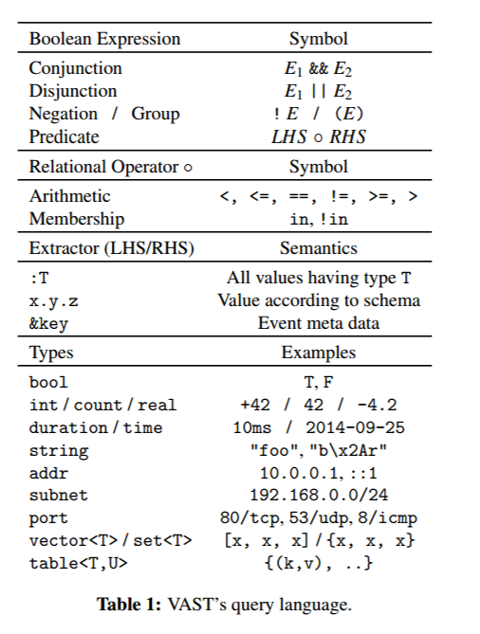
Querying in VAST
Data model consists of types
Types define the physical interpretation of data
Values combine a type with a data instance
An event is a value with additional metadata
Ex time stamp, id, key value pair,.
Schemas describe access structure of one or more types
EX. POSTS
Utilizes Boolean Algebra to query

Slide 14
Querying with Vast

Slide 15
Additional Features of Vast
Varying Indexes
Integral, Temporal, String, Network, Container
Caching
If hits for expression A || B exist then A && D only needs to look up D
VAST does not consume resources unless needed
Continuous Queries
Exporter subscribes to Importer and filters events matching a predefined query.
Can be used to alert operators of potential breaches

Slide 16
Conclusion
VAST provides users with many abilities to help with forensics:
Stores and Indexes vast quantities of data
Can archive an entire networks activity with high fidelity
Supports rapid queries through the use of bitmap indexing
Used in conjunction with current tools like SPARK, VAST can greatly decrease the time of forensics after a breach.

Slide 17
Questions?

