Slide 1
OpenGL Texture Mapping

Slide 2
Basic Stragegy
Three steps to applying a texture
  specify the texture
    read or generate image
    assign to texture
    enable texturing
  assign texture coordinates to vertices
    Proper mapping function is left to application
  specify texture parameters
    wrapping, filtering

Slide 3
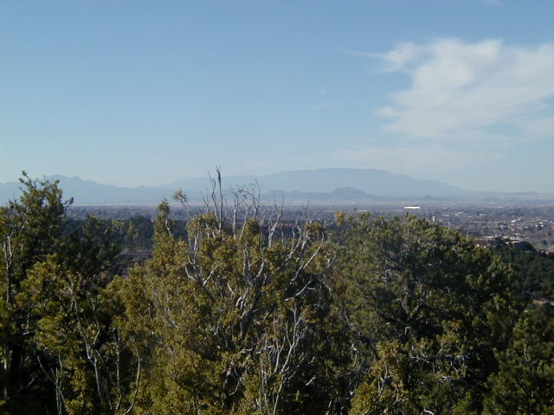
Texture Mapping
y
z
x
geometry
display
t
image
s

Slide 4
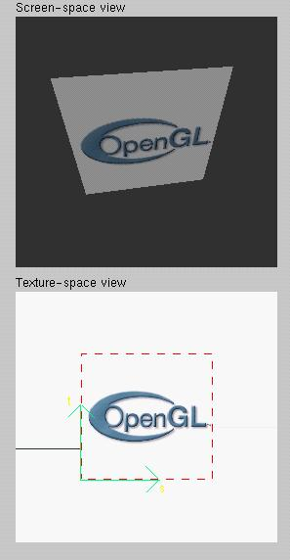
Texture Example
The texture (below) is a 256 x 256 image that has been mapped to a rectangular polygon which is viewed in perspective

Slide 5
Texture Mapping and the OpenGL Pipeline
Images and geometry flow through separate pipelines that join during fragment processing
  “complex” textures do not affect geometric complexity
vertices
geometry pipeline
fragmentprocessor
image
pixel pipeline

Slide 6
Specifying a Texture Image
Define a texture image from an array of
texels (texture elements) in CPU memory
  Glubyte my_texels[512][512];
This array can be filled with RGB values (for example) from
  Loaded from a scanned image
  Generate by application code
Enable texture mapping
  glEnable(GL_TEXTURE_2D)
  OpenGL supports 1-4 dimensional texture maps

Slide 7
Names and Binding
All textures are assigned an index as a name.
For convenience, you can generate many at the same time
  void glGenTextures(GLsizei n, GLuint * textures);
  n is the number of textures to generate at this time (can make more later)
  textures is a pointer to a place to store the names (i.e., indexes)
Once you have a name, you bind the name to set the OpenGL state.
  void glBindTexture(GLenum target, GLuint texture);
  texture is the name of the texture
  Target is the type of texture – usually GL_TEXTURE_2D
Now this texture is your current texture
  Remember: OpenGL is a state machine!

Slide 8
Define Image as a Texture
glTexImage2D( target, level, components,
w, h, border, format, type, texels );
target: type of texture, e.g. GL_TEXTURE_2D
level: used for mipmapping (discussed later), should be 0 otherwise
components: elements per texel, usually 3 (RGB) or 4 (RGBA)
w, h: width and height of texels in pixels
border: used for smoothing (discussed later)
format and type: describe texels
texels: pointer to texel array
glTexImage2D(GL_TEXTURE_2D, 0, 3, 512, 512, 0, GL_RGB, GL_UNSIGNED_BYTE, my_texels);

Slide 9
Converting A Texture Image
OpenGL requires texture dimensions to be powers of 2
If dimensions of image are not powers of 2
gluScaleImage( format, w_in, h_in,
type_in, *data_in, w_out, h_out,
type_out, *data_out );
  data_in is source image
  data_out is for destination image
Image interpolated and filtered during scaling
Notes:
If

Slide 10
Mapping a Texture
Based on parametric texture coordinates
glTexCoord*() specified at each vertex
Texture Space
Object Space
t
1, 1
(s, t) = (0.2, 0.8)
0, 1
A
a
c
(0.4, 0.2)
b
B
C
0, 0
1, 0
s
(0.8, 0.4)

Slide 11
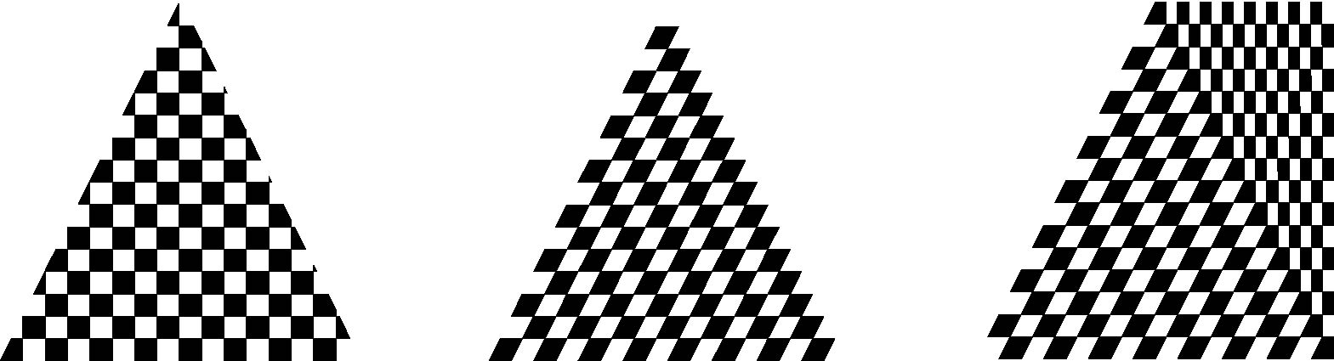
Interpolation
OpenGL uses interpolation to find proper texels from specified texture coordinates
Can be distortions
texture stretched
over trapezoid
showing effects of
bilinear interpolation
good selection
of tex coordinates
poor selection
of tex coordinates

Slide 12
Typical Code
glBegin(GL_POLYGON);
glColor3f(r0, g0, b0); //if no shading used
glNormal3f(u0, v0, w0); // if shading used
glTexCoord2f(s0, t0);
glVertex3f(x0, y0, z0);
glColor3f(r1, g1, b1);
glNormal3f(u1, v1, w1);
glTexCoord2f(s1, t1);
glVertex3f(x1, y1, z1);
.
.
glEnd();
//show demos

Slide 13
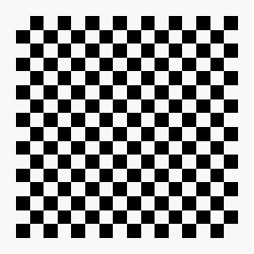
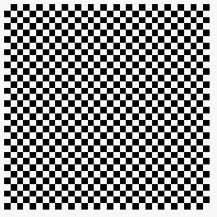

Wrapping Mode
Clamping: if s,t > 1 use 1, if s,t <0 use 0
Wrapping: use s,t modulo 1
  glTexParameteri( GL_TEXTURE_2D,
  GL_TEXTURE_WRAP_S, GL_CLAMP )
  glTexParameteri( GL_TEXTURE_2D,
  GL_TEXTURE_WRAP_T, GL_REPEAT )
t
s
GL_REPEAT
wrapping
GL_CLAMP
wrapping
texture

Slide 14
Magnification and Minification
More than one texel can cover a pixel (minification) or
more than one pixel can cover a texel (magnification)
Can use point sampling (nearest texel) or linear filtering
( 2 x 2 filter) to obtain texture values
Texture
Polygon
Texture
Polygon
Magnification
Minification

Slide 15
Filter Modes
Modes determined by
  glTexParameteri( target, type, mode )
glTexParameteri(GL_TEXTURE_2D, GL_TEXURE_MAG_FILTER,
GL_NEAREST);
glTexParameteri(GL_TEXTURE_2D, GL_TEXURE_MIN_FILTER,
GL_LINEAR);
Note that linear filtering requires a border of an
extra texel for filtering at edges (border = 1)

Slide 16
Texture Functions
Controls how texture is applied
glTexEnv{fi}[v]( GL_TEXTURE_ENV, prop, param )
GL_TEXTURE_ENV_MODE modes
  GL_MODULATE: modulates with computed shade
  GL_BLEND: blends with an environmental color
  GL_REPLACE: use only texture color
  GL(GL_TEXTURE_ENV, GL_TEXTURE_ENV_MODE, GL_MODULATE);
Set blend color with GL_TEXTURE_ENV_COLOR

Slide 17
Applying Textures II
specify textures in texture objects
set texture filter
set texture function
set texture wrap mode
set optional perspective correction hint
bind texture object
enable texturing
supply texture coordinates for vertex
  coordinates can also be generated

