Slide 1
Network algorithms in biology: from accurate genome annotations to personalized medicine
Jianhua Ruan, PhD
Computer Science Department
University of Texas at San Antonio
http://www.cs.utsa.edu/~jruan

Slide 2
Molecular biology in a nutshell
Biology central dogma: DNA => RNA => Protein
  DNA: hereditary material of life (static)
  Protein: real workhorse in the cell (dynamic)
  RNA: information carrier (and other functions)
  Gene: a segment of DNA that encodes a functional protein or RNA
  Gene expression: the process by which information from a gene is used to make a functional product (e.g. protein)
  Transcription: first step of gene expression (DNA => RNA)

Slide 3
Cell as a complex network
Biological system is extremely complex
  1T – 10T cells in human body
  3B chemical bases (A, C, G, or T) in DNA of each cell
Such a complex system, so few genes
  Human DNA encodes between N = 30K to 100K genes depending on definition of gene
    roughly the same number of genes as mouse and rice, 2-3 times of worm or bug, 5 times of yeast, 10 times of e. coli.
  Highly complex interaction network
    Maximum pairwise interactions: N^2
    Interaction may involve more than 2 genes at a time
    Interaction is dynamic rather that static

Slide 4
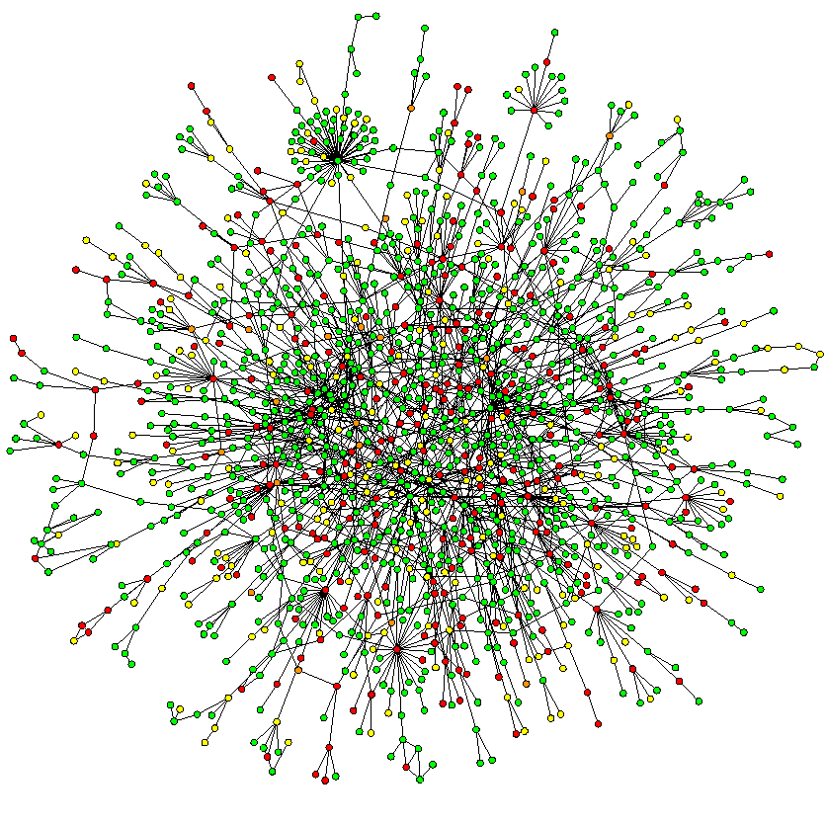
Graph model of biological networks
An abstract of the complex relationships among molecules in the cell
Vertex:
  Gene / protein / metabolite
Edge: pairwise relationship
  Physical interaction
  Functional association / similarity
Share many common statistical properties with real-world networks
  Small-world
  Scale-free
  Hierarchical
  Modular (community structure)
(Jeong et al., 2001)

Slide 5
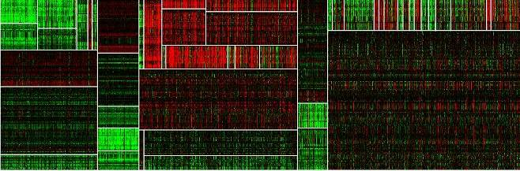
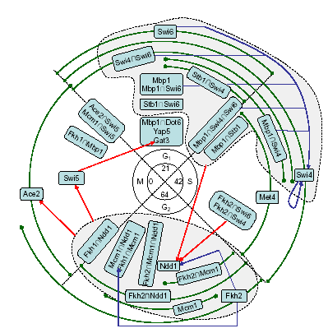
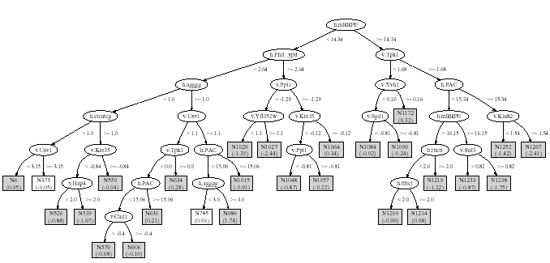
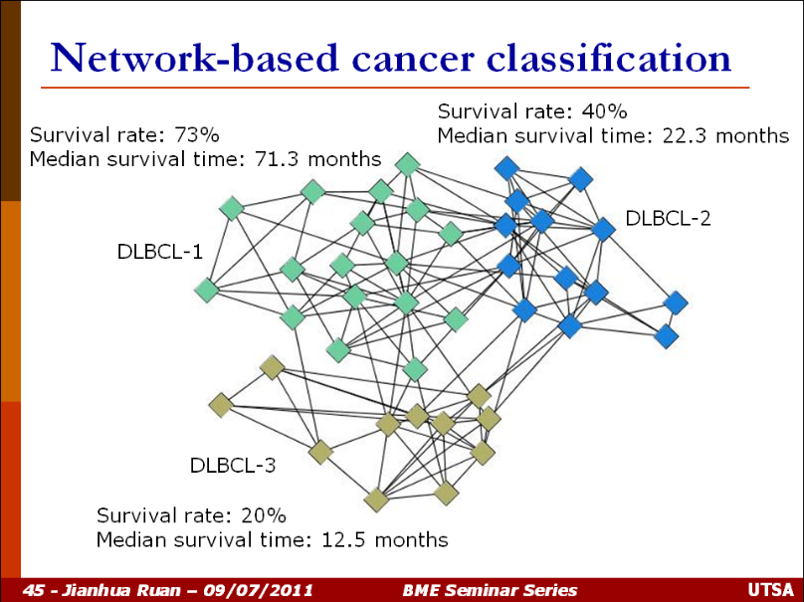
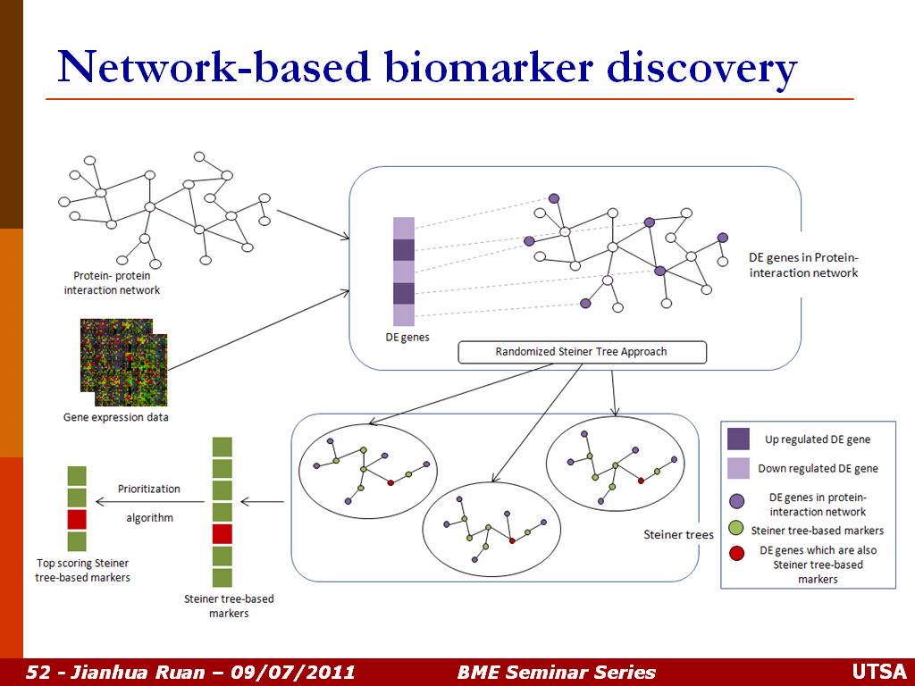
Network reverse-enginnering
Network analysis algs
Machine learning, pattern recognition
Optimization, metrics
Network-based data mining & knowledge discovery
Ruan Lab
“BinfoResDevGrp”
Research Overview
Data integration, classification, clustering, database

Slide 6
Agenda
Community discovery in networks
  How to identify small functional unit from a large network
Network-based cancer prognosis
  how to uses network/group information to improve understanding/prediction of individuals

Slide 7
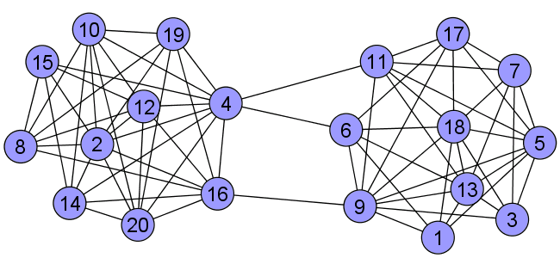
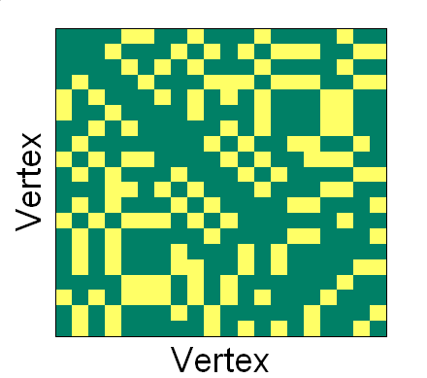
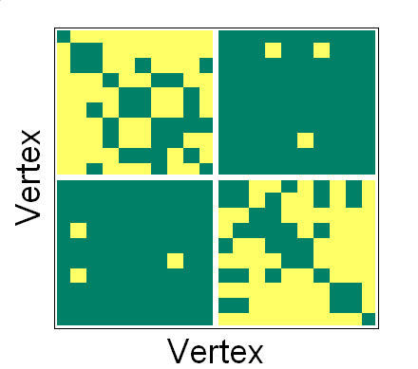
Community discovery problem
Community = functional unit = relatively densely connected sub-networks
Similar to clustering / graph partitioning, but # of communities determined automatically
Vertex
reorder

Slide 8
Modularity function (Q)
Measure strength of community structures
e₁₁
e₂₂
e₃₃
e₄₄
e₅₅
Goal: how to find a partition to optimize Q

Slide 9
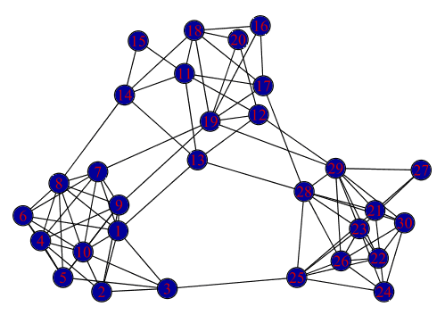
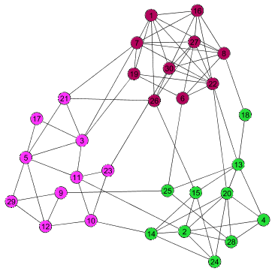
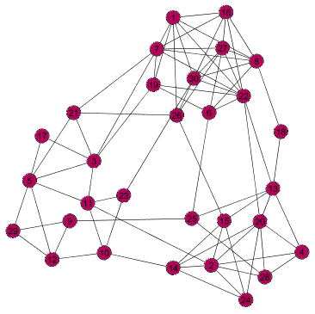
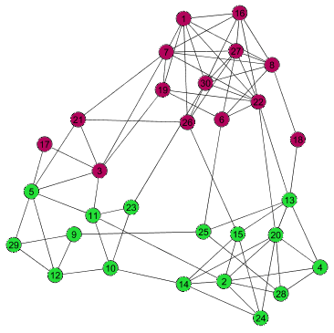
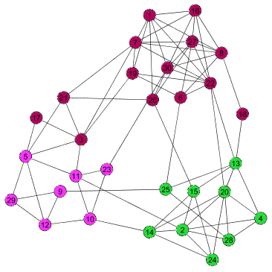
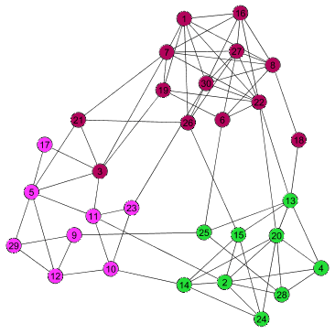
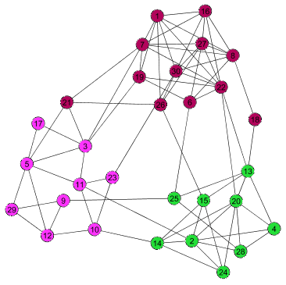
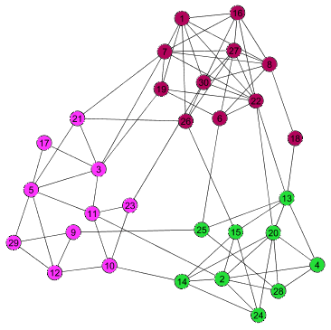
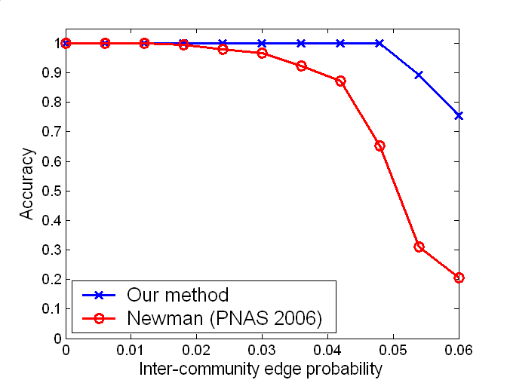
Algorithm Qcut
Recursive multi-way spectral partitioning until Q is max
Improve Q by efficient heuristic search
eig
kmeans
Our method
Accuracy
Newman’s
Inter-community edge probability

Slide 10
Real-world networks
SA: Simulated annealing, Guimera & Amaral, Nature 2005
Newman: Newman, PNAS 2006
 | #Vertices | #Edges | Modularity
 |  |  | Newman | SA | Qcut
Social | 67 | 142 | 0.573 | 0.608 | 0.587
Neuron | 297 | 2359 | 0.396 | 0.408 | 0.398
Ecoli Reg | 418 | 519 | 0.766 | 0.752 | 0.776
Circuit | 512 | 819 | 0.804 | 0.670 | 0.815
Yeast Reg | 688 | 1079 | 0.759 | 0.740 | 0.766
Ecoli PPI | 1440 | 5871 | 0.367 | 0.387 | 0.387
Internet | 3015 | 5156 | 0.611 | 0.624 | 0.632
Physicists | 27519 | 116181 | -- | -- | 0.744
Ruan & Zhang, Phy Rev E. 2008

Slide 11
Running time (seconds)
 | #vertices | #Edges | Running time
 |  |  | Newman | SA | Qcut
Social | 67 | 142 | 0.0 | 5.4 | 2.0
Neuron | 297 | 2359 | 0.4 | 139 | 1.9
Ecoli Reg | 418 | 519 | 0.7 | 147 | 12.7
Circuit | 512 | 819 | 1.8 | 143 | 6.1
Yeast Reg | 688 | 1079 | 3.0 | 1350 | 13.4
Ecoli PPI | 1440 | 5871 | 33.2 | 5868 | 41.5
Internet | 3015 | 5156 | 253.7 | 11040 | 43.0
Physicists | 27519 | 116181 | -- | -- | 2852
Ruan & Zhang, Phy Rev E. 2008

Slide 12
Agenda
Community structure in networks
  Community discovery via modularity optimization
  Protein complex prediction
  Network-based data clustering
Network-based cancer prognosis

Slide 13
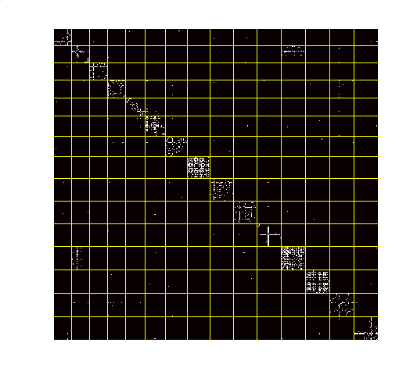
Protein complex prediction
Protein complex: a group of associated proteins performing a discrete biological function
Input: a PPI network
  Data from Krogan et.al., Nature. 2006;440:637-43
  2708 vertices (proteins), 7123 interactions
Output: communities as complexes
Problems:
  Resolution limit problem of modularity (solved by HQcut)
  PPI network often has both false positive and false negative edges
  Hub nodes (sticky proteins) prevent good partitioning

Slide 14
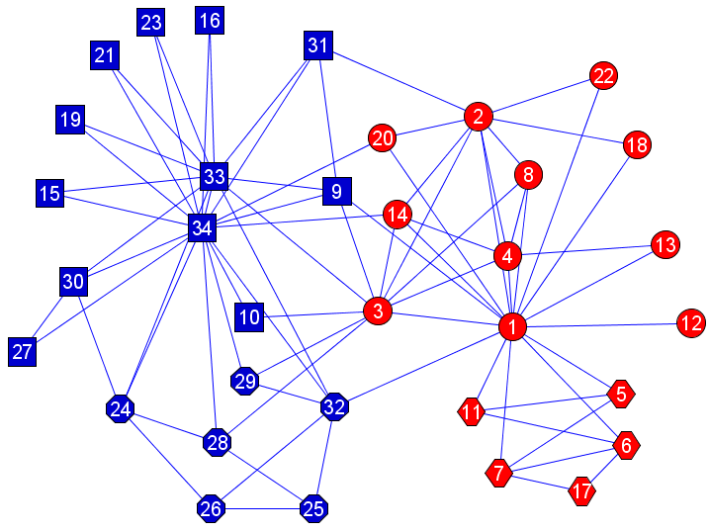
PPI as a link prediction problem
Existing methods: True PPIs share common neighbors
Our method: true PPIs have similar network topology
Original network
Initial prob vectors
Equilibrium prob vectors
Random walk
=
Correlation
threshold
(guided by
topology)
Adjacency matrix
New network
Similarity matrix

Slide 15
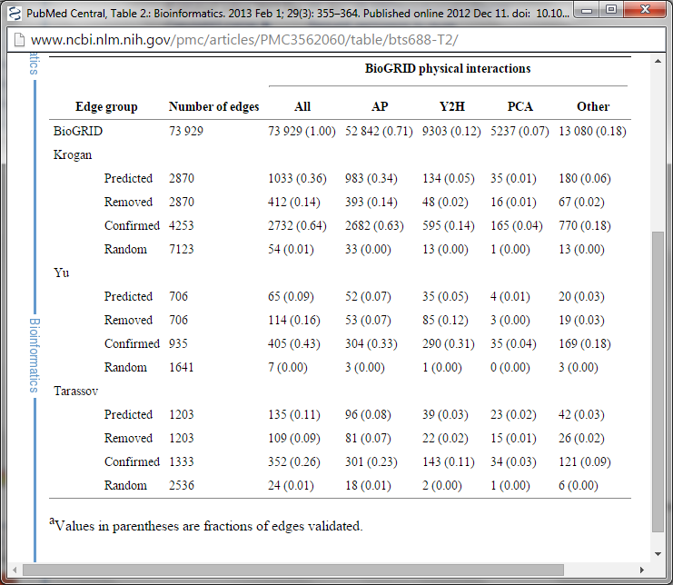
Predicted edges are bona fide physical interactions
Improved human PPI coverage by >100% while maintaining the same quality
Lei et al. Proteome science 2013

Slide 16
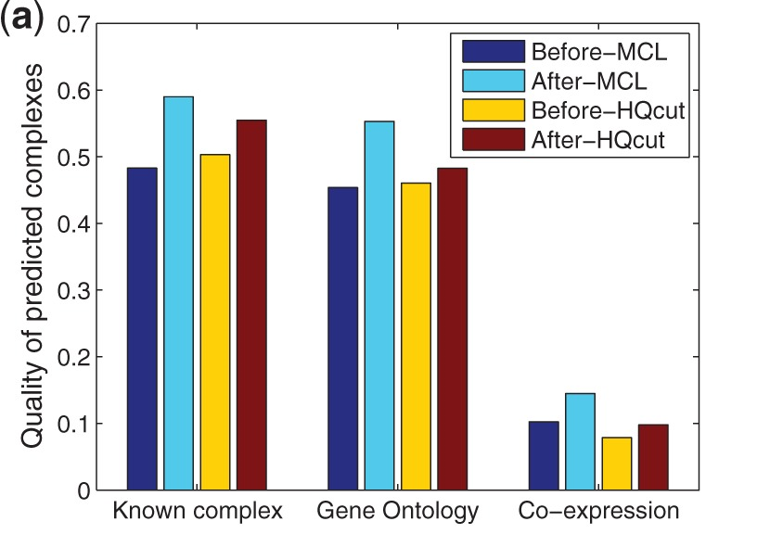
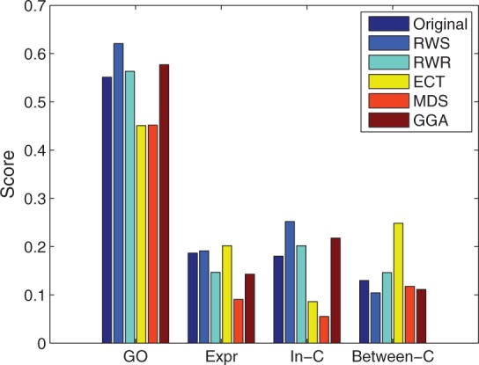
Reconstructed PPI network improves accuracy of protein complex prediction
Lei & Ruan, Bioinformatics 2013

Slide 17
Agenda
Community structure in biological networks
  Community discovery via modularity optimization
  Protein complex prediction
  Network-based data clustering
Network-based cancer prognosis

Slide 18
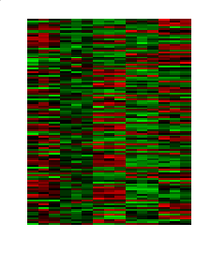
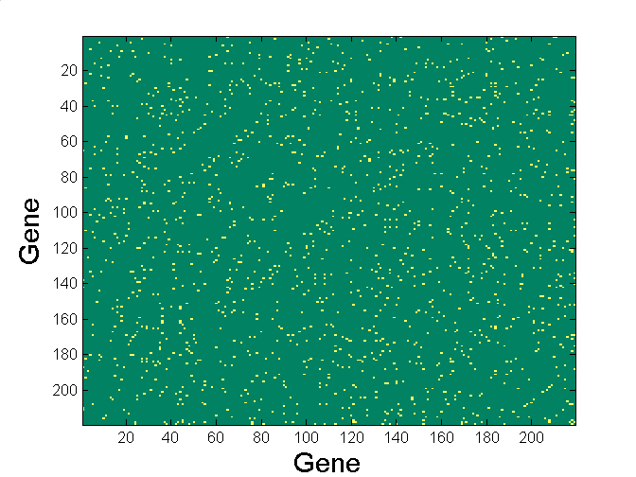
Network-based expression data clustering
Sample
i
Construct
Co-expression
network
j
=
Gene
Genes i and j connected if their expression patterns are “sufficiently similar”
  Pearson correlation coefficient > arbitrary threshold
  K nearest neighbors (KNN)-based co-expression network
  Ruan et. al., BMC Sys Biology, 2010
Key: how to get the “best” network?

Slide 19
Our idea
Ruan, ICDM 2009
Network series
Intuition: the real network is naturally modular
  Can be measured by modularity (Q)
  If constructed right, should have much higher Q than random
Expression
data
Similarity
matrix
Net_1,
Most
dense
Qcut
……
Net_m,
Most
sparse
Qcut

Slide 20
Our idea (cont’d)
True network
Random network
Modularity
Difference
Network density
Therefore, use ∆Q to determine the best network parameter and obtain the best community structure

Slide 21
Network-based clustering - advantages
Completely parameter free
Aware of network topology
Network may have other applications beyond clustering
mKNN-HQcut with optimal k (# edges)
Accuracy
mKNN-HQcut with automatically
determined k
K-means with true number of clusters
∆Q
Ruan, ICDM 2009

Slide 22
Case study: Arabidopsis array data
Top 40 most significant modules
~22000 genes, 1138 samples
1150 singletons
800 modules of size >= 10
> 80% of modules have enriched functions
Much more significant than all five existing studies on the same data set
Ruan et al., BMC Bioinfo, 2011

Slide 23
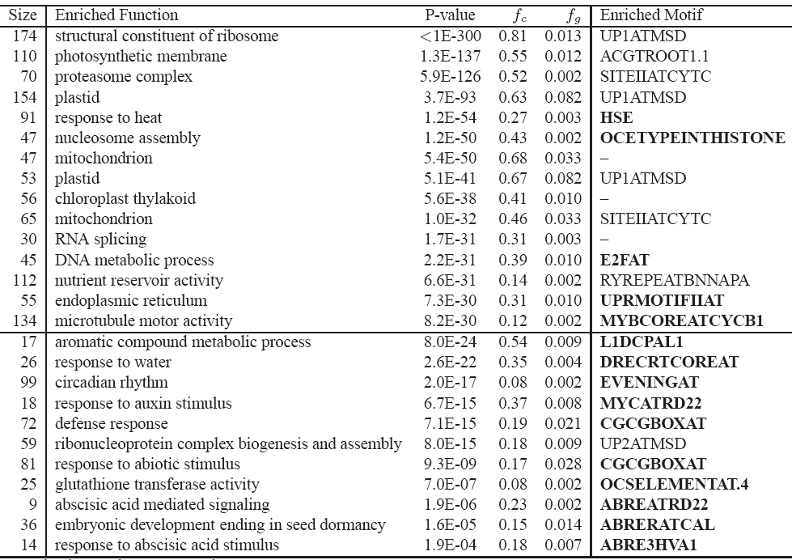

Slide 24
Regulatory network of Arabidopsis
Cis-regulatory
motif
Gene
module
Ruan et al.,
BMC Bioinfo, 2011

Slide 25
From communities to individuals
Biologists care more about individual genes than (large) groups of genes
  Opposite for biostatistician / bioinformatician
Goal: use group characteristics to better understand/predict individual characteristics
  Gao et al. BMC Genomics. 2013, “A genome-wide cis-regulatory element discovery method based on promoter sequences and gene co-expression networks.”
  Jahid et al. Bioinformatics 2014, “A personalized committee classification approach to improving prediction of breast cancer metastasis.“
  Jahid & Ruan, IJCBDD 2016, “An Ensemble Approach for Drug Side Effect Prediction.”

Slide 26
Agenda
Community structure in biological networks
  Community discovery via modularity optimization
  Protein complex prediction
  Network-based data clustering
Network-based cancer prognosis
  Personalized models for cancer prognosis (using patient-patient network)
  Network-based cancer biomarker discovery and prognosis (using gene-gene network)

Slide 27
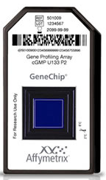
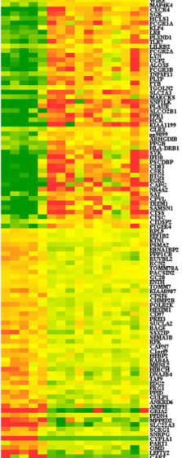
Cancer metastasis prediction
Metastasis is the spread of cancer from one organ (primary) to another (secondary)
Majority of cancer-related death is due to metastasis (M) or over-treatment of M
Accurate prediction of M is important for optimal treatment
Recent models rely on high-throughput gene expression profiling
  Genes as predictor variables (biomarkers)
  Disease outcome as response variable
Clinically approved kits available
  Mammaprint
  Oncotype DX
M
NM
Notes:
27

Slide 28
Limitations of current molecule-based methods for cancer metastasis prediction
Accuracy lower than using clinical variables
Unstable biomarkers / models among different studies
Possible causes
  Noisy data
  Small sample size vs large number of genes
  Downstream changes vs true causal factors
  Heterogeneous experimental platforms
  Heterogeneous cancer subtypes
  Gene-gene interactions
Notes:
28

Slide 29
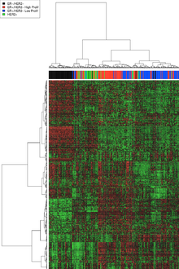
Breast cancer subtypes
Peru and colleagues defined five subtypes for breast cancer:
  Luminal A, Luminal B, ErbB2, Basal, Normal
  Different prognosis / treatment options
One model per subtype?
  Definition of subtype not consistent between different studies
  Recent studies suggest that molecular subtype of cancer may be a continuum
  rather than discrete
x

Slide 30
Personalized cancer prognosis
Personalized model construction
  Build an ensemble of models trained on selected subsets of patients similar to some target patients
  (Train doctors specialized for different patient characteristics)
Personalized model selection
  Find a subset of models best for an individual
  (Doctor-patient matching)
Committee-based decision making
  e.g. confidence-weighted voting

Slide 31
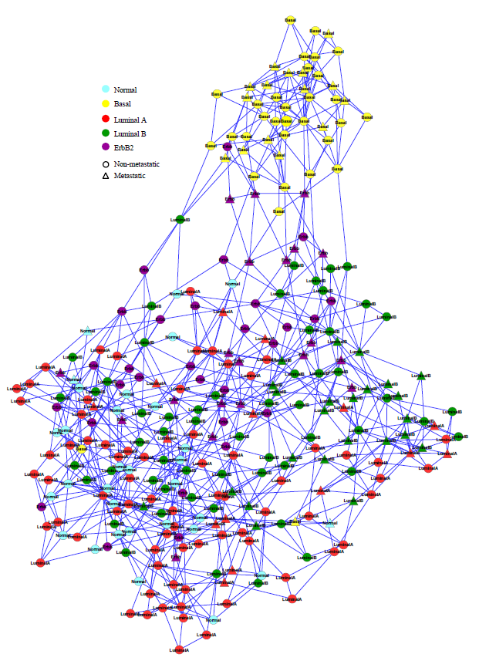
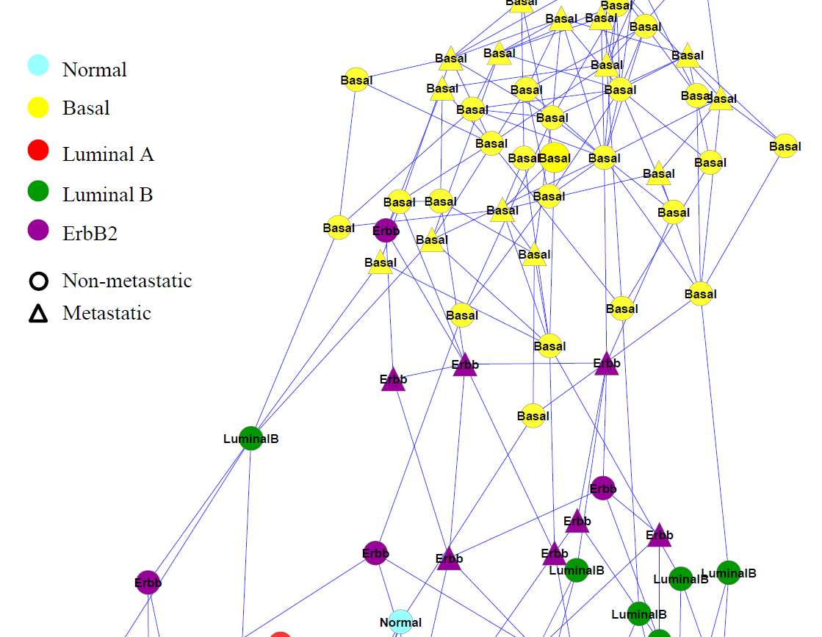
Personalized model construction
  Training data selection
  Each patient (P) is considered as a different subtype
    Implicitly defined by a group of similar patients, which are selected using random walk on the patient-patient network
Notes:
31

Slide 32
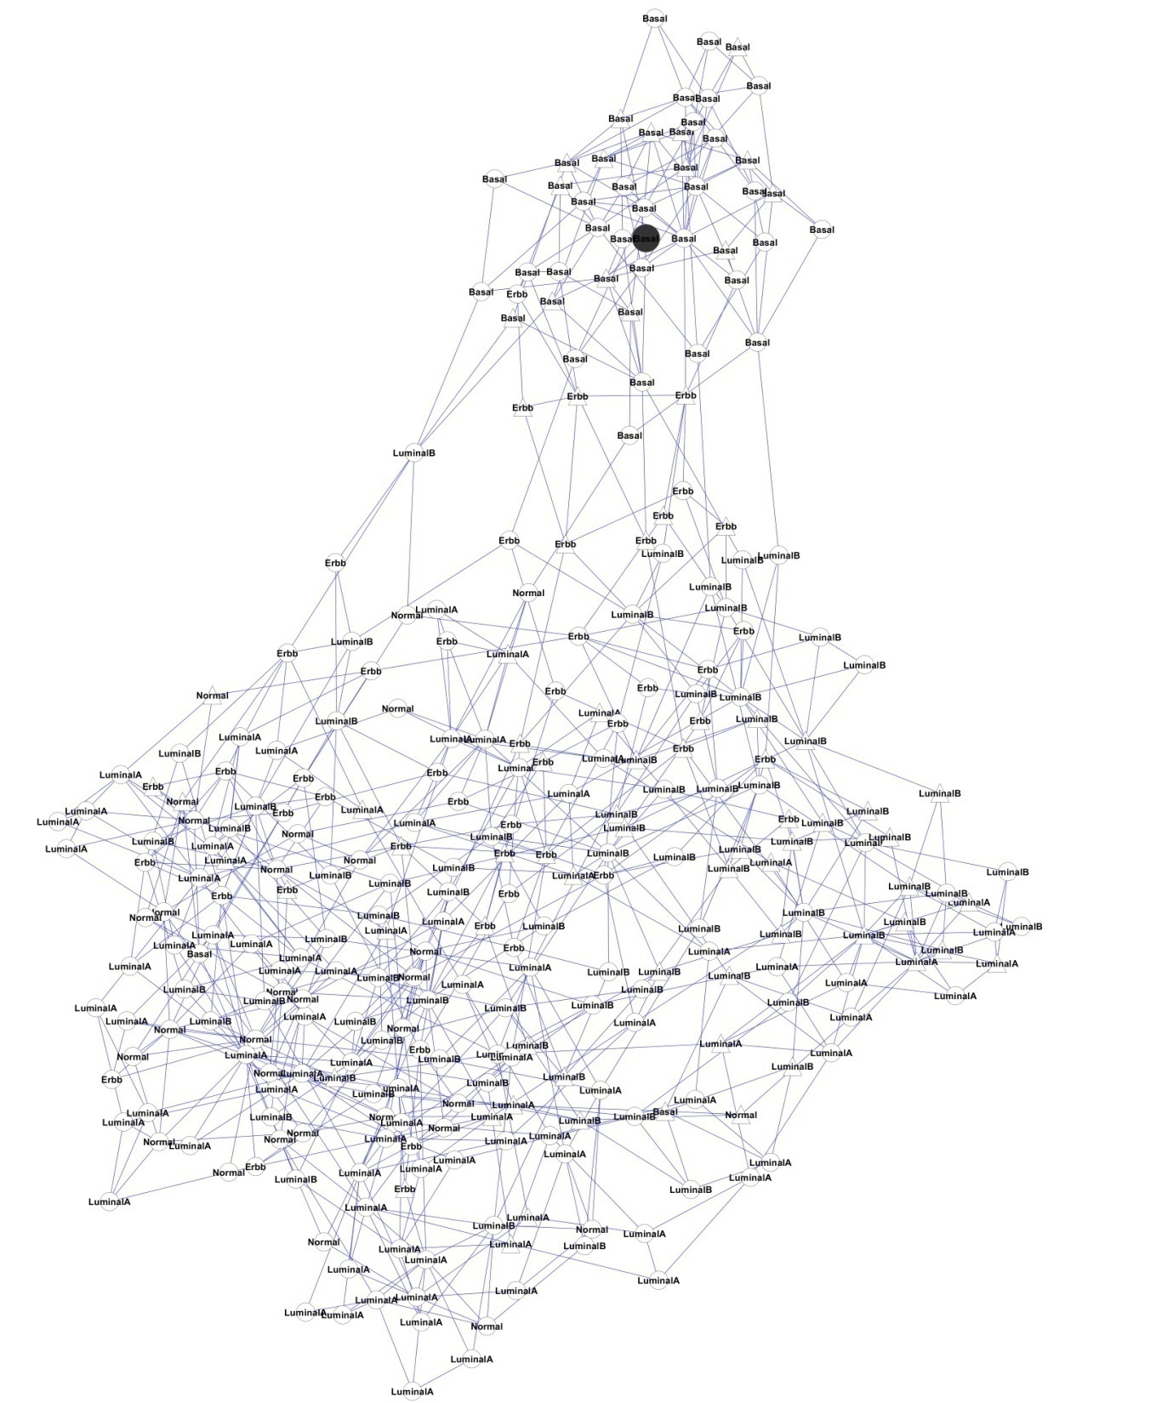
Random walk based neighbor selection
P₀
A
P
P = (1-c) * A * P + c * P₀
  Takes into account distance and topology
  Automatically identify neighbors in the same “cluster”
  Popular and validated method in machine learning
32
Notes:
32

Slide 33
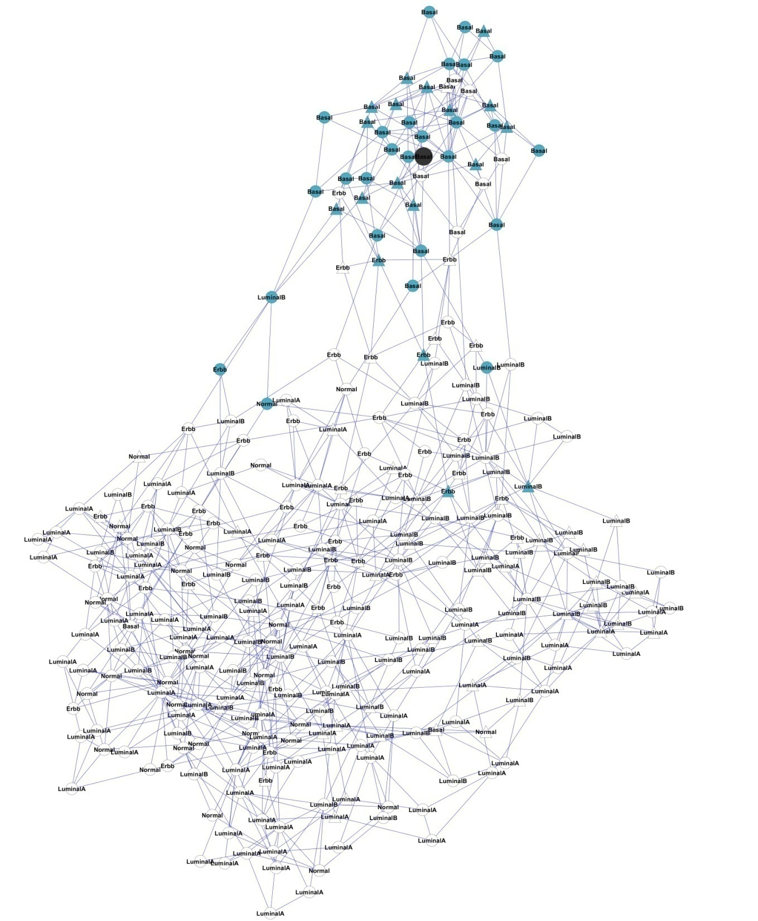
Random walk based neighbor selection
Different cutoffs lead to different number of selected neighbors
33

Slide 34
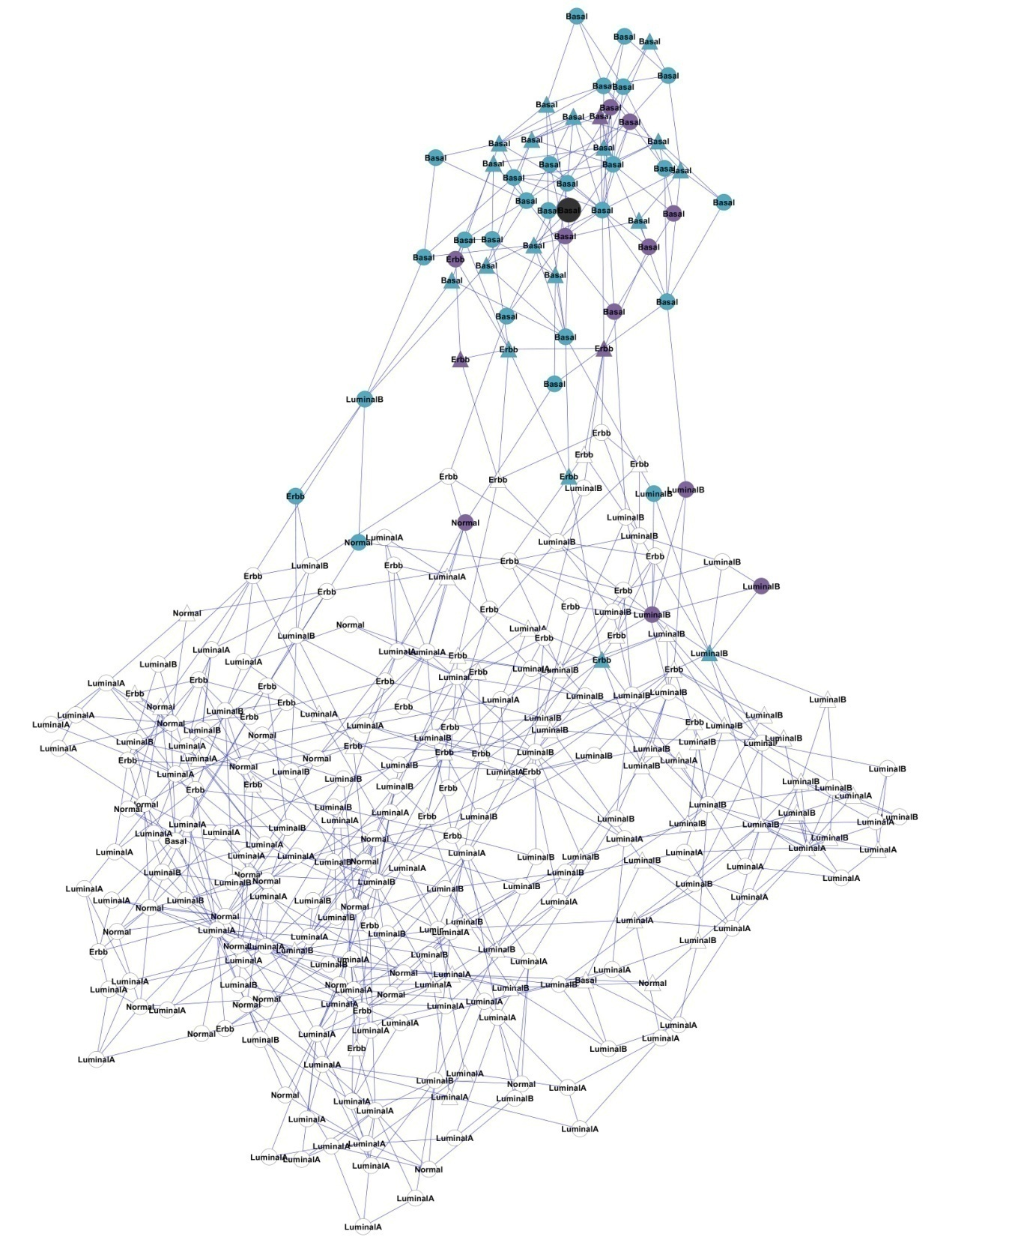
Random walk based neighbor selection
Different cutoffs lead to different number of selected neighbors
34

Slide 35
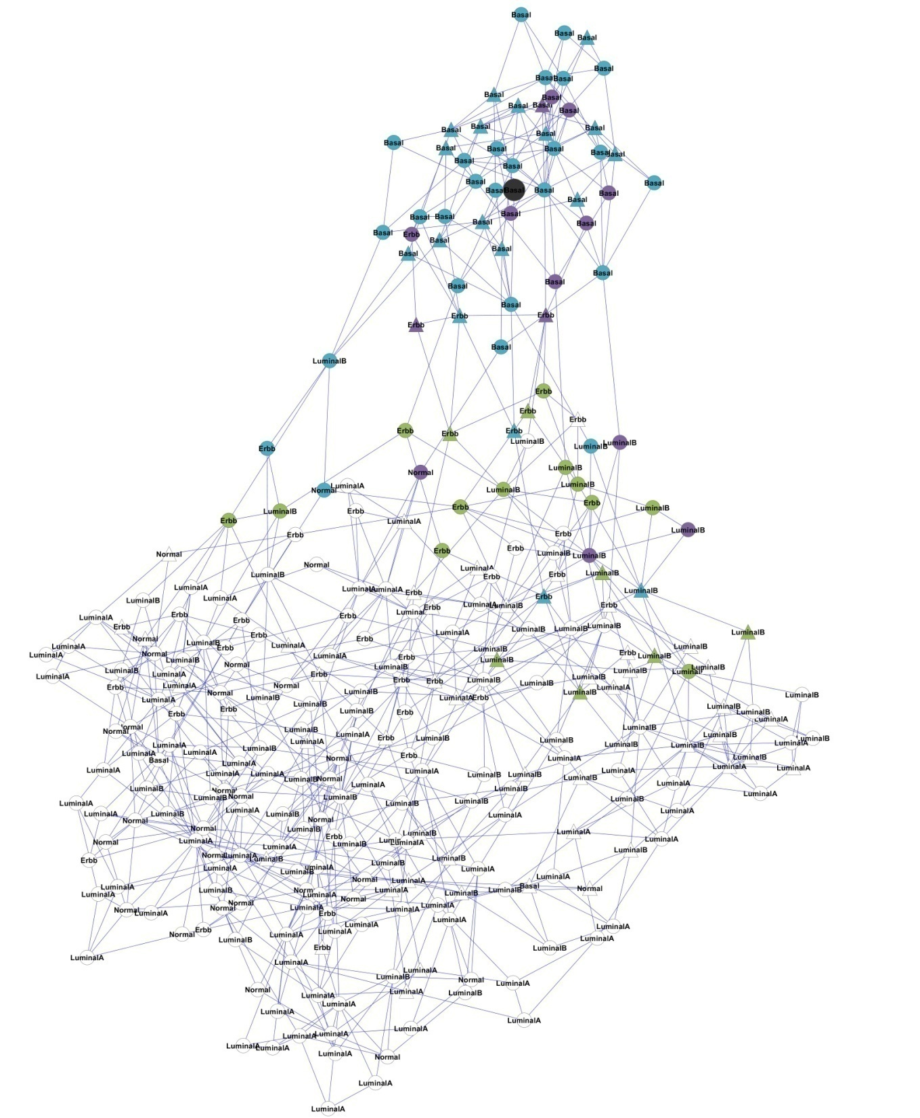
Random walk based neighbor selection
Different cutoffs lead to different number of selected neighbors
35

Slide 36
Personalized model construction
σ₁
σ₂
σ₃
σ₃
σ₄
σ₂
Training sample selection
σ₅
Base classifiers
σ₁
P₁
P₁
σ₄
σ₅
Patient-patient network
P₁’s training samples at different cutoffs
σ₁ σ₂ σ₃ σ₄ σ₅
P₁
P₂
P₃
P₄
P₅
P₆
P₇
P_{N-1}
P_{N}
X
  Multiple models trained for each patient P using selected neighbors
  Incorrect/inaccurate models removed
X
X
X
X
X
X
X
Base classifiers constructed in similar way as P1
X
X
X
X
X
X
Jahid et al., Bioinformatics 2014

Slide 37
Personalized model selection and decision making
P_{Test}
Testing patient
P_{Test}
σ₁ σ₂ σ₃ σ₄ σ₅
P₁
P₂
P₃
P₄
P₅
P₆
P₇
P_{N-1}
P_{N}
X
P_{Test}
X
X
X
P_{Test}
X
Base classifiers constructed in similar way as P1
X
X
X
Output
+
P_{Test}
X
X
X
X
P_{Test}
X
X
⁞
Jahid et al., Bioinformatics 2014
  Identify past patients (with known outcomes) that have similar molecular characteristics as the testing patient
  Reuse the models that worked on these patients
  Final prediction made via weighted voting

Slide 38
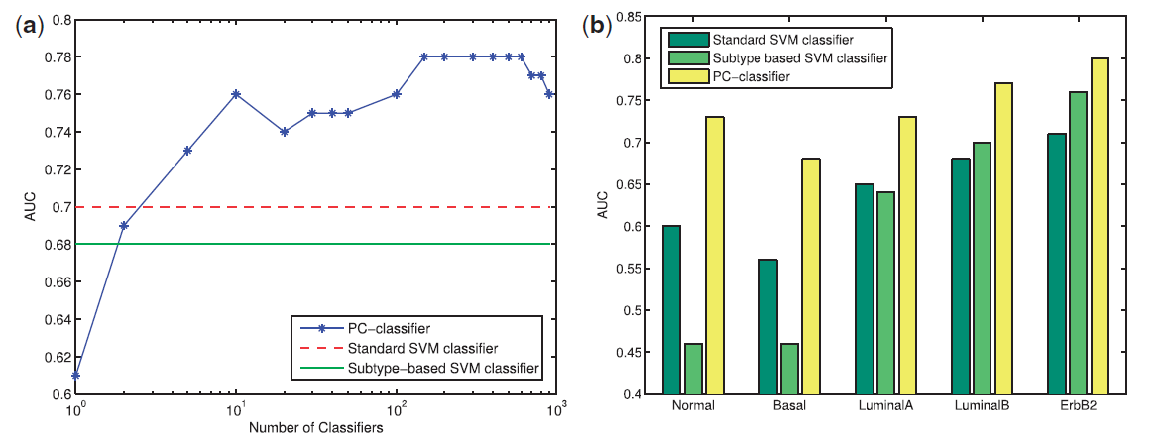
Cross-validation on NKI Dataset
Improvement for all subtypes
  Most significant improvement for Basal and Normal – hardest cases
For luminal subtype, known to be the least lethal one, at 75% sensitivity
  31.5% FPR for PC-classifier vs 43.1% FPR for standard SVM
  11.6% of luminal patients can avoid unnecessary adjuvant chemotherapy
Notes:
38

Slide 39
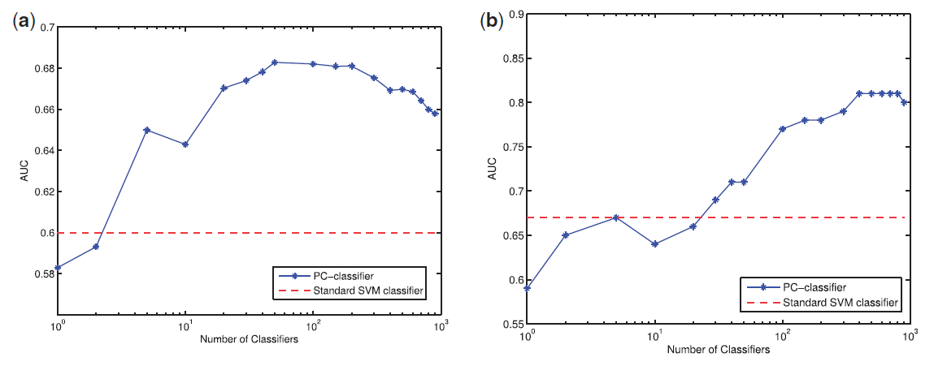
Cross-dataset Performance
Performance on Wang and UNC datasets using models trained from NKI dataset
Wang dataset
UNC dataset
Jahid et al., Bioinformatics 2014
Notes:
39

Slide 40
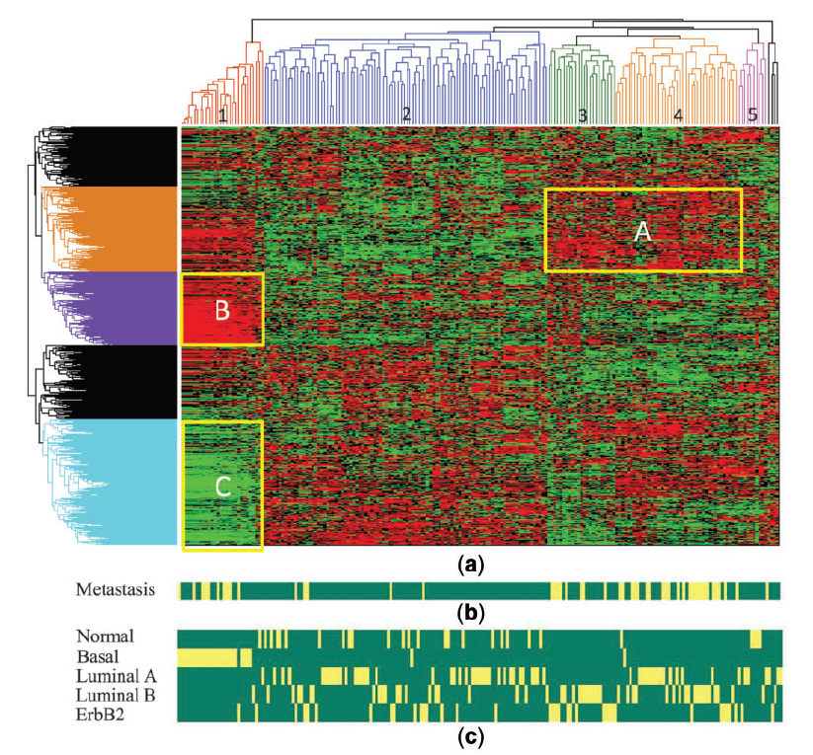
Gene weights in different models
Patient clustering
Gene
clustering
Metastasis status
Known subtype

Slide 41
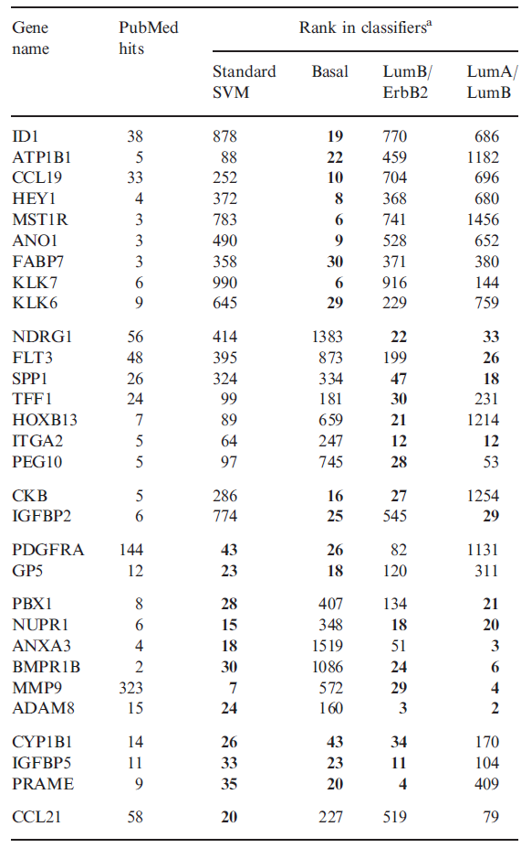
Significance of Top-Ranked Genes
Identify top genes in different clusters
Identify their association with cancer using literature mining
  Search keyword in PubMed abstracts
Many top genes already known to be metastasis related
  MMP9, PDGFRA, CCL21 etc
Notes:
41

Slide 42
Significance of Top-Ranked Genes
Observation:
  Many genes shows subtype specificity and cannot be identified by standard SVM classifier
  ID1, HEY1, MST1R have high rank in Basal group but low rank in standard SVM classifier
  ID1: well known mediator of breast cancer lung metastatic patient for Basal group
  HEY1: target gene for Notch signaling inhibitor for basal group

Slide 43
Significance of Top-Ranked Genes
Observation:
  NDGR1: Known to be related to Luminal subtype
  TFF1: Known to be related to luminal stability
  PDGFRA: Drug-target for basal like tumor
  BMPR1B: Associated with ER-positive breast cancer subtype

Slide 44
Agenda
Community structure in biological networks
  Community discovery via modularity optimization
  Protein complex prediction
  Network-based data clustering
Network-based cancer prognosis
  Personalized models for cancer prognosis (using patient-patient network)
  Network-based biomarker discovery and prognosis (using gene-gene network)

Slide 45
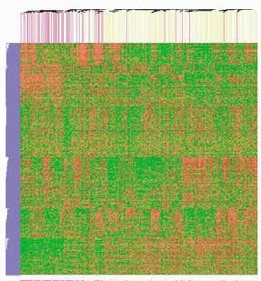
Why use gene networks for cancer?
High-throughput profiling generating tremendous data in cancer studies
“Candidate genes”
  Too many to understand the biology
  Driver vs. passenger
Predictive models
  Not robust
  Biological insight?
Disease
Normal

Slide 46
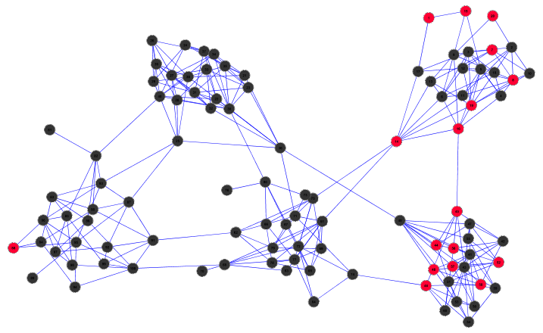
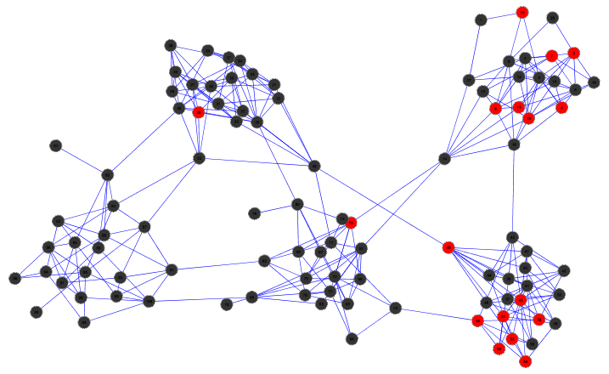
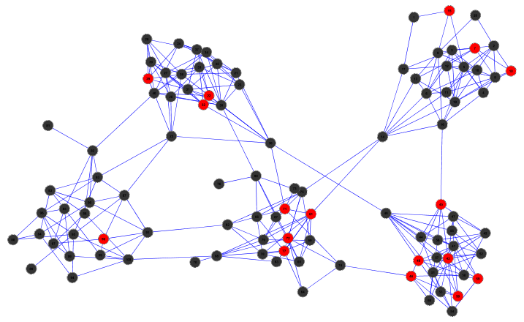
Network-based classification
A
B
Want: A ≈ B ≠ C
But: A • B = 5
A • C = 5
B • C = 4
C
Motivation
Notes:
46

Slide 47
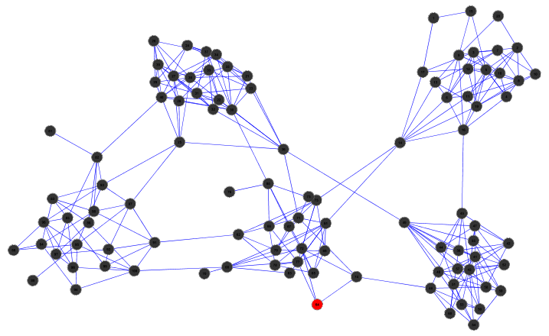
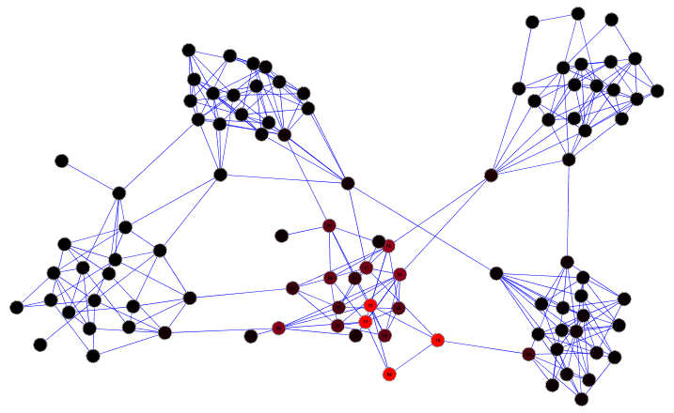
Strategy: information diffusion
P = (1-c) * A * P + c * P₀
P₀
A
P

Slide 48
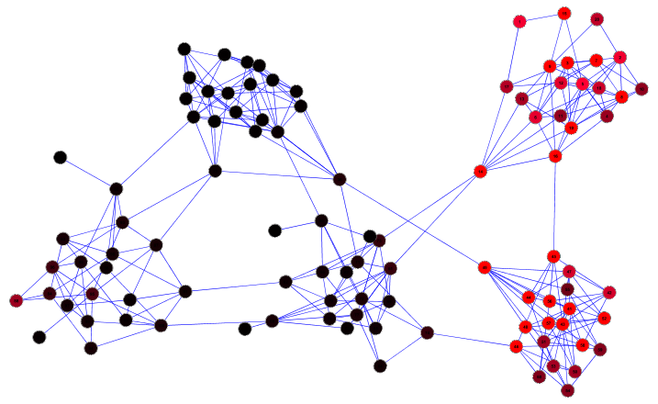
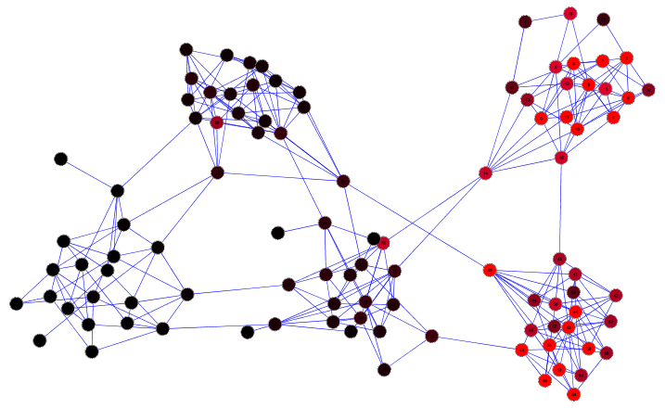
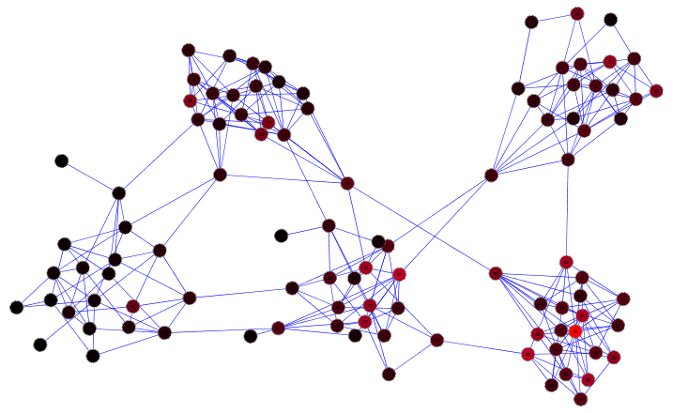

Slide 49
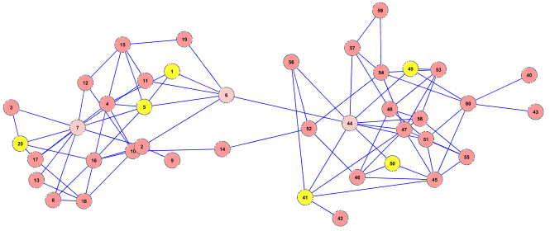
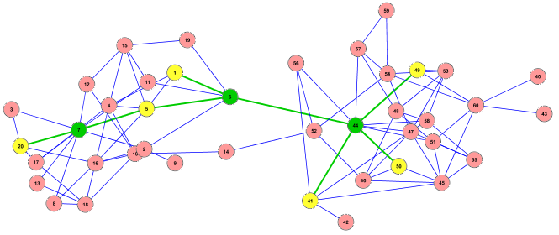
Connectors as additional biomarkers
Steiner tree problem
Many cancer genes are in close proximity to disrupted subnetworks
Goal: given list of genes disrupted in cancer, find a small subnetwork that connects them
Notes:
49

Slide 50

Biomarker subnetwork discovery

Slide 51





Utilizes subnetworks for classification
Selected
Genes
Outcomes
All patients
with known
outcomes
Network-based
classification

Slide 52
Data
60 Endometrial (womb) cancer patients
  16 recurrent (R) in 3 years
  44 non-recurrent (NR)
  12 normal control
Global methylation pattern surveyed by MBDcap-seq at OSU/UTHSCSA
4214 CpG islands differentially methylated between cancer and control
Among them, 135 genes differentially methylated (DM) between R and NR
Notes:
52

Slide 54
Methylation of DM and EC genes
Connectors include both weak DM genes in the same pathway as the DM genes, and genes that are not differentially methylated but facilitate cross-talks between DM pathways

Slide 55
Methylation of EC genes
Before info diffusion
After info diffusion
No genes passed statistical significance test between R and NR
203 (43%) of genes passed statistical significance test (p <0.02)

Slide 57

Classification accuracy
EC*: random walk on real PPI
EC#: random walk on randomized PPI
DS: discriminative subnetworks, Dao et. al. Bioinformatics, 27:205–213, 2011
Ruan et. al. Genomics 2016

Slide 58
Top markers ranked by SVM feature weights
Standardized (z-score)
Recurrence markers
Non-recurrence markers
Ruan et. al. Genomics 2016

Slide 59
Literature validation
Group III genes: ECs not differentially methylated, significance due to info diffusion
Table shows number of pubmed abstracts retrieved using gene name + “metastasis or metastatic”, or gene name + “epigenetic or methylation”
Recurrence markers
Non-recurrence markers
Metastasis
Epigenetic
Metastasis
Epigenetic
EPHB2
18
12
PARP1
31
27
COIL
209
65
TXNDC17
0
0
STAU1
1
1
AVPR1A
7
12
GSK3B
2
3
SPHK1
12
3
ID3
13
8
TLE1
4
8
ID2
23
16
AES
1
5
MCM6
1
1
CORT
0
6
BRCA1
297
356
PAX6
4
51
SSTR2
28
1
NFIC
0
2
SSTR3
8
0
AVPR2
0
0

Slide 60
Summary
Methods for network community discovery
  Fully automated, i.e. parameter-free
  Higher accuracy than competing methods that require extensive parameter tuning
  Improves protein complex prediction and microarray data clustering
  Many other applications
Network-based cancer prognosis
  Patient-patient network helps construct accurate personalized models
  Gene-gene network helps identify key causal genes
  Increases model robustness and accuracy

Slide 61
Ongoing efforts in the lab
Personalized cancer prognosis models
  Further optimize the set of base classifiers
  Generalize the idea to utilize multiple types of omics data
    How to select the best omics data for different patient?
  Combine patient-patient networks and gene-gene networks
Network-based knowledge discovery to help understand high-throughput experimental results
  Chromatin interaction
  Pathway enrichment analysis
Predict protein-DNA interaction using DNA 3D structure and machine learning

Slide 62









Acknowledgements
Collaborators
  Tim Huang
  Rong Li
  Alex Bishop
  Garry Sunter
  Valeria Sponsel
  Brian Herman
  Floyd Wormley
Group members
  Md. Jamiul Jahid
  Chengwei Lei
  Zhen Gao
  Lu Liu
  Saleh Tamim (MS)
  Angela Dean (MS)
  Tao Zhu (Huazhong U of S&T)
  Joseph Perez (Undergrad)
  Brian Hernandez (Undergrad)
Funding
SALSI

Slide 63
Looking for highly-motivated students
CS 5263 Bioinformatics in Spring 2017
Questions?

Slide 64





Q = 0
Q = 0.45
Q = 0.40
Q = 0.56
Q = 0.54
Modularity automatically determines # of communities!

Slide 65


Slide 66

Reconstructed PPI network has better functional relevance
Lei & Ruan, Bioinformatics 2013

Slide 67
Results: synthetic data set 2
Gene expression data
  Thalamuthu et al, 2006
  600 data sets
  ~600 genes, 50 conditions, 15 clusters
  0 or 1x outliers
Without outliers
With outliers
mKNN-HQcut
With optimal k
mKNN-HQcut
With auto k

Slide 68


Comparison with other methods
Ruan et al., BioKDD 2010

Slide 69



Clustering cancer subtypes
Sample
Sample: cancer patient / cell line
Sample
Gene
Qcut
Alizadeh et. al. Nature, 2000

Slide 70

Network of cancer patients
Shape: cell line / cancer type
Color: clustering results
Transformed cell lines
Activated
Blood B
Follicular lymphoma (FL)
DLBCL
DLBCL
Resting Blood B
Blood T
Diffuse large B-cell Lymphoma
(DLBCL)
Chronic lymphocytic leukemia (CLL)
Ruan et al., BMC Syst Bio, 2010

Slide 71

Survival rate after chemotherapy
5-yr survival rate: 40%
Median survival time: 22.3 months
5-yr survival rate: 73%
Median survival time: 71.3 months
DLBCL-2
DLBCL-1
However: large STD => Individuals in the same cluster could have quite different prognosis
DLBCL-3
5-yr survival rate: 20%
Median survival time: 12.5 months
Ruan et al., BMC Syst Bio, 2010

Slide 72

Subtype-specific models
Different models for different subtypes
  Overall slightly worse accuracy
  Improvement for Luminal B and ErbB2 subtypes
  Significantly poorer for normal and basal
Possible causes:
  Subtype definition is
  ambiguous
  Sub-subtypes?
  Fewer training samples
  for each subtype
  => risk of overfitting

Slide 73
Personalized models - preliminary idea
Every patient is different => one model per patient
Each patient is a different subtype!
  Implicitly defined by a group of patients with similar molecular characteristics
For each (target) patient to be predicted
  Identify patients of known outcomes with similar molecular characteristics as target
  Construct a classification model with these patients
  Predict metastasis for target patient using model obtained in step 2

Slide 74
It works!
Modest improvement of accuracy (0.70 to 0.74)
However:
  All models are for one time use only
    Evaluation results / feedback not saved
  Does not provide enough biological insight
To improve:
  Save models and evaluation results
  For new patient, identify and REUSE good models learned from similar patients

Slide 75
Random walk based neighbor selection
P₀
A
P
P = (1-c) * A * P + c * P₀
  Takes into account distance and topology
  Automatically identify neighbors in the same “cluster”
  Popular and validated method in machine learning
75
Notes:
75

Slide 76
Random walk based neighbor selection
Different cutoffs lead to different number of selected neighbors
76

Slide 77
Random walk based neighbor selection
Different cutoffs lead to different number of selected neighbors
77

Slide 78
Random walk based neighbor selection
Different cutoffs lead to different number of selected neighbors
78

Slide 79
# patients used by personalized classifiers
Basal

Slide 80
Personalized cancer prognosis
(a)
σ₁
σ₂
σ₃
σ₃
σ₄
σ₂
Training sample selection
σ₅
Base classifiers
σ₁
P₁
P₁
σ₄
σ₅
Patient-patient network
P₁’s training samples at different cutoffs
(b)
P_{Test}
Testing
P_{Test}
σ₁ σ₂ σ₃ σ₄ σ₅
P₁
P₂
P₃
P₄
P₅
P₆
P₇
P_{N-1}
P_{N}
X
P_{Test}
X
X
X
P_{Test}
X
Base classifiers constructed in similar way as P1
X
X
X
Output
+
P_{Test}
X
X
X
X
P_{Test}
X
X
⁞
Jahid et al., Bioinformatics 2014

Slide 81
Datasets
Subtype | # of patients | Metastatic | Non-metastatic
Normal | 31 | 3 | 28
Basal | 46 | 16 | 30
Luminal A | 88 | 15 | 73
Luminal B | 81 | 24 | 57
ErbB2 | 49 | 20 | 29
  Training: NKI dataset: van de Vijver et al(2002)
  295 patients
  78 had metastasis within 5 years of checkup
  Testing:
  UNC dataset (2010): 116 patients (75 metastasis)
  Wang et al (2005): 286 patients (106 metastasis)

Slide 82


BC patient-patient network
Normal-like
Basal
LumA
van de Vijver cohort
LumB
Her2
Wang cohort

Slide 83
Performance Comparison with Other Ensemble Classifiers
Compare PC-classifiers performance to other popular methods that use multiple classifiers (ensemble classifiers)
Ensemble classifier used
  Bagging
  Dagging
  AdaBoost
  Random Forest
83
Notes:
83

Slide 84

Performance Comparison with Other Ensemble Classifiers
NKI dataset
84
Notes:
84

Slide 85


Performance Comparison with Other Ensemble Classifiers
Wang dataset
UNC dataset
85

Slide 86

Pathway Analysis of PC-classifiers
86

Slide 87
Pathway Analysis of PC-classifiers
87

Slide 88

Clustering of models - correlation
Each row/column is the classification model for a patient in the NKI cohort

Slide 89


Why networks for cancer (cont’d)
Map genes to pathways
  Better biological insight
  Better stability
  Problem: limited # of well annotated genes
Alternatively: protein-protein interaction (PPI) networks
  Provide a global picture of biological processes
  Genes in close proximity involved in similar cellular functions
  Dysfunction of interaction causes disease

Slide 90


Classification results
Linear kernel support vector machine (SVM)
10-fold cross validation (repeat 100 times)
Ruan et. al. ACM-BCB 2012

