Slide 1
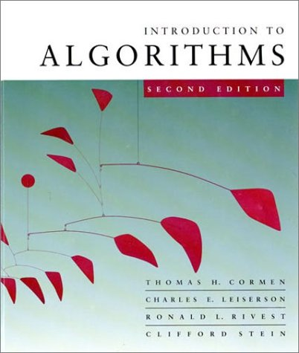
CS 3343: Analysis of Algorithms
Introduction
Some slides courtesy from Jeff Edmonds @ York University

Slide 2
The course
Instructor: Dr. Jianhua Ruan
  Jianhua.ruan@utsa.edu
  Office: NPB 3.318
  Office hours: see course webpage (cs.utsa.edu/~jruan/ under “Teaching” and link to current CS3343)
TA&Grader: see course webpage

Slide 3
The course
Purpose: a rigorous introduction to the design and analysis of algorithms
Textbook: Introduction to Algorithms, Cormen, Leiserson, Rivest, Stein
  An excellent reference you should own
  Go to course website for a link to the errata
  http://cs.utsa.edu/~jruan/teaching/cs3343_spring_2015/
    Or go to http://cs.utsa.edu/~jruan/ then follow “teaching”.
  Under “textbook”

Slide 4
Course Format
3 Lectures + 1 recitation / week
Recitation
  Mandatory
  CS3343.001 should attend CS3341.001/002/005
  CS3343.002 should attend CS3341.003/004
  Otherwise may not receive credit for certain in-class exercises
~8 homework assignments
  Problem sets (paper-based)
  Typically due in 1-1.5 week
  Hard copy submission desired. For email submission, must put “CS3343” in subject line. Otherwise may risk receiving no credit.
~8 in-class quizzes and exercises
Two midterms + final exam

Slide 5
Grading policy
Homework: 25%. One lowest grade in homework will be dropped.
Quiz and participation 5%.
Midterm 1 and Midterm 2 will be averaged and compared with final exam. Whichever is greater will weight 50% and the other will weight 20%.
I reserve the right to slightly adjust the weights of individual components if necessary.

Slide 6
Late homework submissions
10% penalty if submitted the same day after the instructor left classroom
15% penalty each additional day after the submission deadline
Submission will not be accepted once TA shows solution in recitation or instructor puts solution online
Email submission is acceptable in case of emergency. Must include “CS3343” in subject line. Otherwise may risk receiving no credit.

Slide 7
Exams
Exams cannot be made up, cannot be taken early, and must be taken in class at the scheduled time.
Proofs are needed for exceptions or true emergencies

Slide 8
Cheating
You are not allowed to read, copy, or rewrite the solutions written by others (in this or previous terms). Copying materials from websites, books or any other sources is considered equivalent to copying from another student.
If two people are caught sharing solutions, then both the copier and copiee will be held equally responsible, which will result in zero point in homework.
Cheating on an exam will result in failing the course.

Slide 9
Getting answers from the internet is
CHEATING
Getting answers from your friends is
CHEATING
I will send it to the Dean!
You will be nailed!
However, teamwork is encouraged.
Group size at most 3.
Clearly acknowledge who you worked with.

Slide 10
Do NOT get answers
from other groups!
Do NOT do half the assignment
and your partner does the other half.
Each try all on your own.
Discuss ideas verbally at a high-level but write up on your own.

Slide 11
Attendance
Missing 3 or more classes / recitations (whenever attendance is checked) will result in a minimum of 5 points taken off your final grade
In reality, attendance and final grade are highly correlated

Slide 12
Feedbacks
We appreciate your feedbacks
Your feedbacks help me know how I can better deliver my lectures, which will ultimately benefit you
You get bonus points in homework for your feedbacks

Slide 13
Introduction
Why should you study algorithms
What is an algorithm
What you can expect to learn from this course

Slide 14
Please feel free
to ask questions!
Help me know what people
are not understanding
We do have a lot of material
It’s your job to slow me down

Slide 15
So you want to be a computer scientist?

Slide 16
Is your goal to be a mundane programmer?

Slide 17
Or a great leader and thinker?

Slide 18
Boss assigns task:
  Given today’s prices of pork, grain, sawdust, …
  Given constraints on what constitutes a hotdog.
  Make the cheapest hotdog.
Everyday industry asks these questions.

Slide 19
Your answer:
Um? Tell me what to code.
With more sophisticated software engineering systems,
the demand for mundane programmers will diminish.

Slide 20
Your answer:
I learned this great algorithm that will work.
Soon all known algorithms
will be available in libraries.
Your boss might change his mind. He now wants to make the most profitable hotdogs.

Slide 21
Your answer:
I can develop a new algorithm for you.
Great thinkers
will always be needed.

Slide 22
How do I become a great thinker?
Maybe I’ll never be…

Slide 23
Learn from the classical problems

Slide 24
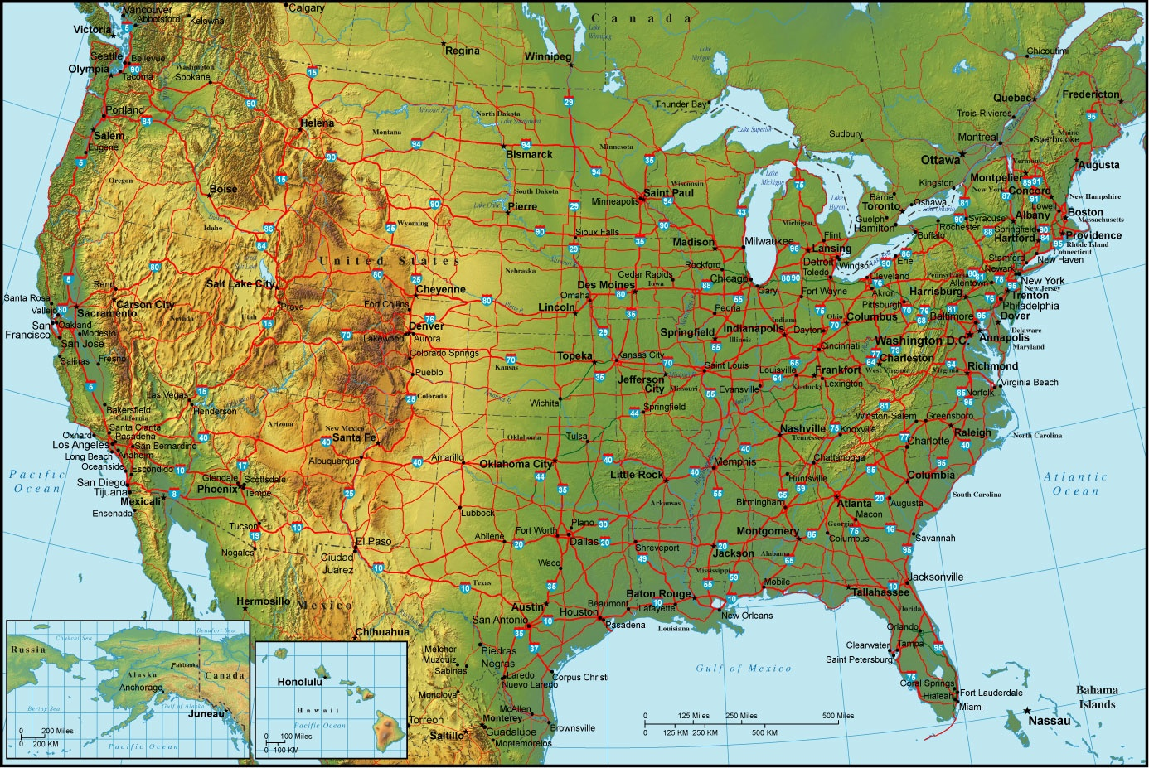
Shortest path
end
Start

Slide 25
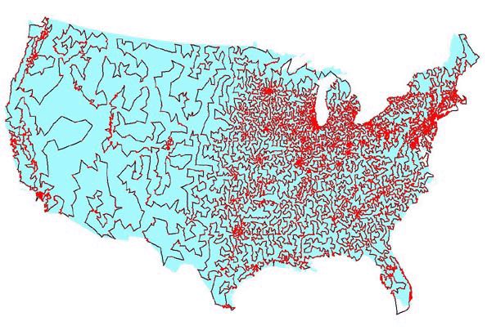

Traveling salesman problem

Slide 26
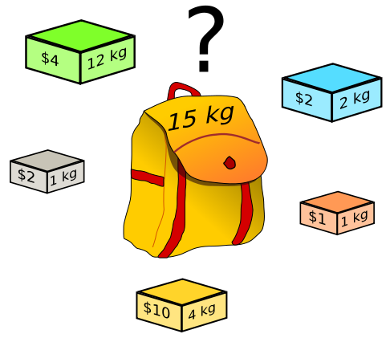
Knapsack problem

Slide 27
There is only a handful of classical problems.
  Nice algorithms have been designed for them
If you know how to solve a classical problem (e.g., the shortest-path problem), you can use it to do a lot of different things
  Abstract ideas from the classical problems
  Map your boss’ requirement to a classical problem
  Solve with classical algorithms
  Modify it if needed

Slide 28
What if you can NOT map your boss’ requirement to any existing classical problem?
How to design an algorithm by yourself?
Learn some meta algorithms
  A meta algorithm is a class of algorithms for solving similar abstract problems
  There is only a handful of them
    E.g. divide and conquer, greedy algorithm, dynamic programming
  Learn the ideas behind the meta algorithms
    Design a concrete algorithm for your task

Slide 29
Useful learning techniques
Read Ahead. Read the textbook before the lectures. This will facilitate more productive discussion during class.
Explain the material over and over again out loud to yourself, to each other, and to your stuffed bear.
Be creative. Ask questions: Why is it done this way and not that way?
Practice. Try to solve as many exercises in the textbook as you can.

Slide 30
What will we study?
Expressing algorithms
  Define a problem precisely and abstractly
  Presenting algorithms using pseudocode
Algorithm validation
  Prove that an algorithm is correct
Algorithm analysis
  Time and space complexity
  What problems are so hard that efficient algorithms are unlikely to exist
Designing algorithms
  Algorithms for classical problems
  Meta algorithms (classes of algorithms) and when you should use which

