Slide 1
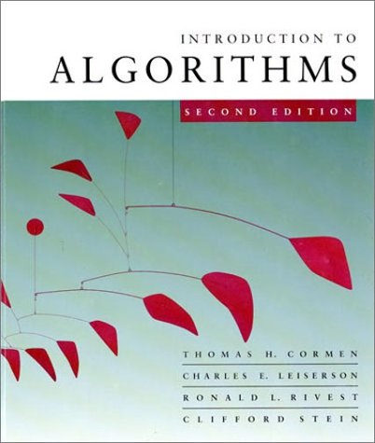
CS 3343: Analysis of Algorithms
Analyzing non-recursive algorithms

Slide 2
True or false?
2n² + 1 = O(n²) T (also Θ)
Sqrt(n) = O(log n) F (ω)
log n = O(sqrt(n)) T (also o)
n²(1 + sqrt(n)) = O(n² log n) F (ω)
3n² + sqrt(n) = O(n²) T (also Θ)
sqrt(n) log n = O(n) T (also o)

Slide 3
True or false?
2n² + 1 = O(n²) T (also Θ)
Sqrt(n) = O(log n) F (ω)
log n = O(sqrt(n)) T (also o)
n²(1 + sqrt(n)) = O(n² log n) F (ω)
3n² + sqrt(n) = O(n²) T (also Θ)
sqrt(n) log n = O(n) T (also o)

Slide 4
Analyzing the complexity of an algorithm

Slide 5
Kinds of analyses
Worst case
Provides an upper bound on running time
Best case – not very useful, can always cheat
Average case
Provides the expected running time
Very useful, but treat with care: what is “average”?

Slide 6
General plan for analyzing time efficiency of a non-recursive algorithm
Decide parameter (input size)
Identify most executed line (basic operation)
worst-case = average-case?
T(n) = ∑_{i} t_{i}
T(n) = Θ (f(n))

Slide 7
Example
repeatedElement (A, n)
// determines whether all elements in a given // array are distinct
for i = 1 to n-1 {
for j = i+1 to n {
if (A[i] == A[j]) return true;
}
}
return false;

Slide 8
Example
repeatedElement (A, n)
// determines whether all elements in a given // array are distinct
for i = 1 to n-1 {
for j = i+1 to n {
if (A[i] == A[j]) return true;
}
}
return false;

Slide 9
Best case?
Worst-case?
Average case?

Slide 10
Best case
A[1] = A[2]
T(n) = Θ (1)
Worst-case
No repeated elements
T(n) = (n-1) + (n-2) + … + 1 = n (n-1) / 2 = Θ (n²)
Average case?
What do you mean by “average”?
Need more assumptions about data distribution.
How many possible repeats are in the data?
Average-case analysis often involves probability.

Slide 11
Find the order of growth for sums
T(n) = ∑_{i=1..n} i = Θ (n²)
T(n) = ∑_{i=1..n} log (i) = ?
T(n) = ∑_{i=1..n} n / 2^{i} = ?
T(n) = ∑_{i=1..n} 2^{i} = ?
…
How to find out the actual order of growth?
Math…
Textbook Appendix A.1 (page 1058-60)

Slide 12
Arithmetic series
An arithmetic series is a sequence of numbers such that the difference of any two successive members of the sequence is a constant.
e.g.: 1, 2, 3, 4, 5
or 10, 12, 14, 16, 18, 20
In general:
Recursive definition
Or:
Closed form, or explicit formula

Slide 13
Sum of arithmetic series
If a₁, a₂, …, a_{n} is an arithmetic series, then
e.g. 1 + 3 + 5 + 7 + … + 99 = ?
(series definition: a_{i} = 2i-1)
This is ∑ _{i = 1 to 50} (a_{i}) = 50 * (1 + 99) / 2 = 2500

Slide 14
Geometric series
A geometric series is a sequence of numbers such that the ratio between any two successive members of the sequence is a constant.
e.g.: 1, 2, 4, 8, 16, 32
or 10, 20, 40, 80, 160
or 1, ½, ¼, 1/8, 1/16
In general:
Recursive definition
Or:
Closed form, or explicit formula

Slide 15
Sum of geometric series
if r < 1
if r > 1
if r = 1

Slide 16
Sum of geometric series
if r < 1
if r > 1
if r = 1

Slide 17
Important formulas

Slide 18
Sum manipulation rules
Example:

Slide 19
Sum manipulation rules
Example:

Slide 20
∑_{i=1..n} n / 2^{i} = n * ∑_{i=1..n} (½)^{i} = ?
using the formula for geometric series:
∑_{i=0..n} (½)^{i} = 1 + ½ + ¼ + … (½)^{n} = 2
Application: algorithm for allocating dynamic memories

Slide 21
∑_{i=1..n} log (i) = log 1 + log 2 + … + log n = log 1 x 2 x 3 x … x n = log n!
= Θ(n log n)
Application: algorithm for selection sort using priority queue

Slide 22
Recursive definition of sum of series
T (n) = ∑_{i=0..n} i is equivalent to:
T(n) = T(n-1) + n
T(0) = 0
T(n) = ∑_{i=0..n} a^{i} is equivalent to:
T(n) = T(n-1) + a^{n}
T(0) = 1
Recurrence
Boundary condition
Recursive definition is often intuitive and easy to obtain. It is very useful in analyzing recursive algorithms, and some non-recursive algorithms too.

Slide 23
Recursive definition of sum of series
How to solve such recurrence or more generally, recurrence in the form of:
T(n) = aT(n-b) + f(n) or
T(n) = aT(n/b) + f(n)

