Slide 1
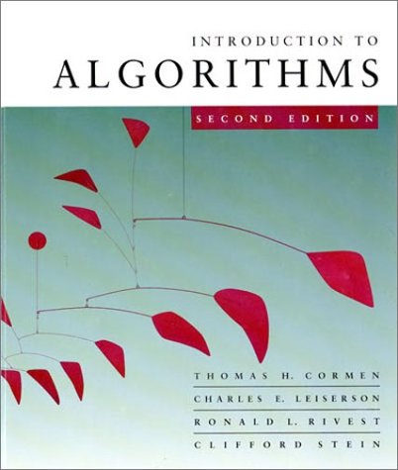
CS 3343: Analysis of Algorithms
Review for final

Slide 2
Final Exam
Closed book exam
Coverage: the whole semester
Cheat sheet: you are allowed one letter-size sheet, both sides
May 4 (sec 1) and 7(sec 2), 12:30 – 3:00pm
Basic calculator (no graphing) allowed
No cell phones!

Slide 3
Final Exam: Study Tips
Study tips:
Study each lecture
Study the homework and homework solutions
Study the midterm exams
Re-make your previous cheat sheets

Slide 4
Topics covered (1)
By reversed chronological order:
Other topics
Graph search & topological sort
String matching
P & NP
Graph algorithms
Representations
MST (Prim’s, Kruskal’s)
Shortest path (Dijkstra’s)
Running time analysis with different implementations
Greedy algorithm
Uniform-profit restaurant location problem
Fractional knapsack problem
How to show that certain greedy choices are optimal
Color key:
Red: Absolutely need to know
Blue: Ideally, you should know
Grey: Possible extra credit question

Slide 5
Topics covered (2)
Dynamic programming
LCS
Restaurant location problem
Shortest path problem on a grid
Other problems
Knapsack, event scheduling, coin changing, etc.
How to define recurrence solution, and use dynamic programming to solve it
Binary heap and priority queue
Heapify, buildheap, insert, exatractMax, changeKey
Running time and analysis

Slide 6
Topics covered (3)
Order statistics
Rand-Select
Worst-case Linear-time selection
Running time
Running time analysis using substitution method
Expected running time analysis of probabilistic algorithm
Sorting algorithms
Insertion sort
Merge sort
Quick sort
Heap sort
Linear time sorting: counting sort, radix sort
Stability of sorting algorithms
Worst-case and expected running time
Memory requirement of sorting algorithms
Running time analysis of quick sort using substitution method

Slide 7
Topics covered (4)
Analysis
Compare order of growth
Prove asymptotic notation using basic definition
Worst case and average case analysis
Analyzing non-recursive algorithms
Sum of arithmetic series
Sum of geometric series
Analyzing recursive algorithms
Defining recurrence
Solving recurrence
Master theorem
Recursion tree (iteration) method
Substitution method

