Slide 1
Fall 2018
Midterm-1 results

Slide 2
AVG sec4 9.49 14.79 8.60 10.97 9.55 53.40
Max 20.00 20.00 20.00 20.00 20.00 90.00
Min 0.00 4.00 0.00 0.00 0.00 13.50
AVG sec3 11.52 15.53 9.91 11.73 13.92 62.61
Max 20.00 20.00 20.00 20.00 20.00 97.00
Min 0.00 6.00 3.00 0.00 0.00 26.00

Slide 4
String Pointer-trace 2D-arrays Command-line-arg File-Dyn-struct

Slide 5
String Pointer-trace 2D-arrays Command-line-arg File-Dyn-struct

Slide 6
String Pointer-trace 2D-arrays
Command-line-arg File-Dyn-struct

Slide 7
Q16 - How would you rank the difficulty of the midterm exam that you just took?
Q32 - I assume you solved some of the sample midterm exams. Compared to previous sample tests, how would you rank the difficulty of the midterm exam that you just took? The exam I just took was

Slide 9
19.5 |  | San Antonio College/St. Phillips C.
24.5 |  |  | Austin community college
25.5 |  |  | Austin Community College
26 |  | LCC
26 |  | Lonestar
27 | northwest vista
27 |  |  |  | PAC in Java
39 |  | Alamo
40 |  |  |  | UTPB
50 |  | Alamo Colleges
51.5 |  | San Antonio College
52.5 |  |  |  | South Texas College
53 |  | Northeast Lakeview College
54.5 |  |  |  | MSOE
55.5 | Northwest Vista
58 |  |  |  | texas tech university
66.5 |  | Alamo Colleges NLC
71 |  | San Antonio College
71.5 | Northwest Vista College
74 |  |  |  | University of Texas at Austin
76 |  | Northeast Lakeview CC
76 |  | Northeast lakeview CC
76.5 | northwest vista
77.5 |  |  | Austin Community College
79 |  |  | Austin Community College
79 | Northwest Vista
84.5 |  |  |  | University of Texas at Rio Grande Valley
90 |  |  | Austin Community College
92 | Northwest Vista CC

Slide 10
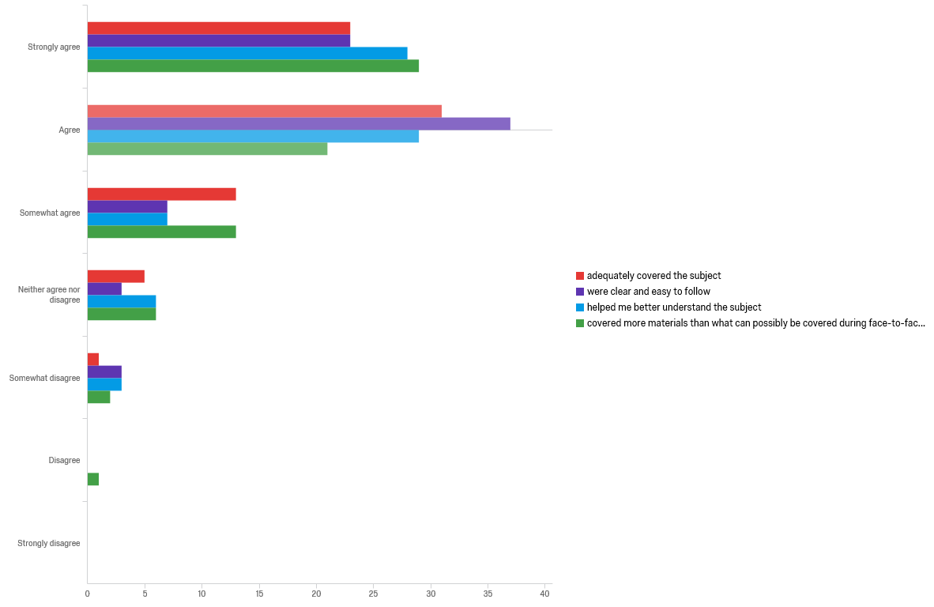
Q23 - Overall, how useful were the video lectures on Review Materials in preparing for the midterm-1 exam that you just took?

Slide 11
Q31 - How clearly did the video solutions present material?
Q33 - How detailed did the video solutions present material?
Q35 - Overall, how would you rate the usefulness of video solutions in your learning the subjects and preparing for the midterm-I?

Slide 12
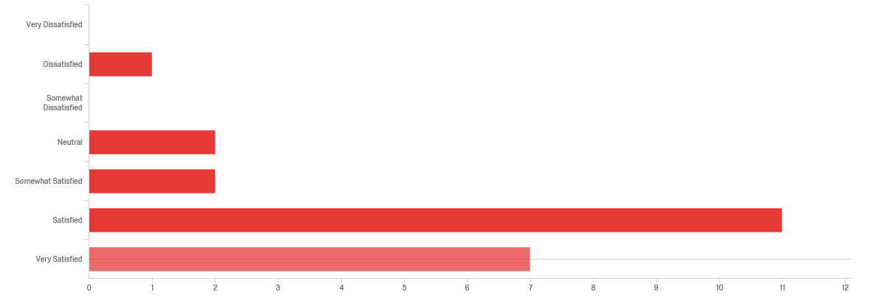
Q38 - How satisfied or dissatisfied were you with the JumpStart sessions provided by the department?
Q36 - Overall, how would you rate the usefulness of JumpStart sessions in your learning the subjects?

Slide 13
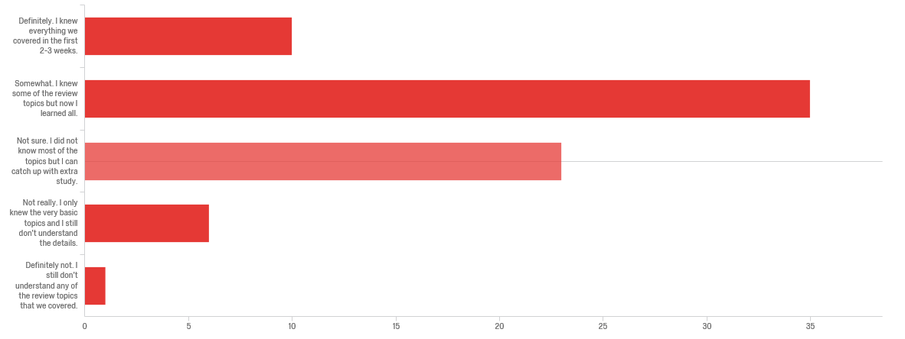
Based on the reviews we did in the first 2-3 weeks through video lectures and problem solving in class , do you think you had sufficient background to take CS 2123?

