Slide 1
Systems Research Group
Tongping Liu
http://www.cs.utsa.edu/~tongpingliu/
Notes:
Hello Everyone. Today, I am going to talk about my research – improving the performance of parallel applications.

Slide 2

Broad Research Field
MY MISSION: help programmers design correct and efficient software systems
Single System
Distributed System
Multithreading
Performance
Reliability
User
Space
Kernel
Space
Hypervisor
Notes:
This is the big vision of my research that I am going to pursue.
Currently, my research focus is to improve the performance and correctness of multithreading programs in the single system. My research experiences spans runtime systems, operating systems, programming languages, compiler, and distributed systems.

Slide 3
Performance Improvement
for Parallel Applications
Tongping Liu
http://people.cs.umass.edu/~tonyliu
Notes:
Hello Everyone. Today, I am going to talk about my research – improving the performance of parallel applications.

Slide 4



Parallelism is Important
Multicore is the standard
  smart phones, tablets
  laptops, workstations
  supercomputers, data centers
Multicore drives parallel computing

Slide 5
Parallel Computing is Challenging
Efficiency Problem
  Algorithm, data structure
  Type and distribution of workload (parallelizable percentage, task granularity, load balance, thread model)
  Hardware effect
Reliability Problem
  Input dependent
  Timing dependent

Slide 6
Parallel Computing is Challenging
Efficiency Problem
  Algorithm, data structure
  Type and distribution of workload (parallelizable percentage, task granularity, load balance, thread model, locality)
  Hardware effect
False sharing on cache lines: Sheriff, Predator
Reliability Problem
  Input dependent
  Timing dependent
Memory error: DoubleTake
Deterministic Multithreading: Dthreads

Slide 7
Research Focus: Parallel Computing
Performance
Reliability
Sheriff: [Liu, OOPSLA’11]
Detecting and Tolerating False Sharing
Dthreads: [Liu, SOSP’11]
Efficient Deterministic Multithreading
Predator: [Liu, PPOPP’14]
Predictive False Sharing Detection
DoubleTake: [Liu, Submission]
Evidence-Triggered Dynamic Analysis
Notes:
Today, I am going to focus on one of performance problems, false sharing. Before I dig into that, I want to discuss about the background: How to do parallel programming, what is false sharing and why it is important.

Slide 8
Outline
False Sharing: Background & Motivation
Correctly and Precisely Detect False Sharing
Automatically Eliminate False Sharing
Other Contributions
Future Work

Slide 9
False Sharing vs. True Sharing
Cache Line
Notes:
False sharing occurs when different threads are updating or accessing different words in the same cache line.
There is another concept, true sharing, which is the opposite of false sharing. For true sharing, different threads are updating the same word.
LABEL CACHE LINE

Slide 10
False Sharing vs. True Sharing
Task 1
Task 3
False
Sharing
Task 2
Task 4
Task 1
True
Sharing
Task 2
False Sharing can dramatically degrade performance
Notes:
False sharing occurs when different threads are updating or accessing different words in the same cache line.
There is another concept, true sharing, which is the opposite of false sharing. For true sharing, different threads are updating the same word.

Slide 11
Parallelism:
Awesome Expectation
Parallel Program
■ Expectation
int count[8];
int W;
void increment(int S)
{
for(in=S; in<S+W; in++)
for(j=0; j<1M; j++)
count[in]++;
}
int main(int THREADS) {
W=8/THREADS;
for(i=0; i<8; i+=W)
spawn(increment,i);
}
False sharing
Runtime (s)
THREADS = 2
count[0]~count[3]
count[4]~count[7]
Notes:
We hope that more threads can help reduce the total runtime. Whenever we double the threads, the runtime will be halved.

Slide 12
Parallelism:
Awful Reality
Parallel Program
■ Reality
■ Expectation
int count[8];
int W;
void increment(int S)
{
for(in=S; in<S+W; in++)
for(j=0; j<1M; j++)
count[in]++;
}
int main(int THREADS) {
W=8/THREADS;
for(i=0; i<8; i+=W)
spawn(increment,i);
}
Runtime (s)
False sharing slows the program by 13X
Notes:
However, when we actually run this program on a real machine with 8 cores,
we got a different result, showed in the red bars.
When we increase the number of threads and cores, we actually increase the total running time,
This phenomena is caused by a false sharing problem in this program. False sharing makes this programs runs 13X slower.

Slide 13

False Sharing in Real Applications
False sharing slows MySQL by 50%

Slide 14

Resource Contention at Cache Line Level
Notes:
Basically, false sharing is caused by resource contention at cache line level.

Slide 15
False Sharing Causes Performance Problems
Core 1
Core 2
Task 1
Task 2
Invalidate
Cache
Cache
Main Memory
Cache line: basic unit of data transfer
Notes:
Now I am going to explain that using a simplified model.
we only use two threads: thread 1 is running on core 1 and thread 2 is running on core 2.
Core 1 and core 2 have their private caches.
Cache normally locates in the same chip with Processor, which has much higher access speed than accesses of main memory.
Whenever a program is trying to access something,
data is fetched to the cache automatically in the unit of cache line, normally 32 bytes or 64 bytes in order to improve the speed of accesses.
Cache line is introduced to reduce the number of fetches.
However, cache line creates the performance problem when there are false sharing inside.
Different cache coherence protocol have different ways to handle updates, including MSI and MESI protocol,
whether this is write-invalidate or write-update.
I am talking about write-invalidate here.
When thread 1 modify some words in a cache line, cache coherence protocol will notice that core2 has the copy of the same data.
Then it should invalidate this data on core in order to guarantee the correctness in true sharing situation.
However, it is unnecessary for false sharing problem.

Slide 16
False Sharing Causes Performance Problems
Core 1
Core 2
Task 1
Task 2
Invalidate
Cache
Cache
Main Memory
Interleaved accesses cause cache invalidations
Notes:
So when thread 2 tries to access something, it has to wait until the data is fetched from core 1.
Same for thread 2, when thread 2 modify something, the data in core 1 will be invalidated.
If there are many interleaved writes from different threads, this can cause a lot of cache invalidations.
The big number of cache invalidations may cause serious performance problem.
The hardware trend, with more cores on a single machine or larger cache line size, makes false sharing problems increasingly common.

Slide 17
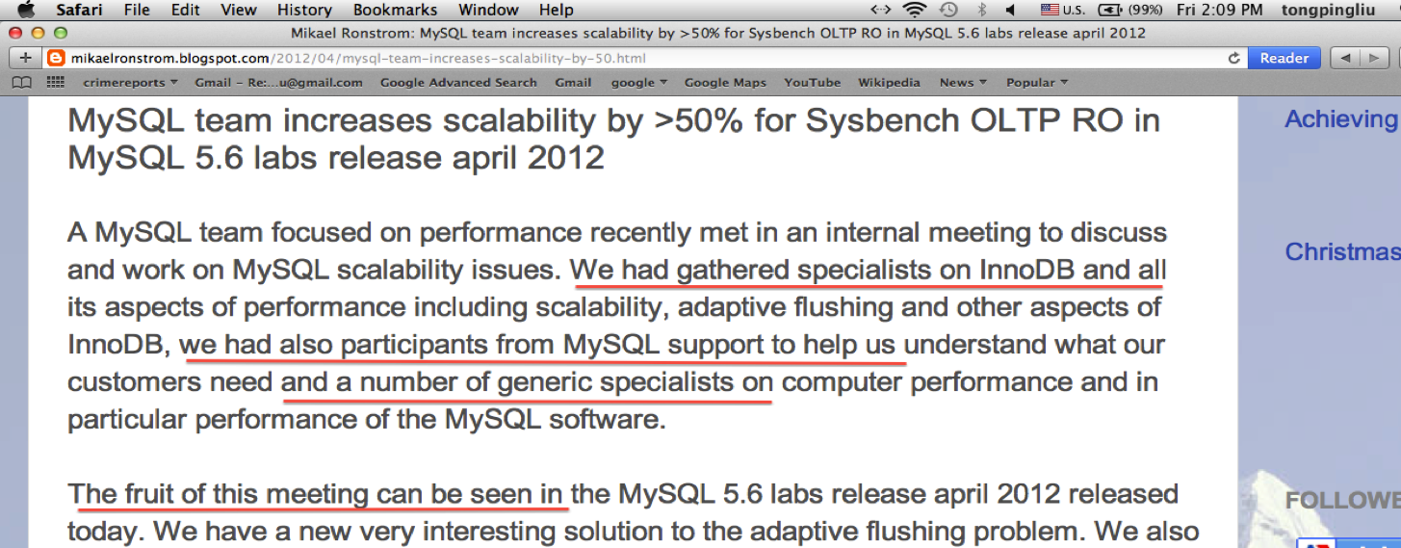
False Sharing is Hard to Diagnose
Multiple experts worked together to
diagnose MySQL scalability issue (1.5M LOC)

Slide 18


Predator: Predictive
False Sharing Detection
PPoPP 2014
Tongping Liu, Chen Tian, Ziang Hu, Emery Berger
Notes:
We have developed a tool to prey every possible false sharing problems in parallel applications, even those false sharing problems that do not occur at all.
.

Slide 19
Interested by Many Companies
“Here IBM has this power platform with different settings from X86. I'm thinking about techniques that can detect false sharing on Power, and your solution is quite relevant on this aspect.”
IBM, Intel, Huawei, SAS, Mathworks
Notes:
The serials of this work have got a lot of attentions from industrial giants, like IBM, Intel, Huawei, SAS, and MathsWork.
Here, it is quote from one of IBM researchers. Huawei and SAS are planning to use this technique to detect false sharing problems inside their products.

Slide 20
Related Work
S.M.Gunther et.al. WBIA 2009.
C.Liu. Master thesis 2009.
Q.Zhao et.al. MIT. VEE2011.
Reports false sharing counters on physical addresses.(120X slower)
Reports false sharing miss ratio. ( > 100X slower)
Reports cache miss ratio and cache invalidation ratio. (6X slower)
False positives
Cannot pinpoint the exact
cause of false sharing
Notes:
Here are some related work in the field. Basically, they relies on different instrumentation mechanism.
They can not pinpoint precisely where the problem is. The first two work introduce significant performance overhead.
The first two work introduced very large performance overhead.
PREDATOR has similar performance overhead with the third one.

Slide 21

Too many false positives
Intel Performance Tuning Utility
Notes:
Now let’s take a look at a commercial tool: PTU (performance tuning utility) from intel.
PTU can not pinpoint the objects with false sharing problems. They can only point out functions at most.
Also, they are reporting too many false positives caused by true sharing, heap object re-usage and non-interleaved false sharing.

Slide 22
Existing Tools vs. Predator
False positives
No false positives
Cannot pinpoint
where are problems
Precisely pinpoint false
sharing problems
Only detect observed
false sharing
Predict potential false
sharing without occurrences
Notes:
Here is a comparison between existing tools and PREDATOR.
Existing tools report a lot of false positives, while PREDATOR does not have false positives and false negatives.
Predator can precisely pinpoint the exact cause of false sharing problems.
Predator also overcomes a shared shortcoming of all existing tools: they can only detected those manifested false sharing problems, which is good but not enough. By contrast, Predator can predict potential false sharing problems that may happen in a different execution.

Slide 23
False Sharing Causes Performance Problems
Core 1
Core 2
Interleaved accesses
Task 1
Task 2
Invalidate
Cache invalidations
Cache
Cache
Performance problems
Main Memory
Detect false sharing causing performance problems
Find cache lines with many cache invalidations
Notes:
Let’s review why false sharing causes performance problem.
Interleaved accesses cause cache invalidations,
While these cache invalidations cause performance problems.
In order to detect false sharing, we should find out those cache lines with many cache invalidations.

Slide 24
Find Cache Lines with Many Invalidations
Memory: Global, Heap
. . . . . . .
……
Track cache invalidations on each cache line
Notes:
To do that, we maintains a status word for each cache line in the memory.
Whenever we track a memory access from a thread, we update those information related cache invalidations.
In the end, we can report those objects involved in cache lines
with a big number of cache invalidations.

Slide 25
Track Invalidations Based on Memory Accesses
Two-entries-history-table
# of invalidations
0
0
0
Notes:
Using a line to mark time.
Location of

Slide 26
Track Invalidations Based on Memory Accesses
Two-entries-history-table
# of invalidations
3
0
1
0
0
2
T2
T2
T1
T2
T1
Time
r
w
r
w
w
r
w
T1
T2
Assumptions
  Each thread runs on a core with its private cache
  Infinite cache capacity
Scalable (based on tid)
Portable (software-only approach)
Notes:
We base on thread id to track cache invalidations

Slide 27
Predator Components
Instruments every memory read/write access
Compiler Instrumentation
Collects memory accesses and reports false sharing
Runtime System
Notes:
Predator relies the compiler instrumentation to track memory read/write accesses. When there is access, we notify runtime system using a library call.
Also, predator has a runtime system to collect memory accesses, update corresponding cache invalidations, and report
False sharing precisely.
In order to do that, predator intercepts every memory allocation and deallocation, and saves those callsites of memory allocation.

Slide 28
Detect Problems Correctly & Precisely
Task 1
Task 3
False
Sharing
Correctly:
  No false alarms
Task 2
Task 4
Task 1
Track memory accesses on each word
True
Sharing
Task 2
Precisely
  Global variables: names
  Heap objects: calling context of memory allocation
Notes:
SHERIFF-DETECT will not report false positives.
As we know, both false sharing and true sharing can cause cache invalidations.
How we can differentiate these two different situation?
The idea is simple. If we are given the graph of memory access, then we can answer this question immediately.

Slide 29
Why do we need prediction?
Notes:
PREDATOR is able to detect all false sharing problems correctly and precisely.
I have to admit that prediction method is very straightforward, although there is no previous works that can do this previously.
Why we need prediction?

Slide 30


Necessity of False Sharing Prediction
Thread 1
Thread 2
Cache line 1
Cache line 2
False Sharing
Cache line 1
Cache line 2
False Sharing
Cache line 1
Notes:
Predator overcomes a shared shortcoming of all existing tools. They can only detect those observed false sharing problem.
Here, I am using an abstraction to show this. Here, two boxes with different colors are accessed by two different threads.
In the first case, when this object is aligned with the cache line, there is no false sharing problem because THREAD 1 and THREAD 2 are accessing different cache lines. However, when they are not aligned, there is a false sharing problem. In the second case,
False sharing can happen in the second cache line.
Also, when we double the cache line size, then there is a false sharing problem.
All existing tools cannot detect false sharing problems if the actual alignment is happening to be the first case.
PREDATOR can predict that false sharing problem might happen in the second and the third case, when the actual execution is the first case.
The point is: object alignment changes the occurrences of false sharing.
CHANGE THE LIGHT GREEN.

Slide 31
False Sharing is Sensitive to Dynamic Properties
Change of memory layout
32-bit platform ← → 64-bit platform
Different memory allocator
Different compiler or optimization
Different allocation order by changing the code
Change of cache line size
Notes:
Actually, a lot of properties may affect the manifest of false sharing problem.
When we are compiling the software to different target platforms, when hardware has different cache line size, or when we are using a different memory allocator or different compiler with didfferent optimization level, the occurrence of false sharing can change.
An extreme case is that you add a printf, then suddenly the performance are greatly improved or degraded. That is very hard to reason about this.
Predator discovers all hiding false sharing problems in a single execution.

Slide 32
False Sharing is Sensitive to Memory Layout
Predator avoids the predicament of testing
Cache line size = 64 bytes
Memory
Offset = 0
Offset = 8
Colors represent threads
Notes:
We run this application on a real machine with 8 cores.
Now we can see that different object alignment brings different performance result.
When the offset is 0 or 56 bytes, there is no false sharing at all. When the offset is 24 bytes, the performance is the worst because of serious false sharing problem inside.
Predator, different with previous tools, can detect false sharing problem inside, even when false sharing does not occur.
This means, we can prevent the predicament of testing: problems happens differently in the testing phase and deployment.

Slide 33
Prediction Based on Virtual Cache Lines
Thread 1
Thread 2
Real case
Cache line 1
Cache line 2
False Sharing
Prediction 1
Virtual cache line 1
Virtual cache line 2
False Sharing
Prediction 2
Virtual cache line 1
Notes:
Predator detects and predicts false sharing in a single execution.
Given the actual case, how can we predict other two cases?
The starting address of heap object is determined in an execution.
Thus, we can only change the cache line. We introduce the virtual line here, where the starting address may not aligned with 64 bytes.
Given this actual case, we can change the starting address or size of a virtual line.
Changing the starting address == changing the memory layout.
Then we can detect whether cache invalidations occur on the virtual line.
That is the basic idea.
Because we also report a potential false sharing problem based on potential cache invalidations, there is no false positive at all.
REFINE SLIDES

Slide 34
Determine Virtual Line by Memory Accesses
X
d
Y
Non-tracked virtual lines
Tracked virtual line
(sz-d)/2
(sz-d)/2
d < the cache line size - sz
(X, Y) from different threads && one of them is write
Notes:
Give X and Y, there are multiple virtual lines that may cover these two words. We only track one of them.
We choose the virtual line that leaves the same offset before X and after Y. If we observe a big number of cache invalidations on this virtual cache line,
Then we actually declaim that a potential false sharing problem may seriously affect the performance.

Slide 35
Detection Results on Phoenix and PARSEC
Benchmarks | Performance Improvements (after fixes)
Histogram | 46%
Linear_regression | 1207%
Streamcluster-1 | 4.77%
Streamcluster-2 | 7.52%
Need prediction to detect
false sharing of Linear_regression
Notes:
Now let’s take a look at the results of Predator.

Slide 36
Detection Results on Real Applications
MySQL
  Problem: different threads update the shared bitmap simultaneously
  Performance improves 180% after fixes
Boost library:
  Problem: “there will be 16 spinlocks per cache line”
  Performance improves about 100%

Slide 37
Caveats of Fixes
Unavailable source code
  Infeasible to fix
No performance improvement
Quote from the MIT’s VEE2011 paper:
“We added padding between the data but the runtime actually increased because of lost cache locality.”

Slide 38

Sheriff: Precise Detection
& Automatic Mitigation of False Sharing
Tongping Liu, Emery Berger
Notes:
Sheriff is published in OOPSLA 2011

Slide 39
Key Observation
Core 1
Core 2
Thread 1
Thread 2
Invalidate
Cache
Cache
Main Memory
Sharing cache lines causes false sharing problems
Notes:
Let’s review why false sharing causes performance problem. We already know that interleaved writes cause cache invalidations.

Slide 40
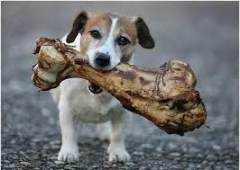
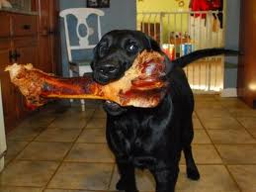
Key Idea: Make Different Threads
Access Different Cache Lines
Thread 1
Thread 2

Slide 41
Prevent False Sharing by Isolation
Core 1
Core 2
“Thread” 1
“Thread” 2
Cache
Cache
“Thread” 1
Main Memory
“Thread” 2
Global State
Notes:
If we can somehow isolate executions of different “threads”, or we can make different threads loading the data from different physical pages, then we can also eliminate false sharing problems.

Slide 42
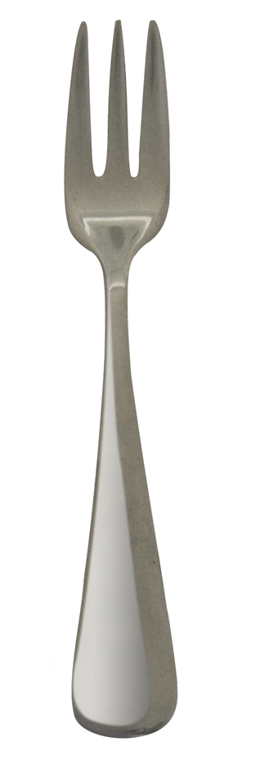
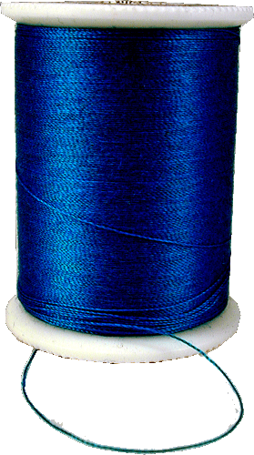
Processes-As-Threads
Threads
Processes
shared address space
disjoint address spaces
Notes:
In order to do this, we turns threads into processes.
Because different processes has their separate address spaces, then we can isolate the execution of different threads.
THREAD – FORK (THREADS)

Slide 43
Sheriff: Isolated Execution
Pthreads
Sheriff
1: Lock();
2: XX;
3: Unlock();
4: YY;
5: Lock();
Lock_Process_Based();
Begin_isolated_execution
XX; //isolated execution
Commit_local_changes
Unlock_Process_Based();
Begin_isolated_execution
YY; //isolated execution
Commit_local_changes
Lock_Process_Based();
Notes:
We divide the execution into different epochs, at boundaries of synchronization points.
Synchronizations are replaced by process-based synchronizations.
Inside each epoch, sheriff runs different threads in a isolated mode.
Those local changes are made available for other threads at synchronization boundaries.
In order to find out local changes, we are using the “snapshot and diffing” mechanism.

Slide 44

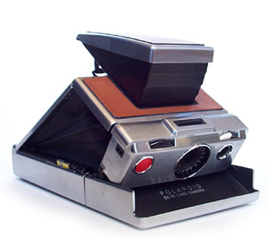

Snapshot and Diffing: Find Local Changes
Snapshot
Working
Notes:
In the beginning of each epoch, SHERIFF takes a snapshot for the state of all memory.
Inside each epoch, when there is a write, SHERIFF creates a private working copy for different threads.
Memory reads are still from the shared mapping.
After the first write, all accesses on this page only happens at this private working copy.
In the end, SHERIFF compares the difference between the working pages and snapshots in order to find out local changes made by a thread.
We use byte-by-byte compare to find out all changes happened in a thread.

Slide 45
Global State
“Thread”
Local State
Begin
Time
Notes:
Now let’s see this in another way.
Initially, different threads are mapped to the global state, backed up a file.
The global state is shared by different threads.

Slide 46
Detailed Memory Layout
Thread Local State
Global State
Global
Heap
Global
Heap
Local (private) ←→ global (shared): connect via file
Applications only access thread local state (read-only initially, writable, read-only)

Slide 47
Global State
“Thread”
Local State
Working
Snapshot
Begin
Execution
Time
Notes:
Insinde a epoch,
if a thread is trying to modify something, SHERIFF intercept this operation using memory protection mechanism.
Inside signal handler, SHERIFF creates the snapshot page and the working page simultaneously.
From now on, this thread can work on its private version for this page.

Slide 48
Global State
Commit
“Thread”
Local State
Working
Diff
Snapshot
Snapshot
Begin
Execution
End
Time
Notes:
In the end of an epoch,
SHERIFF compares the difference between the working pages and their snapshots in order to find local changes.
Then it commits these local changes to the global state so that other threads can see those changes.
Actually, this step achieves the shared memory semantics.
After the commit, this thread deletes the working pages and snapshots, and recovers the mapping.
Thus, it can see changes made by other threads.

Slide 49
13%
Sheriff automatically boosts the
performance of applications with false sharing
Notes:
Now that is take a look at the results of tolerating false sharing problems.
SHERIFF greatly reduce the performance overhead for those applications with false sharing problems inside.
This case, we provide an automatic mechanism to automatically prevent false sharing problems for applications.
If we already detect false sharing problems, then we almost do not need to pay performance overhead.

Slide 50
A Complete Solution for Parallel
Applications with False Sharing
First tool to pinpoint false sharing correctly and precisely
  User can fix problems using padding or thread-local variables
First generalized system to eliminate false sharing
  Automatically boost performance without programmer intervention

Slide 51
Research Focus: Parallel Computing
Performance
Reliability
Sheriff: [Liu, OOPSLA’11]
Detecting and Tolerating False Sharing
Dthreads: [Liu, SOSP’11]
Efficient Deterministic Multithreading
Predator: [Liu, PPOPP’14]
Predictive False Sharing Detection
DoubleTake: [Liu, Submission]
Evidence-Triggered Dynamic Analysis
Notes:
Today, I am going to focus on one of performance problems, false sharing. Before I dig into that, I want to discuss about the background: How to do parallel programming, what is false sharing and why it is important.

Slide 52

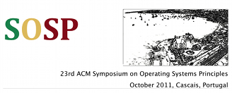
Dthreads:
Efficient Deterministic Multithreading
Tongping Liu, Charlie Curtsinger, Emery Berger
Citation: 101, 4th of 28 papers in SOSP 2011
Notes:
First, I am going to describe an approach to tackle the reliability problem of multithreading programs - DTHREADS. DTHREADS appeared in SOSP 2011. This work is one of influential papers in that year’s SOSP. Also, several deterministic papers are built on our work.

Slide 53



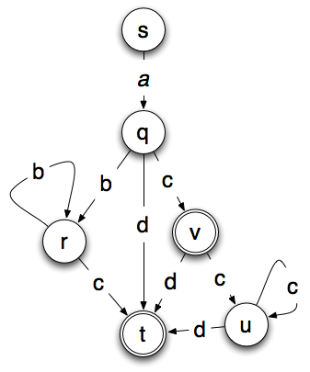
Dthreads Enables…
Deterministic executions
Replay w/o logging
Replicate applications on different machines
Dthreads is the new basis
of Deterministic Multithreading
Notes:
Because of that, DTHREADs actually enables race-free executions, replaying without logging and replicated states over different machines. This can be used to achieve fault tolerance.

Slide 54

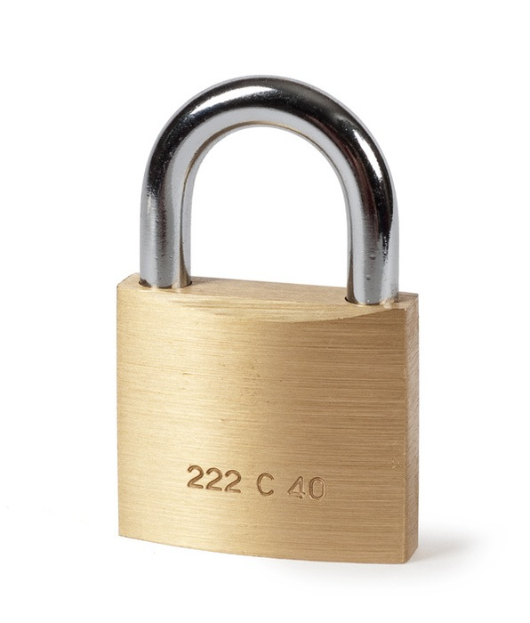
Dthreads Overview
Parallel
Serial
Parallel
mutex_lock
“Thread” 1
cond_wait
“Thread” 2
pthread_create
“Thread” 3
Isolated Memory
Access
Isolated Memory
Access
Deterministic memory commits & syncs

Slide 55

DoubleTake:
Evidence-Triggered Dynamic Analysis
Tongping Liu, Charlie Curtsinger, Emery Berger
Notes:
DoubleTake is a novel dynamic analysis framework: you only pay performance overhead when there are memory errors.

Slide 56
Heartbleed OpenSSL Problem:
“This vulnerability is due to a missing bounds check in the handling of the Transport Layer Security (TLS) heartbeat extension”

Slide 57


Detecting Buffer Overflows
Canaries in freed space detect corruption
Red =
possible
bad
object
known random value
dead canary = corruption
Blue =
not
bad
object
8
10
2
9
3
4
5
1
7
# = object id (allocation time)
Precise detection:
instrument every memory read/write access
Imposing 33% overhead for common path!

Slide 58
Time
Irrevocable
system calls
Snapshot
Snapshot
Normal execution
Check errors
Rollback
Error detected
Instrumented re-execution
Report errors
Notes:
The basic idea of DoubleTake is to check memory errors at irrevocable system calls and uses the program re-execution to pinpoint exact location of memory errors.
Previous tools intercepts all memory accesses in order to capture memory errors on-site.
DoubleTakes imposes very little performance overhead for the common case, programs without the memory errors.

Slide 59
DoubleTake: Efficient
Memory Error Detection
BO: Buffer Overflow
ML: Memory Leak
DP: Dangling Pointers (use-after-free)
BO+ML: only introduces 3% overhead
It is ready for the real deployment!
Notes:
The take-home message is: DoubleTake only introduces 3% performance overhead for detecting buffer overflow and memory leak. It is the fastest tool up to date. AddressSanitizer, introduces over 30% performance overhead to detecting buffer overflow and dangling pointers.
It is very unlikely that there are some tools to beat our performance in the future.
We completely solve the problem of memory error detection after 20 years research in this field.
Also, because of its extremely-low overhead, DoubleTake can be used in another scenario too.
I am planning to use this framework to detect concurrency errors.

Slide 60
Future Work (short-term)
Complete false sharing solutions
  Other languages: Java
  Other software stacks: kernel, hypervisor
  Improve performance using hardware-based approaches
  Automatically fixes
Other performance issues
  lock granularity, thread model, scheduling
Detect and prevent concurrency errors
  Deadlocks, races, etc.

Slide 61
Future Work (long-term)
Emerging hardware
  NUMA: unpredictable performance, data sharing, efficient memory allocator
  Heterogeneous systems (Start at NEC intern)
  Non-volatile memory
Cloud computing and BIG DATA systems
  Quality of service (Related to Redline)
  Performance of BIG DATA systems (Started at IBM intern)
  Improve reliability (In study)
  Energy efficiency (In study)

Slide 62



Conclusion and Future Work
Performance
Operating Systems
Runtime Systems
Compiler
Reliability
[Grace, OOPSLA’09]
[Redline,
OSDI’08]
[Dthreads, SOSP’11]
[Predator,
PPOPP’14]
[Sheriff, OOPSLA’11]
[DoubleTake]
Want real impact, work with me!
Main Contributions:
  Detecting and tolerating false sharing
  Efficiently detecting memory errors
  New basis for deterministic multithreading
Future
Work
False sharing
Concurrency errors
Other performance problems
Emerging hardware
Cloud computing
BIG DATA
Time

Slide 64
Performance Overhead of DoubleTake
BO: Buffer Overflow
ML: Memory Leak
DP: Dangling Pointers (use-after-free)
BO+ML: only introduces 3% overhead
It is ready for the real deployment.
Notes:
The take-home message is: DoubleTake only introduces 3% performance overhead for detecting buffer overflow and memory leak. It is the fastest tool up to date. AddressSanitizer, introduces over 30% performance overhead to detecting buffer overflow and dangling pointers.
It is very unlikely that there are some tools to beat our performance in the future.
We completely solve the problem of memory error detection after 20 years research in this field.
Also, because of its extremely-low overhead, DoubleTake can be used in another scenario too.
I am planning to use this framework to detect concurrency errors.

Slide 65
Detailed Prediction Algorithm
1. Find suspected cache lines
Notes:
The first step is find a cache line which has a large number of writes. Cache lines without a large number of write accesses will never be a suspect of potential false sharing problem.

Slide 66
Detailed Prediction Algorithm
1. Find suspected cache lines
2. Track detailed memory accesses
Notes:
Then we collect detailed accesses in this cache line and its adjacent cache line. Potential false sharing can happen in two adjacent cache lines: forward and backward.

Slide 67
Detailed Prediction Algorithm
1. Find suspected cache lines
2. Track detailed memory accesses
X
Y
3. Predict based on hot accesses
d
d < sz && (X, Y) from different threads, potential false sharing
Notes:
We evaluate the potential false sharing problem based on hot accesses, which has the number of accesses larger than the average. If we can find two accesses X and Y, where the distance d between these two is less than the cache line size. Also, X and Y are accessed by different threads, one of them is a write access, then these two accesses may cause a potential false sharing problem.

Slide 68
4: Tracking Cache
Invalidations on the Virtual Line
X
d
Y
Non-tracked virtual lines
Tracked virtual line
(sz-d)/2
(sz-d)/2
Notes:
Give X and Y, there are multiple virtual lines that may cover these two words. We only track one of them.
We choose the virtual line that leaves the same offset before X and after Y. If we observe a big number of cache invalidations on this virtual cache line,
Then we actually declaim that a potential false sharing problem may seriously affect the performance.

