Slide 1
The Design and Implementation of the Warp Transactional Filesystem
Robert Escriva, Emin Gün Sirer
Computer Science Department, Cornell University
Presented By
Alex Garcia

Slide 2
Common Trends in Distributed Filesystems
Compromises or limitations are often introduced in search of higher performance:
Weak guarantees: (Google File System)
Eventual consistency
Narrow interfaces: (Hadoop Distributed File System)
Writes must be sequential
Concurrent writes prohibited
Unscalable design: (FLAT Data Center Storage)
Full-bisection bandwidth
Large “master” server

Slide 3
Warp Transactional Filesystem (WTF)
WTF represents a new design point in the space of distributed ﬁlesystems
WTF employs the ﬁle-slicing abstraction to provide applications with strong guarantees and zero-copy ﬁlesystem interfaces
Strong guarantees: transactionally access and modify the ﬁlesystem
Expanded interface: traditional POSIX APIs and new zero-copy APIs
Scalable Design: avoids centralized master or expensive network bottlenecks

Slide 4
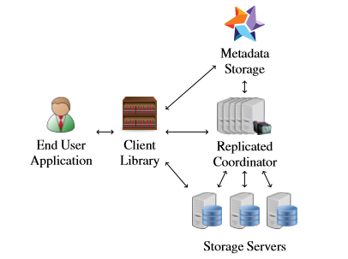
WTF Architecture
Client Library – Contains the majority of the functionality of the system where it combines the Metadata and data into a coherent file system and provides transactional guarantees to the end user.
Metadata Storage – Provides transactional operations over metadata using HyperDex Warp. (No-SQL, Key-Value Store, Fault Tolerant and Strong Consistency, ACID Transactions)
Storage Servers – Hold the file system data and handle most of the I/O
Replicated Coordinator – Serves as a rendezvous point for all the components of the system and maintains a list of the storage servers.

Slide 5
Zero-Copy File Slicing APIs
Traditional APIs transfer bytes back and forth through the ﬁlesystem interface
File-slicing APIs deal in references to data already in the ﬁlesystem (No copying of file content needed)
Yank: Obtain references to data in the ﬁlesystem Analogous to read
Paste: Write referenced data back to the ﬁlesystem Analogous to write append
Append: referenced data to the end of a ﬁle Optimized for concurrency
Concat: Merge one or more ﬁles to create a new ﬁle Does not read or write data from the input ﬁles

Slide 6
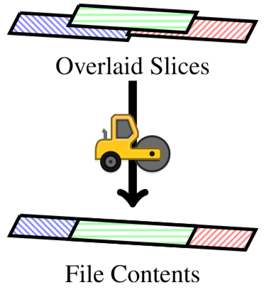
File Slicing Abstraction
The central abstraction is a slice: an immutable, byte-addressable, arbitrarily sized sequence of bytes
A ﬁle is represented by a sequence of slices that, when overlaid, comprise the ﬁle’s contents.
Metadata is a sequence of slices.

Slide 7
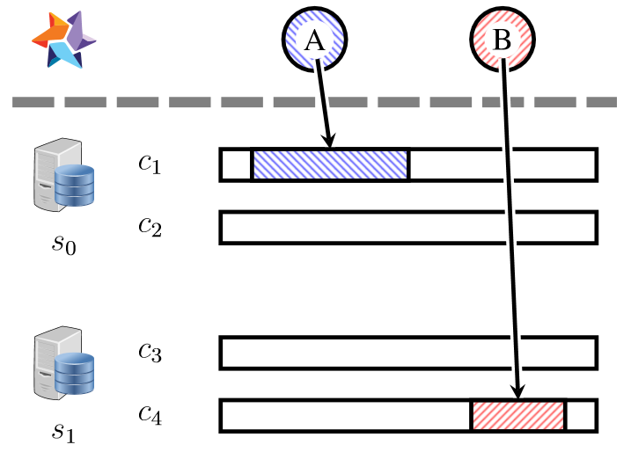
Slices and Slice Pointers
Slices pointers to slices reside in HyperDex.
Slice pointers directly indicate a slice’s location in the system
Slices reside on storage servers
Slice Pointer Tuple:
Unique Identifier for the storage server holding the slice
Local Filename containing the slice on that storage server
File offset of the slice within the file
Length of the slice
Integer offset where the slice is to be overlaid.

Slide 8
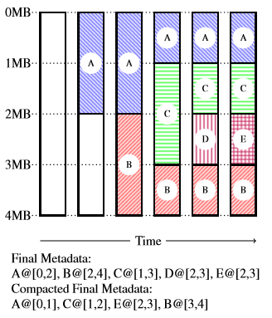
Slices
A Writer creates file slices on the storage servers.
Overalys them at the appropriate positions within the file by appending their slice pointers to the metadata list.
Readers retrieve the metadata list, compact it and determines which slice must be retrieved from the storage servers.
The overlap, the latest takes precedence.

Slide 9
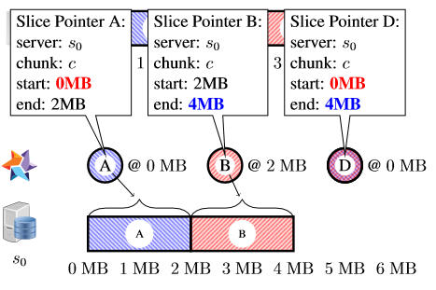
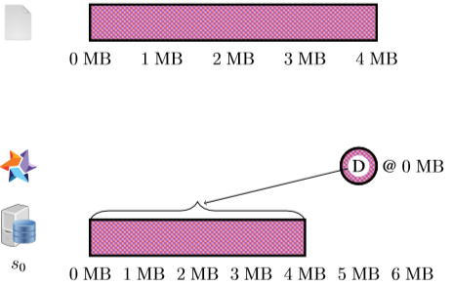
Locality-Aware Slice Placement
Client library place slices contiguously to improve reads and metadata compaction.
Consistent hashing across storage servers in the system on a per-ﬁle basis increases probability that sequentially written slices are adjacent
The metadata for adjacent slices may be represented in a more compact form

Slide 10
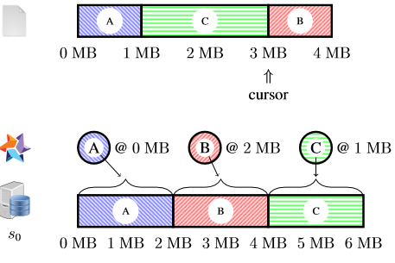
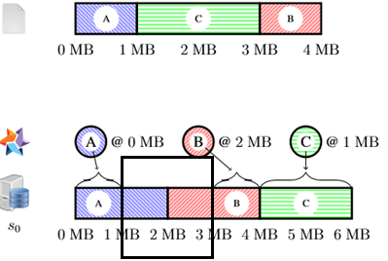
Metadata Compaction and Defragmentation
Compaction reduces the size of the metadata list by removing references to unused/overwritten portions of slices.
Fragmented data is rewritten within the region into a single slice and replaces the metadata with a single pointer to the slice

Slide 11
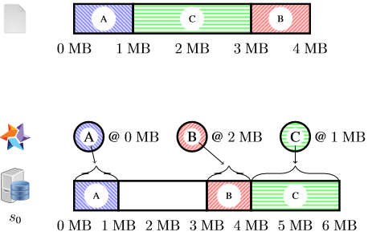
Garbage Collection
Garbage collection cleans up the slices no longer referenced by any slice pointer from the results of metadata compaction.
WTF periodically scans the ﬁlesystem and constructs a list of in-use slice pointers for each storage server.
Storage servers use the scan, along with their local data, to determine which data is garbage.

Slide 12
Fault Tolerance
WTF uses replication to add fault tolerance to the system.
Writers create multiple replicas slices on distinct servers and append their pointers atomically as one list entry.
HyperDex uses value-dependent chaining to coordinate between the replicas and manage recovery from failures.

Slide 13
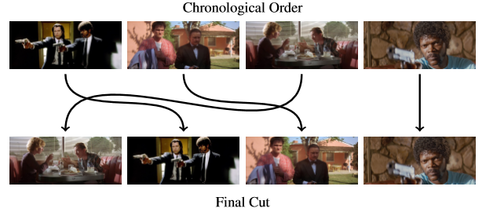
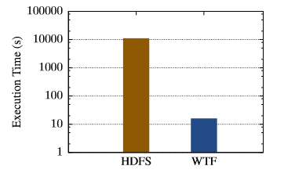
Applications & Evaluation
MapReduce Sort: concat enables an efﬁcient bucket-based merge sort
Work Queue: append units of work are appended to the ﬁle; all contention happens in the metadata layer
Video editor: yank and paste enable the editor to reorder scenes without rewriting the movie
Fuse Bindings: transactional behavior exposed to the user for easy data exploration
WTF can rewrite 377 GB of raw movie footage in 16 s using ﬁle slicing—effectively 23 GB/s, as opposed to rewriting the footage using traditional APIs, which requires approximately three hours

Slide 14
Related Works
Distributed Filesystems
Farsite, AFS, xFS, Swift, Petal, Frangipani, NASD, Panasas
Data Center Filesystems
CalvinFS, GFS, HDFS, Salus, Flat Datacenter Storage, Blizzard, f4, Pelican
Transactional Filesystems
QuickSilver, Transactional LFS, Valor, PerDis FS, KBDBFS, Inversion, Amino

Slide 15
QUESTIONS ?

Slide 16
THANK YOU!

