Slide 1
BUZZ: TESTING CONTEXT-DEPENDENT POLICIES IN STATEFUL NETWORKS
-INTURI SAI HARSHINI

Slide 2
CONTENTS
INTRODUCTION
WHY IS IT CHALLENGING?
WORKFLOW OF BUZZ
IMPLEMENTATION
EVALUATION

Slide 3
INTRODUCTION
Checking whether a network correctly implements intended policies is challenging.
Can X talk to Y?
Existing approaches face fundamental expressiveness and scalability challenge.
Current abstractions cannot capture stateful behaviors.
Trying to reason about stateful behaviors results in state space exposion.

Slide 4


Why is it challenging?
Does the network do what I want it to do?
???
What I want the network to do
Network
operator
Reality
What the network does
A
B
network

Slide 5
STATEFUL FIREWALLING
Incoming traffic is allowed depending on its context.
Even this simple policy cannot be captured.
It doesn’t capture the policy-relevant state of the firewall.
Unsolicited TCP
block
Traffic from internet
Stateful FW
allow
Solicited TCP

Slide 6
CONTEXT-DEPENDENT TRAFFIC MONITORING
Cache hits/misses for H2 should be monitored.
There could be subtle policy violations
  The proxy hides traffic true origin.
  The proxy’s response depends on the hidden policy-relevant state.
block
Xyz.com
Hit/miss
From h2
Web traffic from department
proxy
monitor
allow
otherwise

Slide 7
MULTI STAGE TRIGGERS
context
bad signature
found
state
suspicious
suspicious
Heavy IPS
Block
# bad conn. >= 10
otherwise
A→B
traffic
Light IPS
benign
Allow
Light IPS
How can we check context-dependent policies in stateful networks?
context-dependent
policies
Network
operator
Challenges:
Light IPS
Heavy IPS
Expressiveness: How to capture stateful behaviors?
R₁
R₃
Scalability: How to explore the state space?
R₂
R₄
A
B
stateful network

Slide 8

solution: BUZZ
BUZZ is an active testing framework to check context-dependent policies in stateful data planes
context-dependent
policies
Operator
BUZZ
test
traffic
Pass
Fail
FW
IPS
Proxy
stateful data plane

Slide 9

Challenge 1: Expressive data plane model
context-dependent
policies
Challenge 1:
Expressive models?
Operator
Data plane model
Challenge 2:
Scalable state space exploration
Test traffic
generation
Pass
Fail
test
traffic
FW
IPS
Proxy
stateful data plane

Slide 10
Challenge 1: Expressive data plane model
How to model the traffic unit?
How to model a network function (e.g., an IPS)?
?
?
?
NF₁
NF₂
NF₄
NF₃

Slide 11
suspicious?
or benign?
IP packets
BDU
BDU
IP packets
…
Light IPS
…
Located packet
(e.g., Pyretic, HSA)
Context-carrying
located packet
BUZZ Data Unit (BDU)
struct locPkt {
IPHder ipHdr;
NetworkPort port;
};
struct CntxlocPkt {
IPHder ipHdr;
NetworkPort port;
Context context;
};
struct BDU{
IPHeader ipHdr;
NetworkPort port;
Context context;
…
HTTPHdr httpHdr
…
};
✗
Expressive
✔
Expressive
✗
Scalable
✔
Expressive
✔
Scalable

Slide 12
Challenge 2: scalable TEST TRAFFIC GENERATION
context-dependent
policies
Challenge 1:
Expressive models?
Operator
Data plane model
Challenge 2:
Scalable state space exploration
Test traffic
generation
Pass
Fail
test
traffic
FW
IPS
Proxy
stateful data plane

Slide 13
Challenge 2: Exploring data plane state space
host 1
suspicious?
host 2
Light IPS
Conceptual view of test traffic generation: How to reach a colored state through a sequence of traffic units?
Challenge of scalability wrt traffic space and state space
  Strawman 1: All possible sequences of traffic units
  Strawman 2: Generate random traffic units (e.g., fuzzing)
  Strawman 3: Naïve use of exploration tools (e.g., model checking)

Slide 14
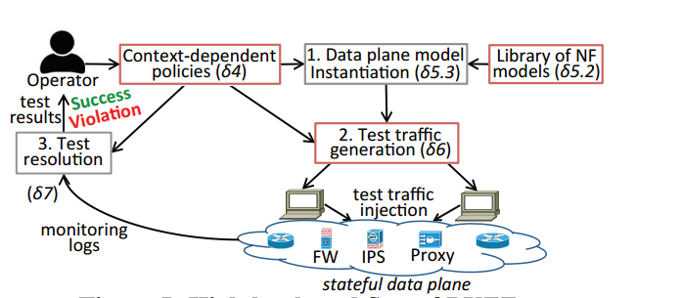
workflow

Slide 15
Evaluation: Scalability of BUZZ
Test generation takes < 2min for a network with 600 switches and 60 middleboxes

Slide 16
conclusion
Existing work has fundamental limitations in checking context-dependent policies in stateful data planes
Challenges:
  Expressive-yet-scalable model of stateful data planes
  Scalable state space exploration
Our solution is BUZZ:
  BUZZ Data Unit (BDU) as traffic unit model
  Ensemble of FSMs as a network function (NF) model
  Scalable exploration via domain-specific optimizations
BUZZ can help find bugs and is scalable

