Slide 1
Enabling Explicit Congestion Notification (ECN) in Multi-Queue Data Centers
(Wei Bai et. al., Hong Kong UST & Microsoft)

Slide 2
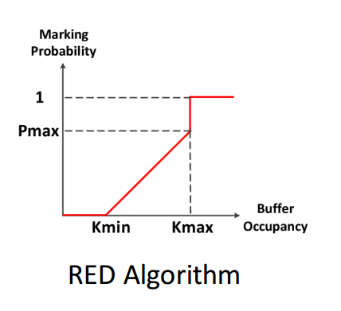
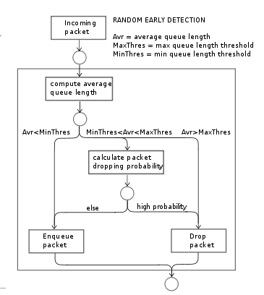
How is ECN/RED Implemented

Slide 3
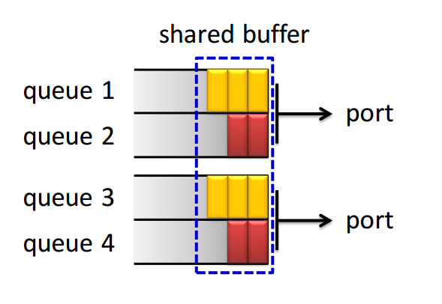
Why Multiple Queues?
What is the Challenge?
Leverage multiple queues to classify traffic
  Isolate traffic from different services/applications
Adopt RED to perform ECN marking
  Per-queue/port/service-pool

Slide 4
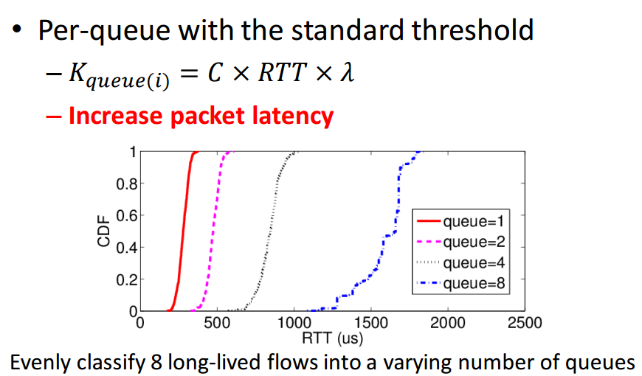
How to do ECN with multiple queues

Slide 5
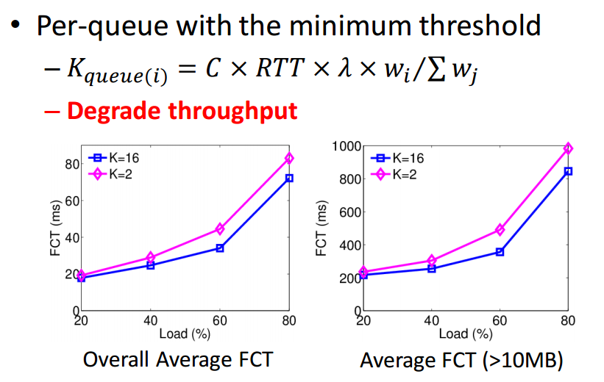
How to do ECN with multiple queues

Slide 6
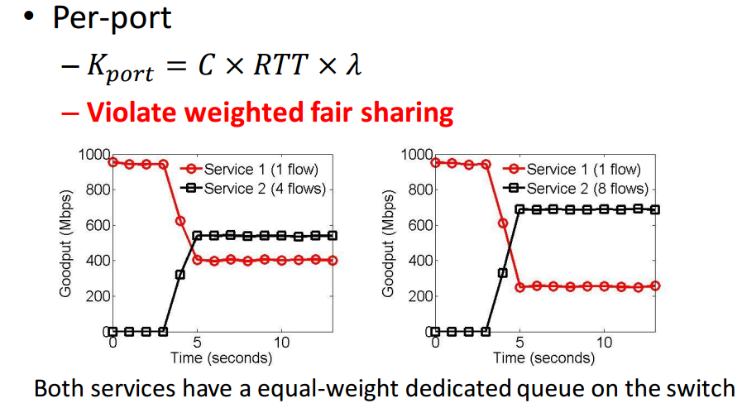
How to do ECN with multiple queues

Slide 7
Multi-Queue ECN
What To Do??

Slide 8
Multi-Queue ECN
Devise a system that:
  Delivers low latency
  Achieves high throughput
  Preserves weighted fair sharing
  Is compatible with legacy ECN/RED implementations on commodity switches
Apply ECN marking on a per queue basis
Can’t use static thresholds

Slide 9
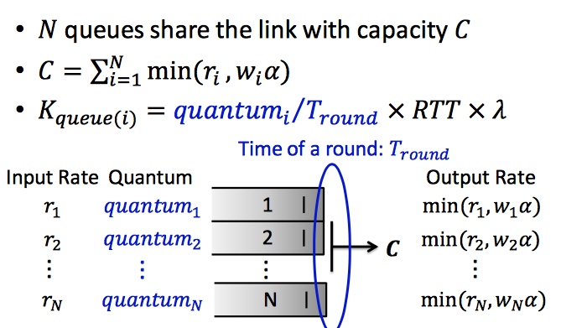
Multi-Queue ECN

