Slide 1
Minimizing Faulty Executions of Distributed Systems
Authors : Colin Scott, Aurojit Panda, Vjekoslav Brajkovic, George Necula, Arvind Krishnamurthy, Scott Shenker
Presented by :
Nahim Adnan
Graduate Student, Department of Computer Science,
University of Texas at San Antonio

Slide 2
Overview
Introduction
Distributed System Model
Algorithm
Assumptions
Experimental Results
Limitations
Conclusion

Slide 3
Introduction

Slide 4
Introduction
49% developer’s time spent on Debugging!!!
Focus on fixing underlying bug

Slide 5
Problem Statement
Identify a minimal causal sequence of events that triggered the bug
Smaller event traces are easier to understand

Slide 6
Computational Model
N distinct process; behaves deterministically
Network buffer
Timer
Configuration
Internal Events

Slide 7
Computational Model
External Events
New process starts
Forced restart
External message

Slide 8
Computational Model
A schedule τ is a sequence of events

Slide 9
Invariant Checking
An invariant is a predicate P over the state of all processes
A faulty execution is one that ends in an invariant violation

Slide 10
Formal Problem Statement
Given: Schedule τ that results in violation of P
Find: Locally minimal reproducing sequence τ‘ :
τ‘ violates P and |τ‘|≤ |τ|
τ‘ contains a subsequence of the external events of τ

Slide 11
Proposed Approach
Pick subsequence with delta debugging
Explore the execution of that subsequence, a schedule closely matched with the original, and then exploring nearby schedules
Found near minimal MCS, then minimize internal events

Slide 12
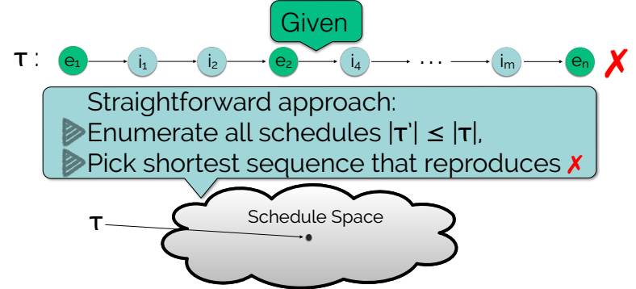
Minimization Approach

Slide 13
Observation 1:Commutative Schedules

Slide 14
Observation 2: Mask Off Extraneous External Events

Slide 15
Observation 2: Mask Off Extraneous External Events

Slide 16
Observation 2: Mask Off Extraneous External Events

Slide 17
Observation 2: Mask Off Extraneous External Events

Slide 18
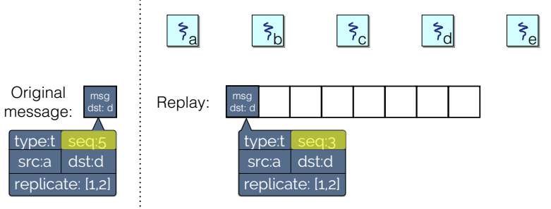
Observation 3: Mask Off Message Content
Match messages by user defined “finger-print”
Match messages by type only
Backtrack for multiple pending messages

Slide 19
Observation 4: Shrink External Message Content

Slide 20
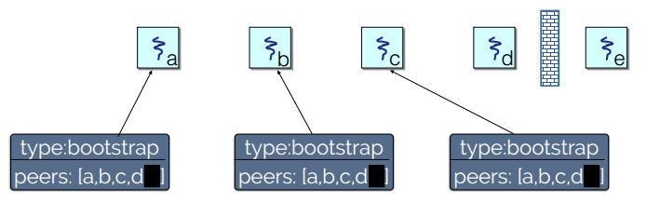
Observation 4: Shrink External Message Content

Slide 21
Observation 4: Shrink External Message Content

Slide 22
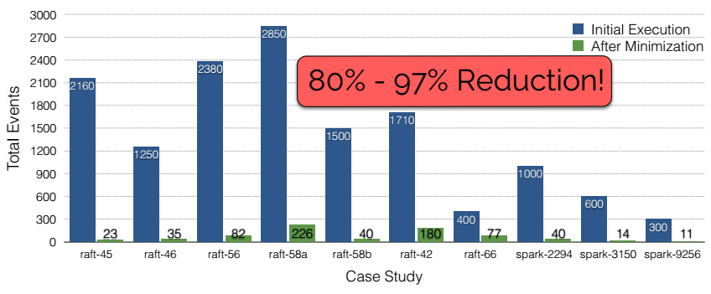
Experimental Results

Slide 23
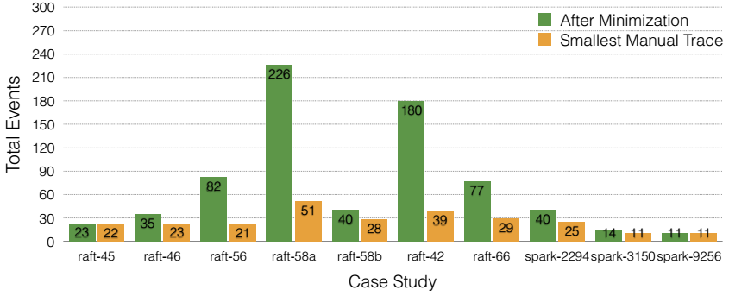
Experimental Results

Slide 24
Limitations
Focused on safety violations
Limited scalability
Shared memory & disk

Slide 25
Conclusions
New avenue of research
Great tool!!!
New enhancements

Slide 26
Thank you!!! Questions???

