Slide 1
Tardigrade: Leveraging Lightweight Virtual Machines to Easily and Efficiently Construct Fault-Tolerant Services OVERVIEW
-Gerson Rodriguez

Slide 2
Outline
Goals, current state
Problems
Solution
Results

Slide 3
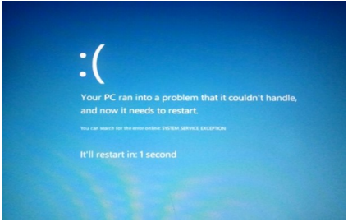
Fault Tolerant Services
Notes:
You have resources to access then a fault occurs. The goal is to create fault tolerant services. DS can aid, if one service fails another can pick up wher you left off.

Slide 4
Virtual Machine (Xen)
Dom 0
VM 1
VM N
Hypervisor
Hardware

Slide 5
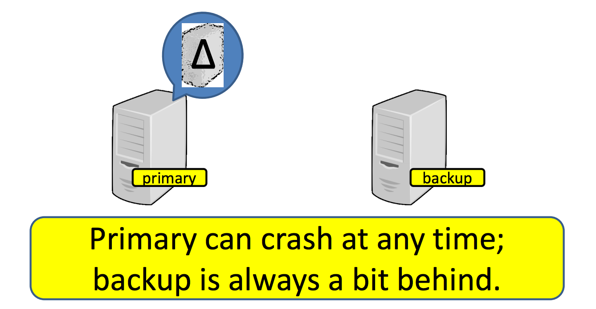
Virtual Machine Replication (VMR)
Notes:
A promising alternative is asynchronous virtual machine replication
REMUS introduces asynchronous virtual machine replicaiton (VMR)
In VMR the protected guest software is encapsulated in a VM and snapshots of its state are frequently sent to a backip host across the network
On the backup, the VM image is resident in memory and begins executions immediately upon primary failure
(One way to accomplish this is using a technqiue called vmr, the primary machine create backups at a given state and pushes the back up during a fault)

Slide 6
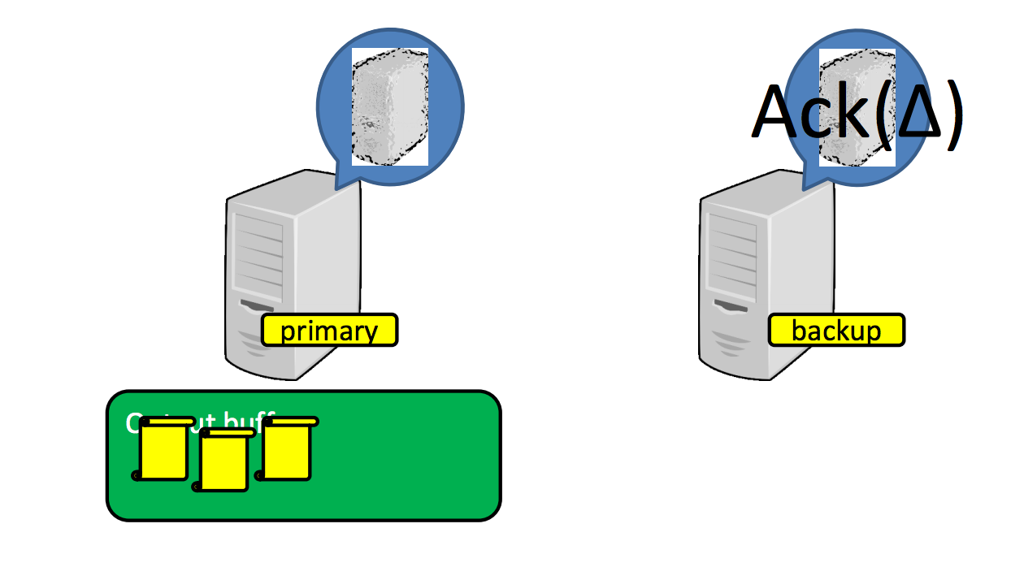
Asynchronous VMR Remus
Take a snapshot of current state of VM
  Perform a checkpoint after each epoch
  Forces output buffer
Notes:
Epoch is the interval of each snapshot
Backup is restored in a failure occurs

Slide 7
Problems
Latency, Having to save an entire VM and load during faults
Non important services can delay packets

Slide 8
Solution
Light weight virtual machine using Bascule / LibOS
Serve only a process and not an entire VM without modifications to binaries
Turn existing binaries into fault tolerant services

Slide 9
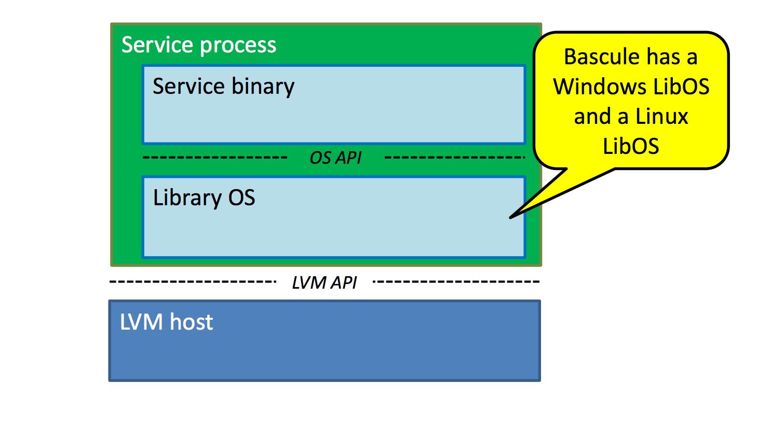
LibOS and Bascule
Bascule allows OS independent extensions to be attached at run time
Allows extentions from LibOS without modification (ie updates can be performed)
Notes:
Library operating system (LibOS) –
The idea of the library OS is that the personality of the OS on which an application depends runs in the address space of the application. A small, fixed set of abstractions connects the library OS to the host OS kernel, offering the promise of better system security and more rapid independent evolution of OS components.

Slide 10
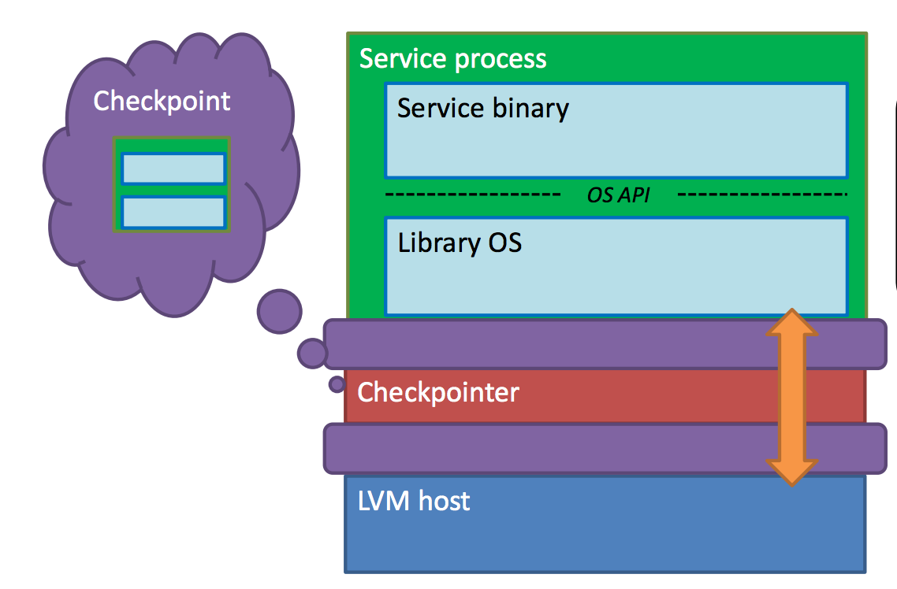
Checkpoint Stack

Slide 11
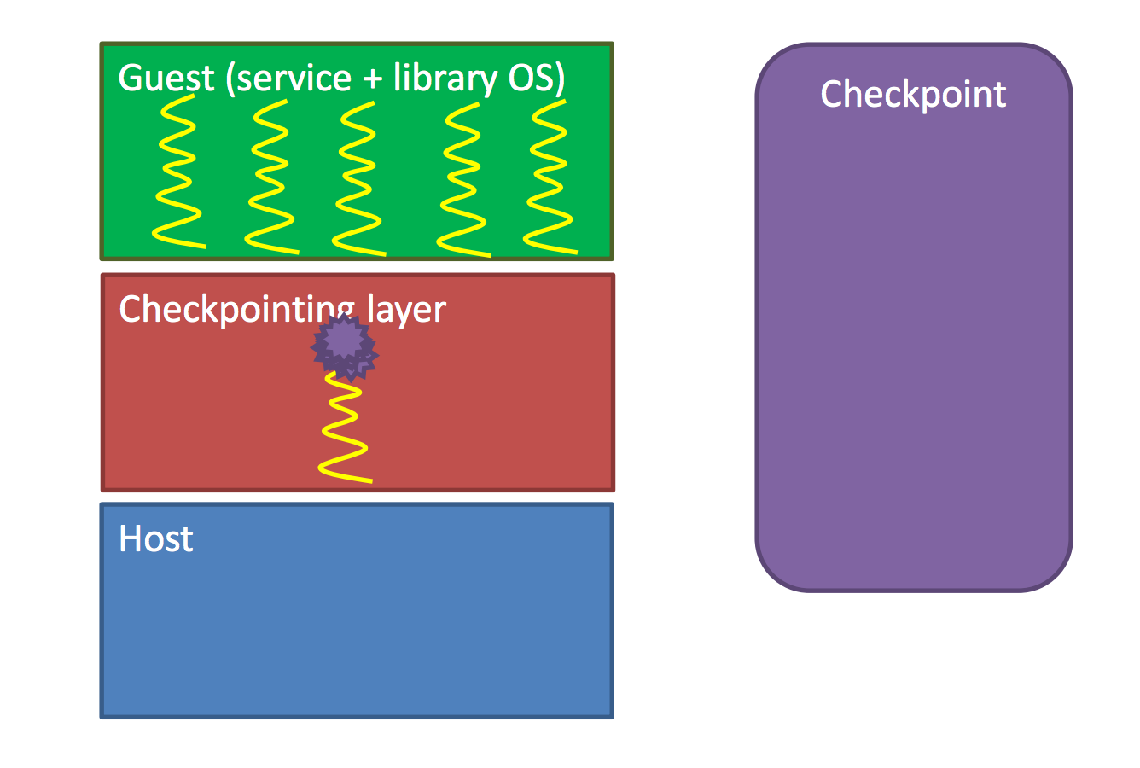
Checkpointer
API does not allow to suspend of
running threads to take a snapshot of current memory.
Solution is to raise an exception in each thread at a
given checkpoint and wait for all threads to reach these exceptions during system calls. Once reached a
checkpoint can be created.
Problem: What if the thread is waiting on IO before
reaching the exception?
Solution: Raise exceptions prior or after known system
calls that may take time to finish execution
Notes:
API does not allow to suspend of running threads to take a snapshop of current memory.
Solution is to raise an exception in each thread at a given checkpoint and wait for all threads to reach these exceptions during system calls. Once reached a checkpoint can be created.
Problem: What if the thread is waiting on IO before reaching the exception?
Solution: Raise exceptions prior or after known system calls that may take time to finish execution

Slide 12
Tardigrade Diagram
View (Primary)
View (Backup)
View (Spare)
Orchestrator (View Manager)
Clients

Slide 13
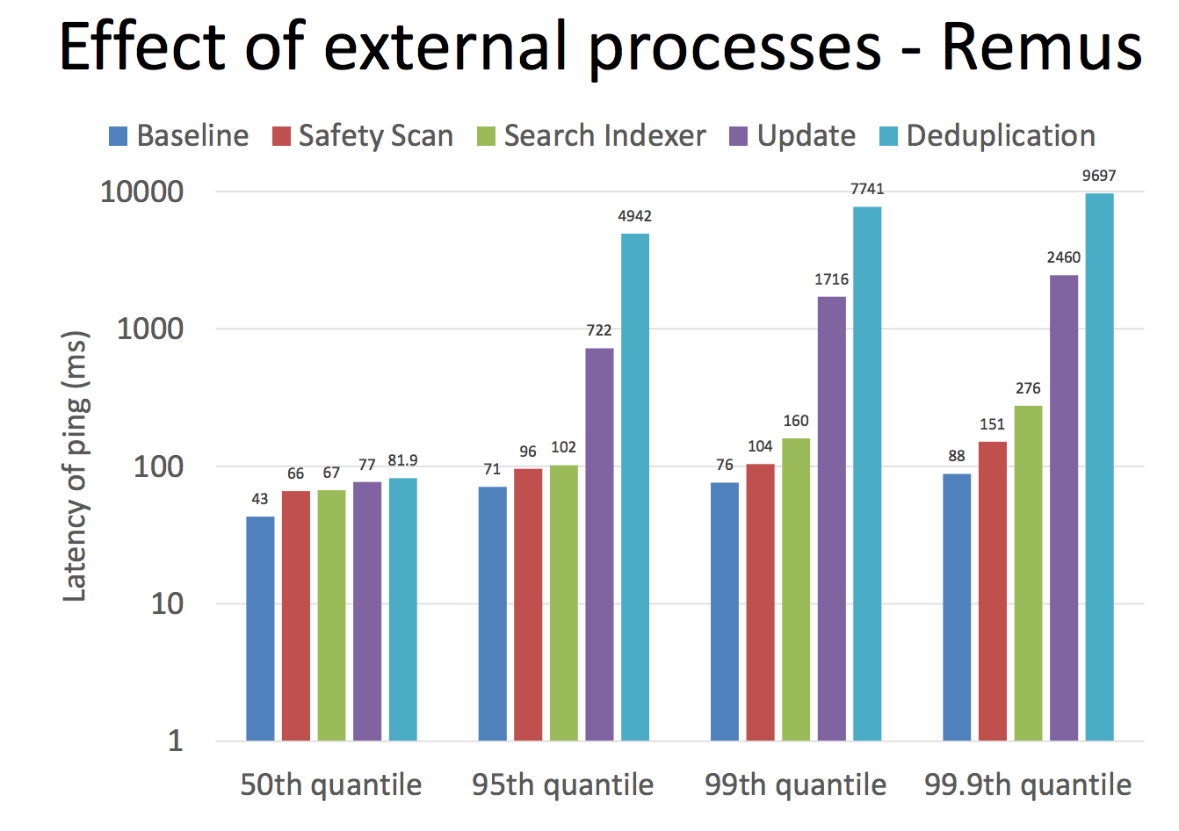
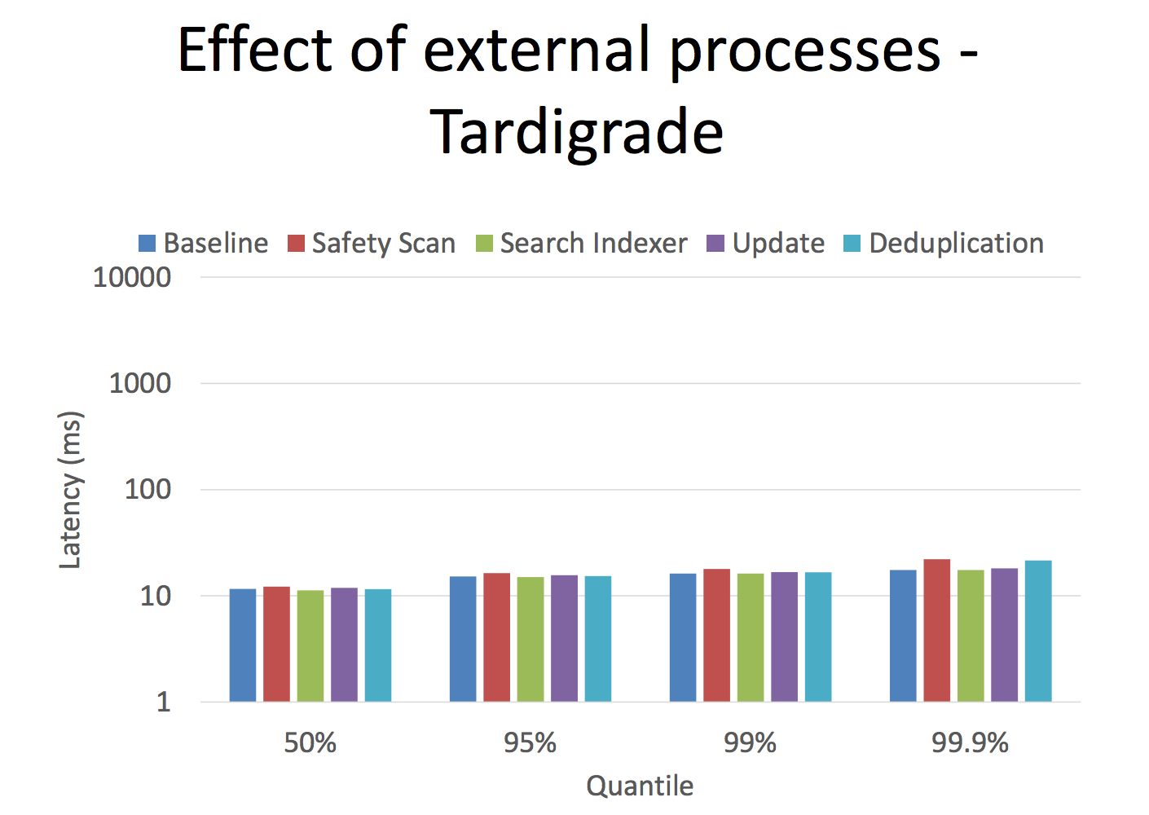

Slide 14
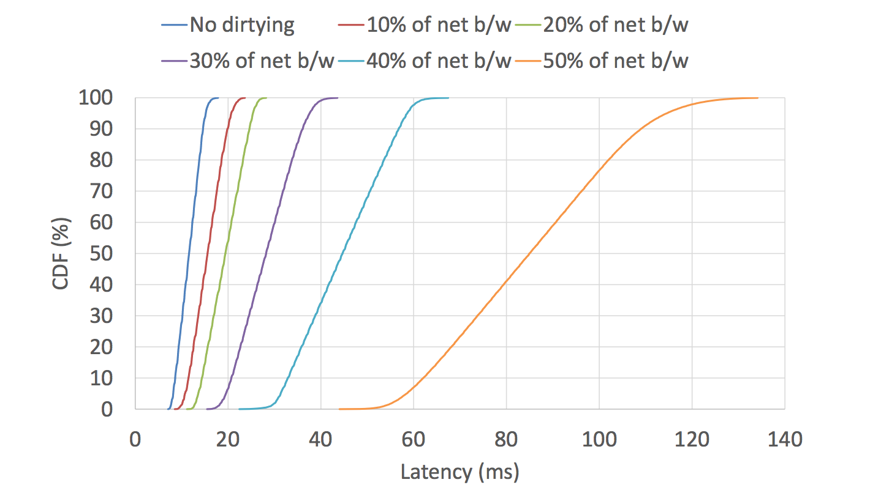
High Latency Impacts
Memory Dirtying
Nondeterministic events
Notes:
-Simple ping server
-Dirties memory at a given rate through a 100MB region one byte at a time, incrementing each byte modulo 256
-client sends 100,000 requests ever 2 ms

Slide 15
Questions?
Notes:
Depending on the type of process, LVMR can create fault tolerant services

