Slide 1
Kinetic: Verifiable Dynamic Network Control
Authors: Hyojoon Kim, Joshua Reich, Arpit Gupta
Muhammad Shahbaz, Nick Feamster, Russ Clark
Presented by: Huashan Chen
Notes:
Mention coauthors

Slide 2
Overview
Background and Research Motivation
Kinetic Design and Implementation
  Kinetic’s Domain Specific Language
  Express Changing Behavior Using FSM
  Verify Program’s Correctness With Model Checker (NuSMV)
Kinetic Evaluation
  Usability Evaluation
  Performance and Scalability
Discussion and Future Work

Slide 3



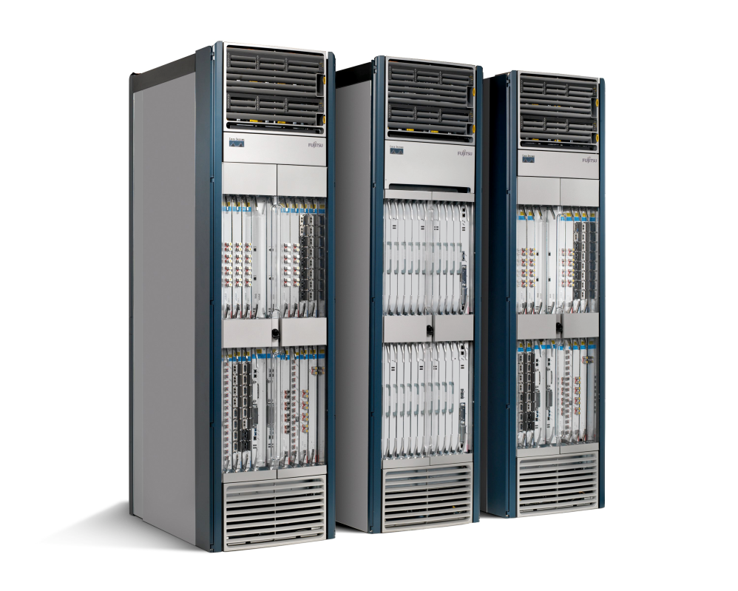










The Way That Networking Is Done
App
App
App
Operating
System
Specialized
Features
Specialized Packet Forwarding Hardware
App
App
App
Specialized
Control
Plane
Operating
System
App
App
App
Specialized Packet Forwarding Hardware
Operating
System
Specialized
Hardware
Specialized Packet Forwarding Hardware
App
App
App
Operating
System
Many complex functions baked into infrastructure
    OSPF, BGP, multicast, differentiated services,
    Traffic Engineering, NAT, firewalls, …
Specialized Packet Forwarding Hardware
Vertically integrated, Closed, Proprietary, Slow innovation

Slide 4
Network Configuration Is Hard!
High-level tasks are realized through low-level commands and scripts: hard to understand
Distributed conﬁguration: hard to manage
Variety of network-wide tasks cause changes to the network: lots of dynamics
No changes are checked for correctness: error- prone

Slide 5
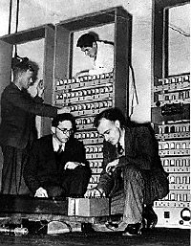
Limitations of Current Networks
No control plane abstraction for the whole network!
It’s like old times – when there was no OS…
Wilkes with the EDSAC, 1949
Notes:
Packages travel inside the network…
Switches pass them along…
But the decisions are made individually by the switches.. such as where to pass them
Nobody is dynamically controlling the network flow

Slide 6



Idea: An OS for Networks
Closed
App
App
App
Operating
System
Specialized Packet Forwarding Hardware
App
App
App
Operating
System
App
App
App
Specialized Packet Forwarding Hardware
Operating
System
App
App
App
Specialized Packet Forwarding Hardware
Operating
System
Specialized Packet Forwarding Hardware
App
App
App
Operating
System
Specialized Packet Forwarding Hardware

Slide 7
Idea: An OS for Networks
App
App
App
Network Operating System
App
App
App
Operating
System
Specialized Packet Forwarding Hardware
App
App
App
Operating
System
App
App
App
Specialized Packet Forwarding Hardware
Operating
System
App
App
App
Specialized Packet Forwarding Hardware
Operating
System
Specialized Packet Forwarding Hardware
App
App
App
Operating
System
Specialized Packet Forwarding Hardware

Slide 8
Idea: An OS for Networks
3. Well-defined open API
2. At least one good operating system
Extensible, possibly open-source
Control Programs
Network Operating System
1. Open interface to hardware
Simple Packet
Forwarding
Simple Packet
Forwarding
Simple Packet
Forwarding
Simple Packet
Forwarding
Simple Packet
Forwarding
Notes:
The key is to have a standardized control interface that speaks directly to hardware
A whole network is like a big machine

Slide 9

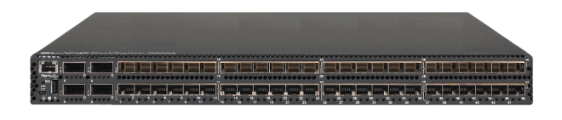
A revolution and Trend
App
App
App
App
App
App
App
App
App
App
App
Specialized
Features
Open Interface
Control
Plane
Control
Plane
Control
Plane
or
or
Specialized
Control
Plane
Open Interface
Specialized
Hardware
Merchant
Switching Chips
Vertically integrated
Closed, proprietary
Slow innovation
Horizontal
Open interfaces
Rapid innovation

Slide 10
Software-Defined Networking (SDN)
SDN Concept: Separate Control plane and Data plane.
Control Plane
Logically-centralized control
Smart
API to the data plane
Separated
Dumb,
fast
Switches
Data Plane

Slide 11


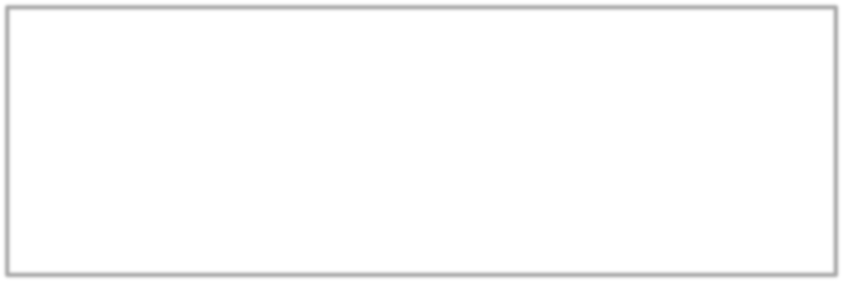


SDN Is Not A Silver Bullet
Low-level commands & scripts:
hard to understand
Distributed conﬁguration:
hard to manage
Many network-­‐wide tasks, lots of changes: lots of dynamics
No correctness guarantee:
error-­‐p rone
Programs: e.g., C++, Java,
Python, Pyretic
Central control
Unsolved
Unsolved

Slide 12
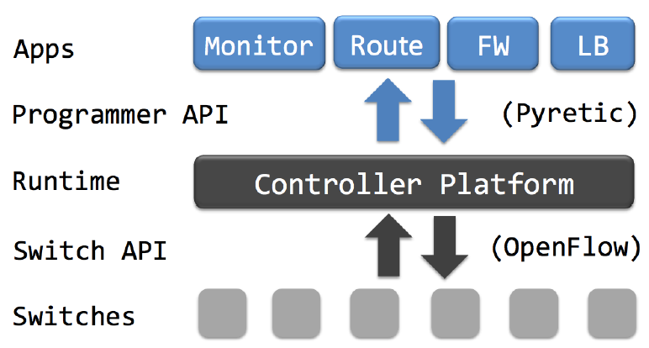
What SDN Platform Needs
Guidance on how to implement a network control program
  How to provide dynamic control that handles arbitrary network events
  E.g, Intrusion detection, traﬃc load shift, etc
Veriﬁcation and guarantees of program’s correctness

Slide 13
Different Types of Network Events
Network traﬃc
  Traﬃc load increase/decrease, security incidents
User-specific
  User authentication, excessive data usage
Date-plane events
  Topology change, switch/link failures
…
9

Slide 14



Different Reactions to An Event
Event Operators Reaction
“Only block that infected host”
Host is infected!
“Block all communications in the network!”
“Direct communication to our internal honeypot”

Slide 15
Insight
Network events and dynamic reactions to them should be programmatically encoded in the network control program by operators

Slide 16


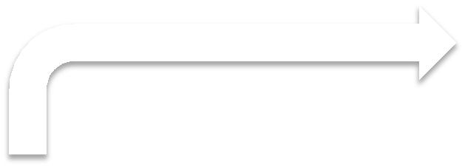

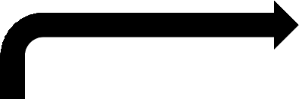

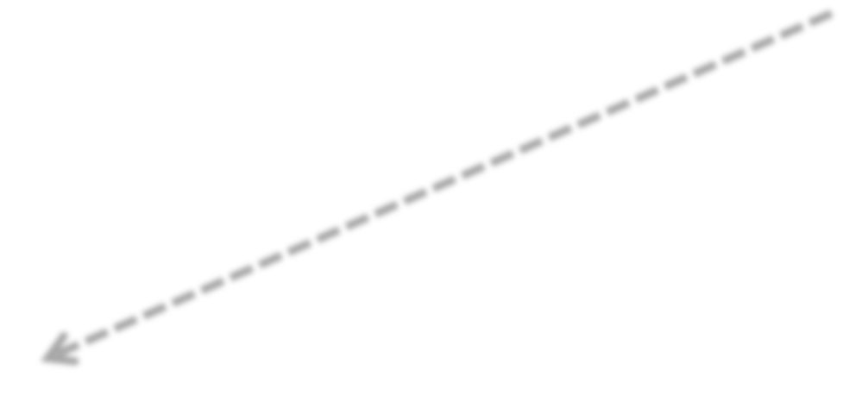
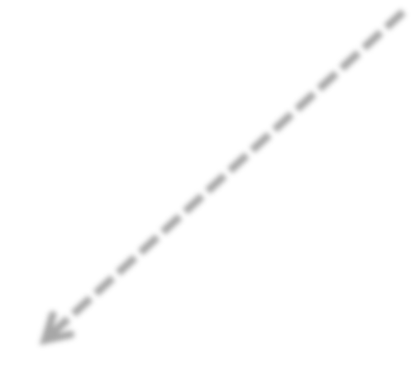


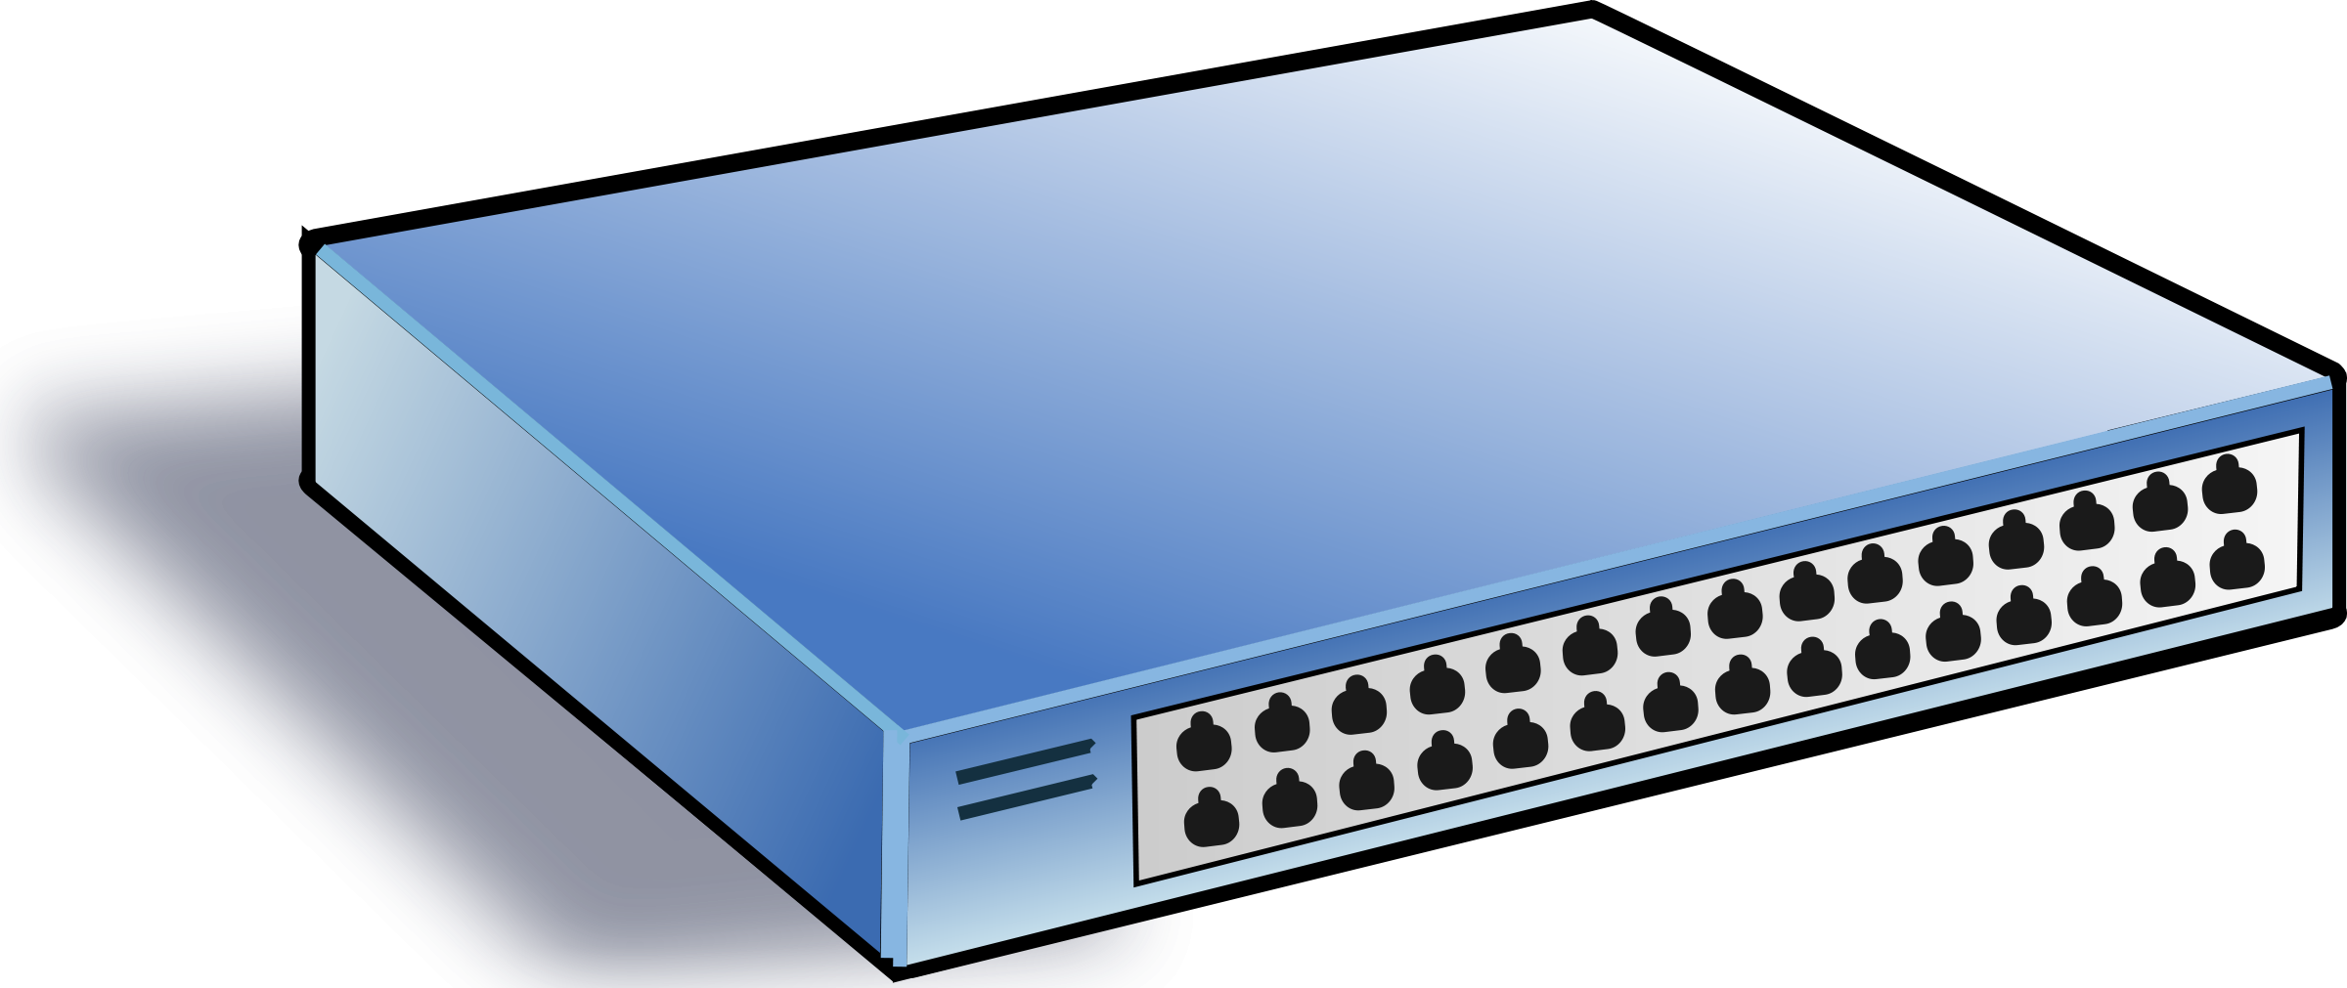
Dynamic Network Control Program
Software program that embeds event – reaction relationships
Software program
Control Plane
policy update
Network events
rule update
Data
Plane

Slide 17
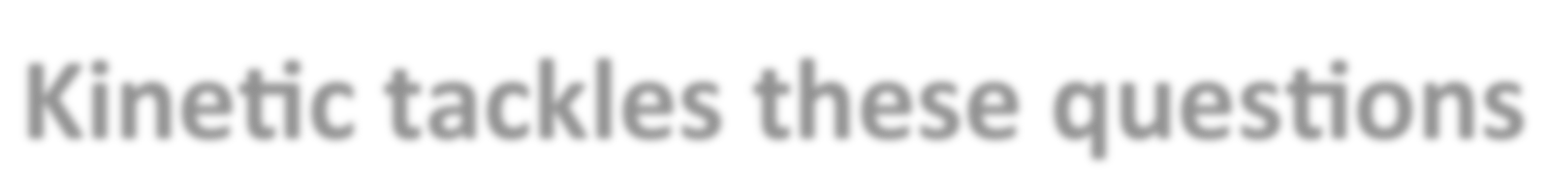
Unanswered Questions
How to embed event-reaction logic in software?
How to verify that the program will make
changes correctly?
Kinetic tackles these questions

Slide 18
Overview
Background and Research Motivation
Kinetic Design and Implementation
  Kinetic’s Domain Specific Language
  Express Changing Behavior Using FSM
  Verify Program’s Correctness With Model Checker (NuSMV)
Kinetic Evaluation
  Usability Evaluation
  Performance and Scalability
Discussion and Future Work

Slide 19
KINETIC
Domain speciﬁc language and control platform
Helps create SDN control programs that embed custom event-reaction relationships
Veriﬁes program’s correctness

Slide 20
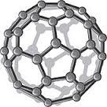
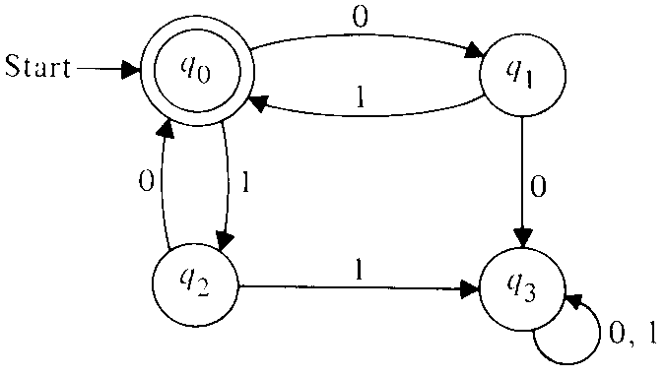
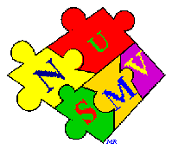
Our Approach
Domain speciﬁc language
– Constrained, but structured
Express changing behavior as a ﬁnite state machine(FSM)
Verify program’s correctness with a model checker (NuSMV)

Slide 21












Kinetic’s Domain Specific Language
Embedded in Python
Borrows some abstractions from Pyretic
– Encodes forwarding behavior in a policy variable
Incoming packet
Policy variable
Outgoing packet
New constructs and functions to express policies that respond to changing conditions
Network event
Policy variable 2
Policy variable 3
Incoming packet
Policy variable 1
Outgoing packet

Slide 22




FSM: IDS Example in KINETIC
Event: infected
State: policy variable’s value
– allow or block packet
event(infected,True)
infected:False Policy:allow
infected:True Policy:block
event(infected,False)
There are many diﬀerent ﬂows
Each ﬂow can have its own independent FSM

Slide 23
















Decomposing to Multiple FSMS
FSM instance is instantiated per ﬂow
Host 1
Host 2
Host 3
Host N
allow
allow
allow
allow
+
+
+
…
+
block
block
block
block
# of hosts: N
Total # of states: 2N Total # of transitions: 2N
State representation is Linear in N (instead of geometric)
18

Slide 24
KINETIC Verification Process
Kinetic veriﬁes correctness of the program
  User-specified temporal properties
  Veriﬁes current and future forwarding behavior based on network events
Veriﬁcation process is automated
  Constrained but structured language allows automatic parsing and translation of program
Veriﬁcation runs before program’s deployment

Slide 25
Model Checking Process
[ Adapted from www.lix.polytechnique.fr/comete/seminar/1-ModelChecking.ppt]
Answer:
Yes, if model satisfies
specification
Counterexample, otherwise
Model
(System Requirements)
Model
Checker
Specification
(System Property)
M╞ φ
For increasing our confidence in the correctness of the model:
Verification: The model satisfies important system properties
Debugging: Study counter-examples, pinpoint the source of the error, correct the model, and try again

Slide 26
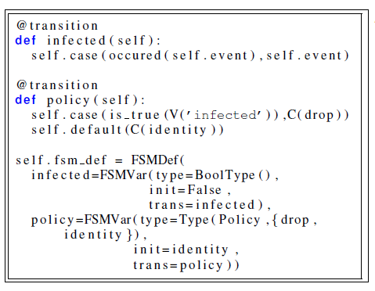
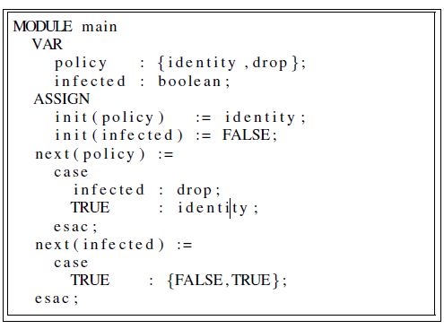
Verification Process
Kinetic program
NuSMV FSM model
Automatically generates
True or False
(w/ counter-­‐example)
User-specified temporal properties
NuSMV Model Checker
21

Slide 27
Overview
Background and Research Motivation
Kinetic Design and Implementation
  Kinetic’s Domain Specific Language
  Express Changing Behavior Using FSM
  Verify Program’s Correctness With Model Checker (NuSMV)
Kinetic Evaluation
  Usability Evaluation
  Performance and Scalability
Discussion and Future Work

Slide 28
Evaluation
Usability evaluation
  User study against over 870 participants
  Lines of code comparison with other SDN solutions
Performance and scalability
  Event handling and policy recompilation

Slide 29
KINETIC: User Study
Profession |  | Experience (years)
Operator | 216 | 1 | 32
Developer | 251 | 1-­‐5 | 310
Student | 123 | 5-­‐10 | 187
Vendor | 80 | 10-­‐15 | 150
Manager | 69 | 15-­‐20 | 122
Other | 138 | > 20 | 73
Total | 877 |  | 874
Demographic
Task
– Implement an enhanced IDS program with Kinetic, Pyretic, and POX.

Slide 30
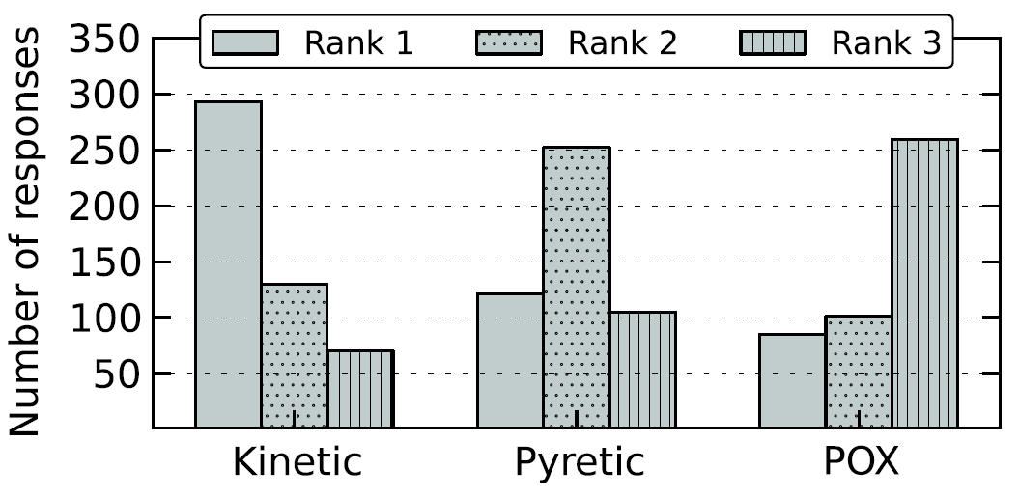
Rank Platforms by Preference

Slide 31
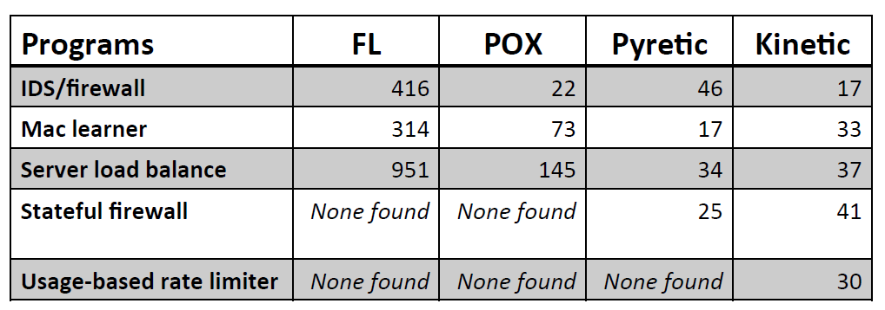
Lines of Code Comparison
26

Slide 32
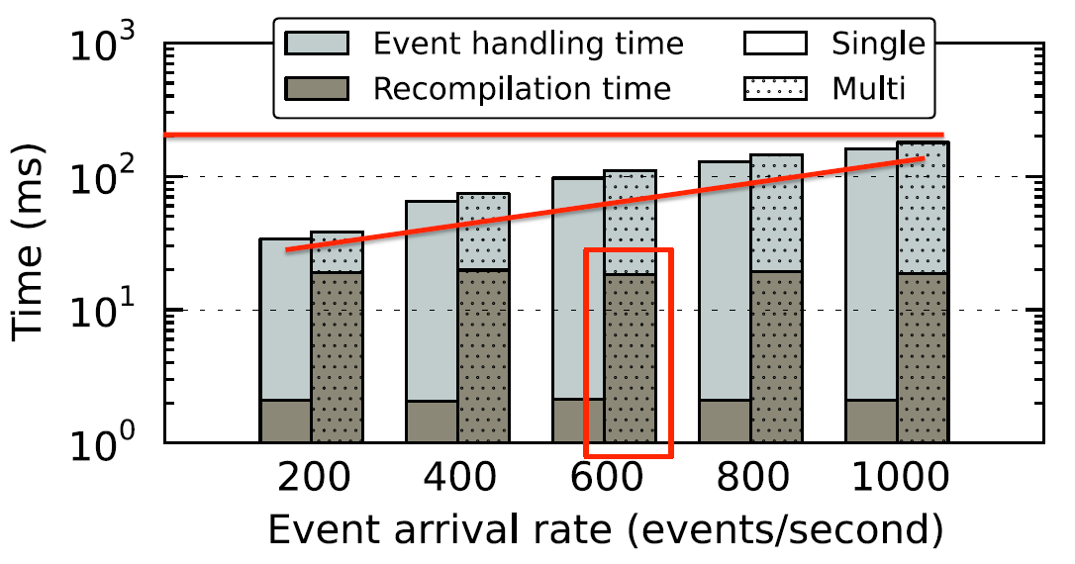
Event Handling and Policy Recompilation
26

Slide 33
Overview
Background and Research Motivation
Kinetic Design and Implementation
  Kinetic’s Domain Specific Language
  Express Changing Behavior Using FSM
  Verify Program’s Correctness With Model Checker (NuSMV)
Kinetic Evaluation
  Usability Evaluation
  Performance and Scalability
Discussion and Future Work

Slide 34
Discussion and Future Work
Combining with veriﬁcations in other stacks
  Consistent updates to data plane
  Veriﬁcation of data-plane state
More dynamic network policies
  Should collect more real network policies
  Need public repository

Slide 35
Thank You!
Questions?

