Slide 1
Embark: Securely Outsourcing Middleboxes to the Cloud.
Chang Lang Justin Sherry Raluca Ada Popa
Sylvia Ratnasamy Zhi Liu
Presented by: Obiora Akutekwe

Slide 2
Contents
Introduction
What is a Middlebox
Overview of Embark system architecture
Security and Encryption
Design and Implementation
Limitations
Evaluation
Related Works
Questions

Slide 3
Introduction
It is now common practice for enterprises and organizations to outsource network processing to the cloud.
However the increasing spate of cyber attacks and loss of confidentiality and trust over the cloud poses a great threat to enterprises deploying this solution.

Slide 4


Introduction
What can be done to ensure confidentiality on the cloud?

Slide 5
Introduction Cont’d
To address these worries, Embark , the first system to allow an enterprise to outsource a wide range of enterprise middleboxes to a cloud provider, while keeping its network traffic confidential was designed.
This approach – termed Network Function Virtualization (NFV) promises many advantages including cost benefits of commodity infrastructure and outsourced management.

Slide 6
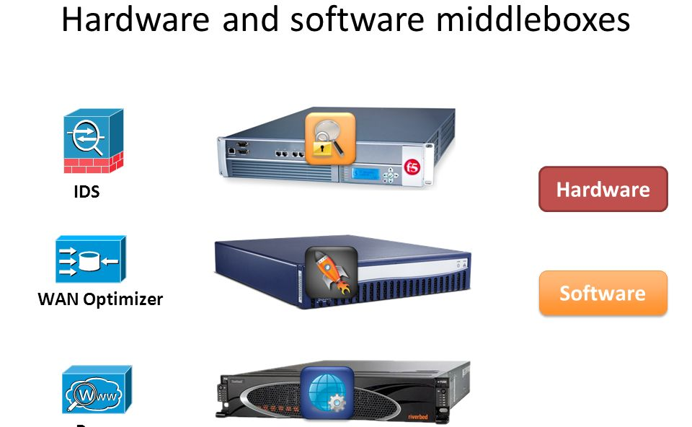
Middleboxes
“A middlebox is defined as any intermediary device performing functions other than the normal, standard functions of an IP router on the datagram path between a source host and destination host.”
Also called a “network appliance” or a “network function.”

Slide 7
Overview
Embark provides a new and fast encryption scheme called PrefixMatch to enable the provider to perform prefix matching. Embark supports a wide range of middleboxes with practical performance.
When compared to a previous design called the blindbox, it was discovered that it has a restricted functionality that supports too few of the middleboxes typically outsourced.
Notes:
PrefixMatch does not reveal the order of encrypted packet fields, while OPE (order preserving encryption) reveals the total ordering among all field.

Slide 8
System Architecture
Embark uses the same architecture as APLOMB, a system which redirects an enterprise’s traffic to the cloud for middlebox processing but augments this architecture with confidentiality protection.
Embark’s compatibility strategy was to reduce the core functionality of the relevant middleboxes to two basic operations over different fields of a packet: prefix and keyword matching.

Slide 9
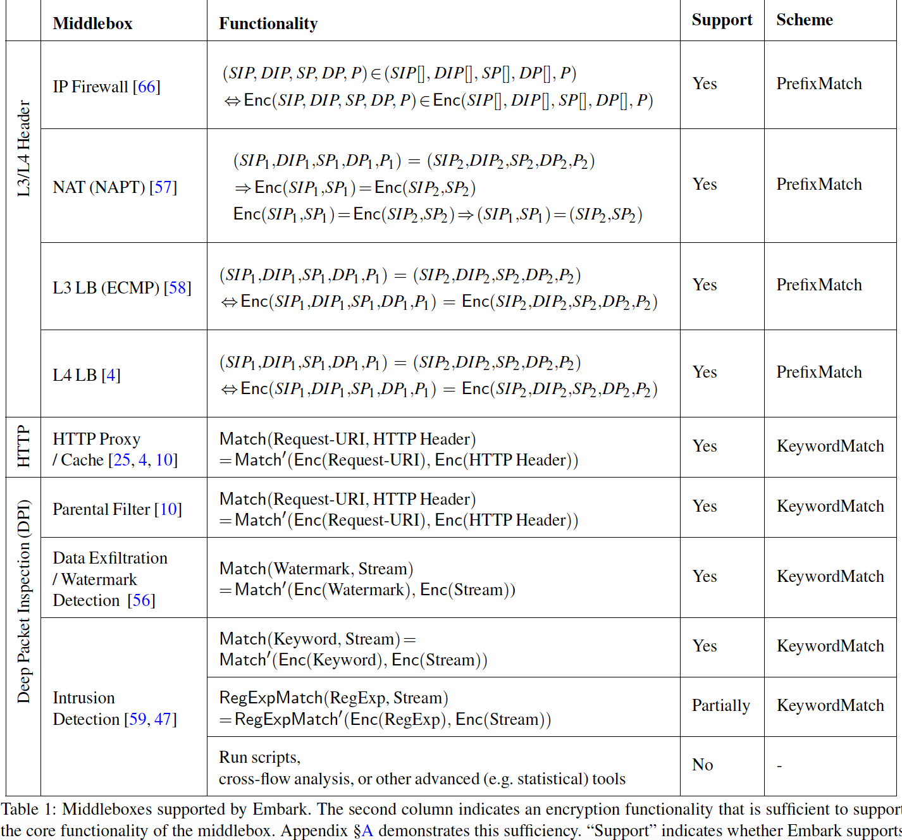
Notes:
PrefixMatch provides stronger security guarantees than these schemes:

Slide 10


Threat Model
2 main reasons clients adopt cloud services:
Reduced cost
Ease of management.
But there is an issue.
Notes:
There is an increased concern that cloud providers may access or leak confidential data in the process of providing service. Disgruntled employees might sell confidential data, and hackers gaining access to data on clouds. This type of threat is referred to as an ‘honest but curious’ or ‘passive’ attacker.

Slide 11
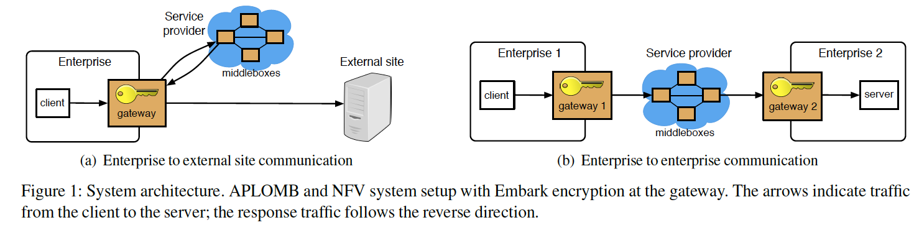
Encryption Overview
To protect privacy, Embark encrypts the traffic passing through the SP.
The SP cant see these traffic because both the header and payload of each packet is encrypted. Embark also provides the SP a set of encrypted rules
Notes:
Headers are encrypted because they contain information about the endpoints.

Slide 12
Figure Explanation
At set up time, the gateway generates the set of encrypted rules using k and provides them to SP. Afterwards, the gateway encrypts all traffic going to the service provider using Embark’s encryption schemes.
The gateway decrypts the traffic generated by the middleboxes using the key K.
Note, throughout this process, middleboxes at SP only handle encrypted traffic and never accessed the decryption key.

Slide 13
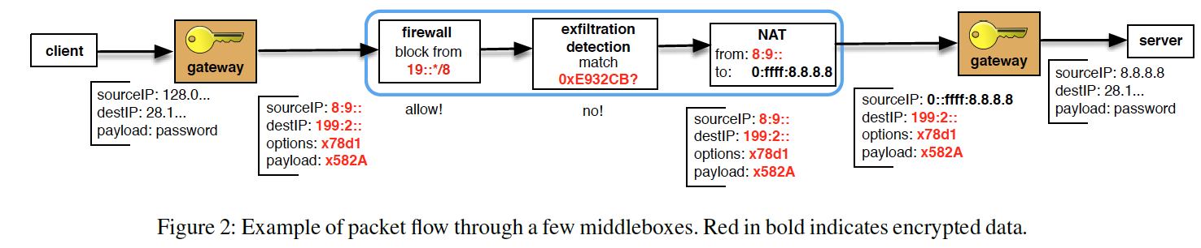
Packet Encryption
Embark handles packet encryption on a field-by-field manner. 3 encryption schemes used to protect the privacy of each field are:
Traditional AES: Provides Strong security
Keyword Match: Detects if an encrypted value is equal to an encrypted rule.
Prefix Match: Detects whether an encrypted value lies in a range of rule values or not.

Slide 14
Embark vs. Blind box
Blind Box Embark
Functionality is limited to few outso- Provides broader functionality and urced middleboxes. better performance. End-host encrypts traffic. Gateway encrypts traffic, hence deployability improves. Per-connection cost is high. There is no per-connection overhead
KeywordMatch: Is an encryption scheme based on which SP checks if an encrypted rule (“the keyword”) matches by equality an encrypted string. E.g: the encryption of the rule “malicious” and a list of encrypted strings; [Enc(“alice”), Enc(‘’malicious’’), Enc(‘’alice”)], the SP can detect that the rule matches the second string.
Notes:
Blindbox has 2 security models: a stronger one to detect rules that are exact match and a weaker one to detect rules that are regular. The more the rules, the higher the per-connection cost.

Slide 15
Requirements for PrefixMatch Design
PrefixMatch must allow for direct order comparison.
Reason: Existing packet classification stays the same.
Enc(v) must be deterministic within a flow to support NAT functionality.
Nothing leaks about the value v for security.
Embark’s middleboxes do not know the order between 2 encrypted values. PrefixMatch does not leak such information.

Slide 16
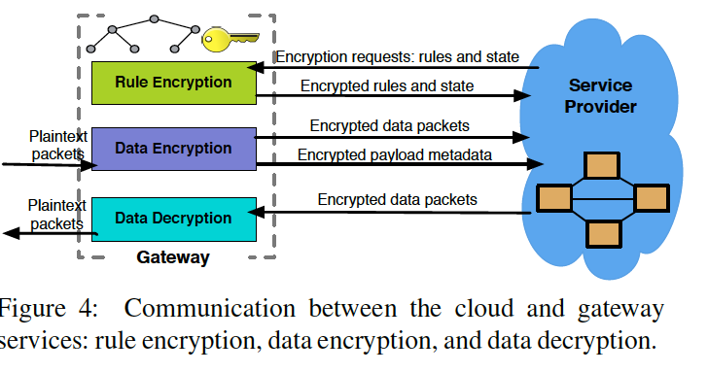
Security Guarantees
PrefixMatch hides the prefixes and values encrypted with EncryptPrefixes and EncryptValues. Only matching information for functionality at the cloud provider is revealed.
The cloud provider learns if 2 encrypted values are equal only if they are part of the same flow. Hence, PrefixMatch leaks less info. than order-preserving encryption.

Slide 17
Limitations
For intrusion detection, Embark does not support regular expressions that cannot be expanded in a number of keyword matches.
Embark does not support application level middleboxes like SMTP firewalls, transcoders or application-level gateways.
Embark does not support scanning because port encryption depends on the associated IP address.
Notes:
Support for these functionalities is part of the authors future work.

Slide 18
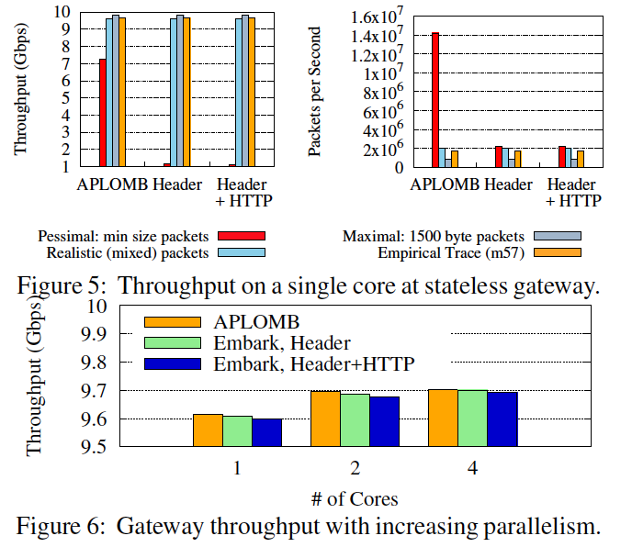
Evaluation
Embark’s enterprise overhead:
For empirical traffic traces with payload encryption (DPI) disabled, Embark averages 9.6Gbps per core. In scalability expt. with 4 cores dedicated to processing, it forwarded up to 9.7Gbps.

Slide 19
Evaluation Cont’d
2 bandwidth costs were evaluated: Increase in bandwidth due to encryption and increase due to ‘bounce’ redirection.
By how much does Embark encryption increase the amount of data sent to the cloud?
If enterprise is using IPv4, there is a 20 byte per packet cost to convert from IPv4 to v6.
If HTTP proxying is enabled, there is on average 132 bytes per request.
If HTTP IDS is enabled, there is at worst 5xoverhead on all HTTP payloads.

Slide 20
Related works
Middlebox Outsourcing: APLOMB is a practical service for outsourcing middleboxes to the cloud.
Data Confidentiality: This is one of the major problems of cloud service. Proposed solutions for software, web applications, databases and VM’s have being made by researchers.
The most closely related work to Embark based on traffic processing is blindbox.

Slide 21

Questions

