Slide 1
Bitcoin-NG A Scalable Blockchain Protocol
Presentation By Ittay Eyal, Adem Efe Gencer
Modified and presented By
Vinodh Kumaran Jayakumar

Slide 2
Notes:
My Notes:
Bitcoin is a type of cryptocurrency introduced by Satoshi Nakamoto to the world.
From the time of it’s launch it was accepted by many companies and eventually evolved by define different services around it from the currency point of view

Slide 3
Notes:
What became more interesting is the infrastructure behind the currency called as block chain. This block chain technology believed by many to support bank to bank settlements around the globe, cheap remittance money sending across ocean and even as part of machine to machine payments. This has grabbed attention of many banks to invest millions of dollars to study this but there is catch the block chain technology as it’s is not fast enough and not scaled to the level they need so they need a bigger and faster boat.
Notes
The infrastructure behind the currency is called as block chain. This block chain technology was believed by many to support bank to bank settlements around the globe, cheap remittance money across ocean and even for machine to machine payments.
This has grabbed attention of many banks to invest millions of dollars to study this but there is a catch, the block chain technology is not fast enough and not scalable to the level they need so they need a bigger and faster
Boat.

Slide 4
Notes:
So they have introduce Bitcoin-NG it’s a replicated state machine like existing blockchain which uses Monte-carlo randamized algorithm which means safely is only guaranty with high probability.
It’s extremely robust like other block chain where the turning machine can join and crash quickly like previous protocols.
But unlike previous block chain technologies it induces high performance, we already reach 10 times throughput and fraction of latency in their experiments.
For Purpose of Evaluations they have used Novel Performance metrics that are suitable for this new family of protocols and experiments run with unmodified nodes running on the OS
Demonstrating low latency and high throughput.
--
For achieving it, they have introduced Bitcoin-NG which is a RSM like existing blocking chain which uses Monte-carlo randomized algorithm which means safety is only guaranty with high probability
It’s also extremely robust like other block chain where the turning can join and crash like previous protocol
But unlike previous BC technologies it has high performance, they were already able to achieve 10x throughput and fraction of latency in their experiment.
For the purpose of evaluation they have used Novel Performance metric that are suitable for these new family of protocols and
Experiments are conducted with unmodified nodes running on the OS demonstrating low latency and high throughput

Slide 5
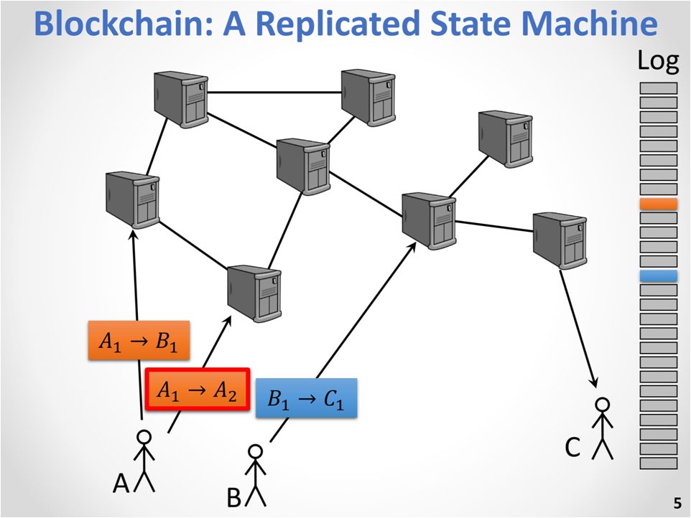
Notes:
A Block chain is a centrally replicated state machine where participants send their messages/transaction into the system and the RSM serializes them if there are two conflict transactions only one will enter the system and the order takes care of that.
==
A block chain is a centralized RSM where participants send their messages/transaction into the system
The RSM serialize them if there are two conflict transaction only one will enter the system and the order takes care of that.

Slide 6
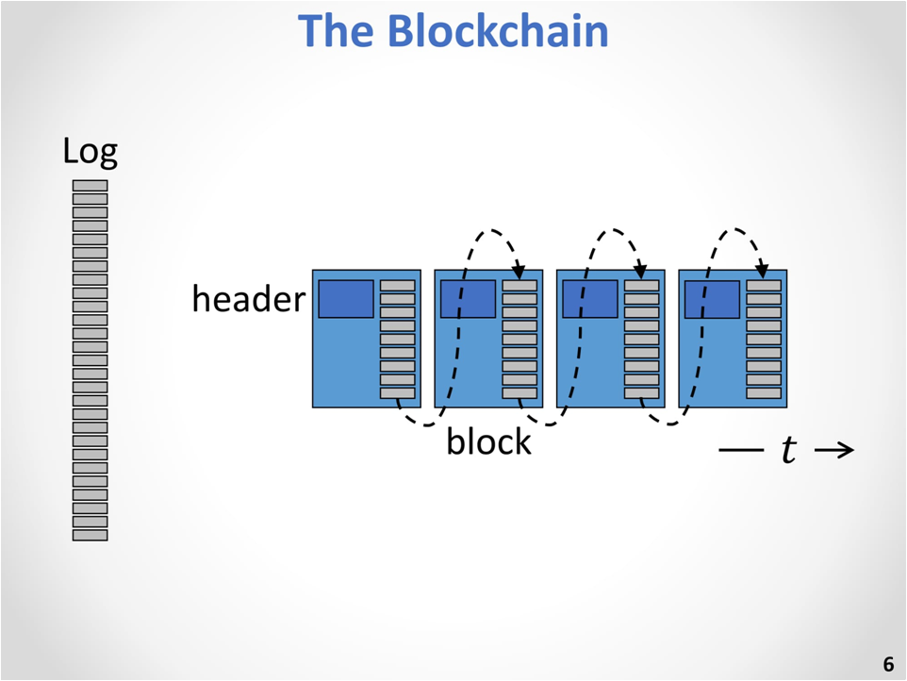
Notes:
As the name hints it’s build in blocks each block is a subset of the transaction and the order of all this transaction forming this global log is defined by the order of the blocks.
==
As Name hints the block chain is build in blocks where each block is a subset of transaction and the order of this transaction forming the global log is defined by the order of the block

Slide 7
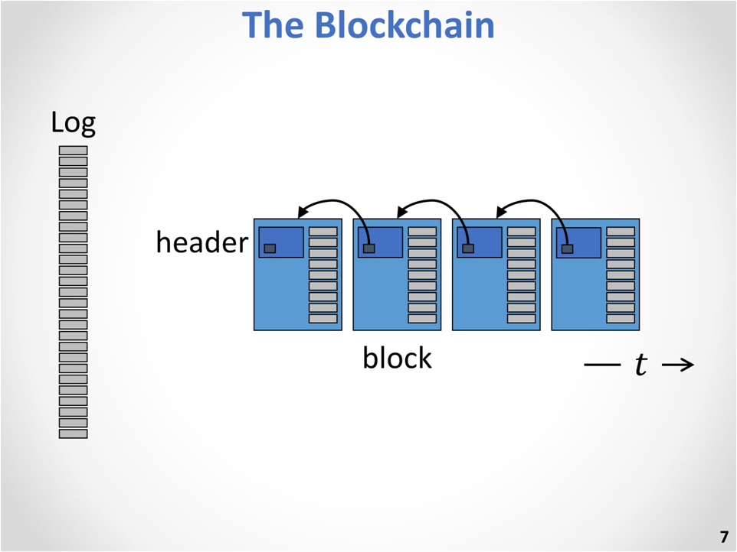
Notes:
The order of the logs is defined by the backward pointers each header of block has a reference hash of the previous block so we get the chain so we have time to going from left to right.
==
The order of the logs is defined by the backward pointers each header of block has a reference hash of the previous block so we get the chain from left to right

Slide 8
Notes:
Each block is only legal only if the hash of it’s header is smaller than the target value
The target is chosen based on a deterministic algorithm
==
Each block is only legal only if the hash of it’s header is smallar than the target value and the target value is chosen based on deterministic algorithm

Slide 9
Notes:
In practice we have nodes creating the block they are called minors
The minors receives the transactions from the participants.
The transaction in practice propogate through a peer to peer network and collected by a minor and minor start guessing answer and he keeps on getting more transaction for which he keep guess answers until hit an answer such that the hash is less than the target then it become a legitimate block it’s published and it become a part of block chain this goes on and on to create a block chain
==
In practice we have nodes creating the block they are called as minors
The minors receives transaction from the participants in the peer to peer networks to which the minor starts to guessing answer for different transaction until it hit an answer such that the hash is less than the target
After that it become a legitimate block and get published and become part of the block chain and this process goes on to create a block chain

Slide 10
Notes:
They way it’s generated the interval between block going to be exponential, exp random variable the mean is going to be constant by automatically setting its target value.
==
This way the blocks are generated, the interval between block going to be exponential, Exp random variable the mean is going to be constant by automatically setting its target value.

Slide 11
Notes:
Why would people do that it takes lot of effort because they get money get a price each block they create they get to create some new money that is introduced in the system they also get some fees from the transaction depending on the size/bits of the transaction not on the amount because of the
==
The reason why people do that as it takes lot of effort is they get money, When a new block is created some new money is introduced to the system they also get fees from the transaction depending on the size/bits involved in the transaction

Slide 12
Notes:
From now only we will move to more abstract drawing for the blocks
sometimes you will get forks because two minors create blocks before hearing one another so they have the same parent
so you get a fork.
==
From now on we will move to a abstract drawing for the blocks.
Sometimes we will get forks bcoz to minors creates block without hearing one another so they have the same parent so you get a fork

Slide 13
Notes:
The fork is not good bcoz we don’t know the state of the system, what transaction are there in the system and so the rule is the longer chain wins
Transaction are reverted from the part it’s pruned and the threat is double-spending you going to having conflict in transaction and you don’t know whether you are in winning side or losing side.
===
Getting fork is not good bcoz we don’t know the state of the system, what transaction are there in the system. So we have the rule as longer chain wins.
Transactions are reverted from the part it’s pruned and the threat is double-spending you going to have conflict in transaction and you don’t know whether you are in winning side or losing side

Slide 14
Notes:
When you are using the transaction you have to pick how confident you want to be of the transaction you have placed wait that long until the transaction is placed in a block and it’s buried after enough blocks
And it’s unlikely that an attack will be able to create blocks faster that that and create a longer branch.

Slide 15
Notes:
This algo is famous exhibiting trade off between security and latency.

Slide 16
Notes:
To be accurate and reasonable about this tradeoff we introduce some metrics like
Bandwidth which is transactions/second
Latency is bit more involved called as consensus delay.
We have also introduced security metrics like Mining power utilization and fairness

Slide 17
Notes:
Mining power utilization is the fraction of blocks that end up in the main chain in the longest chain
If it’s 1 it’s good all the block are in the main chain
The lower it’s the worst it’s because the chain is only secured by the blocks in the main chain if an attacker want to create a longer chain he only has to compete with that if lot of block end up outside the chain it’s not helping us.

Slide 18
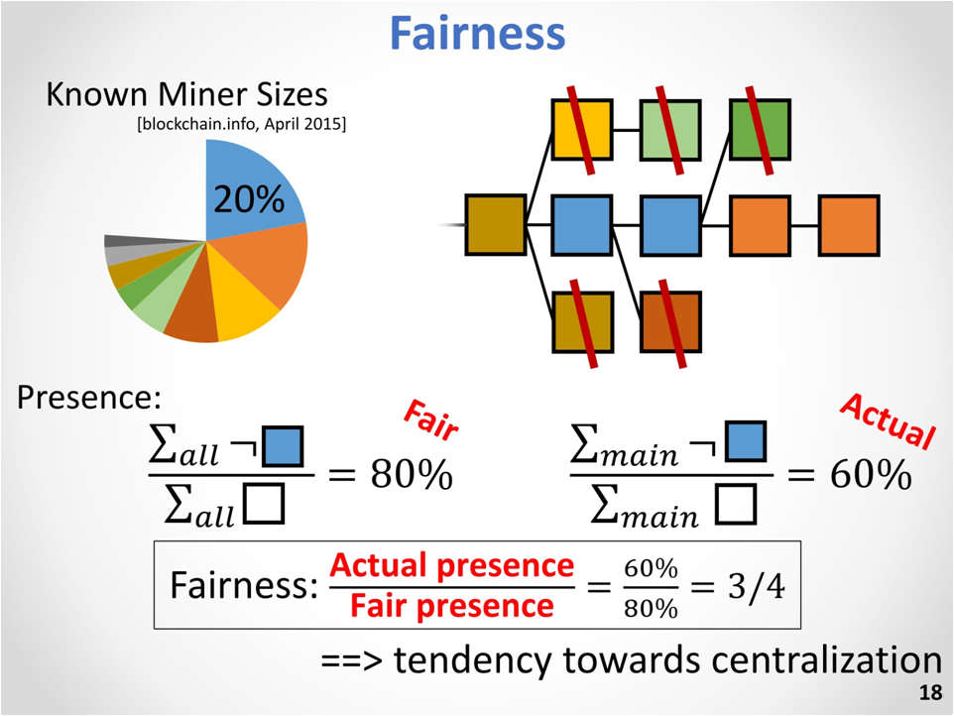
Notes:
Next metrics is fairness Its just natural property of the system
In the pie chart of the miners sizes we can see that blue one is the largest one
Presence of all the blocks not created by the minor is 80%
And the fraction of block not created by minor in the main chain is smaller than that 60%
So there is less fairness. The fraction of these two measurement is the fairness and the best could be 1
Could be low as the System has tendency towards centralization bcoz minor will prefer to form large correlations and the system will not be decentralized

Slide 19
Notes:
They have done two types of experiments first we tried to increase the block frequency
We keep the bandwidth static so we are using more frequent blocks but smaller ones
We can see that as the blocks are arriving faster we have more occasions that we have forks
When we have more forks we have worst security in term of both the metrics

Slide 20
Notes:
Second thing we tried to use larger blocks we are not looking at improving latency just with improving bandwidth and again as it take longer to propagate large blocks we have worst security.

Slide 21
Notes:
In Modern RSM their performance is limited by the capacity of a single node we can reach that.
Can we achieve similar range of block chain technology at the setting that block chain technology uses
The answer is yes and here is how we do it.

Slide 22
Notes:
This is how the nakamoto blocks chain work the original one
The transaction arrive at the system until one node creates a block
It orders the transaction i.e., The block orders the transaction before.

Slide 23
Notes:
There are epochs in the system it starts after the previous blocks and end after the current block

Slide 24
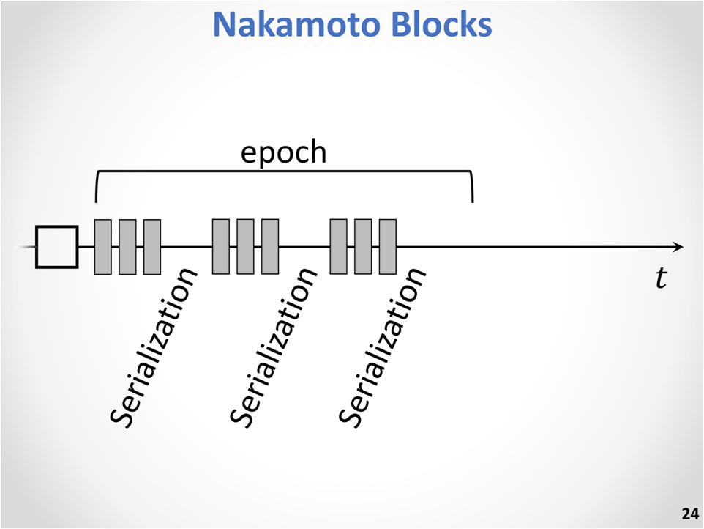
Notes:
Minor that created that block serializes the block and we can’t increase the frequency of the serialization event as we will get the forks

Slide 25
Notes:
The formation of block does two things
It does leader election
It serializes the blocks within the epoch
9:37

Slide 26
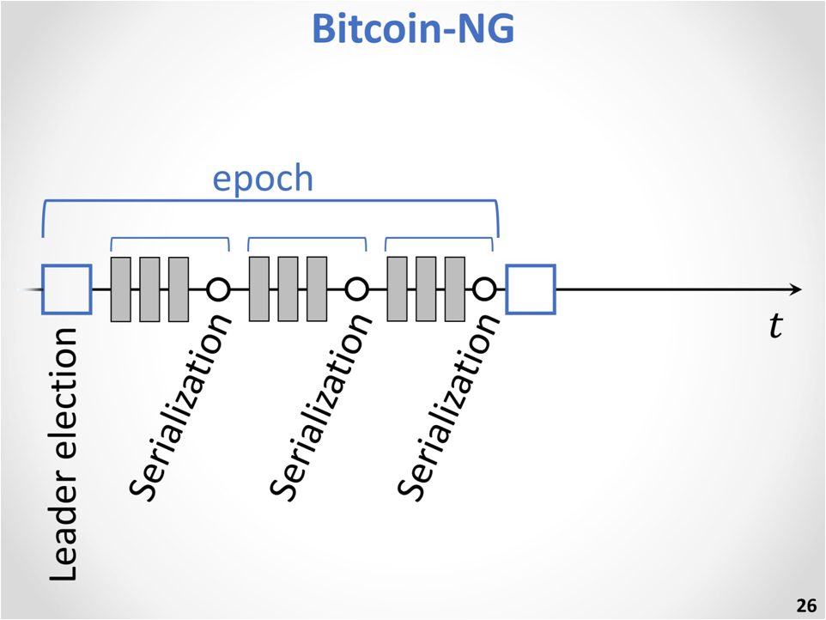
Notes:
This is Bitcoin –NG it start with a special block called as key block
The transactions are kept in micro block generated by the leader once it’s elected

Slide 27
Notes:
We have two types of block in the same chain
The key blocks has no content just the leader election
The micro blocks have all the transaction but no contention
For that epoch we know who is the leader and he is creating the block the micro blocks.

Slide 28
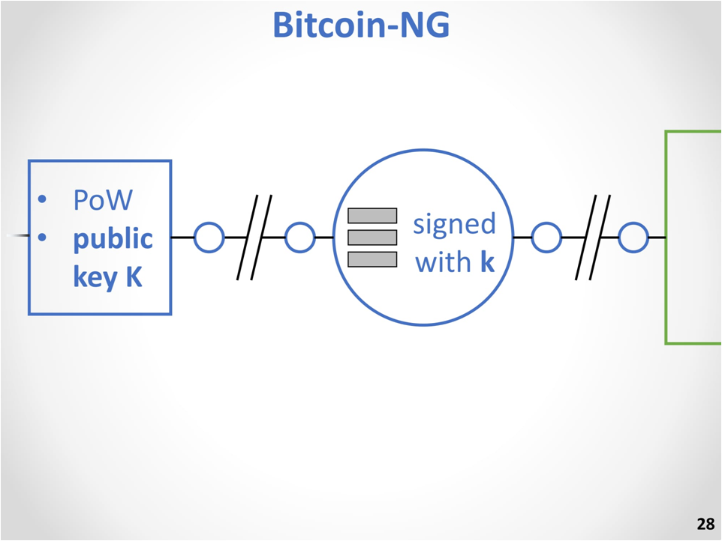
Notes:
In the key block contains the proof of work like the nakamoto chain but also a public key which is used to sign the micro block so that you know that only the leader can create the micro block.

Slide 29
Notes:
Key block have long interval between them
They are exponential bcoz they are build on the proof of work let think 10 min
Microblock are spaced much closer 10sec deterministically

Slide 30
Notes:
How can we enforce it
Different miner act on their own interest how can motivate them to follow the protocol we want
Here is an approach by using micro block as a part of the weight of the system
We are trying to do two thing
Trying to motive the next miner to place as many mico blocks as part after it’s key block
We also want to motivate the leader to place transactions in the microblocks
To do that we can give the leader the transaction fee.
We use a chain selection rule as in nakamoto chain
We just ignore the microblocks we only look at how much POW we used how many hashes were calculated that is the heaviest chain and the microblock carries no weight.
The fee distribution there is a range between 40 to 60
40 % are fees of the transaction back to the current leader so that he is motivated to place them in transaction
60% to the next leader so that leader is motivated to place itself after the transaction he won’t get more by transaction himself

Slide 31
Notes:
To test they have to 1000 standard nodes implemented based on the bitcoin core client
Infrastruce is 150 machines with 7 cores and 1GB network.

Slide 32
Notes:
They have measure latency and BW
The implementation uses Virtual Network interfaces and kernal rate limiting.
Finally they have validated with block propagation times that present the same trends from previous works.

Slide 33
Notes:
The Latency experiment
As we increase the latency in the x we get better consensus delay as we expected

Slide 34
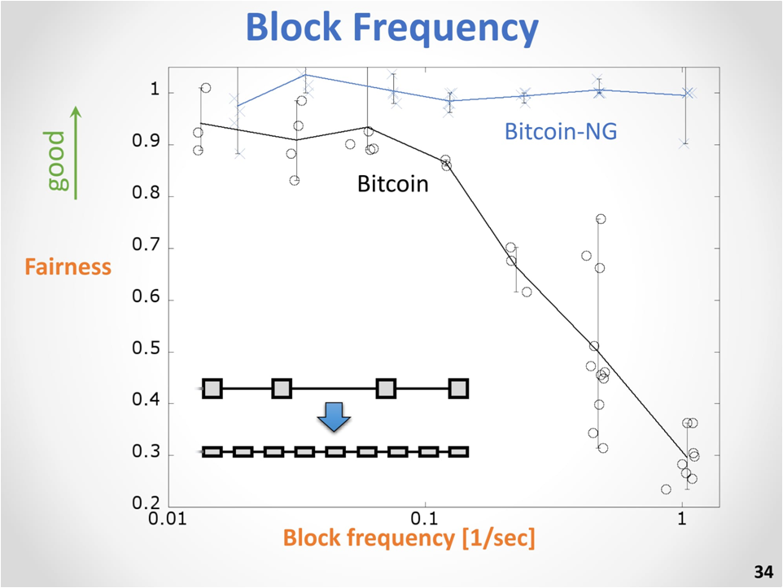

Slide 36
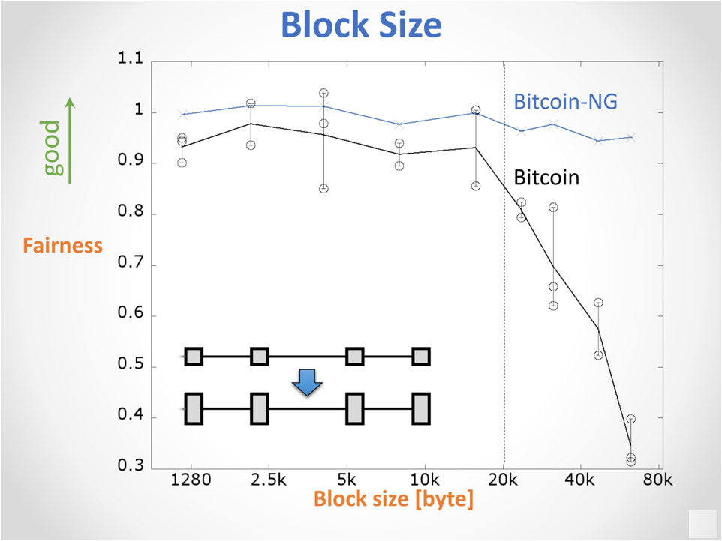
36

Slide 37
37

Slide 38
38
Notes:
We have different related work that solves different problems
The paper doesn’t speak about any limitations

