Slide 1
HUG: Multi-Resource Fairness for Correlated and Elastic Demands
Authors: Mosharaf Chowdhury, Zhenhua Liu, Ali Ghodsi, and Ion Stoica
M. Chowdhury, Z. Liu, A. Ghodsi, and I. Stoica. HUG: Multi-Resource Fairness for Correlated and Elastic Demands. In NSDI, 2016.
Visuals taken from the NSDI 2016 presentation of this paper.
Presented by: Jarred Deeley

Slide 2
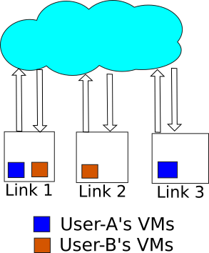
Environment
Network environments with shared resources
Public clouds
Users don’t have to play fair
Private network / clouds
No lying about demands

Slide 3
Problem
How to share resource links between multiple tenants?
Isolation Guarantee
System Utilization

Slide 4
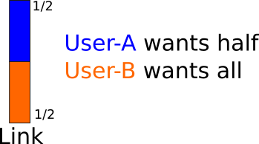
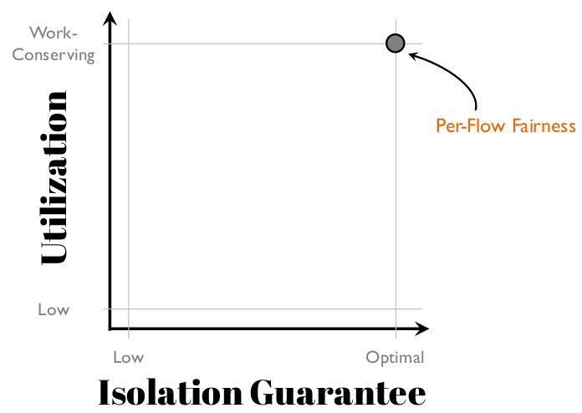
Max-Min Fairness for single link

Slide 5
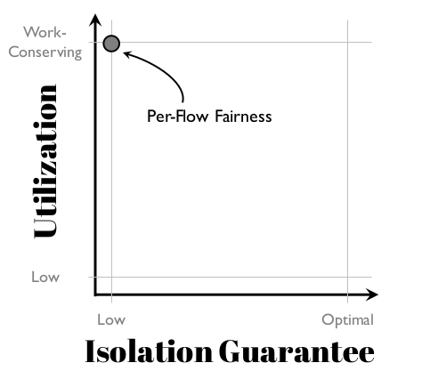
Can’t Focus on a Single link
Tenants have demands on different links
Low Isolation Guarantee
High Utilization

Slide 6
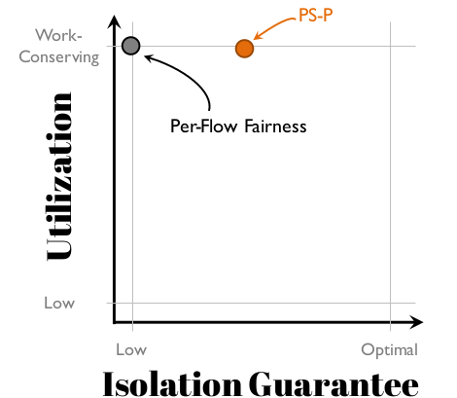
Proportional-Sharing on Proximate links
Tenant-level max-min fairness
Elastic demands, unknown what demands are

Slide 7
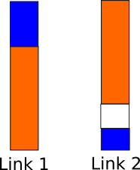
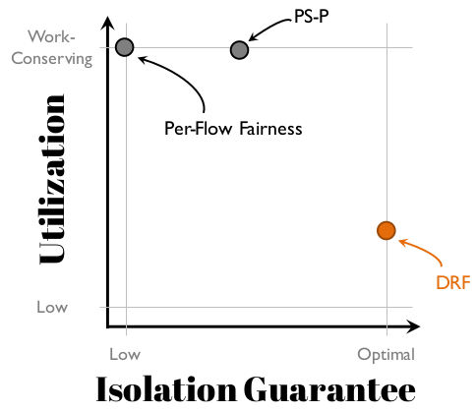
Dominant Resource Fairness (DRF)
Extends max-min fairness to multiple resources
Maximizes isolation guarantee in a strategy-proof manner
Only assumes inelastic demands

Slide 8
What If we made DRF more work-conserving?
Gives incentives for tenants to lie
Race to get the unused bandwidth
More harm than good

Slide 9
Work conservation cannot exist with strategy-proofness
Tradeoff between optimal isolation guarantee and work conservation

Slide 10
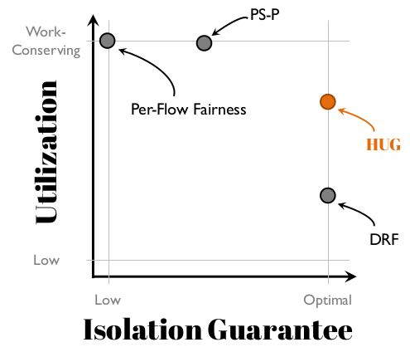
High Utilization with Guarantees
Two-stage allocation algorithm
Optimal isolation guarantee
Strategy-proofness
Highest utilization possible

Slide 11
HUG
First stage
Allocates resources to maximize isolation guarantees
Second stage
Maximizes utilization while keeping allocation strategy-proof

Slide 12
HUG Issues
Doesn’t provide long-term isolation or fairness guarantees
Centralized design

Slide 13
HUG in Cooperative Setting
Users don’t lie about their demands

