Slide 1
Wormhole: Reliable Pub-sub to Support Geo-Replicated internet services
Presented By: Irving Rodriguez

Slide 2
Introduction
Facebook
Social networking service
Connects many people across the globe
Allows them to share information with each other

Slide 3
Purpose of This Paper
Focus revolves around Facebook’s design & implementation of Wormhole
Maintain Availability
Efficiency
Reliability
Scalability

Slide 4
Storing Data
Storing Data
Anytime a user posts content, it is written to a database
e.g (comments, likes, shares, posts, etc…)
Stored on many different storage systems
Get sharded and geo-replicated to multiple data centers

Slide 5
Why is this important?
Applications are interested when these writes occur
Example:
News Feeds are interested to serve new stories to friends
Users receiving a notification may wish to immediately view the content
Want to be notified when specific type of event changes occur
Creation of an event
Deletion of an object
Writes to a certain association

Slide 6
Existing Approaches
Polling the Database
Types
Long Poll Intervals
Issue: Leads to stale data
Frequent Polling Intervals
Issue: interferes with production workload

Slide 7
Existing Approaches (continued)
Publish-Subscribe Sytems
Advantages
Scalable
Identify updates
Transmit notifications to subscribers on events
Disadvantages
Require custom data stores that are interposed on writes
Would require modifications across software stack
Introduce intermediary storage system that might fail

Slide 8
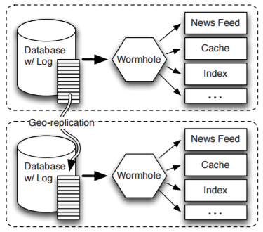
Solution
Wormhole
A pub-sub system that identifies new writes and publishes updates to all interested applications

Slide 9
How is this different?
What Wormhole does
Upon a new write, wormhole encapsulates data and corresponding metadata
Creates a custom Wormhole Update
Always encoded as a set of key-value pairs
Interested applications don’t have to worry about where the underlying data lives
Delivers this update to subscribers

Slide 10
Major Difference
Major Differences
No need to create a custom data store
Does not have to create custom modifications for each software stack
Scalability

Slide 11
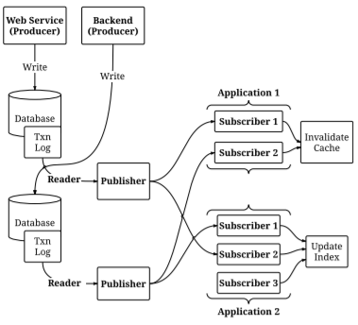
Key Terms
Publishers
Producers
Subscribers

Slide 12
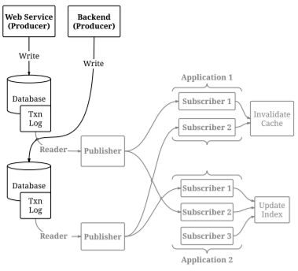
Key Terms
Producers
Produce data and write to datastores

Slide 13
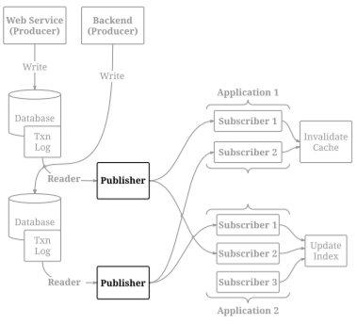
Key Terms
Publishers
Directly read the transaction logs maintained by the data storage systems, constructs updates, and sends them to subscribers of various applications

Slide 14
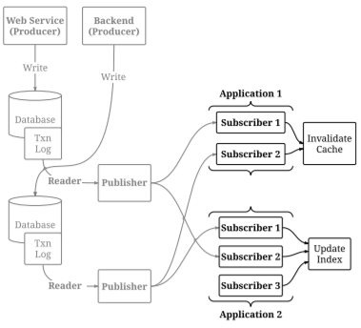
Key Terms
Subscribers
The consumers interested in a particular event change that do application specific work

Slide 15
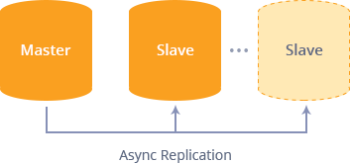
Architecture and Design
Storage Systems are geo-replicated
One Master, Multiple Slaves
Wormhole delivers updates to geo-replicated subscribers
Piggybacking on publishers running slave replicas that are close to subscribers

Slide 16
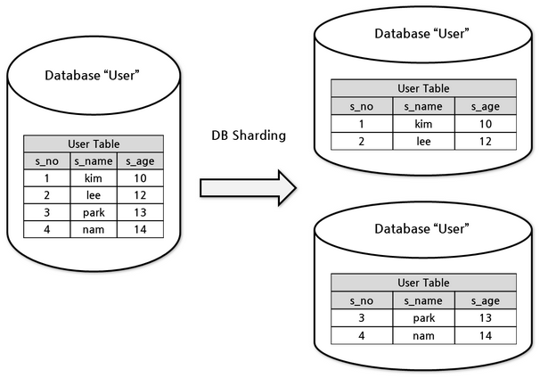
Implementation - Data Model
Datasets
Collection of related data (e.g. user generated data)
Partitioned into shards for scalability
Datastores collect these shards

Slide 17
Implementation – Producers
On Write
Data is written to the transaction log of the master replica
It is then replicated asynchronously to the slaves
Creates a Wormhole Update
A key-value pair in a serialized format
Different for each log type (e.g. RocksDB, MySQL, etc.)
Publishers take care of translating them to standardized form

Slide 18
Implementation – Publisher
Each datastore has 1 publisher
Reads updates from the transaction log
Filters updates
Sends updates to the subscriber
Wormhole publishers running on the slave
Simply read new update off the local transaction log
Provide updates to local subscribers

Slide 19
Implementation – Subscribers
Subscribing applications are also sharded
Links to a subscriber library
Flow
Subscribers receive a stream of updates for every shard
Load Balance
Single shards are always sent to one subscriber
Not split amongst multiple subscribers
API lives on the application
OnShardNotice(), onUpdate(), onToken(), onDataLoss()

Slide 20
Implementation – Tracking Updates
Datamarkers
One per flow
Created when subscriber acknowledges that an update has been processed
Essentially a pointer in the datastore
Indicates the position of last received update by the subscriber

Slide 21
Implementation – Keeping Order
Example
Assume we receive an update for a shard
Then, all updates for that shard prior to the update received must have already been processed
Otherwise, stored in caravans to be processed
Think of this as a scheduler processing a queue from the transaction log by using the datamarkers

Slide 22
Fault Tolerance - Publisher
Wormhole provides multiple-copy reliable delivery
Allows application to set primary and secondary sources where they may receive updates from
On Failure
Starts sending updates from one of the secondary publishers

Slide 23
Fault Tolerance - Subscriber
Publishers periodically store for each application the position of the most recent acknowledged update
On Failure
Wormhole find where to start sending update
Uses the bookkeeping from the datastore’s transaction log
Resumes delivering updates

Slide 24
Reliability - SCRD
Single-Copy Reliable Datasets (SCRD)
Leverages the reliability of TCP to ensure delivery (Underlying specifics not mentioned)
Wormhole’s guarantee that when an application is subscribed to the single copy of the data set
Then it’s subscribers have at least once received all updates contained within that data set in order

Slide 25
Reliability - MCRD
Multiple-Copy Reliable Datasets (SCRD)
When SCRD fails permanently (hardware failure)
Expect replicated datastores to take over and do SCRD where failure originated
Essentially “SCRD with publisher failover”

Slide 26
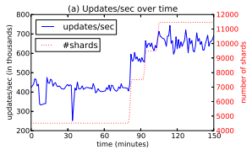
Evaluation and Performance
Been in production for 3 years (Time of writing)
Transports over 35GBytes/sec of updates
5 Trillion messages per day
Transports 200GBytes/sec on failovers
Averages around 600,000 updates/sec

Slide 27
How it Compares to Others
Most other solutions use Brokers
Intermediate datastores that store and forward updates
Difference
Undesirable since they require additional infrastructure to support
Add significant latency to message delivery

Slide 28
How it Compares to Others (cont.)
SIENA (pub-sub)
Does not support replicated data sources
Thialfi (Google)
Not concerned about I/O efficiency
Only cares about most recent data, does not backfill
Kafka (LinkedIn)
Average throughput is at 250MBytes/sec vs Wormhole’s 35GBytes/sec
Others
Hedwig (Apache)
IronMQ (Amazon)
TIBCO Rendezvous

Slide 29
Questions?

